Slide 1
What Should We Think About Abortion
¿Qué debemos pensar sobre el aborto?
Exton
Sunday, 11 am
May 25, 2019

Slide 2
Forgiveness Perdón
2 Chronicles 33 ⁶ He made his sons pass through the fire
2 Kings 21 ¹⁶ Moreover, Manasseh shed very much innocent blood until he had filled Jerusalem from one end to another
2 Chronicles 33 ¹² When he was in distress, he entreated the Lord his God and humbled himself greatly before the God of his fathers.
¹³ When he prayed to Him, He was moved by his entreaty and heard his supplication, and brought him again to Jerusalem to his kingdom. Then Manasseh knew that the Lord was God.
2 Crónicas 33 ⁶ Pasó sus hijos por fuego
2 Reyes 21¹⁶ Además, Manasés derramó tal cantidad de sangre inocente que llenó a Jerusalén de extremo a extremo
2 Crónicas 33 ¹² Pero cuando se vio en angustia, oró a Jehová, su Dios, y se humilló profundamente en la presencia del Dios de sus padres.
¹³ Oró a él, y fue atendido; pues Dios oyó su oración y lo hizo retornar a su reino en Jerusalén. Entonces reconoció Manasés que Jehová era Dios.

Slide 3
Forgiveness Perdón
Ezekiel 16
²⁰ Moreover, you took your sons and daughters whom you had borne to Me and sacrificed them to idols to be devoured. Were your harlotries so small a matter? ²¹ You slaughtered My children and offered them up to idols by causing them to pass through the fire.
⁶² Thus I will establish My covenant with you, and you shall know that I am the Lord, ⁶³ so that you may remember and be ashamed and never open your mouth anymore because of your humiliation, when I have forgiven you for all that you have done,” the Lord God declares.
Ezequiel 16
²⁰ Tomaste además a tus hijos y a tus hijas que habías dado a luz para mí, y se los sacrificaste como alimento. ¿Acaso eran poca cosa tus prostituciones, ²¹ para que mataras a mis hijos y se los ofrecieras haciéndolos pasar por fuego?
⁶² Estableceré mi pacto contigo; y sabrás que yo soy el Señor; ⁶³ para que recuerdes y te avergüences, y nunca más abras la boca a causa de tu humillación, cuando yo te haya perdonado por todo lo que has hecho —declara el Señor Dios.

Slide 4
The Biblical Portrayal
of a Child in the Womb
La Representación Bíblica de un Niño en el Útero
Luke 1
⁴¹ When Elizabeth heard Mary’s greeting, the baby leaped in her womb; and Elizabeth was filled with the Holy Spirit. ⁴² And she cried out with a loud voice and said, “Blessed are you among women, and blessed is the fruit of your womb! ⁴³ And how has it happened to me, that the mother of my Lord would come to me? ⁴⁴ For behold, when the sound of your greeting reached my ears, the baby leaped in my womb for joy.”
Lucas 1
⁴¹ Y aconteció que cuando oyó Elisabet la salutación de María, la criatura saltó en su vientre, y Elisabet, llena del Espíritu Santo, ⁴² exclamó a gran voz:
—Bendita tú entre las mujeres y bendito el fruto de tu vientre. ⁴³ ¿Por qué se me concede esto a mí, que la madre de mi Señor venga a mí?, ⁴⁴ porque tan pronto como llegó la voz de tu salutación a mis oídos, la criatura saltó de alegría en mi vientre.
Notes:
duckling

Slide 5
The Biblical Portrayal
of a Child in the Womb
La Representación Bíblica de un Niño en el Útero
Genesis 25
²¹ Isaac prayed to the Lord on behalf of his wife, because she was barren; and the Lord answered him and Rebekah his wife conceived. ²² But the children struggled together within her; and she said, “If it is so, why then am I this way?” So she went to inquire of the Lord. ²³ The Lord said to her,
“Two nations are in your womb; And two peoples will be separated from your body; And one people shall be stronger than the other; And the older shall serve the younger.”
Génesis 25
²¹ Isaac oró a Jehová por su mujer, Rebeca, que era estéril; lo aceptó Jehová, y Rebeca concibió. ²² Pero como los hijos luchaban dentro de ella, Rebeca pensó: «Si es así,
¿para qué vivo yo?» Y fue a consultar a Jehová; ²³ y Jehová le respondió:
«Dos naciones hay en tu seno, dos pueblos divididos desde tus entrañas. Un pueblo será más fuerte que el otro pueblo, y el mayor servirá al menor.»
Notes:
Nathan sucking his thumb

Slide 6
The Biblical Portrayal
of a Child in the Womb
La Representación Bíblica de un Niño en el Útero
Genesis 25
²¹ Isaac prayed to the Lord on behalf of his wife, because she was barren; and the Lord answered him and Rebekah his wife conceived. ²² But the children struggled together within her; and she said, “If it is so, why then am I this way?” So she went to inquire of the Lord. ²³ The Lord said to her,
“Two nations are in your womb; And two peoples will be separated from your body; And one people shall be stronger than the other; And the older shall serve the younger.”
Génesis 25
²¹ Isaac oró a Jehová por su mujer, Rebeca, que era estéril; lo aceptó Jehová, y Rebeca concibió. ²² Pero como los hijos luchaban dentro de ella, Rebeca pensó: «Si es así, ¿para qué vivo yo?» Y fue a consultar a Jehová; ²³ y Jehová le respondió:
«Dos naciones hay en tu seno, dos pueblos divididos desde tus entrañas. Un pueblo será más fuerte que el otro pueblo, y el mayor servirá al menor.»

Slide 7
The Biblical Portrayal
of a Child in the Womb
La Representación Bíblica de un Niño en el Útero
La Biblia de las Américas tiene una nota que literalmente…
Exodus 21
²² “If men struggle with each other and strike a woman with child so that she gives birth prematurely, yet there is no injury, he shall surely be fined as the woman’s husband may demand of him, and he shall pay as the judges decide.
²³ But if there is any further injury, then you shall appoint as a penalty life for life, ²⁴ eye for eye, tooth for tooth, hand for hand, foot for foot, ²⁵ burn for burn, wound for wound, bruise for bruise.
Éxodo 21
²² Si algunos riñen y hieren a una mujer embarazada, y ésta aborta, pero sin causarle ningún otro daño, serán penados conforme a lo que les imponga el marido de la mujer y juzguen los jueces.
²³ Pero si le causan otro daño, entonces pagarás vida por vida, ²⁴ ojo por ojo, diente por diente, mano por mano, pie por pie, ²⁵ quemadura por quemadura, herida por herida, golpe por golpe.
sus hijos salen

Slide 8
The Biblical Portrayal
of Children as Being from God
La Representación Bíblica
de los Niños como Seres de Dios
Psalm 127
³ Behold, children are a gift of the Lord, The fruit of the womb is a reward. ⁴ Like arrows in the hand of a warrior, So are the children of one’s youth. ⁵ How blessed is the man whose quiver is full of them; They will not be ashamed When they speak with their enemies in the gate.
Salmos 127
³ Herencia de Jehová son los hijos; cosa de estima el fruto del vientre. ⁴ Como saetas en manos del valiente, así son los hijos tenidos en la juventud. ⁵ ¡Bienaventurado el hombre que llenó su aljaba de ellos! No será avergonzado cuando hable en la puerta con los enemigos.

Slide 9
The Biblical Portrayal
of Children as Being from God
La Representación Bíblica
de los Niños como Seres de Dios
Psalm 139
¹³ For You formed my inward parts; You wove me in my mother’s womb.
Salmos 139
¹³ Tú formaste mis entrañas; me hiciste en el vientre de mi madre.
An interesting parallel…
Isaiah 44
²⁴ Thus says the Lord, your Redeemer, and the one who formed you from the womb
Genesis 12 ³ And I will bless those who bless you, And the one who curses you I will curse.
Un paralelo interesante ...
Isaías 44
²⁴ Así dice Jehová, tu Redentor, que te formó desde el vientre
Génesis 12
³ Bendeciré a los que te bendigan, y a los que te maldigan maldeciré;

Slide 10
The Biblical Portrayal
of Children as Being from God
La Representación Bíblica
de los Niños como Seres de Dios
God is called “the Father of Spirits”
When does the child become a living spirit?
Dios es llamado "el padre de los espíritus"
¿Cuándo se convierte el niño en un espíritu viviente?
Can I prove a living spirit from that moment?
No
if not then, when?
a difference in attitude…
life as owed to God
vs.
doing as I please
¿Puedo probar un espíritu vivo desde ese momento?
No
si no entonces, cuando?
una diferencia de actitud…
La vida como se le debe a Dios
vs.
Hacer lo que me plazca
Notes:
while biologically, clearly there is life at conception (the zygote isn't dead; it's a living cell), I don't know that I can prove from the Bible that at the moment of conception the zygote is a being that has a relationship with God, from that moment, such that if something in those first few moments should go wrong, that being would have eternal life. I can't prove that. But if that is not the case, I have no way of knowing when it becomes the case. What I do know is that my attitude toward a pregnancy will be very different if I believe we are creatures of God, if I believe Psalm 139:13 (and I do), and if I believe every life is owed to God, than if I believe my life is my own to live as I please, and any embryo conceived is nothing until I say it's something. It's just two different mindsets. One looks to God as the source of life and all good things and views pregnancy as part of God's desire to have creatures who follow his will, and the other looks to self and what self wants.

Slide 11
Justifications of Abortion
Justificaciones del Aborto
“my body, my right”
The obvious reply
1 Corinthians 6
¹⁹ Or do you not know that your body is a temple of the Holy Spirit who is in you, whom you have from God, and that you are not your own? ²⁰ For you have been bought with a price: there- fore glorify God in your body.
"Mi cuerpo, mi derecho"
La respuesta obvia
1 Corintios 6
¹⁹ ¿O ignoráis que vuestro cuerpo es templo del Espíritu Santo, el cual está en vosotros, el cual habéis recibido de Dios, y que no sois vuestros?, ²⁰ pues habéis sido comprados por precio; glorificad, pues, a Dios en vuestro cuerpo y en vuestro espíritu, los cuales son de Dios.

Slide 12
Justifications of Abortion
Justificaciones del Aborto
“men aren’t burdened/held accountable”
"Los hombres no son agobiados / responsabilizados"

Slide 13
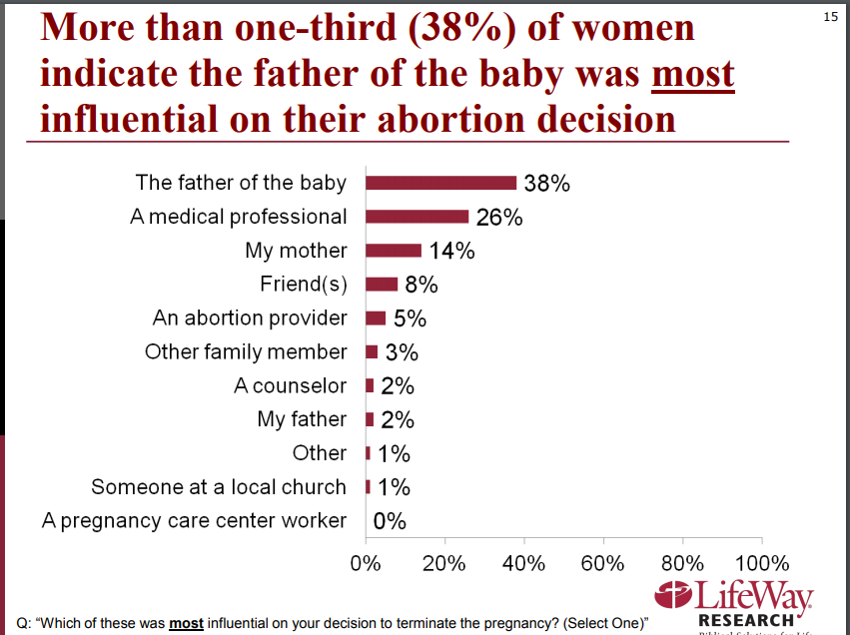
Justifications of Abortion
Justificaciones del Aborto
“men aren’t burdened/held accountable”
"Los hombres no son agobiados / responsabilizados"

Slide 14
Justifications of Abortion
Justificaciones del Aborto
“men aren’t burdened/held accountable”
"Los hombres no son agobiados / responsabilizados"

Slide 15
Justifications of Abortion
Justificaciones del Aborto
“men aren’t burdened/held accountable”
"Los hombres no son agobiados / responsabilizados"

Slide 16
Justifications of Abortion
Justificaciones del Aborto
“men aren’t burdened/held accountable”
"Los hombres no son agobiados / responsabilizados"

Slide 18
Two mindsets
Justifications
not a human life (briefly answer and dismiss)
my body my right, 1 Cor. 6 (note context: fornication)
men don’t have to deal with this
presupposes that this is outside of marriage, right there is the problem in this world!
But there’s a point to be made: note the survey- how many abortions come about because of the father’s influence
Get the quotes from the journal article “father didn’t want the baby”
Solution is God’s way
But if I make a mistake, whether male or female, accept the consequences
Abortion comes about because of following the lusts of men rather than will of God, whether it’s the lust that led to relations outside of marriage, or the desire to avoid responsibilities and burden of children on the part of a married couple, or the lust or hatred of a rapist – wait why should I suffer for the wrong that another does to me? But you know what, that was part of being the Christ , and that’s part of being a Christian.
FORGIVENESS

