Slide 1
Exton
Sunday 11 am
April 21, 2019

Slide 2
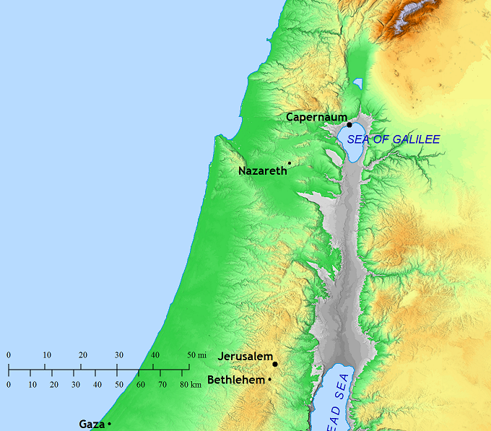
Samaria

Slide 3
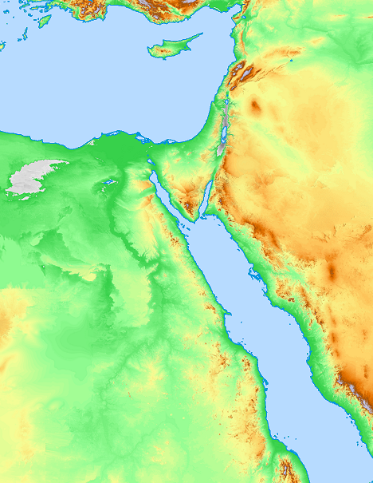
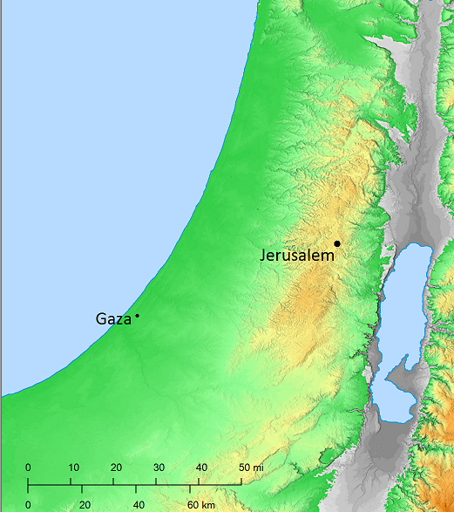
NT
Isaiah
Jerusalem
Isaiah 53
Like a lamb that is led to slaughter, And like a sheep that is silent before its shearers, So He did not open His mouth. By oppression and judgment He was taken away; And as for His generation, who considered That He was cut off out of the land of the living
Acts 8
³⁴The eunuch answered Philip and said, "Please tell me, of whom does the prophet say this? Of himself or of someone else?"
³⁵Then Philip opened his mouth, and beginning from this Scripture he preached Jesus to him.
Realm of Candace
Ancient “ETHIOPIA”

Slide 4
Isaiah 53
⁴Surely our griefs He Himself bore, And our sorrows He carried; Yet we ourselves esteemed Him stricken, Smitten of God, and afflicted. ⁵But He was pierced through for our transgressions, He was crushed for our iniquities; The chastening for our well-being fell upon Him, And by His scourging we are healed.
⁶All of us like sheep have gone astray,
Each of us has turned to his own way;
But the LORD has caused the iniquity of us all
To fall on Him
⁷He was oppressed and He was afflicted,
Yet He did not open His mouth;
Like a lamb that is led to slaughter, And like a sheep that is silent before its shearers, So He did not open His mouth.
Facts
Matthew 27:26
Then he released Barabbas for them; but Jesus he scourged and delivered over to be crucified.
Mark 14:60-61a
And the high priest arose and came forward and questioned Jesus, saying, “Do You make no answer to what these men are testifying against You?” But He kept silent, and made no answer.”

Slide 5
Isaiah 53
⁸By oppression and judgment He was taken away; And as for His generation, who considered That He was cut off out of the land of the living,
For the transgression of my people to whom the stroke was due?
⁹His grave was assigned to be with wicked men,
Yet with a rich man in His death;
Although He had done no violence,
Nor was there any deceit in His mouth.
Facts
Matthew 27:57-60
And when it was evening, there came a rich man from Arimathea, named Joseph, who himself had also become a disciple of Jesus. This man came to Pilate and asked for the body of Jesus. Then Pilate ordered it to be given over to him. And Joseph took the body and wrapped it in a clean linen cloth, and laid it in his own new tomb, which he had hewn out in the rock and he rolled a large stone against the entrance of the tomb and went away.

Slide 6
Isaiah 53
¹⁰But the LORD was pleased To crush Him, putting Him to grief;
If He would render Himself as a guilt offering ,
He will see His offspring,
He will prolong His days,
And the good pleasure of the LORD will prosper in His hand.
¹¹As a result of the anguish of His soul,
He will see it and be satisfied;
By His knowledge the Righteous One,
My Servant, will justify the many,
As He will bear their iniquities.
¹²Therefore, I will allot Him a portion with the great,
And He will divide the booty with the strong; Because He poured out Himself to death,
And was numbered with the transgressors;
Yet He Himself bore the sin of many,
And interceded for the transgressors.
Facts

Slide 7
Isaiah 53
⁴Surely our griefs He Himself bore, And our sorrows He carried; Yet we ourselves esteemed Him stricken, Smitten of God, and afflicted. ⁵But He was pierced through for our transgressions, He was crushed for our iniquities; The chastening for our well-being fell upon Him, And by His scourging we are healed.
⁶All of us like sheep have gone astray,
Each of us has turned to his own way;
But the LORD has caused the iniquity of us all
To fall on Him
⁷He was oppressed and He was afflicted,
Yet He did not open His mouth;
Like a lamb that is led to slaughter, And like a sheep that is silent before its shearers, So He did not open His mouth.
NT
1 Peter 2
²² Who committed no sin, nor was any deceit found in His mouth; ²³ and while being reviled, He did not revile in return, while suffering, He uttered no threats, but kept entrusting Himself to Him who judges righteously; ²⁴ and He Himself bore our sins in His body on the cross, that we might die to sin and live to righteousness; for by His wounds you were healed. ²⁵ For you were continually straying like sheep, but now you are returned to the Shepherd and Guardian of your souls.
1 Peter 2
²² Who committed no sin, nor was any deceit found in His mouth; ²³ and while being reviled, He did not revile in return, while suffering, He uttered no threats, but kept entrusting Himself to Him who judges righteously; ²⁴ and He Himself bore our sins in His body on the cross, that we might die to sin and live to righteousness; for by His wounds you were healed. ²⁵ For you were continually straying like sheep, but now you are returned to the Shepherd and Guardian of your souls.
1 Peter 2
²² Who committed no sin, nor was any deceit found in His mouth; ²³ and while being reviled, He did not revile in return, while suffering, He uttered no threats, but kept entrusting Himself to Him who judges righteously; ²⁴ and He Himself bore our sins in His body on the cross, that we might die to sin and live to righteousness; for by His wounds you were healed. ²⁵ For you were continually straying like sheep, but now you are returned to the Shepherd and Guardian of your souls.
1 Peter 2
²² Who committed no sin, nor was any deceit found in His mouth; ²³ and while being reviled, He did not revile in return, while suffering, He uttered no threats, but kept entrusting Himself to Him who judges righteously; ²⁴ and He Himself bore our sins in His body on the cross, that we might die to sin and live to righteousness; for by His wounds you were healed. ²⁵ For you were continually straying like sheep, but now you are returned to the Shepherd and Guardian of your souls.
1 Peter 2
²² Who committed no sin, nor was any deceit found in His mouth; ²³ and while being reviled, He did not revile in return, while suffering, He uttered no threats, but kept entrusting Himself to Him who judges righteously; ²⁴ and He Himself bore our sins in His body on the cross, that we might die to sin and live to righteousness; for by His wounds you were healed. ²⁵ For you were continually straying like sheep, but now you are returned to the Shepherd and Guardian of your souls.
53:9
Transfer of sin
&
Substitutionary
Punishment
53:7
53:5
53:6

Slide 8
Isaiah 53
⁸By oppression and judgment He was taken away; And as for His generation, who considered That He was cut off out of the land of the living,
For the transgression of my people to whom the stroke was due?
⁹His grave was assigned to be with wicked men,
Yet with a rich man in His death;
Although He had done no violence,
Nor was there any deceit in His mouth.
Transfer of sin
&
Substitutionary
Punishment

Slide 9
Isaiah 53
¹⁰But the LORD was pleased To crush Him, putting Him to grief;
If He would render Himself as a guilt offering ,
He will see His offspring,
He will prolong His days,
And the good pleasure of the LORD will prosper in His hand.
¹¹As a result of the anguish of His soul,
He will see it and be satisfied;
By His knowledge the Righteous One,
My Servant, will justify the many,
As He will bear their iniquities.
¹²Therefore, I will allot Him a portion with the great,
And He will divide the booty with the strong; Because He poured out Himself to death,
And was numbered with the transgressors;
Yet He Himself bore the sin of many,
And interceded for the transgressors.
Transfer of sin
&
Substitutionary
Punishment

Slide 10
Isaiah 53
¹⁰But the LORD was pleased To crush Him, putting Him to grief;
If He would render Himself as a guilt offering ,
He will see His offspring,
He will prolong His days,
And the good pleasure of the LORD will prosper in His hand.
¹¹As a result of the anguish of His soul,
He will see it and be satisfied;
By His knowledge the Righteous One,
My Servant, will justify the many,
As He will bear their iniquities.
¹²Therefore, I will allot Him a portion with the great,
And He will divide the booty with the strong; Because He poured out Himself to death,
And was numbered with the transgressors;
Yet He Himself bore the sin of many,
And interceded for the transgressors.
Justice

Slide 11
Acts 8
³⁶As they went along the road they came to some water; and the eunuch said, "Look! Water! What prevents me from being baptized?"
³⁸And he ordered the chariot to stop; and they both went down into the water, Philip as well as the eunuch, and he baptized him. ³⁹When they came up out of the water, the Spirit of the Lord snatched Philip away; and the eunuch no longer saw him, but went on his way rejoicing.
Deuteronomy 23:1
No one who is emasculated, or has his male organ cut off, shall enter the assembly of the LORD.
Isaiah 56:3-5

