Slide 1
BUILDING HOUSES Exton Sunday, 11 a.m. March 10, 2019

Slide 2
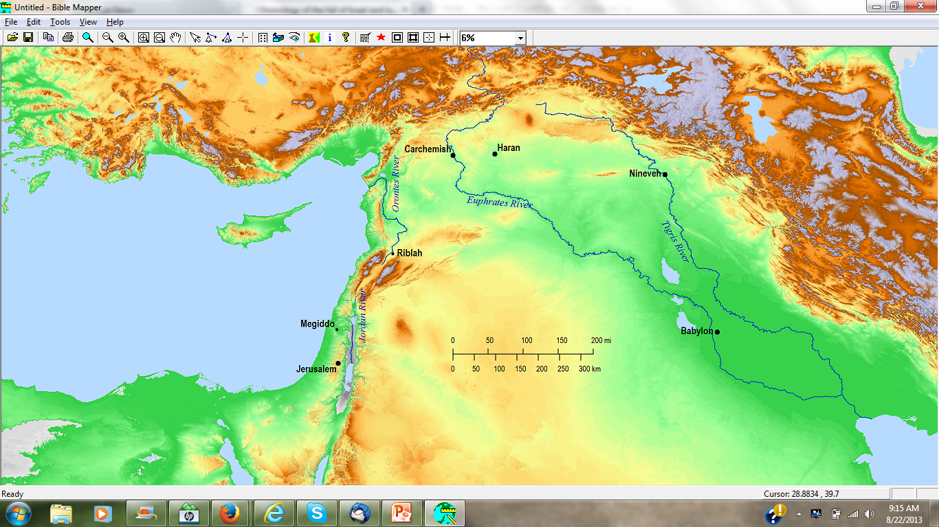
Ezekiel 11:3
“Is not the time near to build houses?”
Babylon
Jeremiah 29
⁴ “Thus says the Lord of hosts, the God of Israel, to all the exiles whom I have sent into exile from Jerusalem to Babylon, ⁵ ‘Build houses and live in them;

Slide 4
Genesis 13
¹⁰ Lot lifted up his eyes and saw all the valley of the Jordan, that it was well watered everywhere—
this was before the Lord destroyed Sodom and Gomorrah—
like the garden of the Lord, like the land of Egypt as you go to Zoar.
¹¹ So Lot chose for himself all the valley of the Jordan, and Lot journeyed eastward….
¹² …Lot settled in the cities of the valley, and moved his tents as far as Sodom.
¹³ Now the men of Sodom were wicked exceedingly and sinners against the Lord.

Slide 5
1 Samuel 2
²⁷ Then a man of God came to Eli and said to him, “Thus says the Lord, ‘Did I not indeed reveal Myself to the house of your father when they were in Egypt in bondage to Pharaoh’s house?
²⁸ Did I not choose them from all the tribes of Israel to be My priests, to go up to My altar, to burn incense, to carry an ephod before Me; and did I not give to the house of your father all the fire offerings of the sons of Israel?

Slide 6
1 Samuel 2
³¹ Behold, the days are coming when I will break your strength and the strength of your father’s house so that there will not be an old man in your house.
³² You will see the distress of My dwelling, in spite of all the good that I do for Israel; and an old man will not be in your house forever.
³³ all the increase of your house will die in the prime of life.

Slide 7
Matthew 7
²⁴ “Therefore everyone who hears these words of Mine and acts on them, may be compared to a wise man who built his house on the rock. ²⁵ And the rain fell, and the floods came, and the winds blew and slammed against that house; and yet it did not fall, for it had been founded on the rock.
²⁶ Everyone who hears these words of Mine and does not act on them, will be like a foolish man who built his house on the sand. ²⁷ The rain fell, and the floods came, and the winds blew and slammed against that house; and it fell—and great was its fall.”

Slide 8
Acts 16
¹⁴ A woman named Lydia, from the city of Thyatira, a seller of purple fabrics, a worshiper of God, was listening; and the Lord opened her heart to respond to the things spoken by Paul. ¹⁵ And when she and her household had been baptized, she urged us, saying, “If you have judged me to be faithful to the Lord, come into my house and stay.” And she prevailed upon us.

Slide 9
Acts 16
³¹ They said, “Believe in the Lord Jesus, and you will be saved, you and your household.”
³² And they spoke the word of the Lord to him together with all who were in his house. ³³ And he took them that very hour of the night and washed their wounds, and immediately he was baptized, he and all his household.
³⁴ And he brought them into his house and set food before them, and rejoiced greatly, having believed in God with his whole household.

Slide 10
1 Corinthians 16
¹⁵ …(you know the household of Stephanas, that they were the first fruits of Achaia, and that they have devoted themselves for ministry to the saints)

Slide 11
2 John 1
¹ The elder to the chosen lady and her children
⁴ I was very glad to find some of your children walking in truth

Slide 12
Shaphan
1 Kings 22
³ Now in the eighteenth year of King Josiah, the king sent Shaphan…
⁸ Then Hilkiah the high priest said to Shaphan the scribe, “I have found the book of the law in the house of the Lord.” And Hilkiah gave the book to Shaphan who read it.
⁹ Shaphan the scribe came to the king
¹⁰ …Shaphan the scribe told the king saying, “Hilkiah the priest has given me a book.” And Shaphan read it in the presence of the king.
¹¹ When the king heard the words of the book of the law, he tore his clothes. ¹² Then the king commanded Hilkiah the priest, Ahikam the son of Shaphan, Achbor the son of Micaiah, Shaphan the scribe, and Asaiah the king’s servant saying, ¹³ “Go, inquire of the Lord for me

Slide 13
Shaphan
his son Ahikam
Jeremiah 26
²⁴ But the hand of Ahikam the son of Shaphan was with Jeremiah, so that he was not given into the hands of the people to put him to death.

Slide 14
Shaphan
his son Ahikam
his son Gemariah
Jeremiah 36
⁴ Then Jeremiah called Baruch the son of Neriah, and Baruch wrote on a scroll at the dictation of Jeremiah all the words of the Lord which He had spoken to him.
¹⁰ Then Baruch read from the book the words of Jeremiah in the house of the Lord in the chamber of Gemariah the son of Shaphan the scribe, in the upper court, at the entry of the New Gate of the Lord’shouse, to all the people.

Slide 15
Shaphan
his son Ahikam
his son Gemariah
his grandson Micaiah
Jeremiah 36
¹¹ Now when Micaiah the son of Gemariah, the son of Shaphan, had heard all the words of the Lord from the book, ¹² he went down to the king’s house, into the scribe’s chamber. And behold, all the officials were sitting there—Elishama the scribe, and Delaiah the son of Shemaiah, and Elnathan the son of Achbor, and Gemariah the son of Shaphan, and Zedekiah the son of Hananiah, and all the other officials. ¹³ Micaiah declared to them all the words that he had heard when Baruch read from the book to the people.

Slide 16
Shaphan
his son Ahikam
his son Gemariah
his grandson Micaiah
Jeremiah 36
²⁵ Even though Elnathan and Delaiah and Gemariah pleaded with the king not to burn the scroll, he would not listen to them.

Slide 17
Shaphan
his son Ahikam
his son Gemariah
his grandson Micaiah
Elasah (Jeremiah 29:3)

Slide 18
Shaphan
his son Ahikam
his son Gemariah
his grandson Micaiah
Elasah (Jeremiah 29:3)
Gedaliah

Slide 19
Shaphan
his son Ahikam
his son Gemariah
his grandson Micaiah
Elasah
Gedaliah
Jaazaniah
Ezekiel 8
¹⁰ So I entered and looked, and behold, every form of creeping things and beasts and detestable things, with all the idols of the house of Israel, were carved on the wall all around. ¹¹ Standing in front of them were seventy elders of the house of
Israel, with Jaazaniah the son of Shaphan standing among them, each man with his censer in his hand and the fragrance of the cloud of incense rising. ¹² Then He said to me, “Son of man, do you see what the elders of the house of Israel are committing in the dark, each man in the room of his carved images? For they say, ‘The Lord does not see us; the Lord has forsaken the land.’”

Slide 20
Independence
Independence of Maturity
build on the rock
Independence of Rebellion
To Young People
identity
pride
To Parents
priorities
Joshua 24:15
“as for me and my house, we will serve the Lord.”

