Slide 1
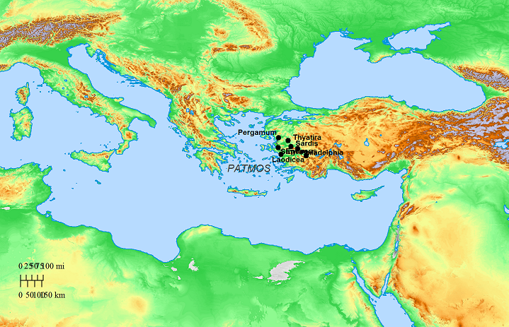

Slide 2
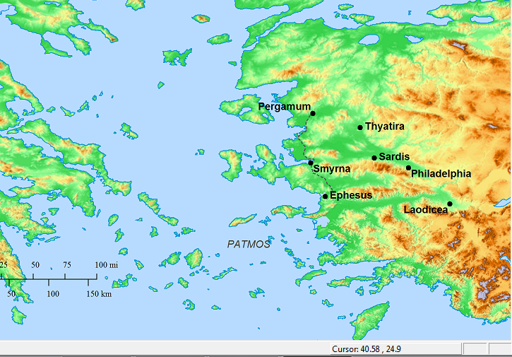

Slide 3
Ephesus
walks in the midst of the seven golden candlesticks
will move thy candlestick out of its place
Smyrna
was dead, and lived
Be thou faithful unto death, and I will give thee the crown of life
Pergamum
has the sharp two-edged sword
I will make war against them with the sword of my mouth
Thyatira
has his eyes like a flame of fire
I am he that searches the reins and hearts
Sardis
has...the seven stars
I will confess his name... before His angels
Philadelphia
has the key of David, he that opens and none shall shut
I have set before thee a door opened, which none can shut

Slide 4
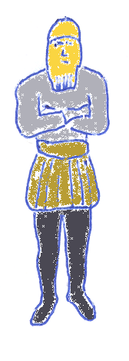
DANIEL 2
Medo Persia
Rome
Babylon
Greece
GOLD
SILVER
BRONZE
IRON, w/ clay
GOLD
SILVER
BRONZE
IRON, w/ clay
Daniel

Slide 5
DANIEL & REVELATION
what will take place in the latter days...
Babylon Lion
Medo/Persia Bear
Greece Leopard
Rome “Different”
Judgment

Slide 6
DANIEL & REVELATION
what will take place in the latter days...
Babylon Lion
Medo/Persia Bear
Greece Leopard
Rome “Different”

