Slide 1
Intelligent Design...
(1) Science, Faith, or Logic?
(2) A Fact of Life

Slide 2
Exton
January 20, 2019
Sunday, 11 am

Slide 3
Intelligent Design...
(1) Science, Faith, or Logic?
(2) A Fact of Life

Slide 4
Intelligent Design...
(1) Science, Faith, or Logic?
Something has happened that no one has ever seen, that has never been scientifically demonstrated
The Theory of Biogenesis
The Law of Biogenesis
“All life comes from pre-existing life”

Slide 5
Intelligent Design...
(1) Science, Faith, or Logic?
Is
“Intelligent Design”
Science?
That’s Not the Question
I’m more interested in this:
Was there an
“Intelligent Designer”?

Slide 6
Intelligent Design...
(1) Science, Faith, or Logic?
Was there an
“Intelligent Designer”?

Slide 7
Intelligent Design...
(1) Science, Faith, or Logic?
Was there an
“Intelligent Designer”?
The Bible Can Answer That Question
But For Many, It is Answered Without the Bible
“There has to be something out there”

Slide 8
Intelligent Design...
(1) Science, Faith, or Logic?
Was there an
“Intelligent Designer”?
But For Many, It is Answered Without the Bible
“There has to be something out there”
NOTE:
What sort of Designer?
not… 6 Days of Creation
not… Jesus, Born of Virgin
just… Is Intelligence Responsible For What We See?

Slide 9
Intelligent Design...
(1) Science, Faith, or Logic?
Was there an
“Intelligent Designer”?
But For Many, It is Answered Without the Bible
Acts 14¹⁷ Yet he did not leave himself without witness, for he did good by giving you rains from heaven and fruitful seasons, satisfying your hearts with food and gladness.”
just… Is Intelligence Responsible For What We See?

Slide 10
Intelligent Design...
(1) Science, Faith, or Logic?
Was there an
“Intelligent Designer”?
“somewhere in the universe” “higher intelligence” “a very, very high level of technology”
But For Many, It is Answered Without the Bible
Romans 1 ¹⁹⁻²⁰ For what can be known about God is plain to them, because God has shown it to them. For his invisible attributes, namely, his eternal power and divine nature, have been clearly perceived, ever since the creation of the world, in the things that have been made.
what can be known about God
Richard
Dawkins
eternal
divine
just… Is Intelligence Responsible For What We See?

Slide 11
Intelligent Design...
(1) Science, Faith, or Logic?
Wikipedia
Intelligent design (ID)

Slide 12
Intelligent Design...
(1) Science, Faith, or Logic?
Wikipedia
Intelligent design (ID) is a pseudoscientific argument for the existence of God, presented by its proponents as "an evidence-based scientific theory about life's origins".
pseudoscientific
God
Science

Slide 13
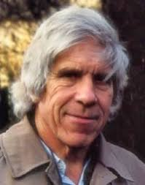
Intelligent Design...
“I’m also quite open to the view that there is some kind of ultimate good which is of a religious nature — that we just have to look beyond what the evolutionary theory tells us and accept promptings of what ultimate good is, coming from some other source.”
“I could enlarge on that in terms of the possible existence of extraterrestrial manipulators who interfere, and so on, but I think this would be getting too far from the general topic of discussion.”
BUT, the interviewer was intrigued, and “asked him if he meant that there was some kind of ‘transcendental purpose’ that we humans are generally oblivious to. He answered:
“Yes, yes. There’s one theory of the universe that I rather like — I accept it in an almost joking spirit — and that is that Planet Earth in our solar system is a kind of zoo for extraterrestrial beings who dwell out there somewhere….every now and then they see something which doesn’t look quite right…[they] insert a finger and just change some little thing. And maybe those are the miracles which the religious people like to so emphasize.”
“I put it forward in an almost joking spirit. But I think it’s a kind of hypothesis that’s very, very hard to dismiss.”
(1) Science, Faith, or Logic?
Wikipedia
Intelligent design (ID) is a pseudoscientific argument for the existence of God, presented by its proponents as "an evidence-based scientific theory about life's origins".
extraterrestrial manipulators
pseudoscientific
God
Science
Wikipedia
W. D. Hamilton “English evolutionary biologist,
widely recognised as one
of the most significant evolutionary theorists of
the 20th century.”
https://www.youtube.com/watch?time_continue=4&v=IjnvNT5ARTk

Slide 14
Intelligent Design...
(1) Science, Faith, or Logic?
extraterrestrial manipulators
Science
Francis Crick of Watson & Crick suggested life was "seeded on earth."
"life on Earth was the result of a deliberate infection, designed by aliens who had purposely fled mother nature’s seed to a new home in the sun."
Icarus
Volume 19, Issue 3, July 1973, Pages 341-346
https://blogs.scientificamerican.com/guest-blog/the-origins-of-directed-panspermia/

Slide 15
Intelligent Design...
(1) Science, Faith, or Logic?
extraterrestrial manipulators
Science
“Crick and Orgel proposed their Directed Panspermia theory at a conference on Communication with Extraterrestrial Intelligence, organized by Carl Sagan and held at the Byuraka Observatory in Soviet Armenia in 1971. This theory which they described as an ’highly unorthodox proposal’ and ’bold speculation’ was presented as a plausible scientific hypothesis.” (emph. mine, JS)
The Origins of Directed Panspermia
By Christian Orlic on January 9, 2013
https://blogs.scientificamerican.com/guest-blog/the-origins-of-directed-panspermia/

Slide 16
Intelligent Design...
(1) Science, Faith, or Logic?
extraterrestrial manipulators
Science
BUT WE HAVEN’T FOUND THEM!
just speculation based on the fact that we exist, but have no good explanation for how we came to exist
Scientific fact (we exist) points to a cause. THAT’S LOGIC
(But how would we find out if they existed?)

Slide 17
Darwin did not believe Science eliminated God
Origin of Species, Charles Darwin, p. 193
Origin of Species, Charles Darwin, p. 194
WHY WOULD HE SAY THAT??

Slide 18
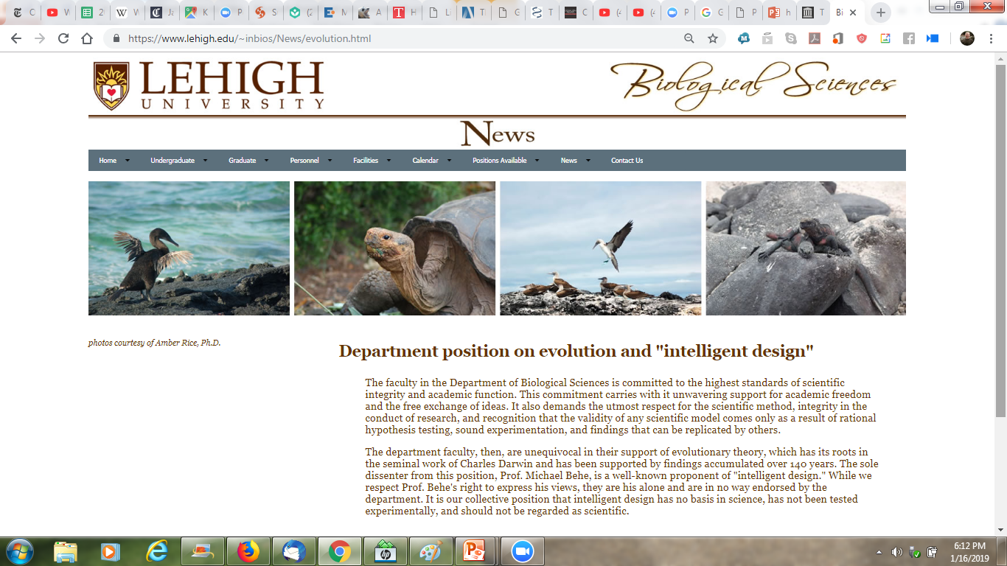
Origin of Species,
Charles Darwin, Chp VI, p. 190f
What is Science?
SCIENTIFIC AMERICAN:
“science avoids design explanations for natural phenomena out of logical necessity.
The scientific method involves rigorously observing and experimenting on the material world. It accepts as evidence only what can be measured or otherwise empirically validated”
https://www.scientificamerican.com/article/six-things-ben-stein-doesnt-want-you-to-know/
…the validity of any scientific model comes only as a result of rational hypothesis testing, sound experimentation, and findings that can be replicated by others.
The department faculty, then, are unequivocal in their support of evolutionary theory, which has its roots in the seminal work of Charles Darwin….It is our collective position that intelligent design has no basis in science, has not been tested experimentally, and should not be regarded as scientific.
That may be Reason, but it’s not Science

Slide 19
Origin of Species,
Charles Darwin, Chp VI, p. 190f
Maybe what [Darwin] should have said is, “Well, maybe you can’t think of --maybe you’re too thick to think of a reason why the eye could have come about by gradual steps, but perhaps you should go away and think a bit harder.” Now, I’ve done it for the eye.*
Richard
Dawkins
* https://www.pbs.org/thinktank/transcript410.html

Slide 20
Suppose we start with an ancestor who didn’t really have an eye at all, just a single, simple sheet of light sensitive cells… This animal with hardly any eye at all would at least be able to tell the difference between light and dark….
The next stage in evolution would be to have a shallow cup. This animal would be able to tell the direction that light is coming from because a shadow would appear…Then you can tell the direction that a predator is coming from…It would probably be an indentation. And it would be a gradual indentation….It’s easy to see that that shadow effect…would work progressively and gradually as the cup gets bigger…
…gradually bigger again, so big that it becomes just a little hole in the end. Now, this animal has a very good idea of exactly where the light is and, by the same token, exactly where, for example, the predator is. And I think with this eye, we might even get a little image…so an animal with an eye like this would be able to see perhaps just a little bit what kind of predator it was.
Richard
Dawkins

Slide 21
Let’s go to the logical conclusion which would be a pinhole. Remember, it is all gradual, gradual change in evolution…If I were this animal I could see my predator in some detail.
There is an animal that has a pinhole camera for an eye. It’s a mollusk called nautilus.
Now a pinhole camera is not a very good way of seeing. It does produce a sharp image, but because it’s so narrow, you hardly get any light in. The answer to this problem is that ingenious device, the lens.
How might the lens have evolved? Let’s imagine that it started with just a single transparent sheet of some transparent material…. All that it’s doing is protecting the eye. …This animal now has some protection.
https://www.youtube.com/watch?v=Nwew5gHoh3E
Maybe what [Darwin] should have said is, “Well, maybe you can’t think of --maybe you’re too thick to think of a reason why the eye could have come about by gradual steps, but perhaps you should go away and think a bit harder.” Now, I’ve done it for the eye.*
He doesn’t KNOW this is what happened.
But because the eye exists, he’s inferring what neither he nor anyone else has ever demonstrated scientifically.
He’s looking at what he sees, and inferring what he hasn’t seen and can’t see.
What's the difference between this and what I'm doing?
He is ASSUMING the explanation cannot be by design. I am assuming the explanation could be by design.
How might the lens have evolved? Let’s imagine that it started with just a single transparent sheet of some transparent material….
Richard
Dawkins

Slide 22
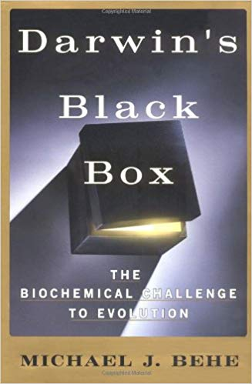
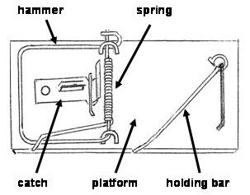
Intelligent Design...
Two Ideas
Black Box
What’s inside a computer?
What’s inside a cell?
Irreducibly Complex Systems

Slide 23
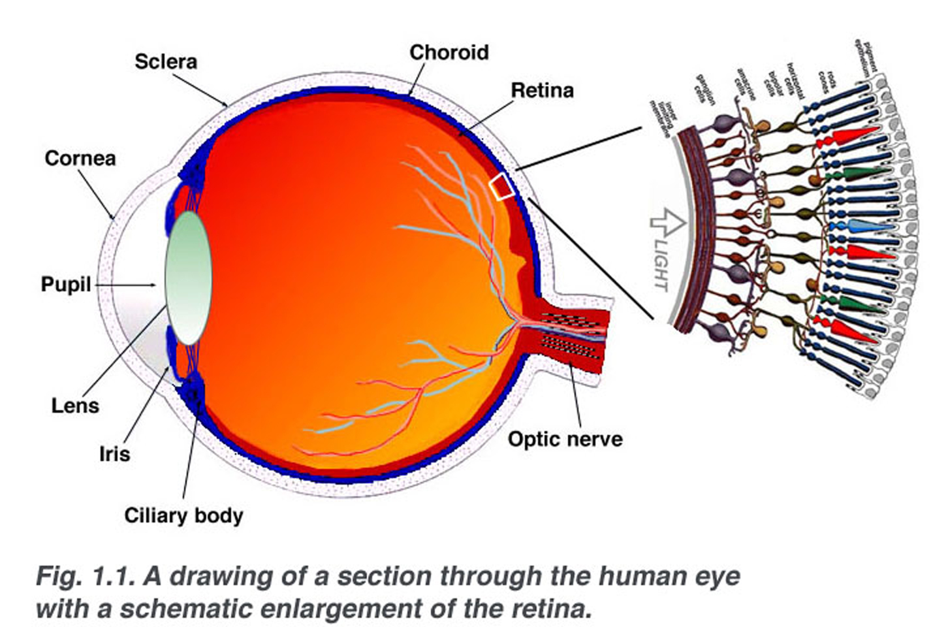
Let’s Look at the Eye
CREDIT http://webvision.med.utah.edu
https://webvision.med.utah.edu/book/part-i-foundations/simple-anatomy-of-the-retina/

Slide 24
CREDIT http://webvision.med.utah.edu
https://webvision.med.utah.edu/book/part-i-foundations/simple-anatomy-of-the-retina/

Slide 25
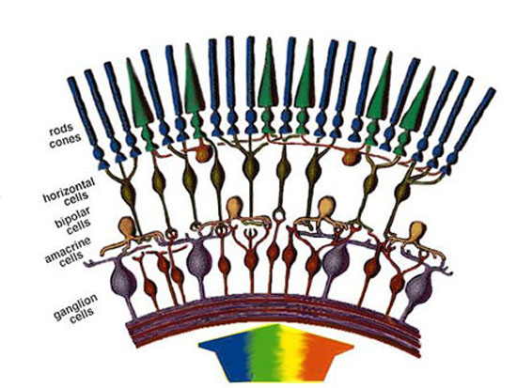
ROD
CONE
CONE
ROD
ROD
http://www.appstate.edu/~steelekm/classes/psy3215/EyePhysio/simple_retina.htm

Slide 26
http://www.appstate.edu/~steelekm/classes/psy3215/EyePhysio/simple_retina.htm

Slide 28
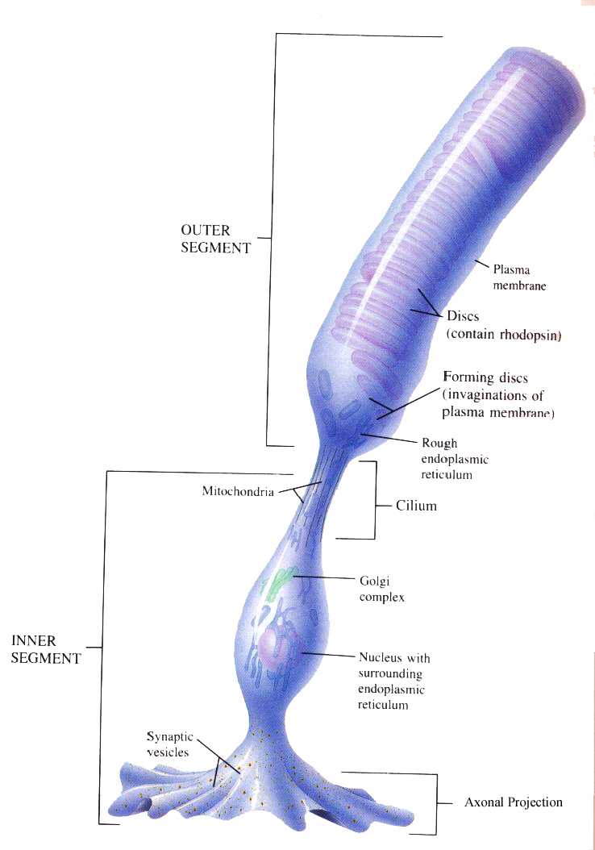
http://www.doctorc.net/EYE/ROD.HTM

Slide 29
“ON”

Slide 30
“ON”

Slide 31
“ON”

Slide 33
cGMP
cGMP
Na⁺
Ca
Na⁺
Na⁺
Na⁺
cGMP
Na⁺
Ca
Na⁺
Na⁺
Ca
Na⁺
Ca
Na⁺
cGMP
cGMP
cGMP
Ca
Na⁺
Na⁺
Na⁺
Na⁺
Na⁺
Ca
Na⁺
Na⁺
cGMP
Na⁺
Na⁺
Na⁺
Ca
cGMP
cGMP
cGMP
Ca
Na⁺
Na⁺
Na⁺
Na⁺
Ca
Na⁺
Na⁺
Na⁺
cGMP

Slide 34
cGMP
Na⁺
Ca
Na⁺
Na⁺
Na⁺
cGMP
Na⁺
Ca
Na⁺
Na⁺
Ca
Na⁺
Ca
Na⁺
Na⁺
Na⁺
Ca
Ca
Ca
cGMP
Ca
Na⁺
Na⁺
Na⁺
Na⁺
Na⁺
Ca
Na⁺
Na⁺
cGMP
Na⁺
Na⁺
Na⁺
Ca
Ca
Ca
cGMP
Na⁺
Na⁺
Na⁺
Na⁺
Ca
Na⁺
Na⁺
Na⁺
Na⁺
Ca
Na⁺
Na⁺
Na⁺

Slide 35
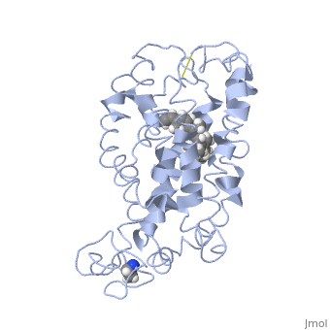
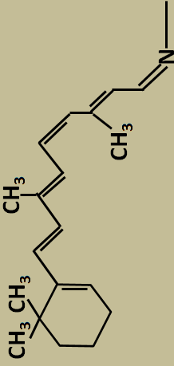
metarhodopsin II
rhodopsin
https://proteopedia.org/wiki/index.php/Rhodopsin

Slide 36
GTP
GDP
transducin
cGMP
cGMP
cGMP
cGMP
GTP
transducin
PED
PED
GTP
GTP
transducin
transducin
cGMP
PED
PED
Ca
Na⁺
Na⁺
Na⁺
Na⁺
Na⁺
Ca
cGMP
cGMP
cGMP
cGMP
cGMP

Slide 37
cGMP
GTP
transducin
PED
GMP

Slide 38
cGMP
cGMP
Na⁺
Ca
Na⁺
Na⁺
Na⁺
cGMP
Na⁺
Ca
Na⁺
Na⁺
Ca
Na⁺
Ca
Na⁺
Na⁺
Na⁺
cGMP
cGMP
Ca
Ca
Ca
cGMP
Ca
Na⁺
Na⁺
Na⁺
Na⁺
Na⁺
Ca
Na⁺
Na⁺
cGMP
Na⁺
Na⁺
Na⁺
Ca
Ca
Ca
cGMP
cGMP
Na⁺
Na⁺
Na⁺
Na⁺
cGMP
Ca
Na⁺
Na⁺
Na⁺
Na⁺
Ca
Na⁺
Na⁺
Na⁺
cGMP

Slide 39
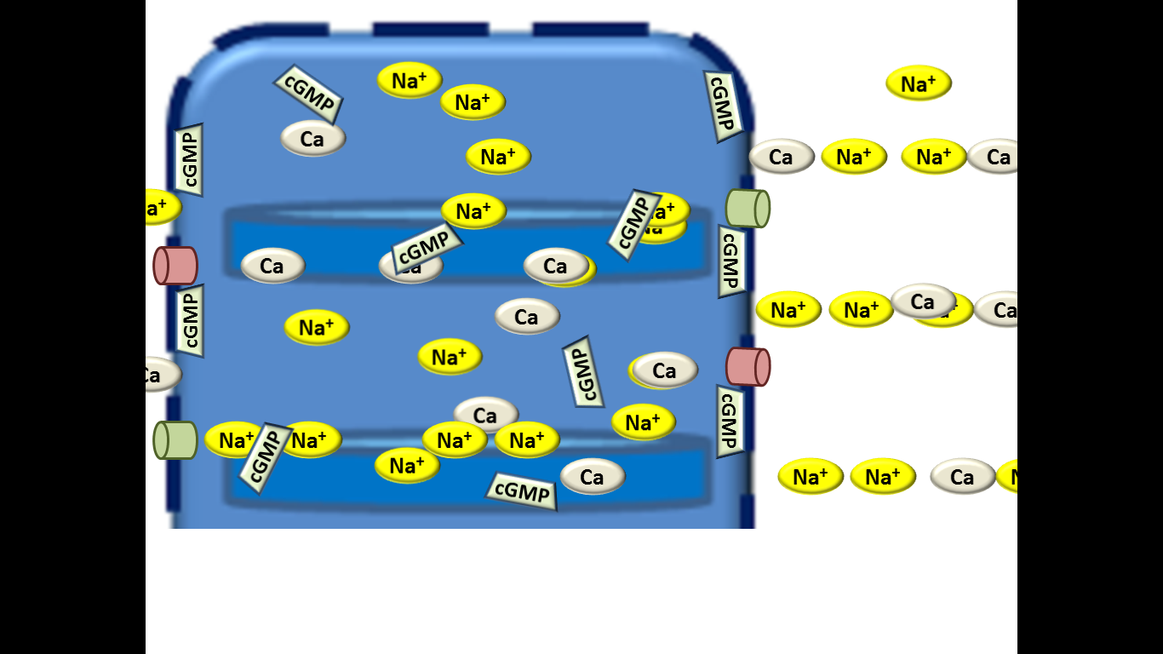

Slide 40
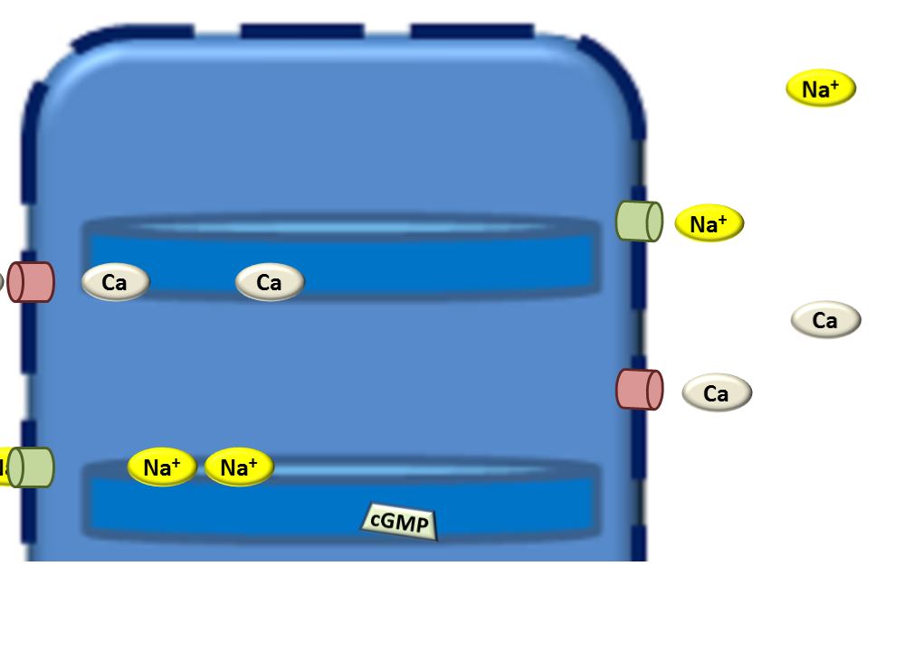

Slide 45
http://www.appstate.edu/~steelekm/classes/psy3215/EyePhysio/simple_retina.htm

Slide 47
CREDIT http://webvision.med.utah.edu
https://webvision.med.utah.edu/book/part-i-foundations/simple-anatomy-of-the-retina/

Slide 48
Depleted Sodium ions
Depleted cGMP
11-cis-retinal has become trans-retinal
Rhodopsin has turned into Metarhodopsin II
PROBLEM: This is a Depleted Rod!

Slide 49
cGMP
cGMP
cGMP
cGMP
GTP
transducin
Na⁺
Ca
Na⁺
Na⁺
Na⁺
cGMP
GTP
Na⁺
Ca
Na⁺
Na⁺
transducin
Ca
Na⁺
Ca
PED
Na⁺
GMP
Na⁺
Na⁺
PED
GMP
cGMP
cGMP
Ca
Ca
Ca
cGMP
Ca
Na⁺
Na⁺
Na⁺
Na⁺
Na⁺
Ca
Na⁺
Na⁺
cGMP
Na⁺
Na⁺
Na⁺
Ca
Ca
Ca
cGMP
cGMP
Na⁺
Na⁺
Na⁺
Na⁺
cGMP
Ca
Na⁺
Na⁺
Na⁺
Na⁺
Ca
Na⁺
Na⁺
Na⁺
cGMP
The More PED accomplishes, the less it accomplishes!
By cutting cGMP, it closes channels, eliminating inflow of Calcium, which results in slower PED function
1

Slide 50
cGMP
cGMP
Na⁺
Ca
Na⁺
Na⁺
Na⁺
cGMP
Na⁺
Ca
Na⁺
Na⁺
Ca
Na⁺
Ca
Na⁺
cGMP
cGMP
cGMP
Ca
Na⁺
Na⁺
Na⁺
Na⁺
Na⁺
Ca
Na⁺
Na⁺
cGMP
Na⁺
Na⁺
Na⁺
Ca
cGMP
cGMP
cGMP
cGMP
cGMP
Ca
Na⁺
Na⁺
Na⁺
Na⁺
Ca
Na⁺
Na⁺
Na⁺
With Lower Calcium Concentration, an enzyme (guanylate cyclase) starts making cGMP
2

Slide 51
GTP
transducin
PED
GTP
transducin
PED
An enzyme (rhodopsin kinase) modifies metarhodopsin II so that it binds with arrestin, which prevents activation of transducin, which prevents binding with PED
3

Slide 52
An enzyme adds two hydrogen atoms, making rotation possible
Another enzyme rotates it, forming 11-cis retinol
A third enzyme removes the extra hydrogen atoms, thus forming 11-cis retinal
CH₃
CH₃
CH₃
CH₃
CH₃
CH₃
CH₃
N
CH₃
N

Slide 53
CH₃
CH₃
CH₃
CH₃
CH₃
CH₃
CH₃
N
CH₃
N

Slide 54
Intelligent Design...
A Wave of the Hand
the anatomical level vs. the biochemical level
knowing how it works is not the same as knowing how it came to be
And we still don’t fully understand HOW it all works!

Slide 55
Intelligent Design...
(1) Science, Faith, or Logic?
God
Logic
FAITH
Science
This is not yet Faith
Romans 10:17

Slide 56
Intelligent Design...
(2) A Fact of Life

Slide 57
Intelligent Design...
(2) A Fact of Life
Arrowheads
Extra-Terrestrial Life
Deep Blue
HOW HARD IS CHESS?
By DAVID GELERNTER
Deep Blue is just a machine. It doesn't have a mind any more than a flowerpot has a mind. Deep Blue is a beautiful and amazing technological achievement. It is an intellectual milestone, and its chief meaning is this: that human beings are champion machine builders.
http://content.time.com/time/magazine/article/0,9171,137690,00.html

Slide 58
Intelligent Design...
(2) A Fact of Life
Machines
https://www.youtube.com/watch?v=zm-3kovWpNQ
Ken Dill
biophysicist and chemist
TEDx talk at Stoneybrook University, October 2013
member of the National Academy of Sciences
Start at 7:49 End 9:19
Which is more impressive, the molecular machinery, or the at people can figure it out?
Either way, do chance and natural selection seem adequate explanations?

Slide 59
Intelligent Design...
(2) A Fact of Life
Machines
Kinesin
https://www.youtube.com/watch?v=y-uuk4Pr2i8
Which is more impressive, the molecular machinery, or the at people can figure it out?
Either way, do chance and natural selection seem adequate explanations?

Slide 60
Intelligent Design...
(2) A Fact of Life
Machines
https://www.youtube.com/watch?v=X_tYrnv_o6A
Start at 1:15 End 2:45
Which is more impressive, the molecular machinery, or the at people can figure it out?
Either way, do chance and natural selection seem adequate explanations?

Slide 61
Intelligent Design...
(2) A Fact of Life
00110001 00110000 00100000 01010000 01010010 01001001 01001110 01010100 00100000 00100010 01001000 01100101 01101100 01101100 01101111 00101100 00100000 01110111 01101111 01110010 01101100 01100100 00100001 00100010 00001101 00001010 00110010 00110000 00100000 01000101 01001110 01000100
Machines
10 PRINT "Hello, world!"
20 END
"Hello, world!"

Slide 62
00110001 00100000 00100011 00100000 01100011 00110010 01011111 01100011 01101001 01110010 01100011 01101100 01100101 01110011 01101101 01101001 01101100 01100101 00101110 01101011 01100010 01110011 00001101 00001010 00110010 00100000 00100011 00100000 01110011 01101101 01101001 01101100 01101001 01101110 01100111 00100000 01100110 01100001 01100011 01100101 00100000 01101101 01100001 01100100 01100101 00100000 01110111 01101001 01110100 01101000 00100000 01100011 01101001 01110010 01100011 01101100 01100101 01110011 00001101 00001010 00110011 00001101 00001010 00110100 00100000 00100011 00100000 01100011 01101100 01100101 01100001 01110010 00100000 01110100 01101000 01100101 00100000 01110011 01100011 01110010 01100101 01100101 01101110 00001101 00001010 00110101 00100000 01100011 01101100 01100111 00001101 00001010 00110110 00100000 01100011 01101111 01101100 01101111 01110010 00100000 01110111 01101000 01101001 01110100 01100101 00001101 00001010 00110111 00100000 01110010 01100101 01100011 01110100 00100000 00110000 00101100 00110000 00101100 00110011 00110000 00110000 00101100 00110011 00110000 00110000 00001101 00001010 00111000 00001101 00001010 00111001 00100000 00100011 00100000 01100100 01110010 01100001 01110111 00100000 01110100 01101000 01100101 00100000 01100110 01100001 01100011 01100101 00001101 00001010 00110001 00110000 00100000 01100011 01101111 01101100 01101111 01110010 00100000 01111001 01100101 01101100 01101100 01101111 01110111 00001101 00001010 00110001 00110001 00100000 01100011 01101001 01110010 01100011 01101100 01100101 00100000 00110001 00110101 00110000 00101100 00110001 00110101 00110000 00101100 00110001 00110101 00110000 00001101 00001010 00110001 00110010 00001101 00001010 00110001 00110011 00100000 00100011 00100000 01100100 01110010 01100001 01110111 00100000 01110100 01101000 01100101 00100000 01101101 01101111 01110101 01110100 01101000 00001101 00001010 00110001 00110100 00100000 01100011 01101111 01101100 01101111 01110010 00100000 01100010 01101100 01100001 01100011 01101011 00001101 00001010 00110001 00110101 00100000 01100011 01101001 01110010 01100011 01101100 01100101 00100000 00110001 00110101 00110000 00101100 00110010 00110000 00110000 00101100 00110111 00110000 00001101 00001010 00110001 00110110 00100000 01100011 01101111 01101100 01101111 01110010 00100000 01111001 01100101 01101100 01101100 01101111 01110111 00001101 00001010 00110001 00110111 00100000 01100011 01101001 01110010 01100011 01101100 01100101 00100000 00110001 00110101 00110000 00101100 00110001 00110101 00110000 00101100 00110111 00110000 00001101 00001010 00110001 00111000 00001101 00001010 00110001 00111001 00100000 00100011 00100000 01110000 01110101 01110100 00100000 01101111 01101110 00100000 01110100 01101000 01100101 00100000 01100101 01111001 01100101 01110011 00001101 00001010 00110010 00110000 00100000 01100011 01101111 01101100 01101111 01110010 00100000 01100010 01101100 01100001 01100011 01101011 00001101 00001010 00110010 00110001 00100000 01100011 01101001 01110010 01100011 01101100 01100101 00100000 00110001 00110000 00110000 00101100 00110001 00110000 00110000 00101100 00110011 00110000 00001101 00001010 00110010 00110010 00100000 01100011 01101001 01110010 01100011 01101100 01100101 00100000 00110010 00110000 00110000 00101100 00110001 00110000 00110000 00101100 00110011 00110000
1 # c2_circlesmile.kbs
2 # smiling face made with circles
3
4 # clear the screen
5 clg
6 color white
7 rect 0,0,300,300
8
9 # draw the face
10 color yellow
11 circle 150,150,150
12
13 # draw the mouth
14 color black
15 circle 150,200,70
16 color yellow
17 circle 150,150,70
18
19 # put on the eyes
20 color black
21 circle 100,100,30
22 circle 200,100,30

Slide 63
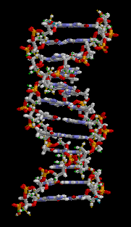
Intelligent Design...
(1) A Fact of Life

Slide 64
Intelligent Design...
(1) A Fact of Life
Our bodies run on Enzymes
Enzymes are made up of proteins
Proteins are made up of amino acids
the 20 amino acids
Ala Alanine Asp Aspartic acid Glu Glutamic acid Cys Cysteine Phe Phenylalanine Gly Glycine His Histidine Ile Isoleucine Lys Lysine Leu Leucine Met Methionine Asn Asparagine Pro Proline Gln Glutamine Arg Arginine Ser Serine Thr Threonine Val Valine Trp Tryptophan Tyr Tyrosine

Slide 65
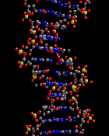
Intelligent Design...
(1) A Fact of Life

Slide 66
Intelligent Design...
T
G
A
C
C
A
A
G
A
C
C
A
G
A
A
C
C
A
A
G
A
A
C
T
G
G
T
T
C
T
G
G
T
C
T
T
G
G
T
T
C
T
(1) A Fact of Life

Slide 67
Intelligent Design...
T
G
A
C
C
A
A
G
A
C
C
A
G
A
A
C
C
A
A
G
A
A
C
T
G
G
T
T
C
T
G
G
T
C
T
T
G
G
T
T
C
T
(1) A Fact of Life
THESE ARE THE INSTRUCTIONS FOR MAKING…
Structures like hair, muscles, etc.
Machines (Enzymes)

Slide 68
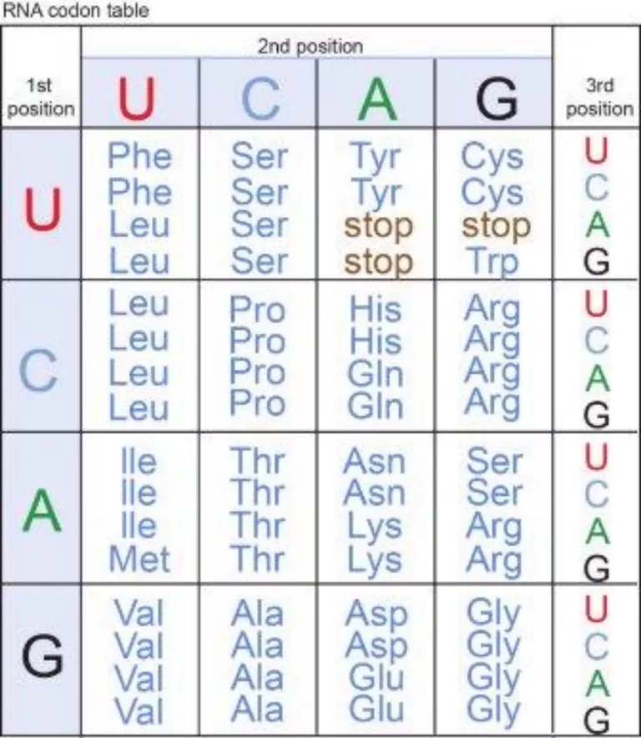
Intelligent Design...
T
G
A
C
C
A
A
G
A
C
C
A
G
A
A
C
C
A
A
G
A
A
C
T
G
G
T
T
C
T
G
G
T
C
T
T
G
G
T
T
C
T
(1) A Fact of Life
an enzyme, a little machine made of proteins, will read the instructions
THESE ARE THE INSTRUCTIONS FOR MAKING…
Structures like hair, muscles, etc.
Machines (Enzymes)

Slide 69
Intelligent Design...
T
G
A
C
C
A
A
G
A
C
C
A
G
A
A
C
C
A
A
G
A
A
C
T
G
G
T
T
C
T
G
G
T
C
T
T
G
G
T
T
C
T
(1) A Fact of Life
A
T
A
T
A
A
A
T
A
T
A
A
A
A

Slide 70
RNA POLYMERASE
Intelligent Design...
(1) A Fact of Life
Adenine
Thymine
Guanine
Cytosine
Guanine
Cytosine
Thymine
Adenine
Guanine
Cytosine
Thymine
Adenine

Slide 71
RNA POLYMERASE
RNA POLYMERASE
Intelligent Design...
(1) A Fact of Life
Adenine
Thymine
Uracil
Guanine
Cytosine
Cytosine
Guanine
Cytosine
Cytosine
Thymine
Adenine
Adenine
Guanine
Cytosine
Cytosine
Thymine
Adenine
UNTIL IT REACHES A STOP CODE
Adenine

Slide 72
Intelligent Design...
(1) A Fact of Life
Adenine
Thymine
Uracil
Guanine
Cytosine
Cytosine
Guanine
Cytosine
Cytosine
Messenger RNA
Thymine
Adenine
Adenine
Guanine
Cytosine
Cytosine
Thymine
Adenine
Adenine

Slide 73
Amino acid
Transfer RNA

Slide 75
Intelligent Design...
(1) A Fact of Life
Search for Extra Terrestrial Life
Recent news: Sometime last year, repeating fast burst radio signals…
“fast radio bursts" “The bursts…repeated 13 times”
USA TODAY:
If they had gotten something like the DNA code, they’d have been convinced intelligence was behind it!
https://www.bbc.com/news/science-environment-46811618
https://www.usatoday.com/story/news/2019/01/09/fast-radio-bursts-more-bizarre-signals-detected-outer-space/2526767002/
https://www.sciencenews.org/article/second-repeating-fast-radio-burst-tracked-distant-galaxy
“Indeed, some astronomers have considered the idea that these bursts could be signals from intelligent aliens, Science News reported.”

Slide 76
Intelligent Design...
(1) A Fact of Life
“Did the code and the means of translating it appear simultaneously in evolution? It seems almost incredible that any such coincidences could have occurred, given the extraordinary complexities of both sides and the requirement that they be coordinated accurately for survival.” C. Haskins, Advances and Challenges in Science, in American Scientist, 59, 1971, pg. 298

Slide 77
) But that still doesn't explain how it ORIGINATED, wherever it originated. It only serves to highlight the fact that evolution doesn't explain it, hence the need to speculate about aliens. Mark this down: No one has a sufficiently compelling story to tell about how life originated from non-intelligent chance to prevent scientists from speculating that it came from outer space!
So if there's no good argument that it came from non-intelligence, and yet it exists, that points to an INTELLIGENT source.
“Crick and Orgel proposed their Directed Panspermia theory at a conference on Communication with Extraterrestrial Intelligence, organized by Carl Sagan and held at the Byuraka Observatory in Soviet Armenia in 1971. This theory which they described as an ’highly unorthodox proposal’ and ’bold speculation’ was presented as a plausible scientific hypothesis.”
https://blogs.scientificamerican.com/guest-blog/the-origins-of-directed-panspermia/
The Origins of Directed Panspermia
By Christian Orlic on January 9, 2013
From the abstract: “we have considered Directed Panspermia, the theory that organisms were deliberately transmitted to the earth by intelligent beings on another planet. We conclude that it is possible that life reached the earth in this way, but that the scientific evidence is inadequate at the present time to say anything about the probability. We draw attention to the kinds of evidence that might throw additional light on the topic.”
https://www.sciencedirect.com/science/article/abs/pii/0019103573901103

Slide 78
evolutionists infer exaptation, precursors, etc. trying to explain away irreducible complexity
the eye thing, the flagellum thing, etc.
with referrence to the flagellum thing...
Dr. Bruce Weber Professor of Biochemistry CSU Fullerton
"working on the premise that there might well be exaptation occurring, people have been looking at the sequences of the genes for these different proteins and looking for homologies with other functional protein clusters in bacteria. About 85% of the proteins have been identified. Now this doesn't prove that that's how it happened, but it's at least suggestive of the possibility of exaptation and allows for the possibility of guiding further research. It's possible - I'm not going to make a prediction - but I'll say it's possible that when we get together 10 years from now here that we might have to concede that this has, can be explained by a series of exaptations and is therefore not irreducibly complex,"
weber quote: don't know, maybe in 10 years....

Slide 79
Logical Inference
William Harvey
(Behe p. 8)
Galen figured out the heart pumps blood, but thought it was a one-way deal.
But in 17th century, William Harvey calculated 2 oz. per beat, 72 beats per minute, = 540 lbs in an hour. Therefore, though he couldn’t see it, he could infer that what he saw didn’t account for the origin of that much blood. So, blood must be circulating.
That’s logic.
This sort of inference can be (and eventually was) scientifically, observable, demonstrated.
Inferring the origin of life can’t be. Does that mean it’s not logic?
You may say it’s not science, and I’m fine with that. But it’s also not faith. It’s logic.
We’ll come to faith later on.
What‘s more, though the intelligent designer can’t be described by science, it is science that infers it. So what is not science is the description of the intelligent designer, but what is science is the observation of machines, complexity, etc. whose origin can’t be accounted for by science, and therefore points to some intelligent designer outside the realm of what is scientifically observable.

Slide 80
Settled Science
Science is “knowledge” but knowledge can be wrong
Returning Galen and Harvey
Something along the lines of Galen’s ideas were “settled science”
https://www.aaas.org/circulatory-system-galen-harvey
In 1628, Harvey published his De Moto Cordis. "...since this only book does affirm the blood to pass forth and back through unwonted tracts," wrote Harvey at the time, "contrary to the received way, through so many ages of years, and evidenced by innumerable, and those famous and learned men, I was greatly afraid to let this little book ... either to come abroad or across the sea, lest it might seem an action too full of arrogancy..."
Harvey was right to be concerned; his medical practice suffered greatly from all the criticism he received. A whole practice of medicine involving purging and bleeding rested on Galen's system, and it would not pass away for generations to come. In later life, Harvey became something of a recluse. "Much better is it oftentimes to grow wise at home and in private," said Harvey," than by publishing what you have amassed with infinite labour, to stir up tempests that may rob you of peace and quiet for the rest of your days."
Just because it’s what everyone “scientifically” believes, doesn’t mean it’s write.

Slide 81
Did Darwinism Settle Science?
Darwin’s black box
Remember the computer analogy
Darwin worked at a time when microscopic investigation was just under way, and he was limited by light microscopes. See Behe p. 10. His concept of the cell was something like our medieval friends’ observation of the computer without opening it. He could see the cell, but not what was going on inside.
Questions for amanda: what microscope was she using 1st time? 2nd time?

Slide 82
War & Peace, with Babies!
Anyway, mutations happen in the DNA. Now we're told there are 6 billion letters in the code (I think maybe that's counting both sides of the DNA strand? because somewhere I think I saw "3 billion pairs"?) I found one estimate that in humans, each of us may have anywhere from 35 to 400 mutations in our reproductive DNA. So let's just say, 50, fifty random, unrelated mutations, affecting all sorts of different genes or instructions for a variety of things.
It's a given that most mutations are deleterious, even if maybe many are only very mildly so. Quite a few would be neutral (I'm thinking of the fact that GAA, GAG, GAT, GAC produce CUU, CUC, CUA, CUG, all of which code for Leucine.) But very few are going to provide some advantage. SO, in the event that there is some individual mutation which could conceivably provide some advantage to an organism in some environment, all else being equal, such that natural selection would advance this mutation, it seems to me there is one huge remaining hurdle: All else is NOT equal. All the other 49 mutations will also have some affect on this organism! So if there is some minute, infinitesimal advantage provided by one favorable mutation, but simultaneously there are also minute or not so minute disadvantages provided by other mutations, how likely is it that there is a NET advantage, so that overall the organism has a better chance of surviving, a significantly better chance such that it out-competes its peers? It's not like one baby banging on a keyboard; it's like 50 babies banging on the same keyboard simultaneously, and you have to reject or accept the each iteration of banging as a whole.

Slide 83
War & Peace, with Babies!
Or actually, it's like Leonard Tolstoy typing most of the prose for his new volume, War and Peace, but his typing is assisted by 50 babies whose random strokes on a keyboard must be randomly included. Suppose one of them lucks out and hits a key that produces a favorable letter at the right place. But you have to take into consideration the keystrokes of the other 40 babies, and the total result is to be accepted or rejected based on whether or not its better writing than the previous draft.

Slide 84
Deep Blue is just a machine. It doesn't have a mind any more than a flowerpot has a mind. Deep Blue is a beautiful and amazing technological achievement. It is an intellectual milestone, and its chief meaning is this: that human beings are champion machine builders. All sorts of activities that we thought could be done only by minds can in fact be done by machines too, if the machine builders are smart enough. Deep Blue underscores the same lesson about human thought we learned a couple of generations ago from mechanical calculators. You can't do arithmetic without using your mind, but when a calculator does arithmetic, we don't conclude that it has a mind. We conclude that arithmetic can be done without a mind.
Winning at chess, of course, is much harder than adding numbers. But when you think about it carefully, the idea that Deep Blue has a mind is absurd. How can an object that wants nothing, fears nothing, enjoys nothing, needs nothing and cares about nothing have a mind? It can win at chess, but not because it wants to. It isn't happy when it wins or sad when it loses. What are its apres-match plans if it beats Kasparov? Is it hoping to take Deep Pink out for a night on the town? It doesn't care about chess or anything else. It plays the game for the same reason a calculator adds or a toaster toasts: because it is a machine designed for that purpose.
Computers as we know them will never have minds. No matter what amazing feats they perform, inside they will always be the same absolute zero. The philosopher Paul Ziff laid this out clearly almost four decades ago. How can we be sure, he asked, that a computer-driven robot will never have feelings, never have a mind? "Because we can program a robot to behave any way we want it to behave. Because a robot couldn't mean what it said any more than a phonograph record could mean what it said." Computers do what we make them do, period. However sophisticated the computer's performance, it will always be a performance.
Not so fast, someone might say. The human brain is a machine too. How can we dismiss Deep Blue as just a machine when we don't dismiss the human brain as just a machine?
Because if your brain is just a machine, it's a machine that can do one trick that computers have no hope of doing. A trick that is intrinsic to the machinery, that can't be duplicated onto some other machine, stored on a disc, reworked by smart programmers or appropriated by Microsoft. Because of the stuff it is made of, or the way its parts are arranged, the brain is a machine that is capable of creating an "I."

Slide 85
Deep Blue is just a machine. It doesn't have a mind any more than a flowerpot has a mind. Deep Blue is a beautiful and amazing technological achievement. It is an intellectual milestone, and its chief meaning is this: that human beings are champion machine builders. All sorts of activities that we thought could be done only by minds can in fact be done by machines too, if the machine builders are smart enough. Deep Blue underscores the same lesson about human thought we learned a couple of generations ago from mechanical calculators. You can't do arithmetic without using your mind, but when a calculator does arithmetic, we don't conclude that it has a mind. We conclude that arithmetic can be done without a mind.
Winning at chess, of course, is much harder than adding numbers. But when you think about it carefully, the idea that Deep Blue has a mind is absurd. How can an object that wants nothing, fears nothing, enjoys nothing, needs nothing and cares about nothing have a mind? It can win at chess, but not because it wants to. It isn't happy when it wins or sad when it loses. What are its apres-match plans if it beats Kasparov? Is it hoping to take Deep Pink out for a night on the town? It doesn't care about chess or anything else. It plays the game for the same reason a calculator adds or a toaster toasts: because it is a machine designed for that purpose.
Computers as we know them will never have minds. No matter what amazing feats they perform, inside they will always be the same absolute zero. The philosopher Paul Ziff laid this out clearly almost four decades ago. How can we be sure, he asked, that a computer-driven robot will never have feelings, never have a mind? "Because we can program a robot to behave any way we want it to behave. Because a robot couldn't mean what it said any more than a phonograph record could mean what it said." Computers do what we make them do, period. However sophisticated the computer's performance, it will always be a performance.
Not so fast, someone might say. The human brain is a machine too. How can we dismiss Deep Blue as just a machine when we don't dismiss the human brain as just a machine?
Because if your brain is just a machine, it's a machine that can do one trick that computers have no hope of doing. A trick that is intrinsic to the machinery, that can't be duplicated onto some other machine, stored on a disc, reworked by smart programmers or appropriated by Microsoft. Because of the stuff it is made of, or the way its parts are arranged, the brain is a machine that is capable of creating an "I."

Slide 86
Intelligent Design...
(1) Science, Faith, or Logic?
“Supernatural”
“Natural”

Slide 87
Intelligent Design...
(1) Science, Faith, or Logic?
“Something beyond our ability to perceive”
“Natural”

Slide 88
Intelligent Design...
(1) Science, Faith, or Logic?
“Something beyond our ability to perceive”
“Something we can perceive”

Slide 89
Intelligent Design...
(1) Science, Faith, or Logic?
“Something beyond our ability to perceive”
“Something we can perceive”
“SCIENCE”

Slide 90
Intelligent Design...
(1) Science, Faith, or Logic?
“Something beyond our ability to perceive”
“Something we can perceive”
“NOT SCIENCE”
“SCIENCE”
Remains of an ancient civilization
Bite out of a tomato plant
Signals from outer space
DNA
Our Existence

Slide 92
Some notes for myself...
Science, Faith, or Logic
Empirical Science, Darwinism isn't
Darwinism infers something that hasn't been observed based on what has been observed and a naturalistic presumption
The language of Naturalists: they can't even talk about nature without using the language of intelligent design
Turn to alien intelligence, and seek evidence of it based on recognition of design that would indicate intelligence
Intelligent Design infers something that hasn't been observed based on what has been observed and a logical presumption
Every day life assembling objects

Slide 93
5 Average letters/word (english and russian)
X 587,287 words in W&P
2,936,435 characters excluding spaces and punctuation
Roughly 3 million
Add in spaces

Slide 94
Darwin: the Origin of Species
Not, the origin of life
IOW, Darwin didn't attempt to explain how life came to be.
Evolutionist such as Dawkins (it could be that at some earlier time somewhere in the universe a civilisation evolved by probably some kind of Darwinian means to a very very high level of technology and designed a form of life that they seeded onto perhaps this this planet, uhm,now that is a possibility and an intriguing possibility and I suppose it's possible that you might find evidence for that if you look at the details of biochemistry molecular biology you might find a signature of some sort of designer...and that designer could well be a higher intelligence from elsewhere in the universe) and _____ have suggested it came from outer space. Francis Crick of Watson & Crick suggested life was "seeded on earth." ( https://blogs.scientificamerican.com/guest-blog/the-origins-of-directed-panspermia/ "life on Earth was the result of a deliberate infection, designed by aliens who had purposely fled mother nature’s seed to a new home in the sun." /
Icarus
Volume 19, Issue 3, July 1973, Pages 341-346
Directed panspermia
Author links open overlay panel F.H.C.CrickL.E.Orgel Directed Panspermia, the theory that organisms were deliberately transmitted to the earth by intelligent beings on another planet. We conclude that it is possible that life reached the earth in this way, but that the scientific evidence is inadequate at the present time to say anything about the probability

