Slide 1

367 - The Rock That Is Higher Than I - Title

Slide 2
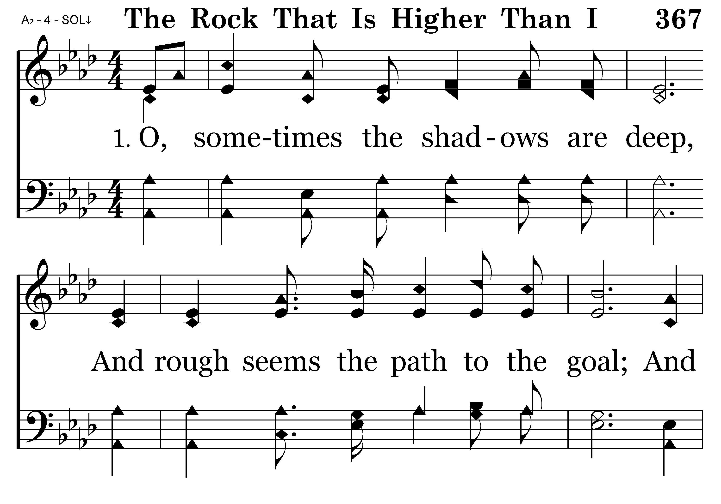
367 - The Rock That Is Higher Than I - 1.1

Slide 3
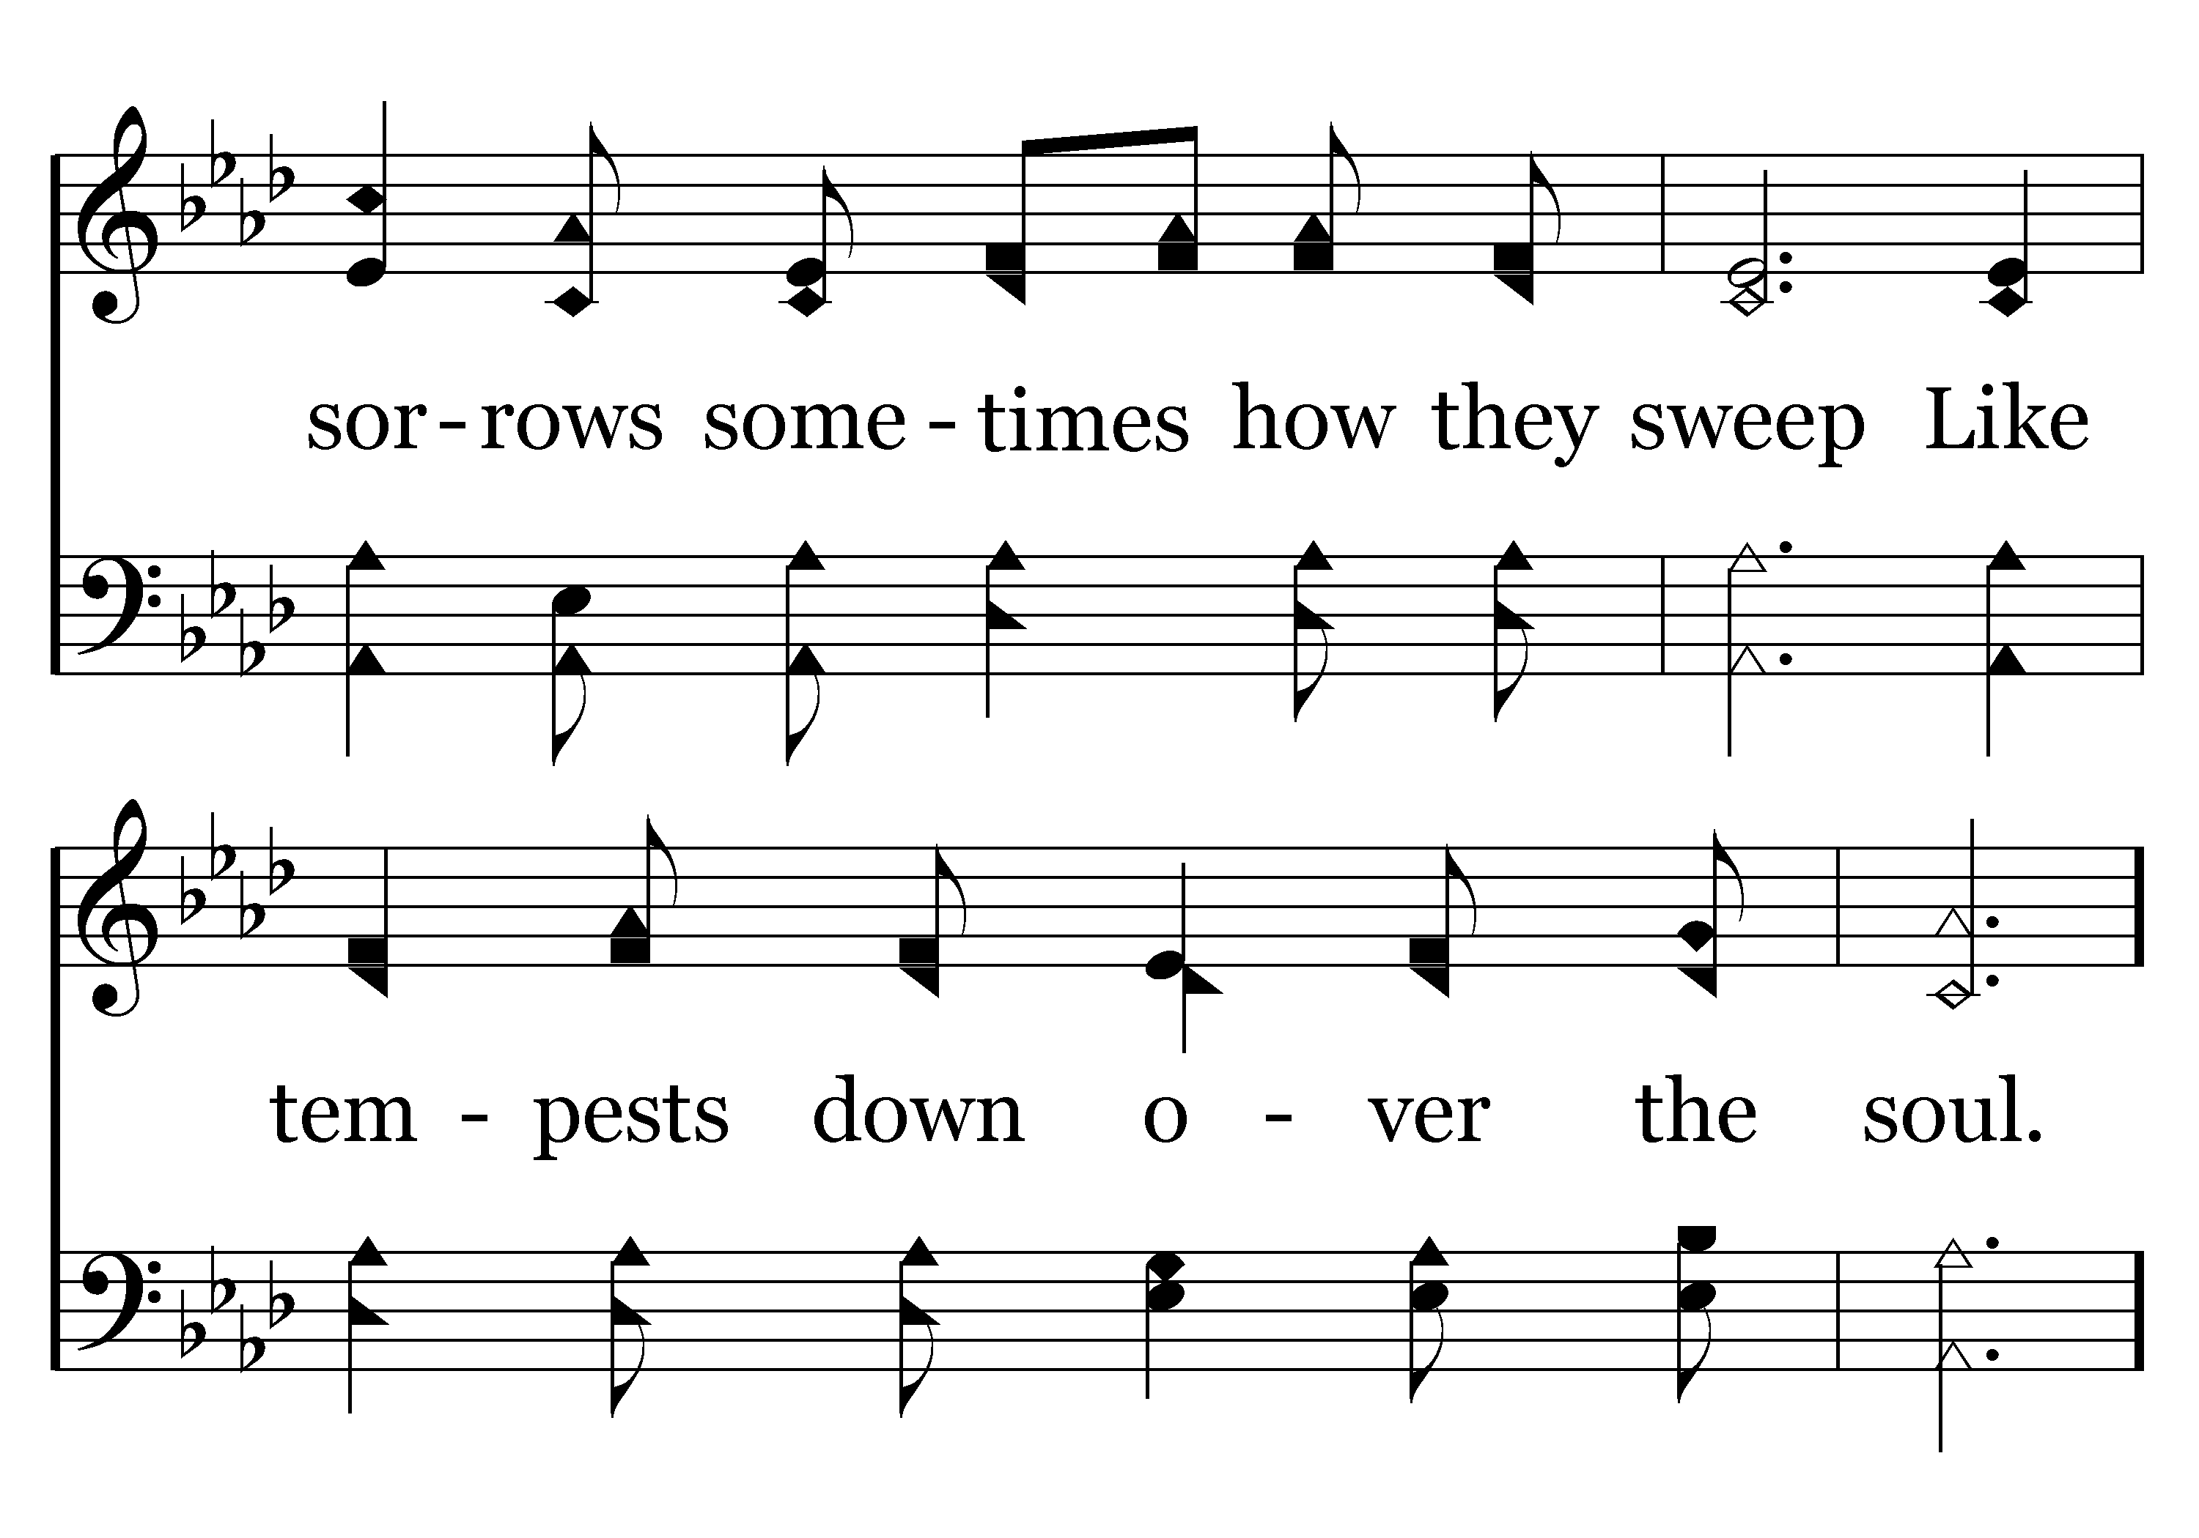
367 - The Rock That Is Higher Than I - 1.2

Slide 4
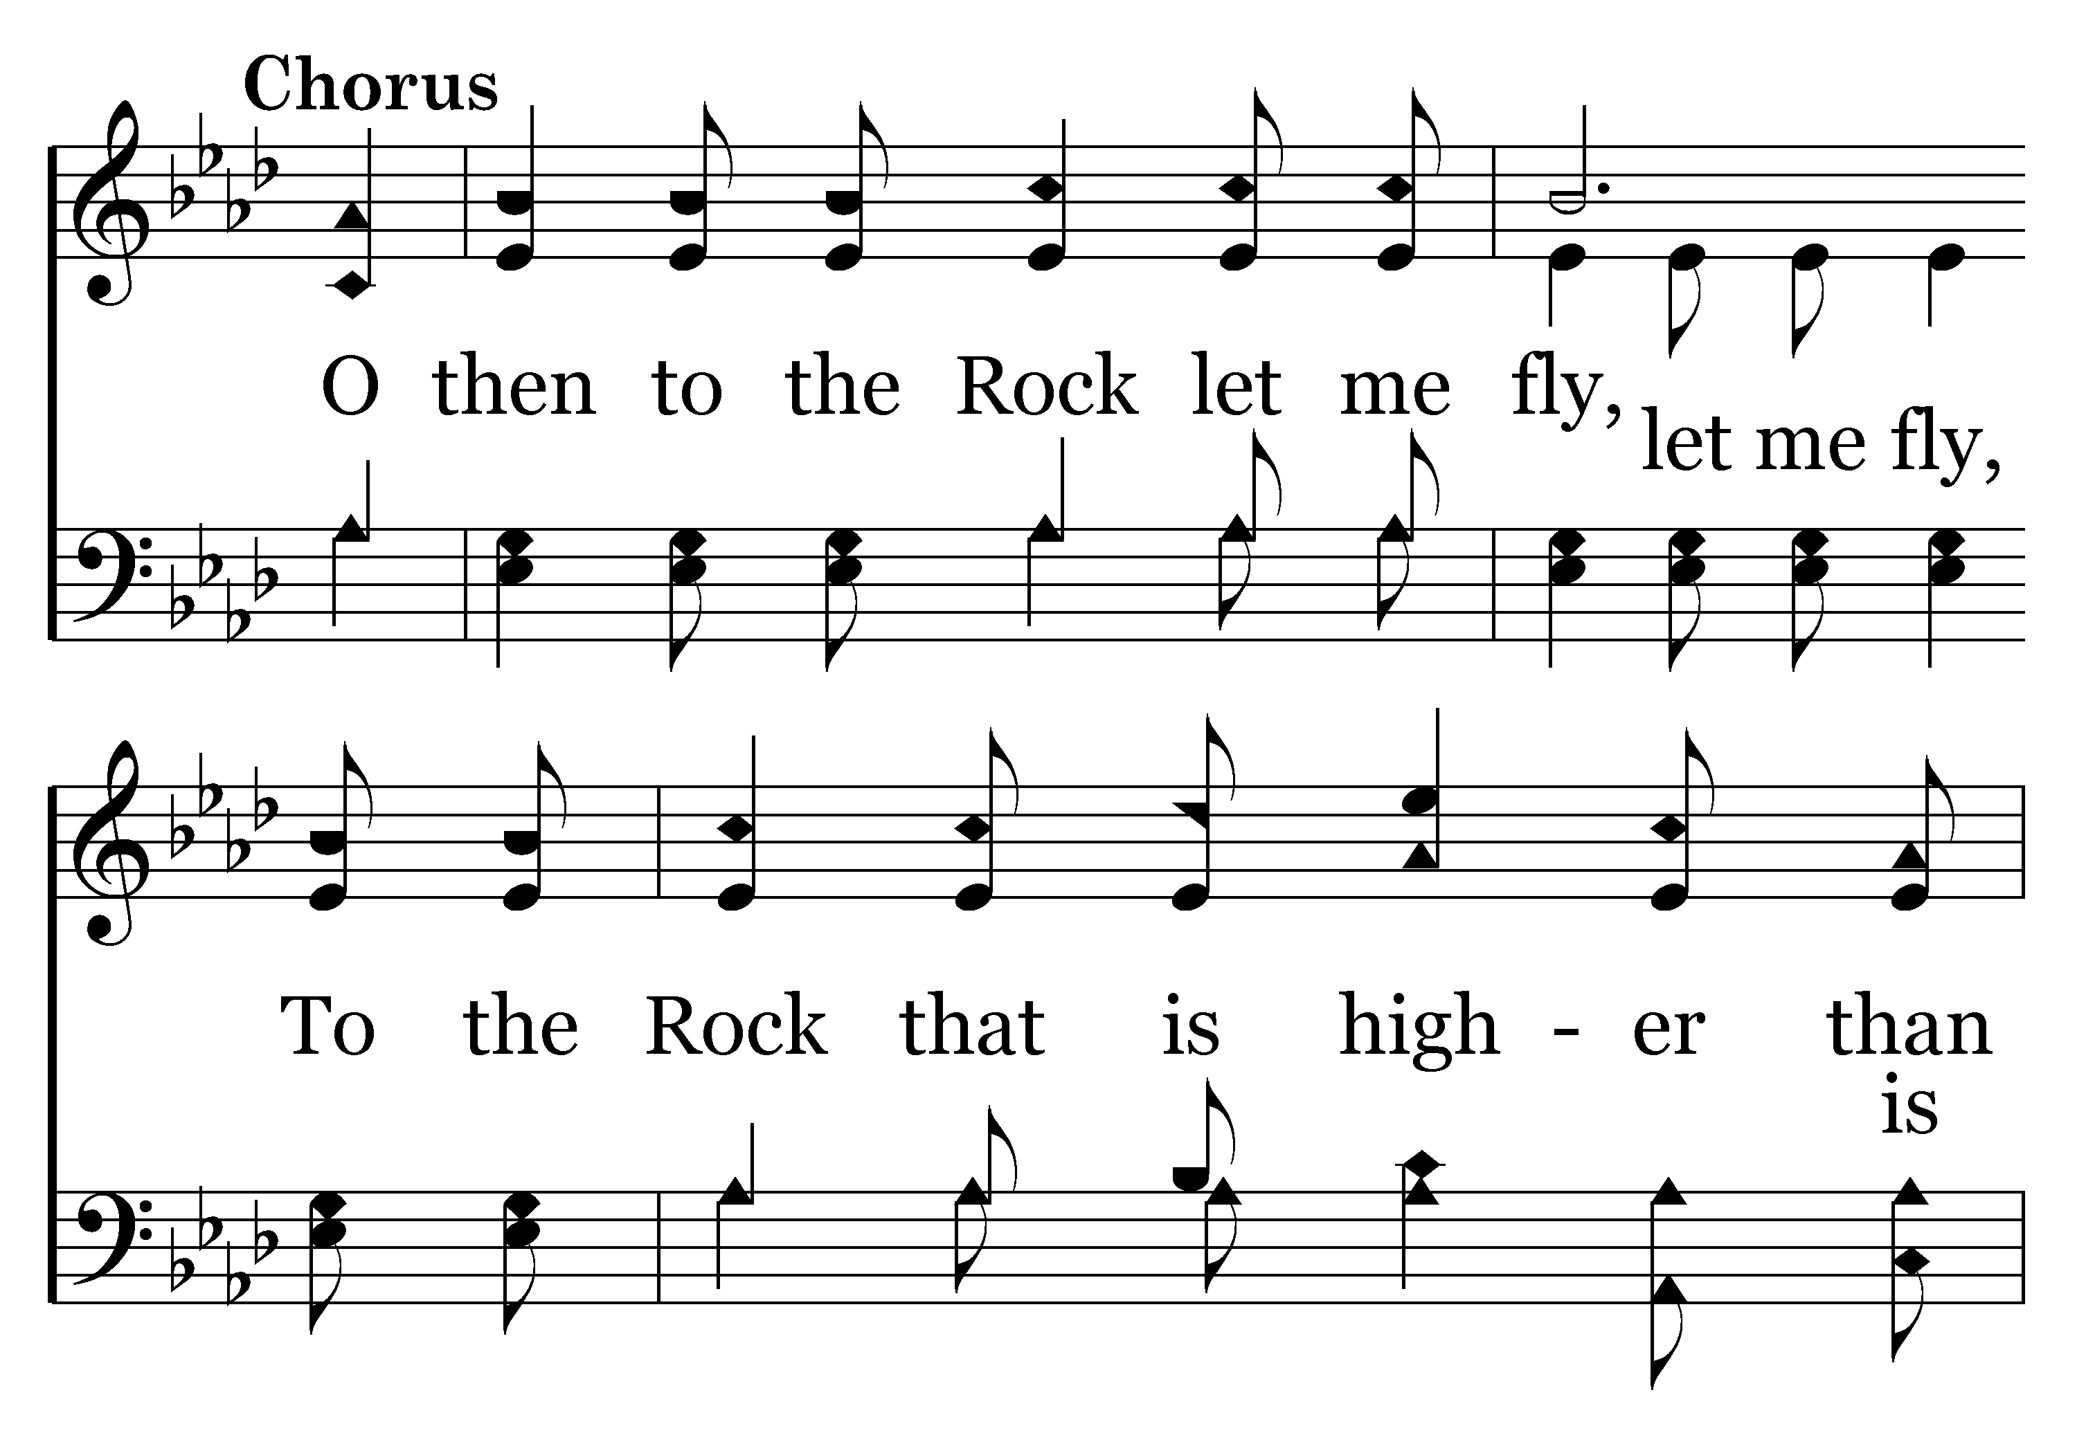
367 - The Rock That Is Higher Than I - C.1

Slide 5
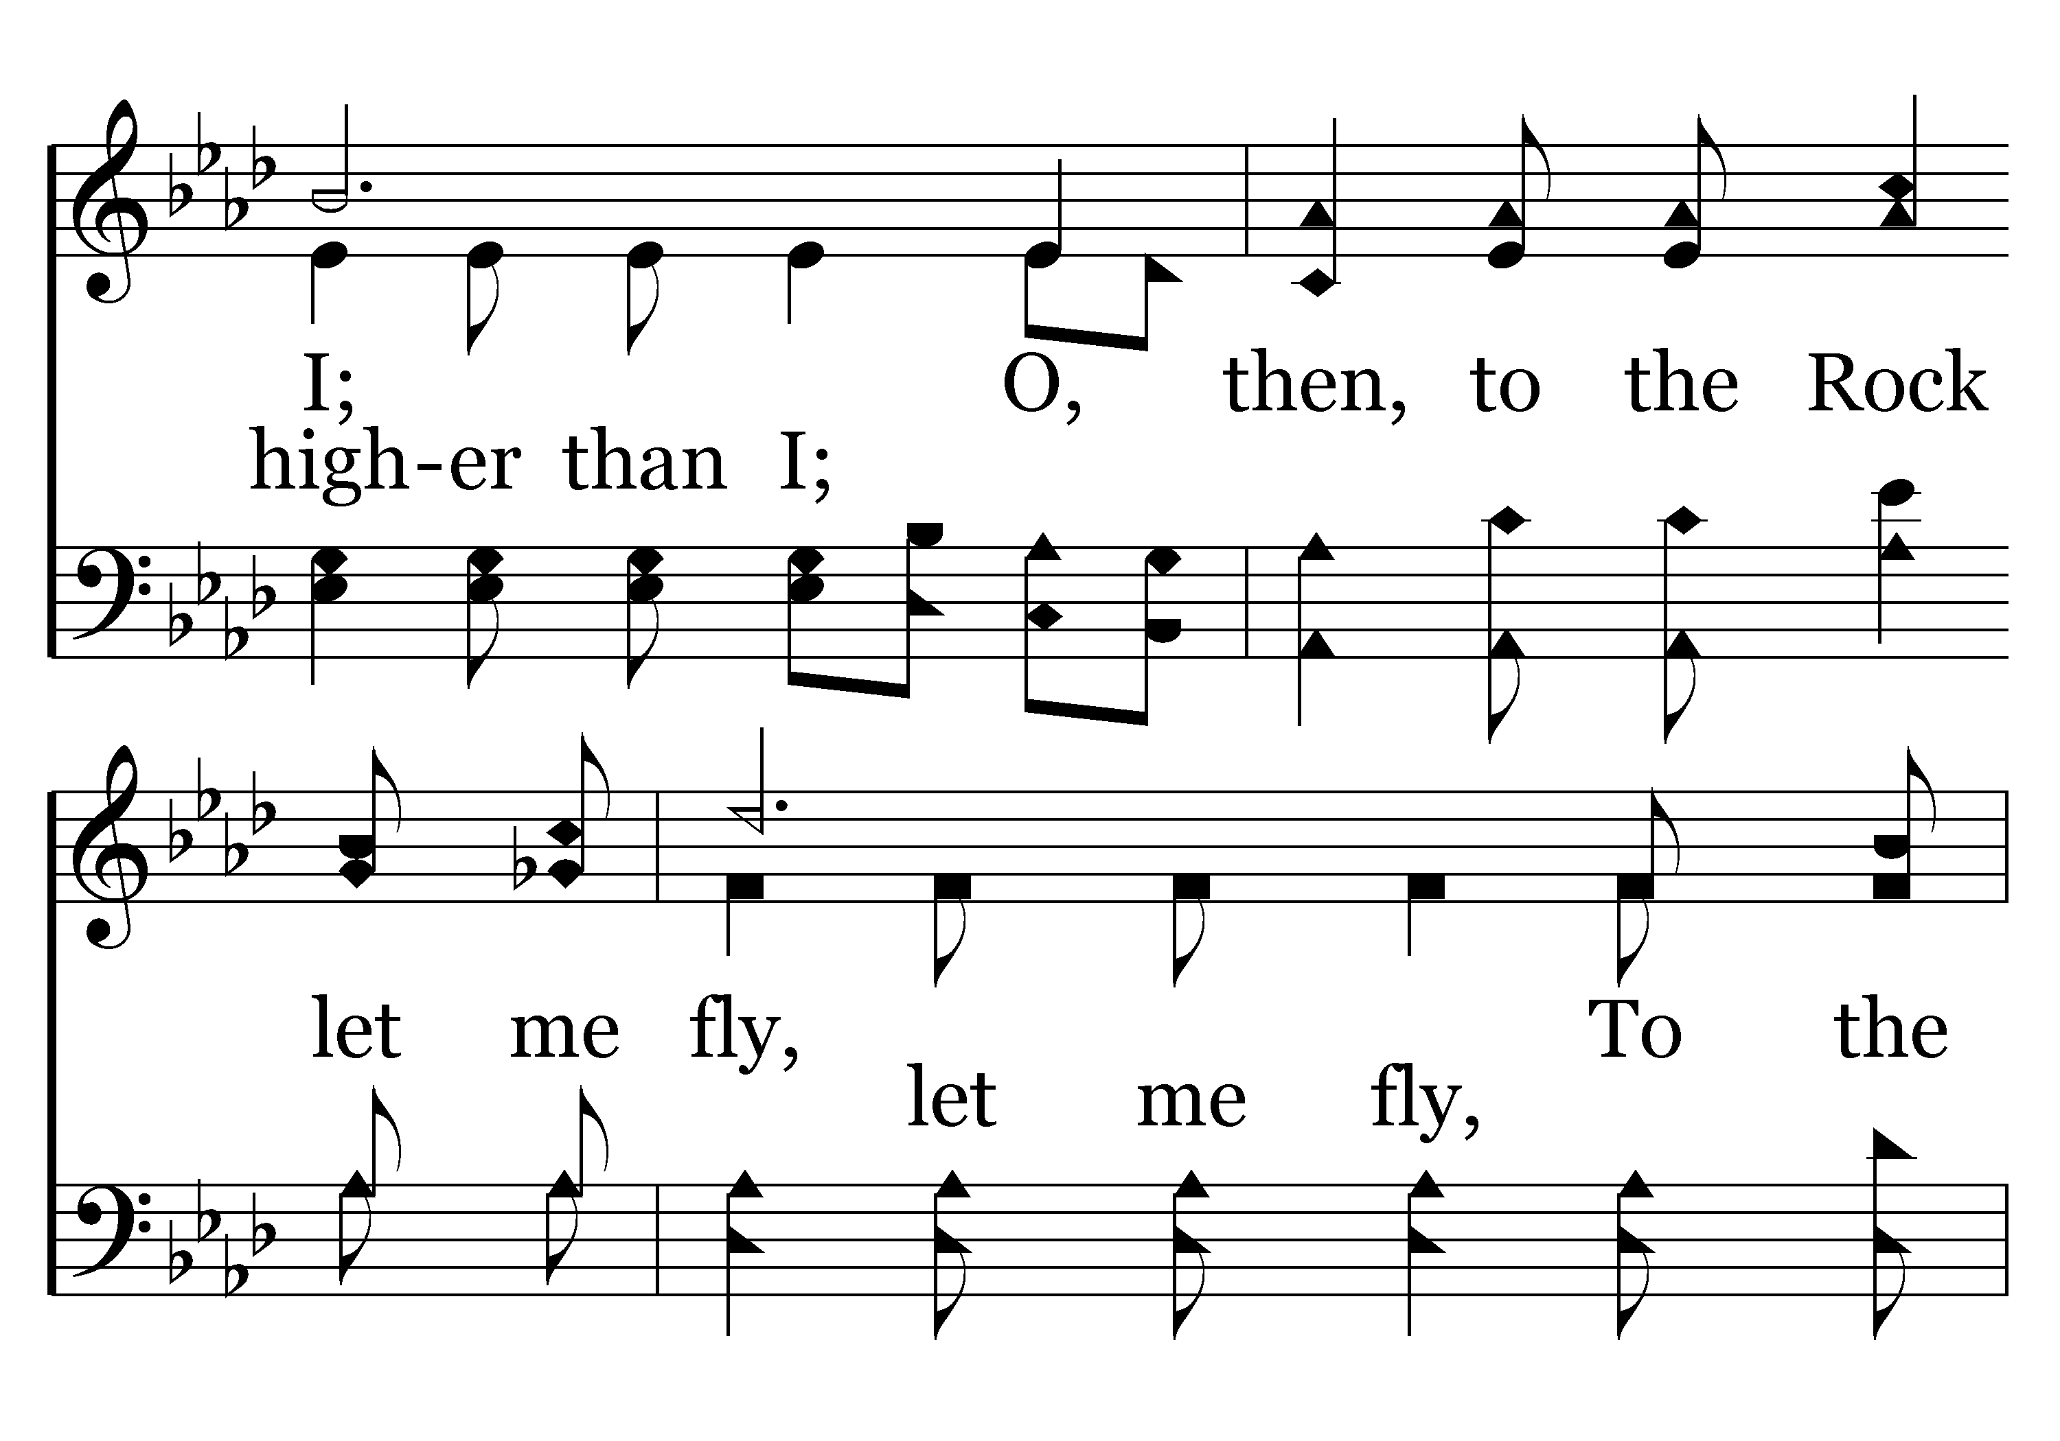
367 - The Rock That Is Higher Than I - C.2

Slide 6
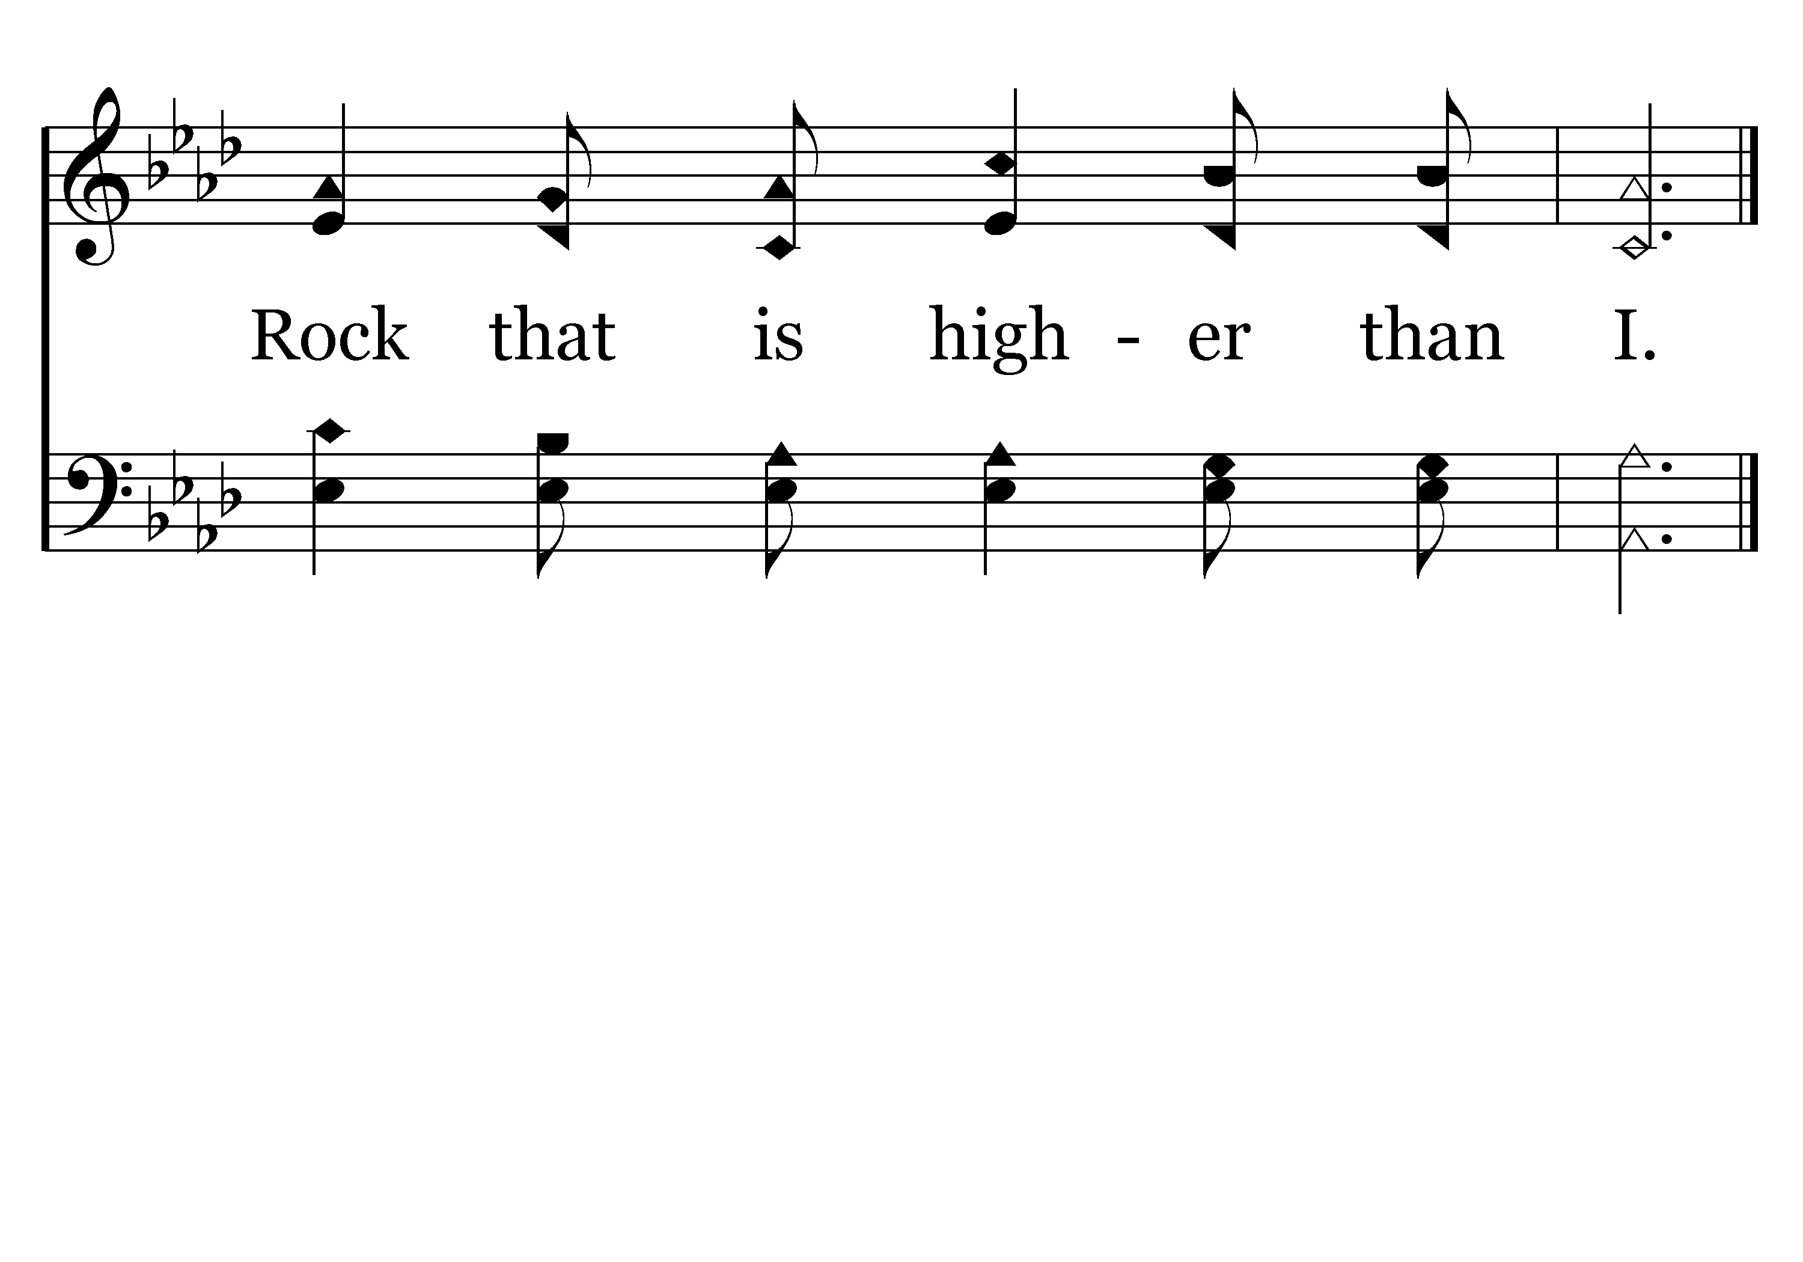
367 - The Rock That Is Higher Than I - C.3
End of Verse 1

Slide 7
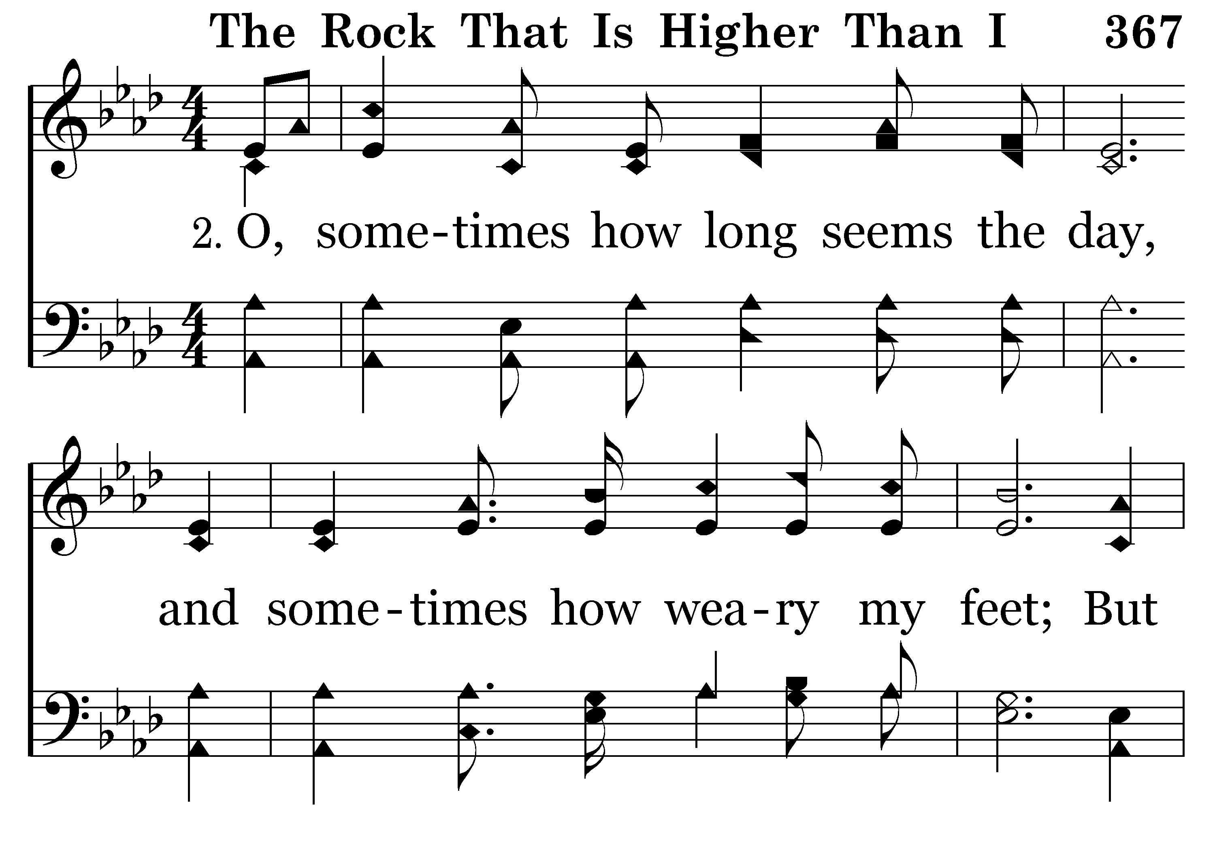
367 - The Rock That Is Higher Than I - 2.1

Slide 8
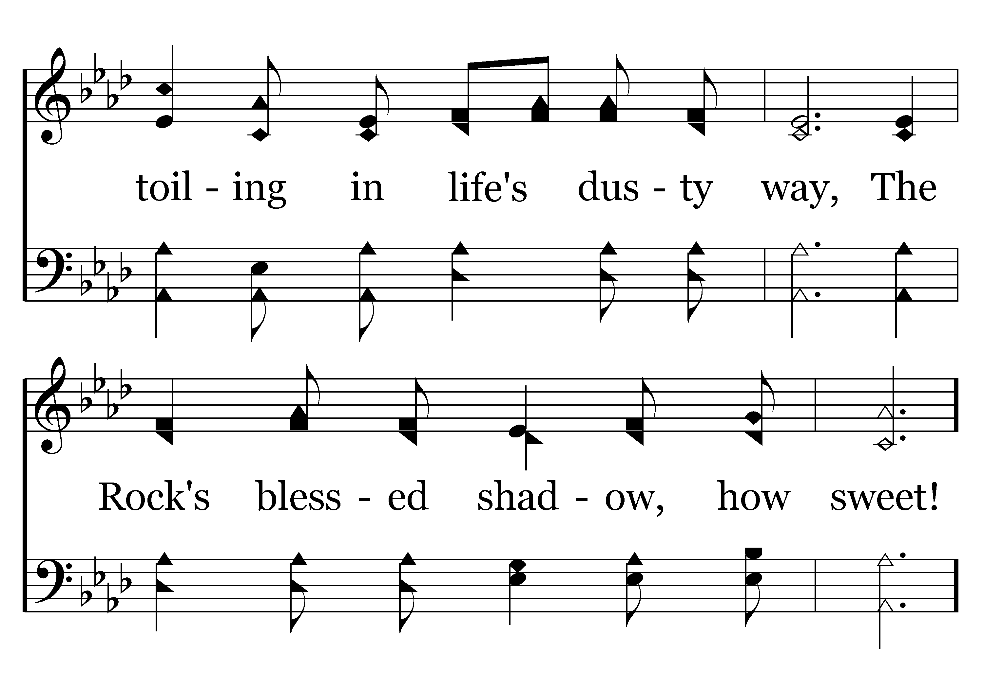
367 - The Rock That Is Higher Than I - 2.2

Slide 9
367 - The Rock That Is Higher Than I - C.1

Slide 10
367 - The Rock That Is Higher Than I - C.2

Slide 11
367 - The Rock That Is Higher Than I - C.3
End of Verse 2

Slide 12
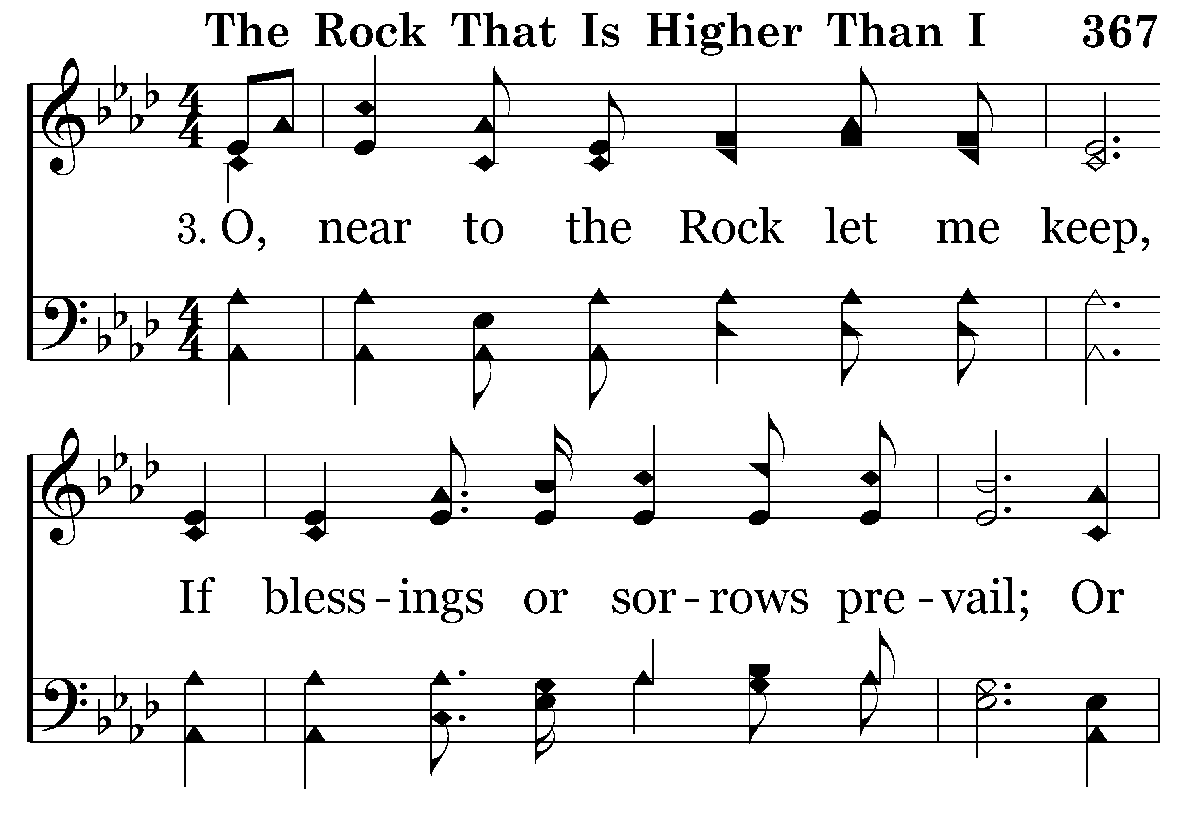
367 - The Rock That Is Higher Than I - 3.1

Slide 13
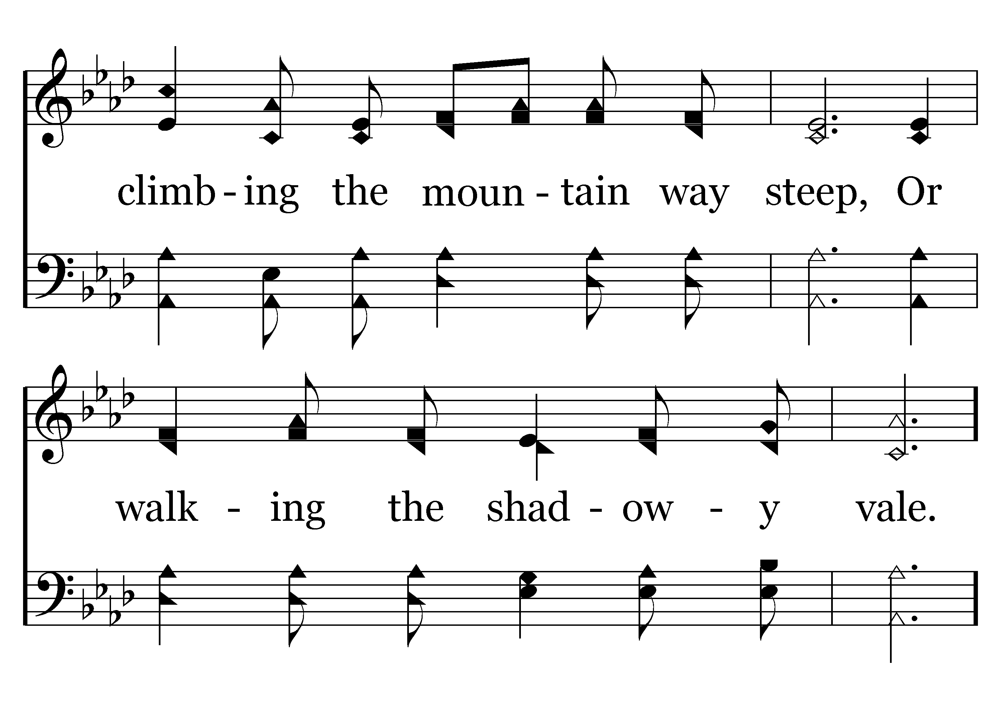
367 - The Rock That Is Higher Than I - 3.2

Slide 14
367 - The Rock That Is Higher Than I - C.1

Slide 15
367 - The Rock That Is Higher Than I - C.2

Slide 16
367 - The Rock That Is Higher Than I - C.3
End of Song

Slide 17
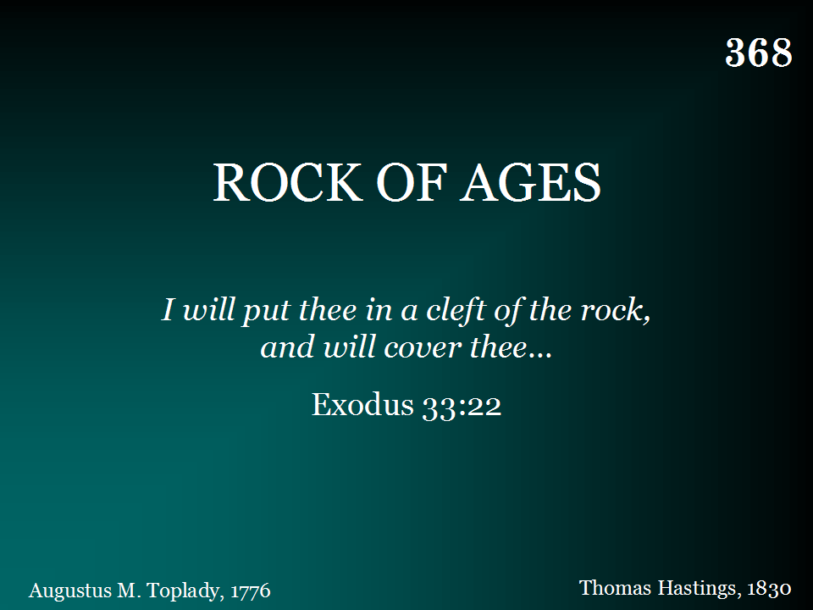
368 - Rock Of Ages - Title

Slide 18
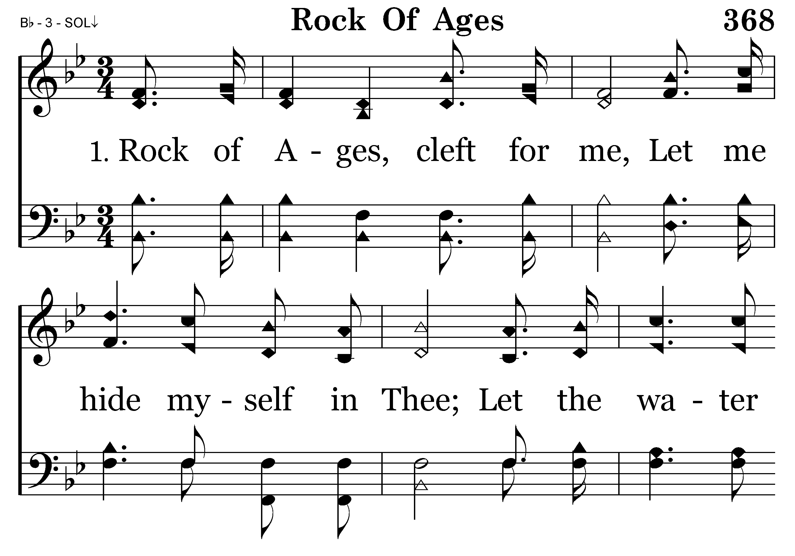
368 - Rock Of Ages - 1.1

Slide 19
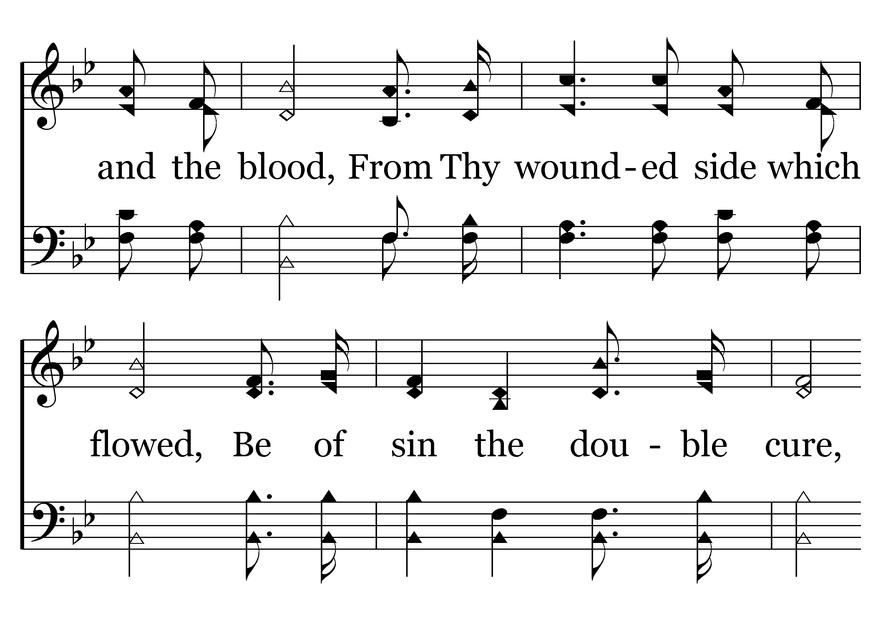
368 - Rock Of Ages - 1.2

Slide 20
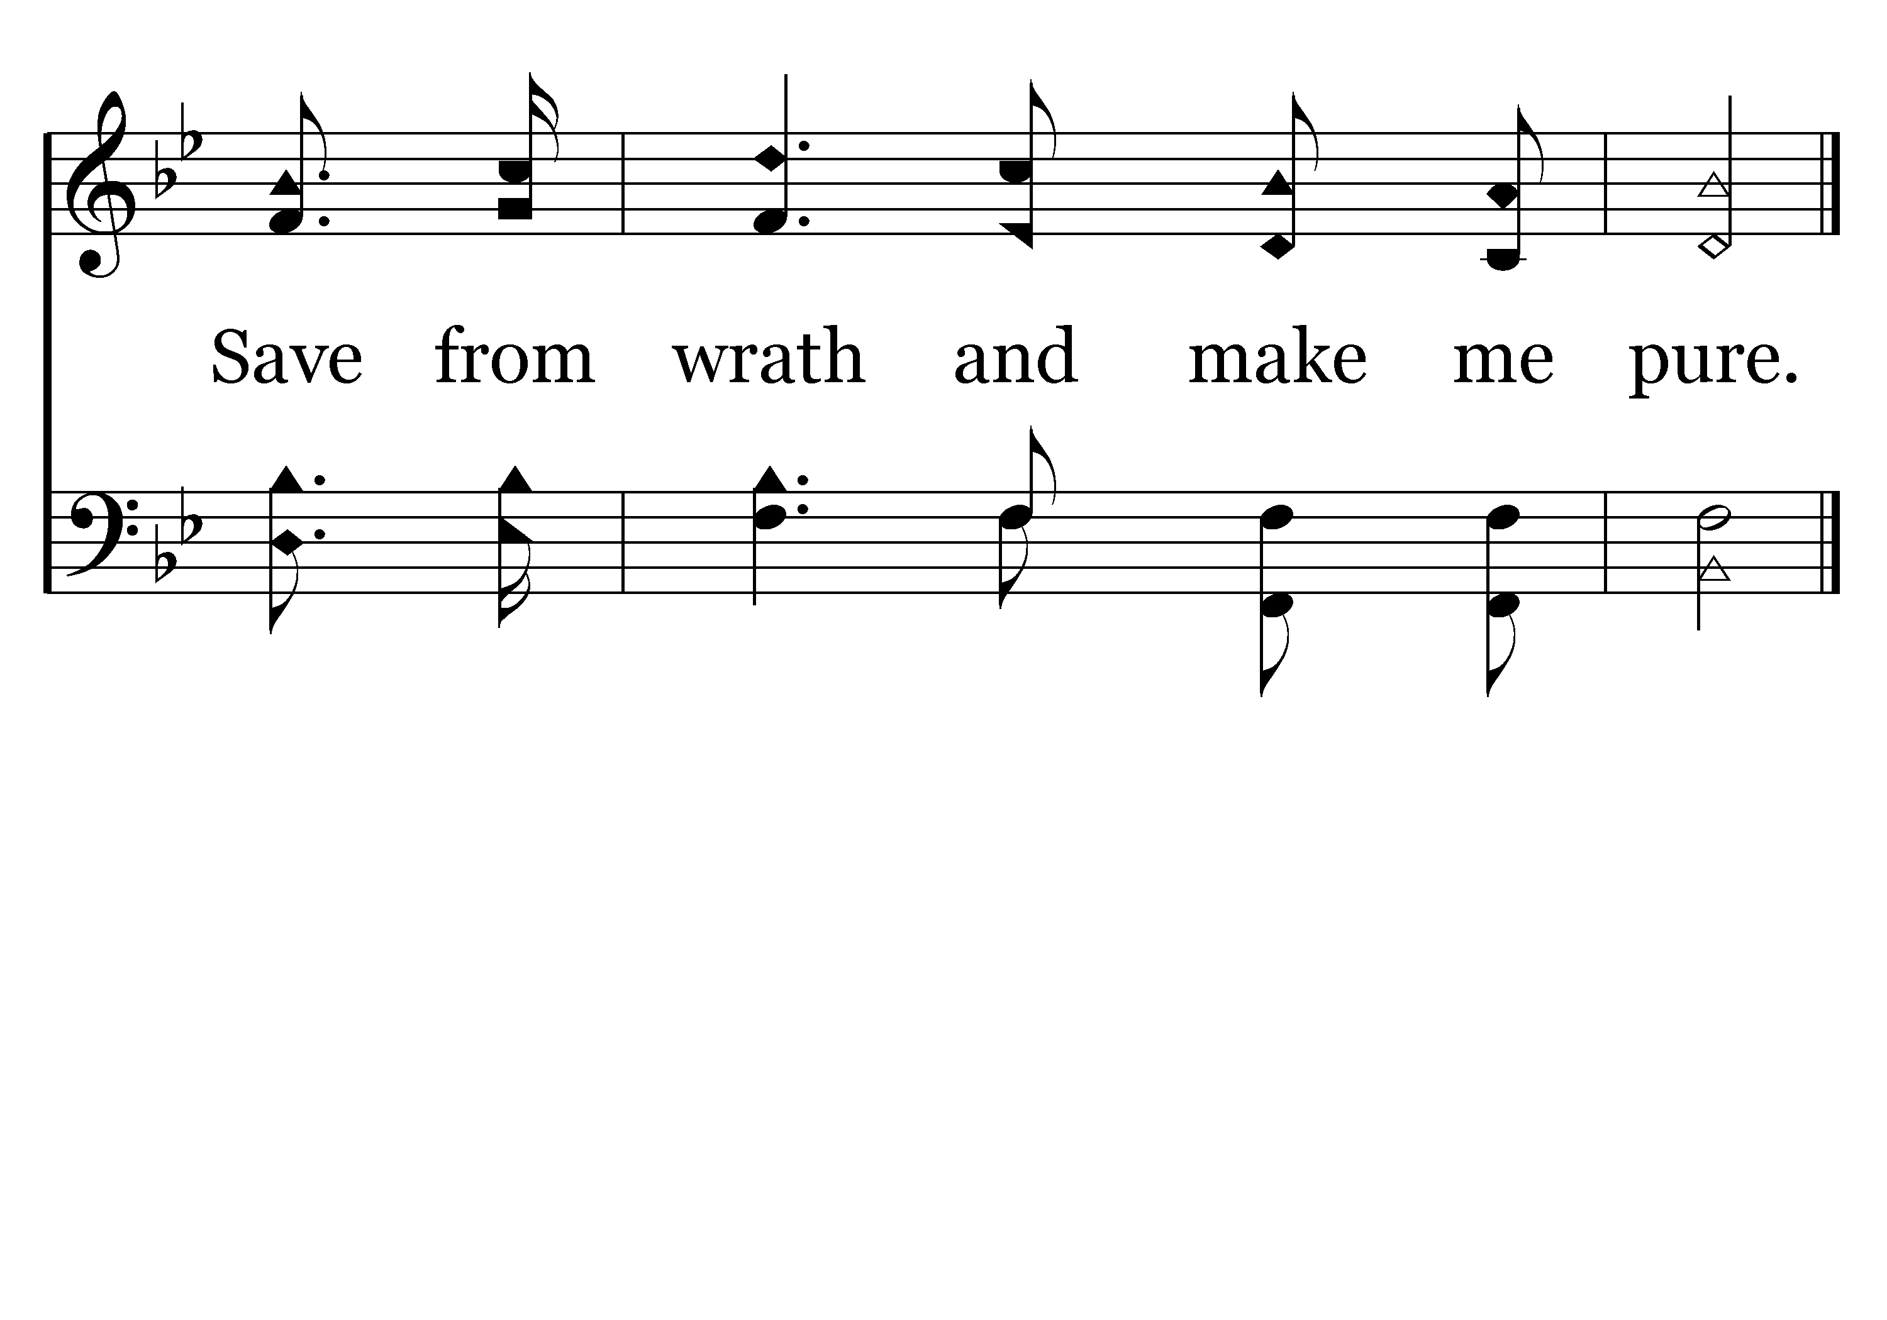
368 - Rock Of Ages - 1.3
End of Verse 1

Slide 21
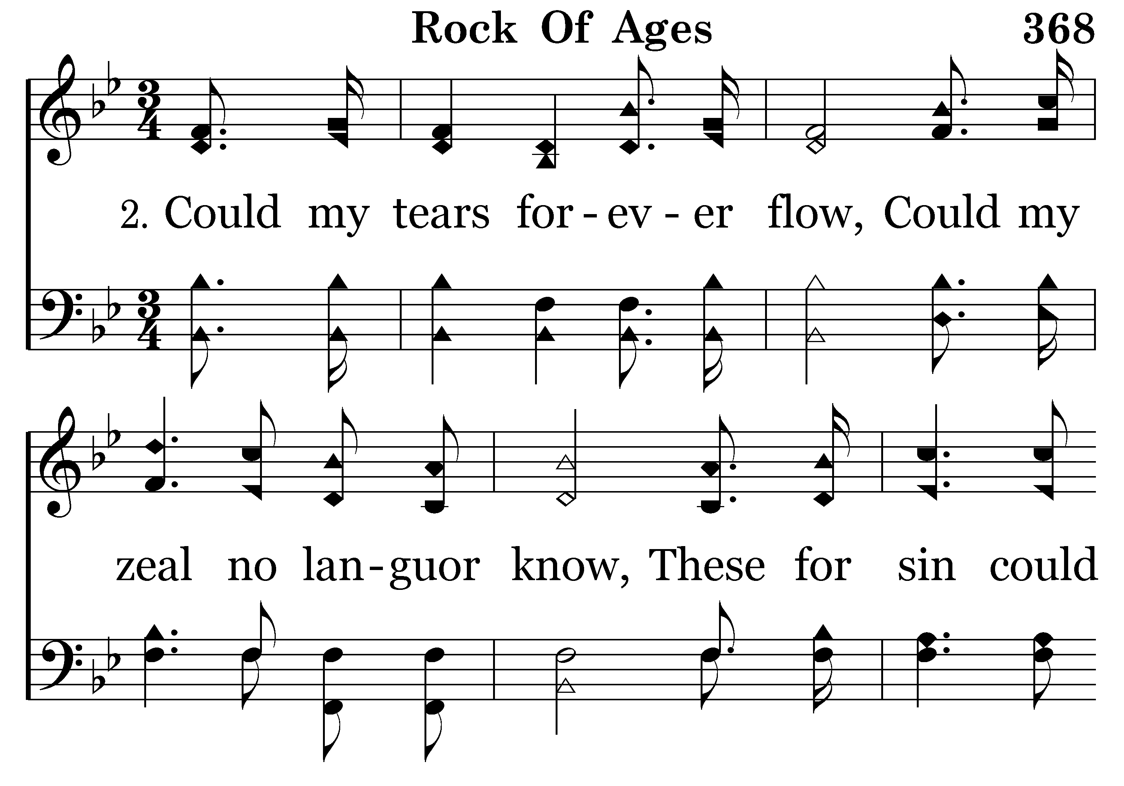
368 - Rock Of Ages - 2.1

Slide 22
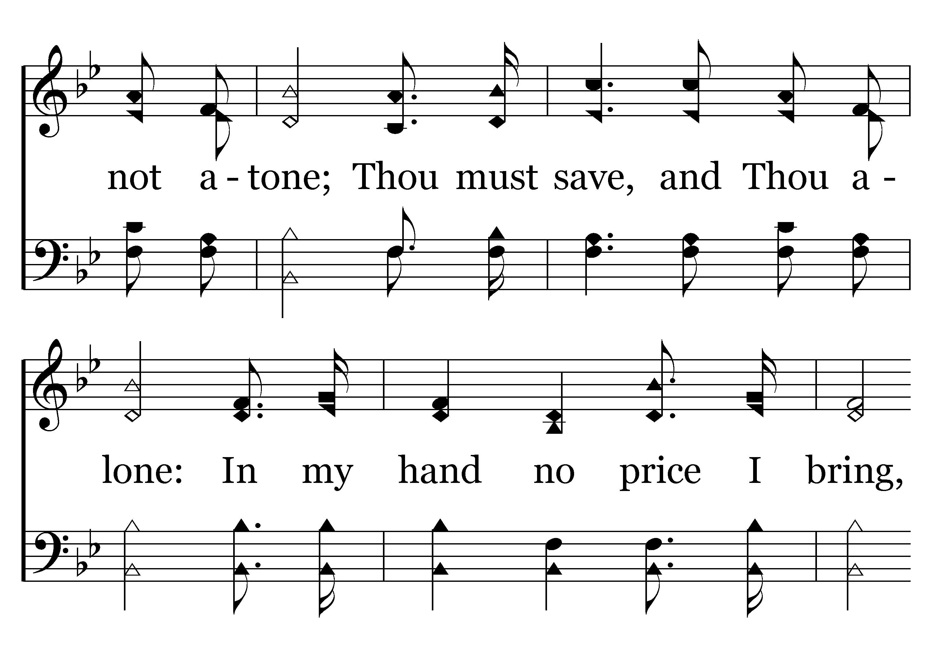
368 - Rock Of Ages - 2.2

Slide 23
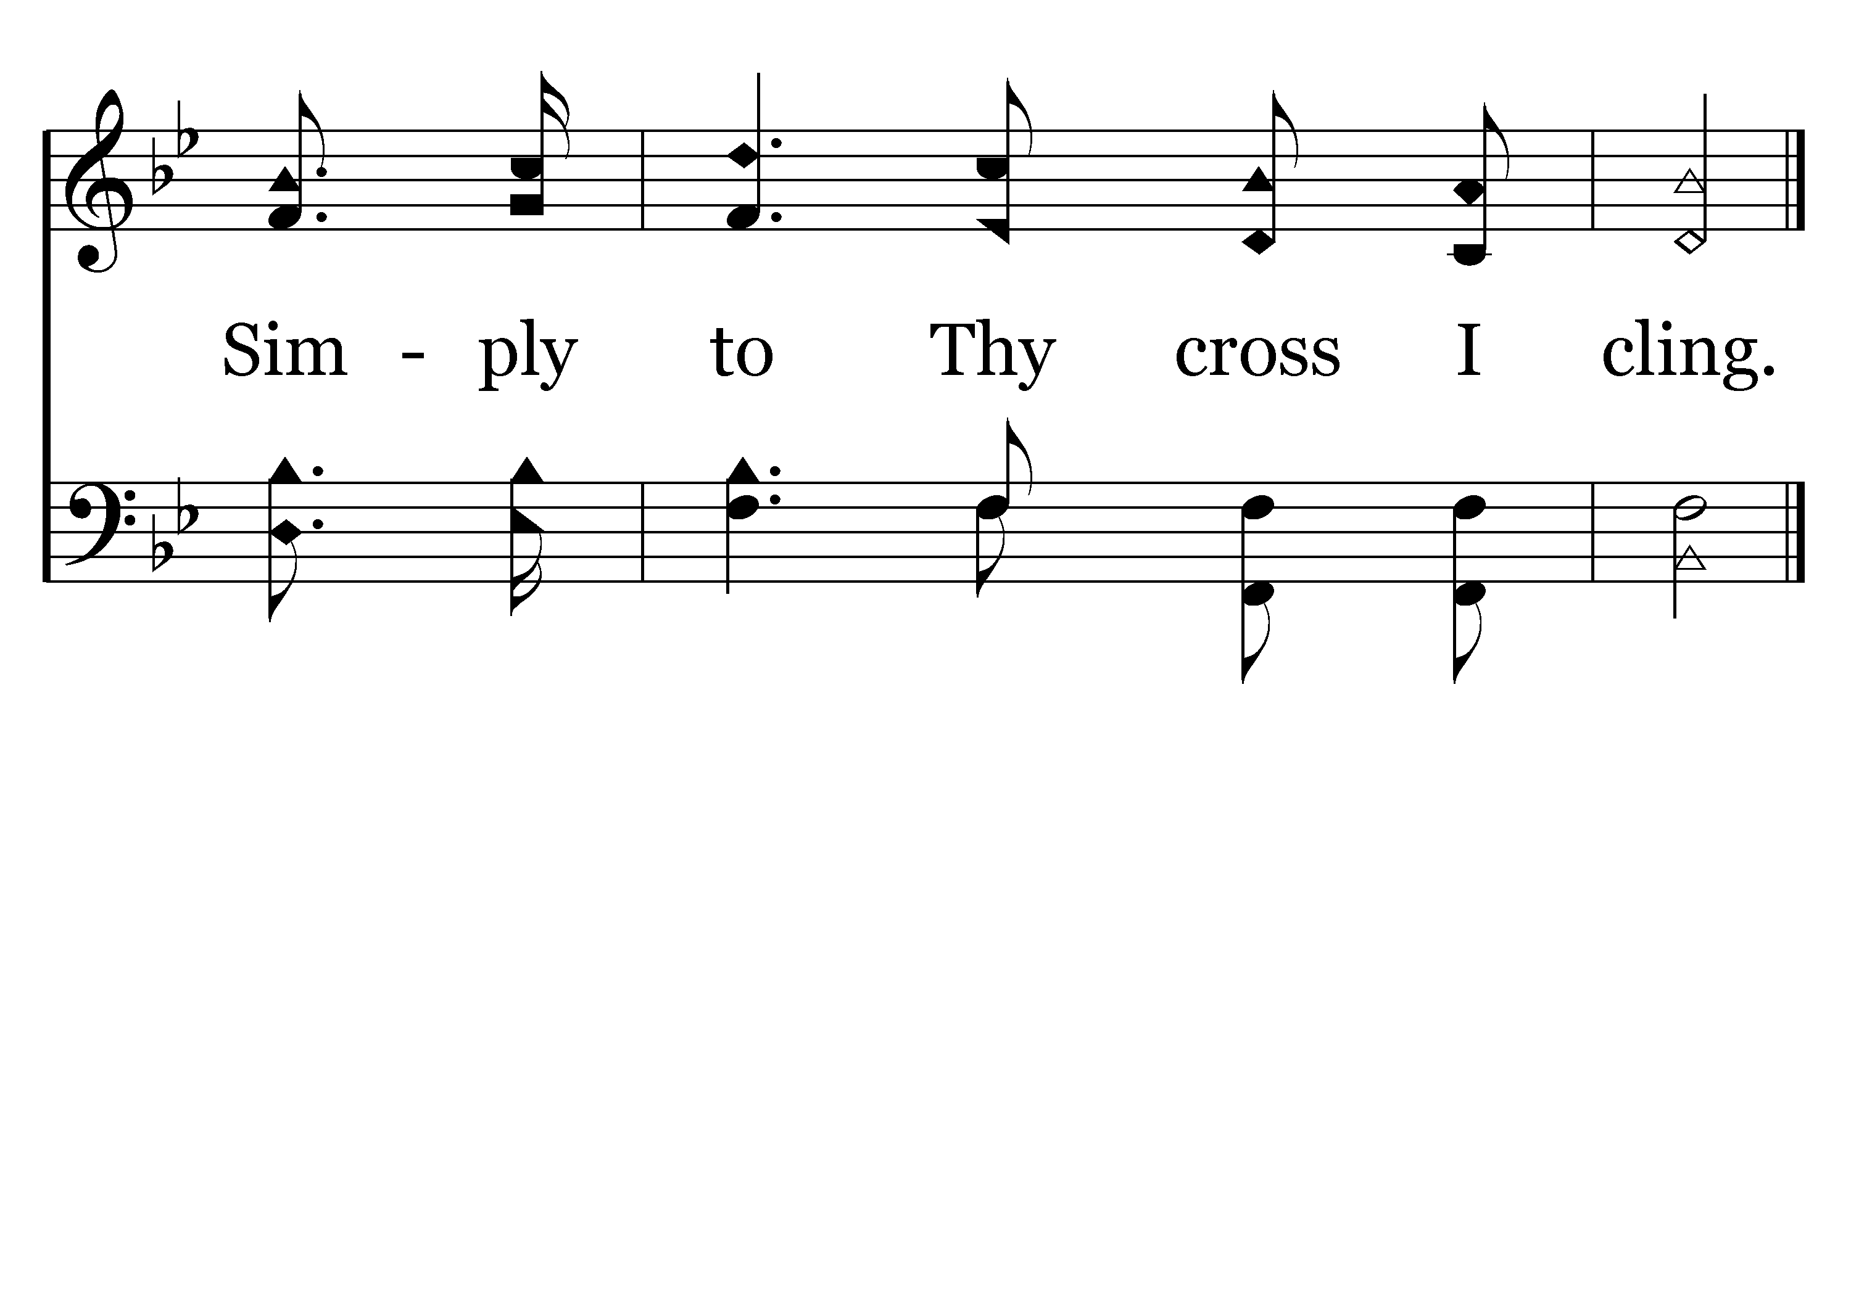
368 - Rock Of Ages - 2.3
End of Verse 2

Slide 24
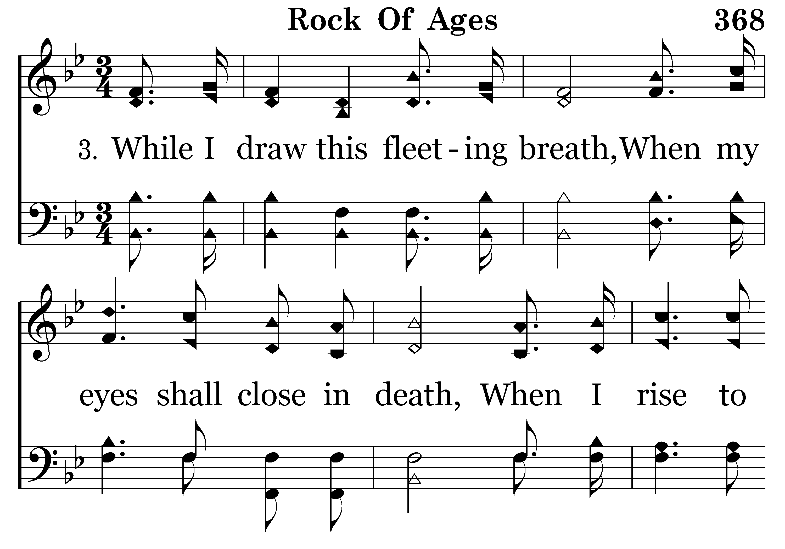
368 - Rock Of Ages - 3.1

Slide 25
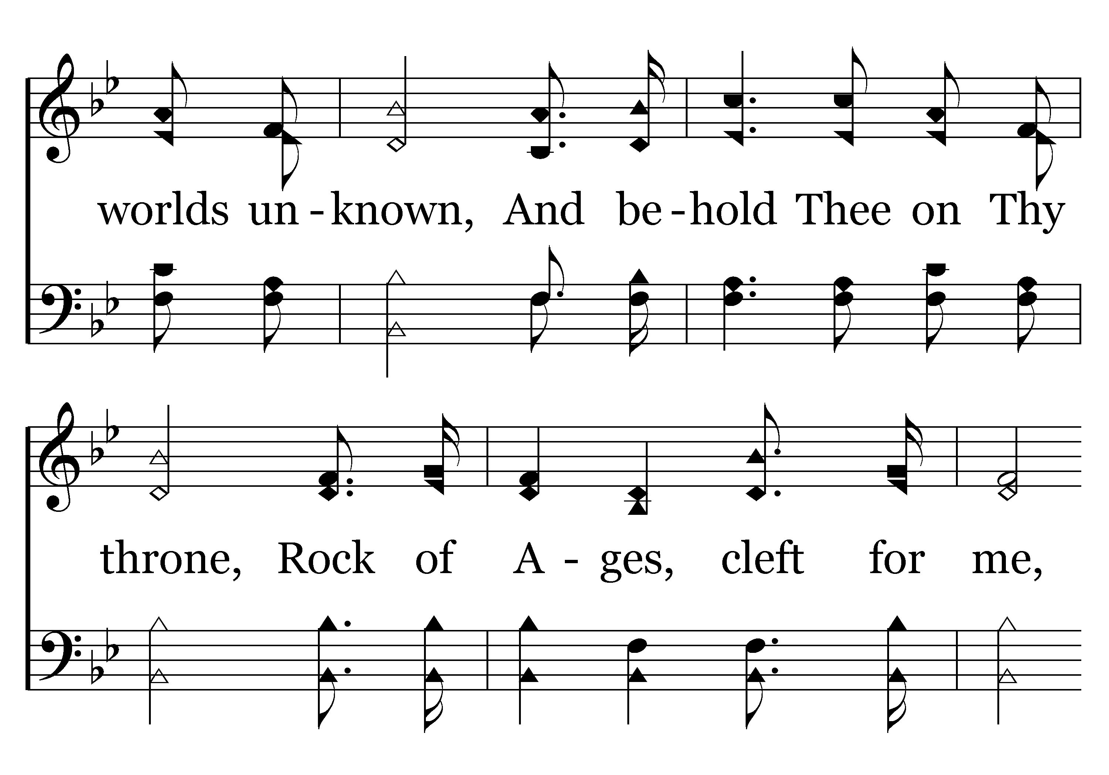
368 - Rock Of Ages - 3.2

Slide 26
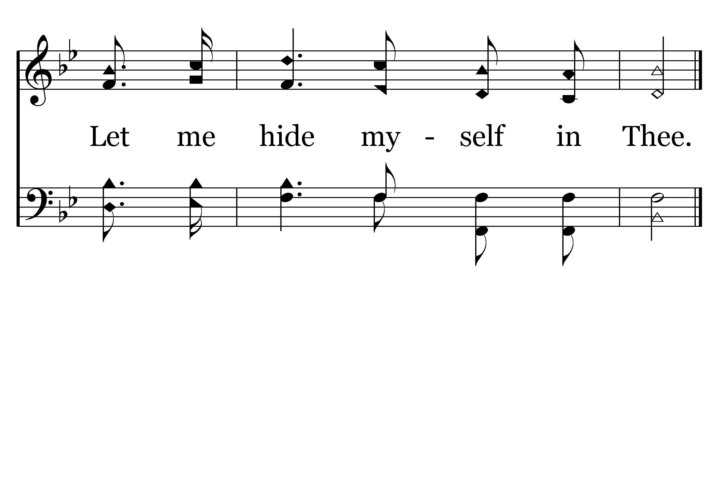
368 - Rock Of Ages - 3.3
End of Song

Slide 28
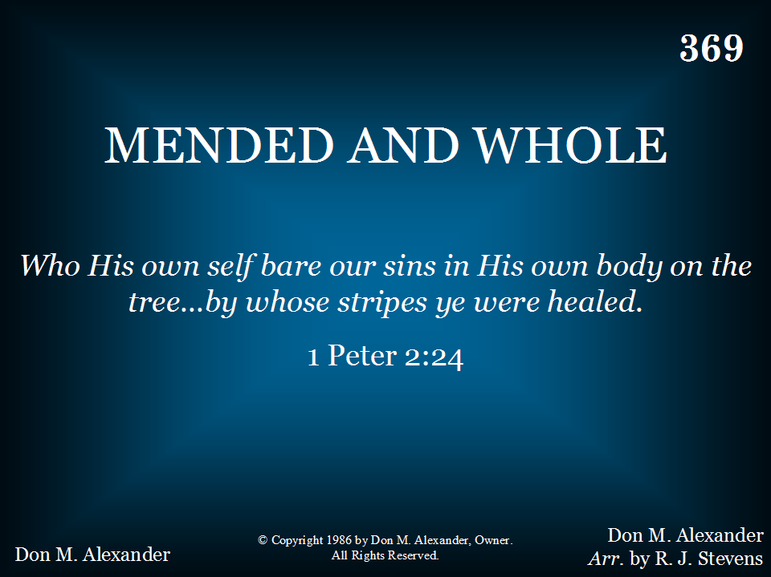
369 - Mended And Whole - Title

Slide 29
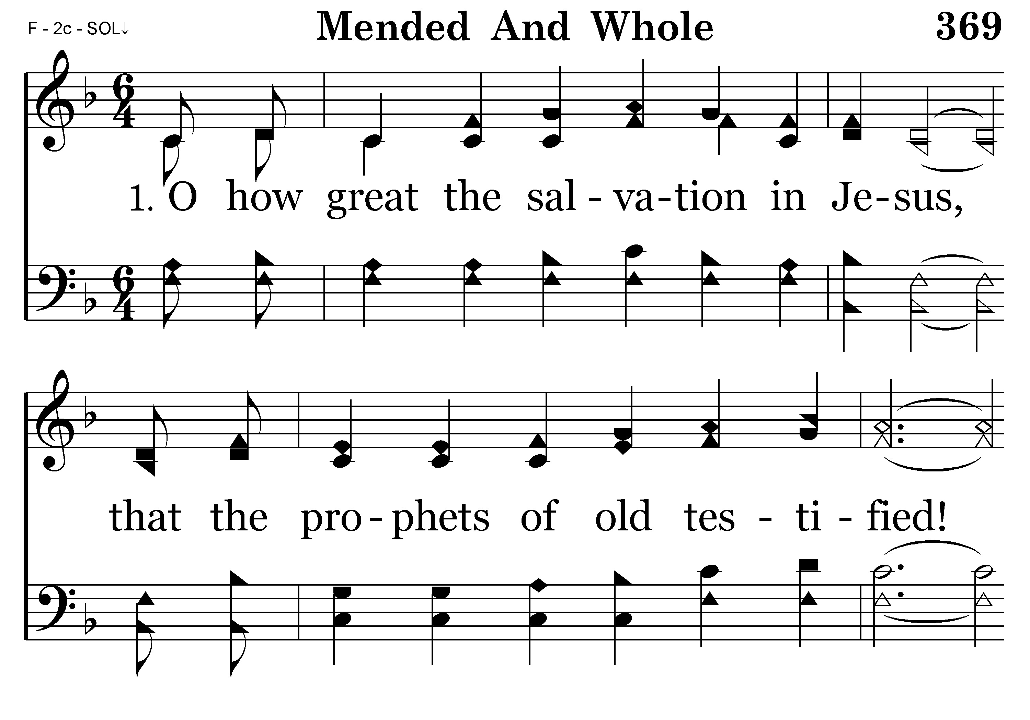
369 - Mended And Whole - 1.1

Slide 30
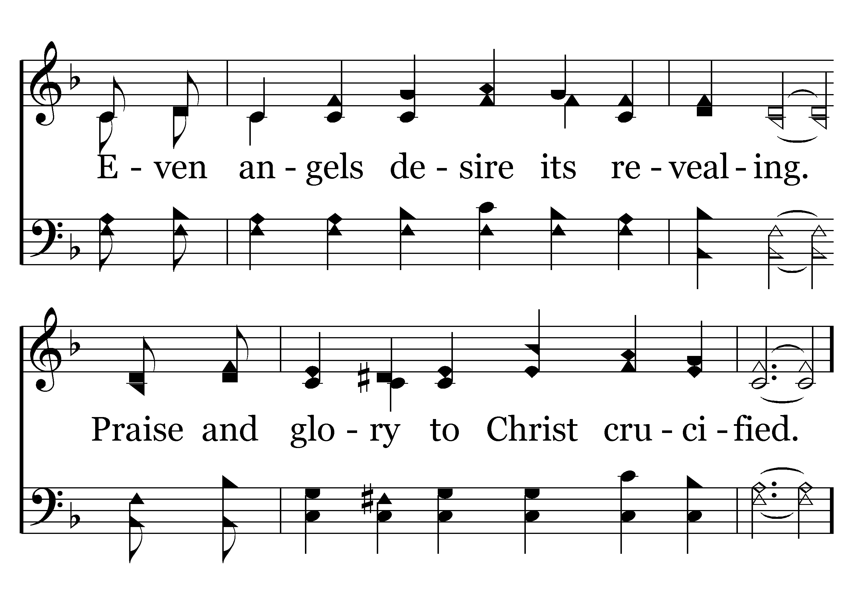
369 - Mended And Whole - 1.2

Slide 31
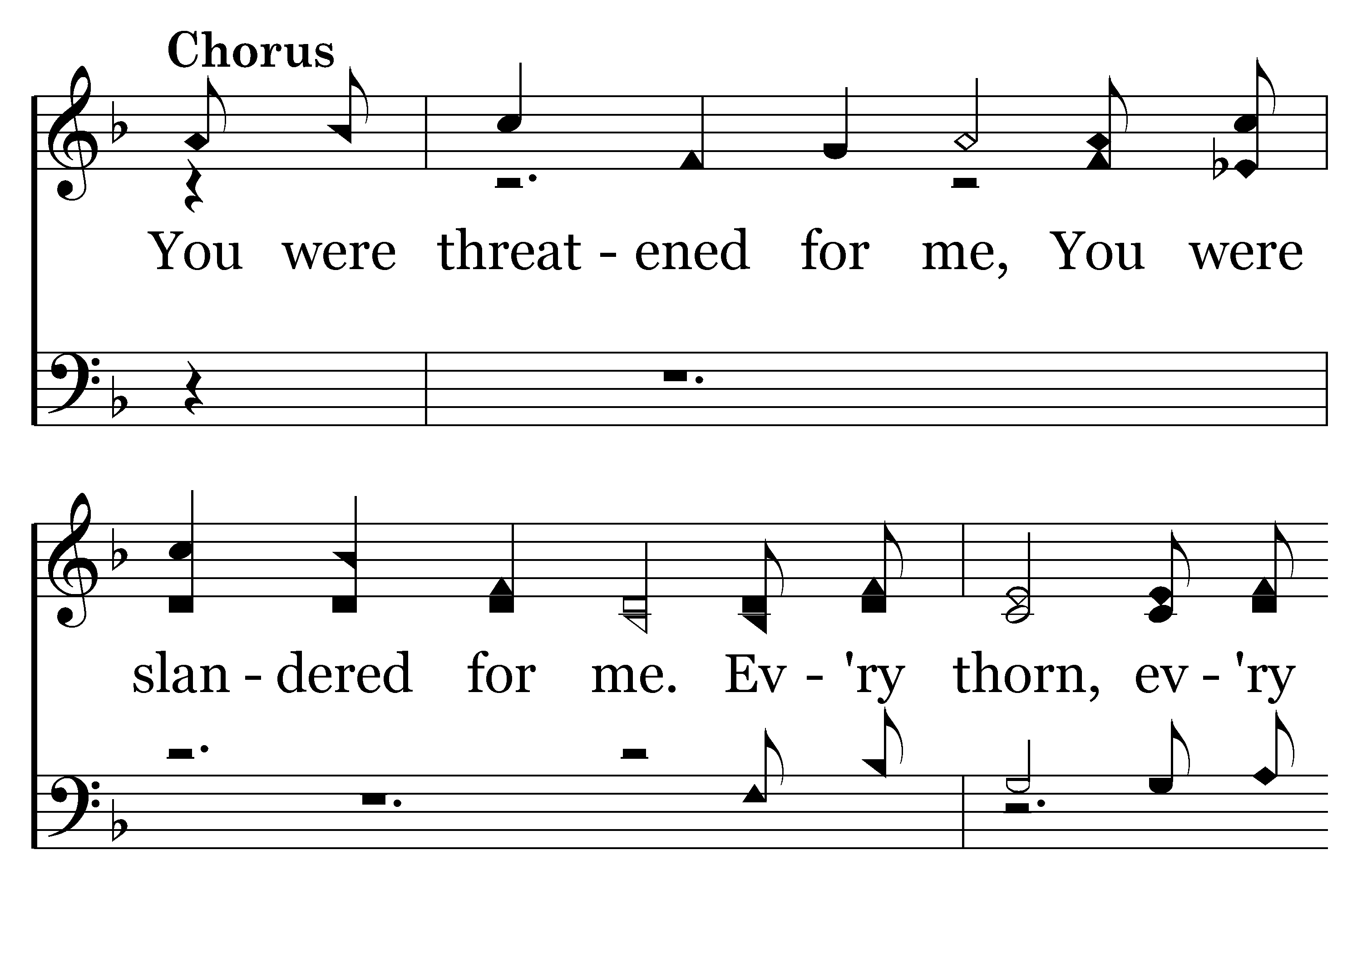
369 - Mended And Whole - C.1

Slide 32
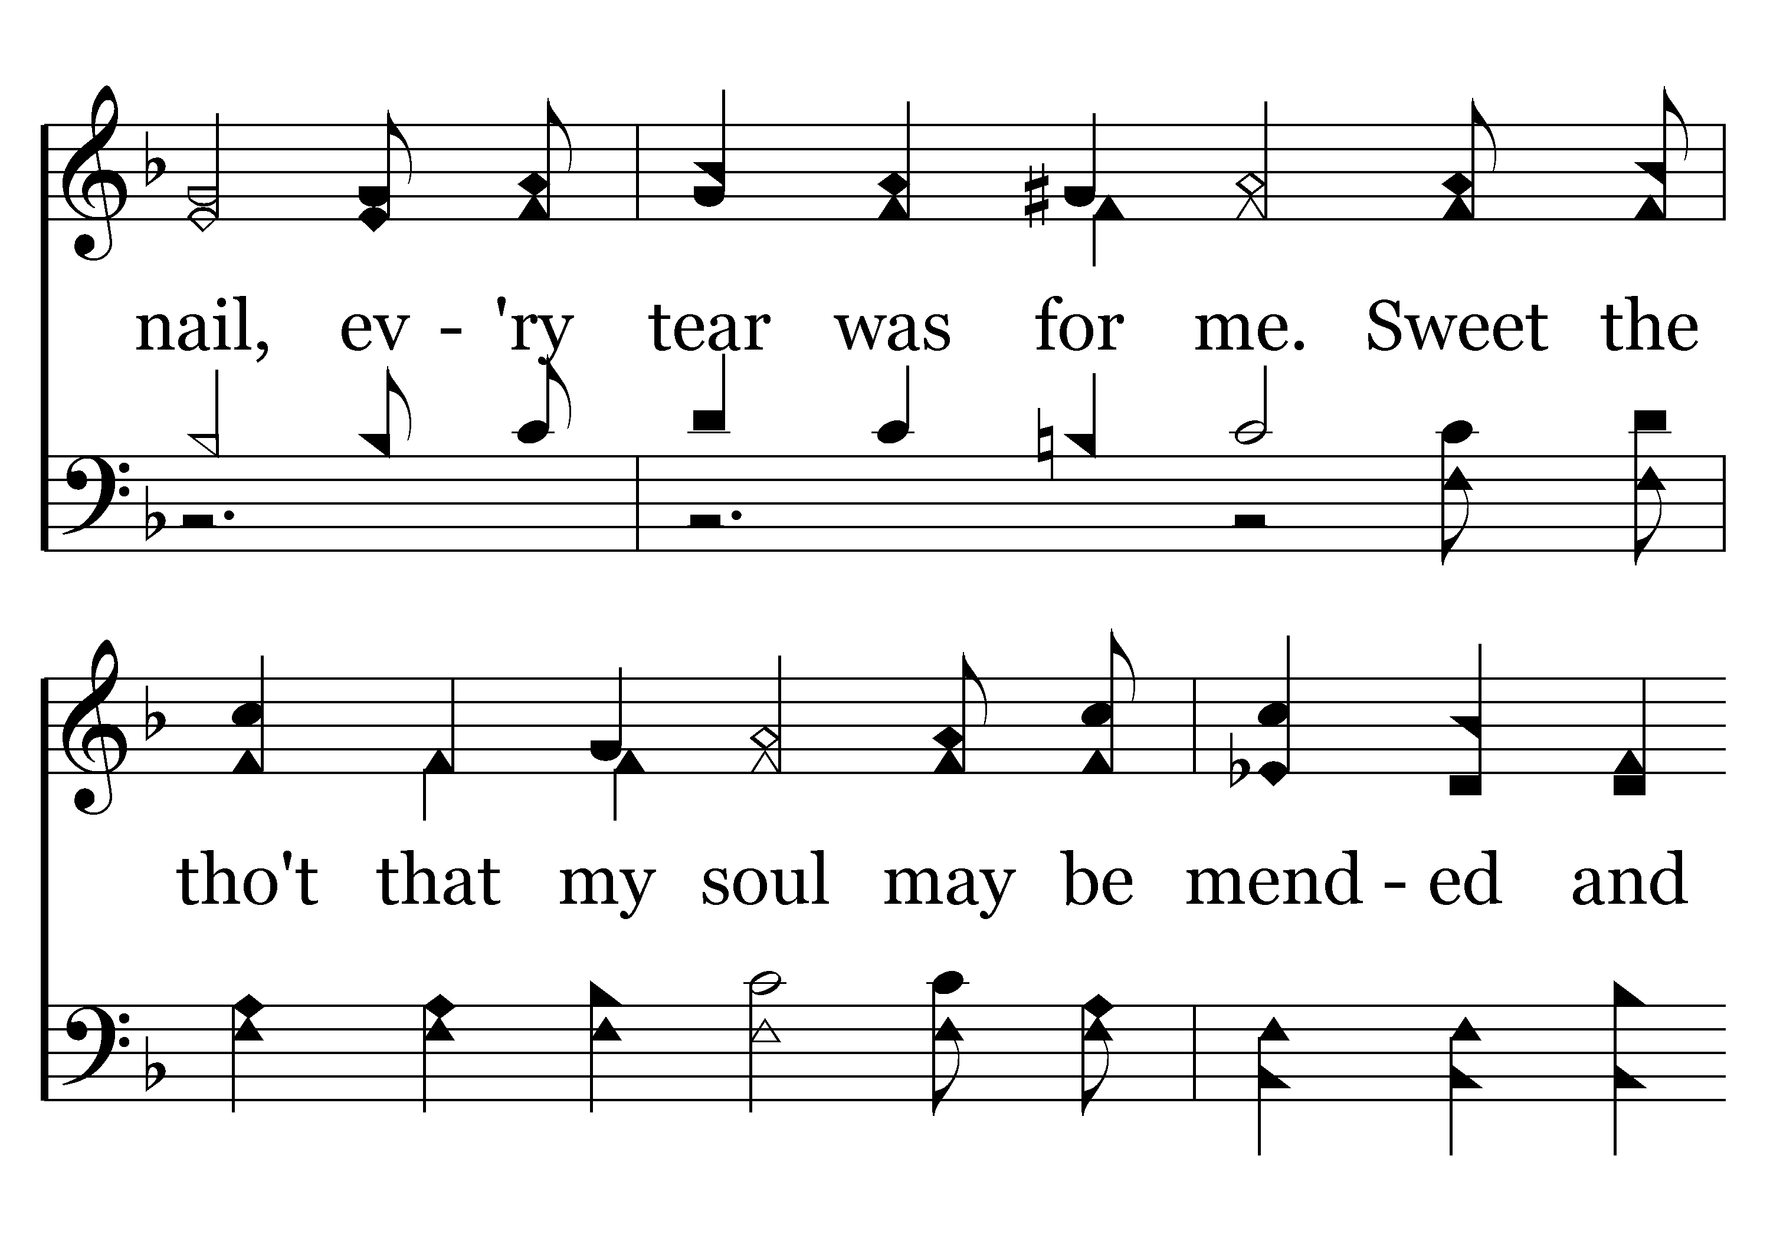
369 - Mended And Whole - C.2

Slide 33
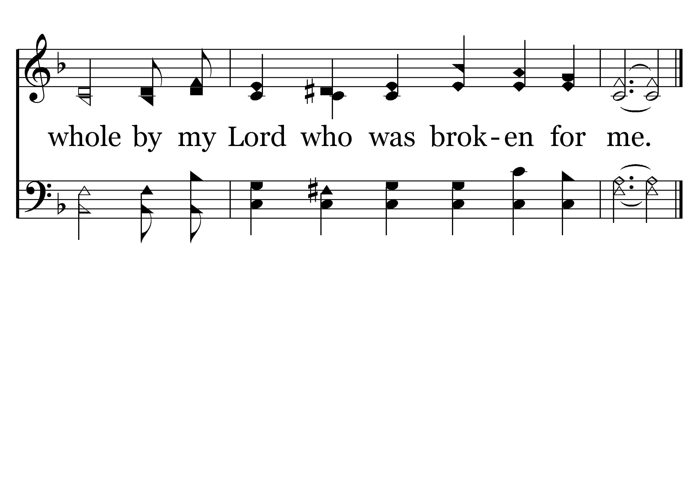
369 - Mended And Whole - C.3
End of Verse 1

Slide 34
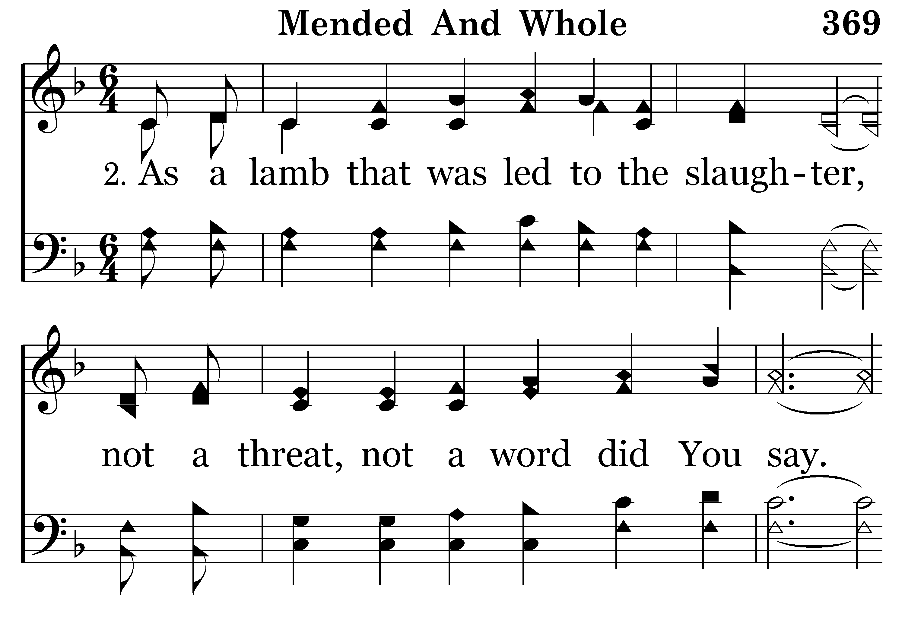
369 - Mended And Whole - 2.1

Slide 35
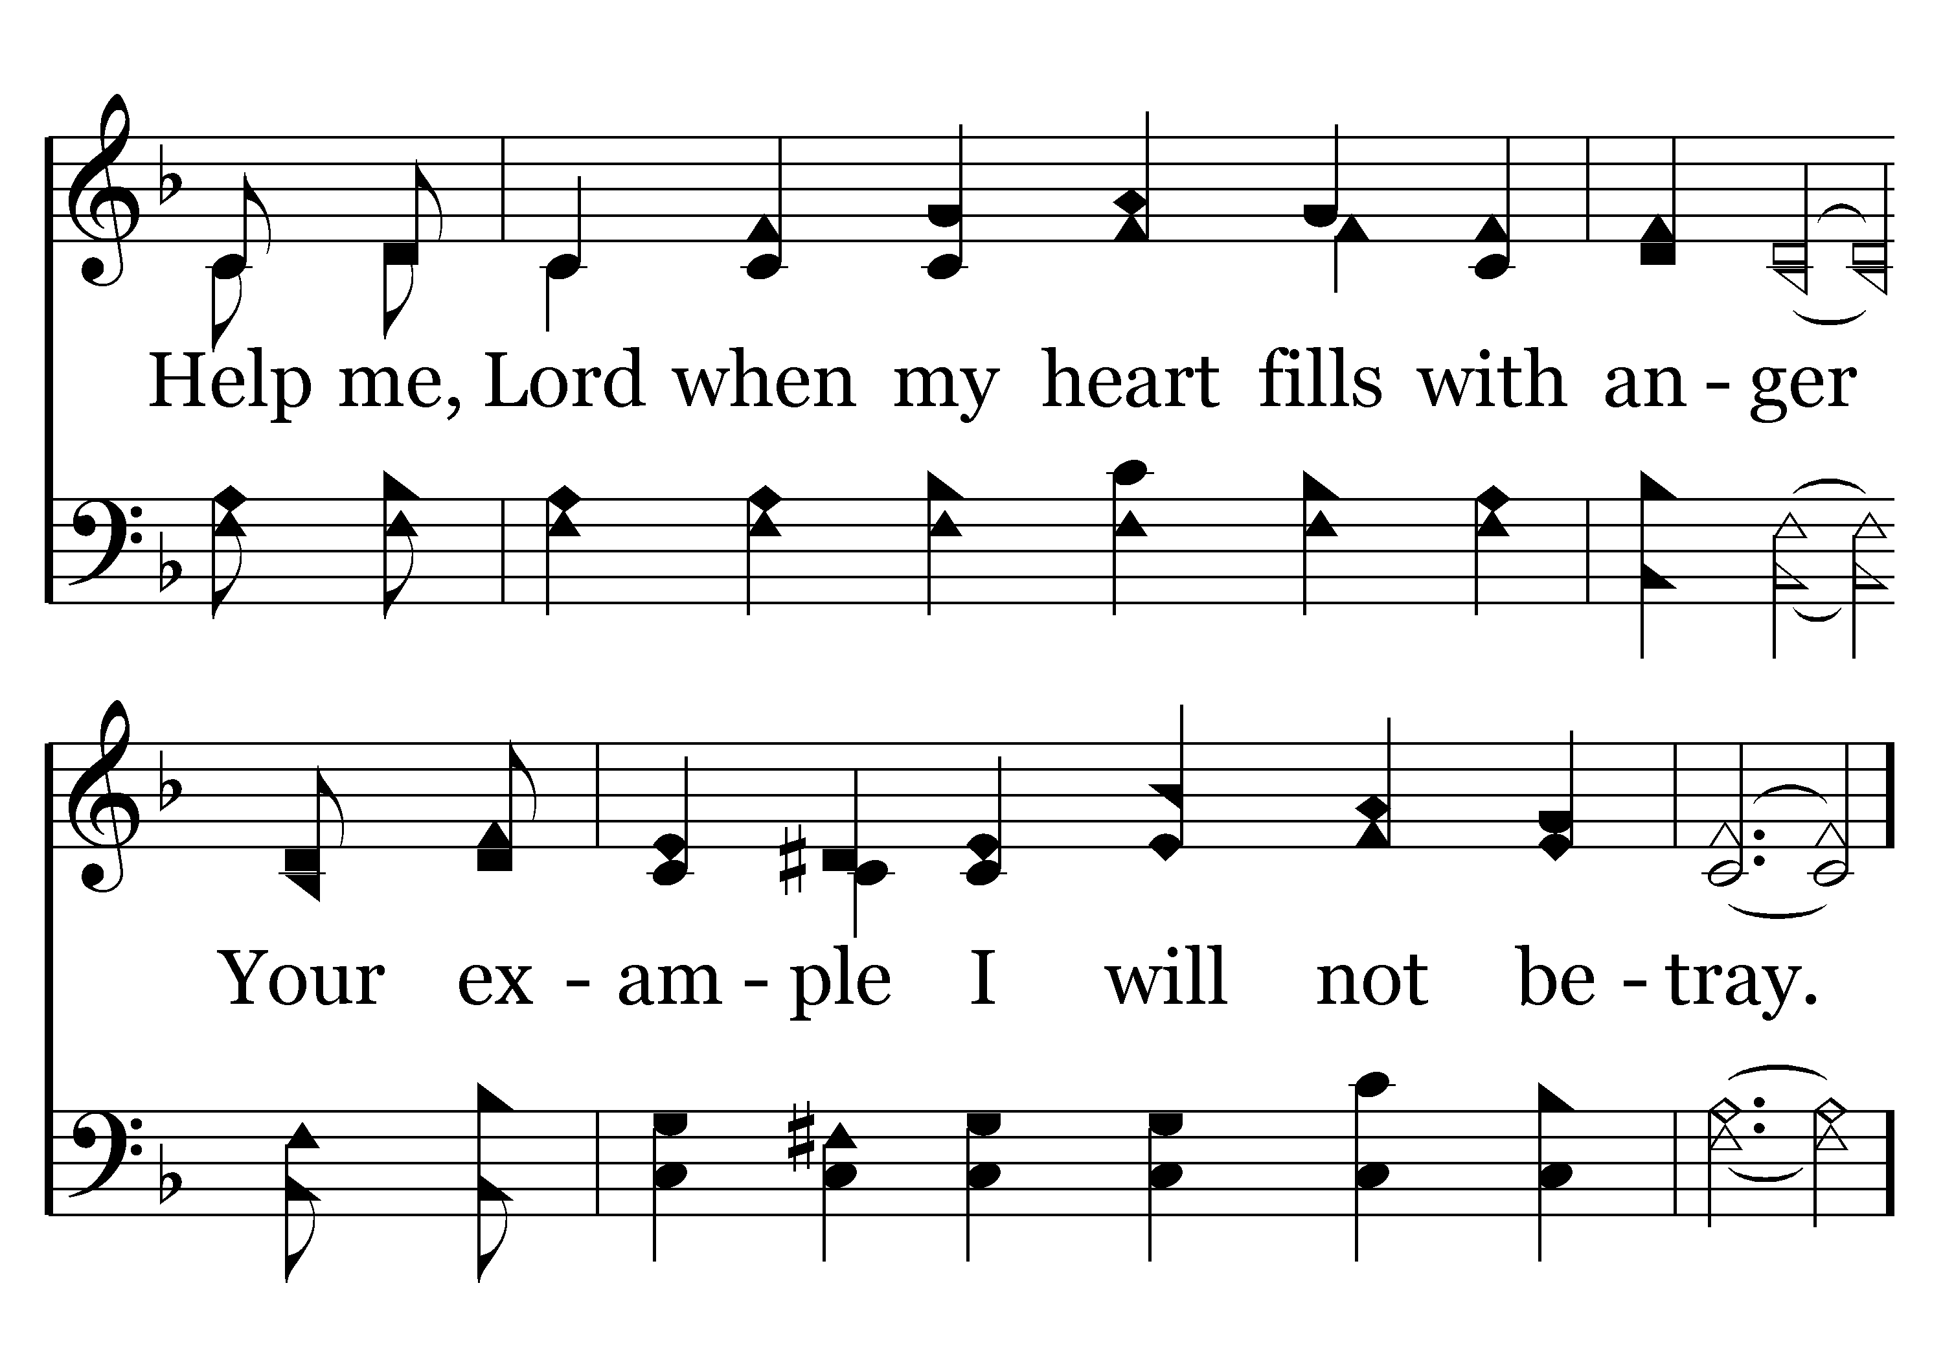
369 - Mended And Whole - 2.2

Slide 36
369 - Mended And Whole - C.1

Slide 37
369 - Mended And Whole - C.2

Slide 38
369 - Mended And Whole - C.3
End of Verse 2

Slide 39
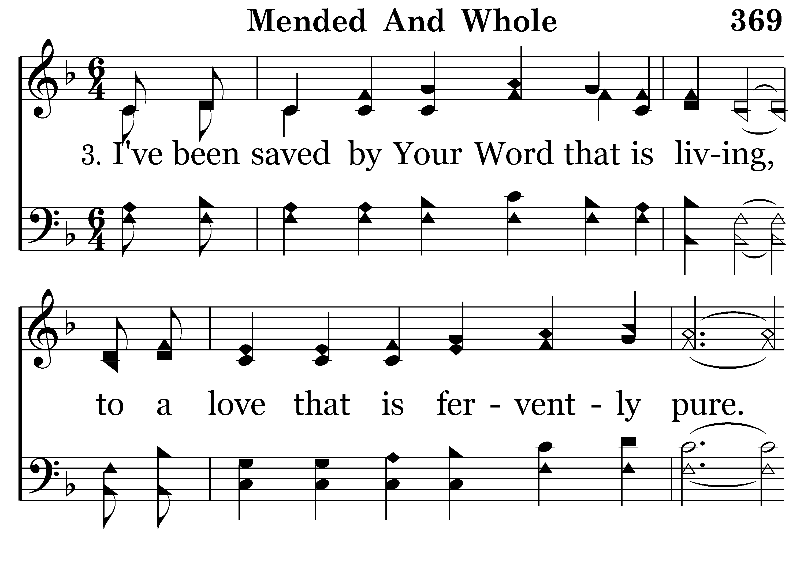
369 - Mended And Whole - 3.1

Slide 40
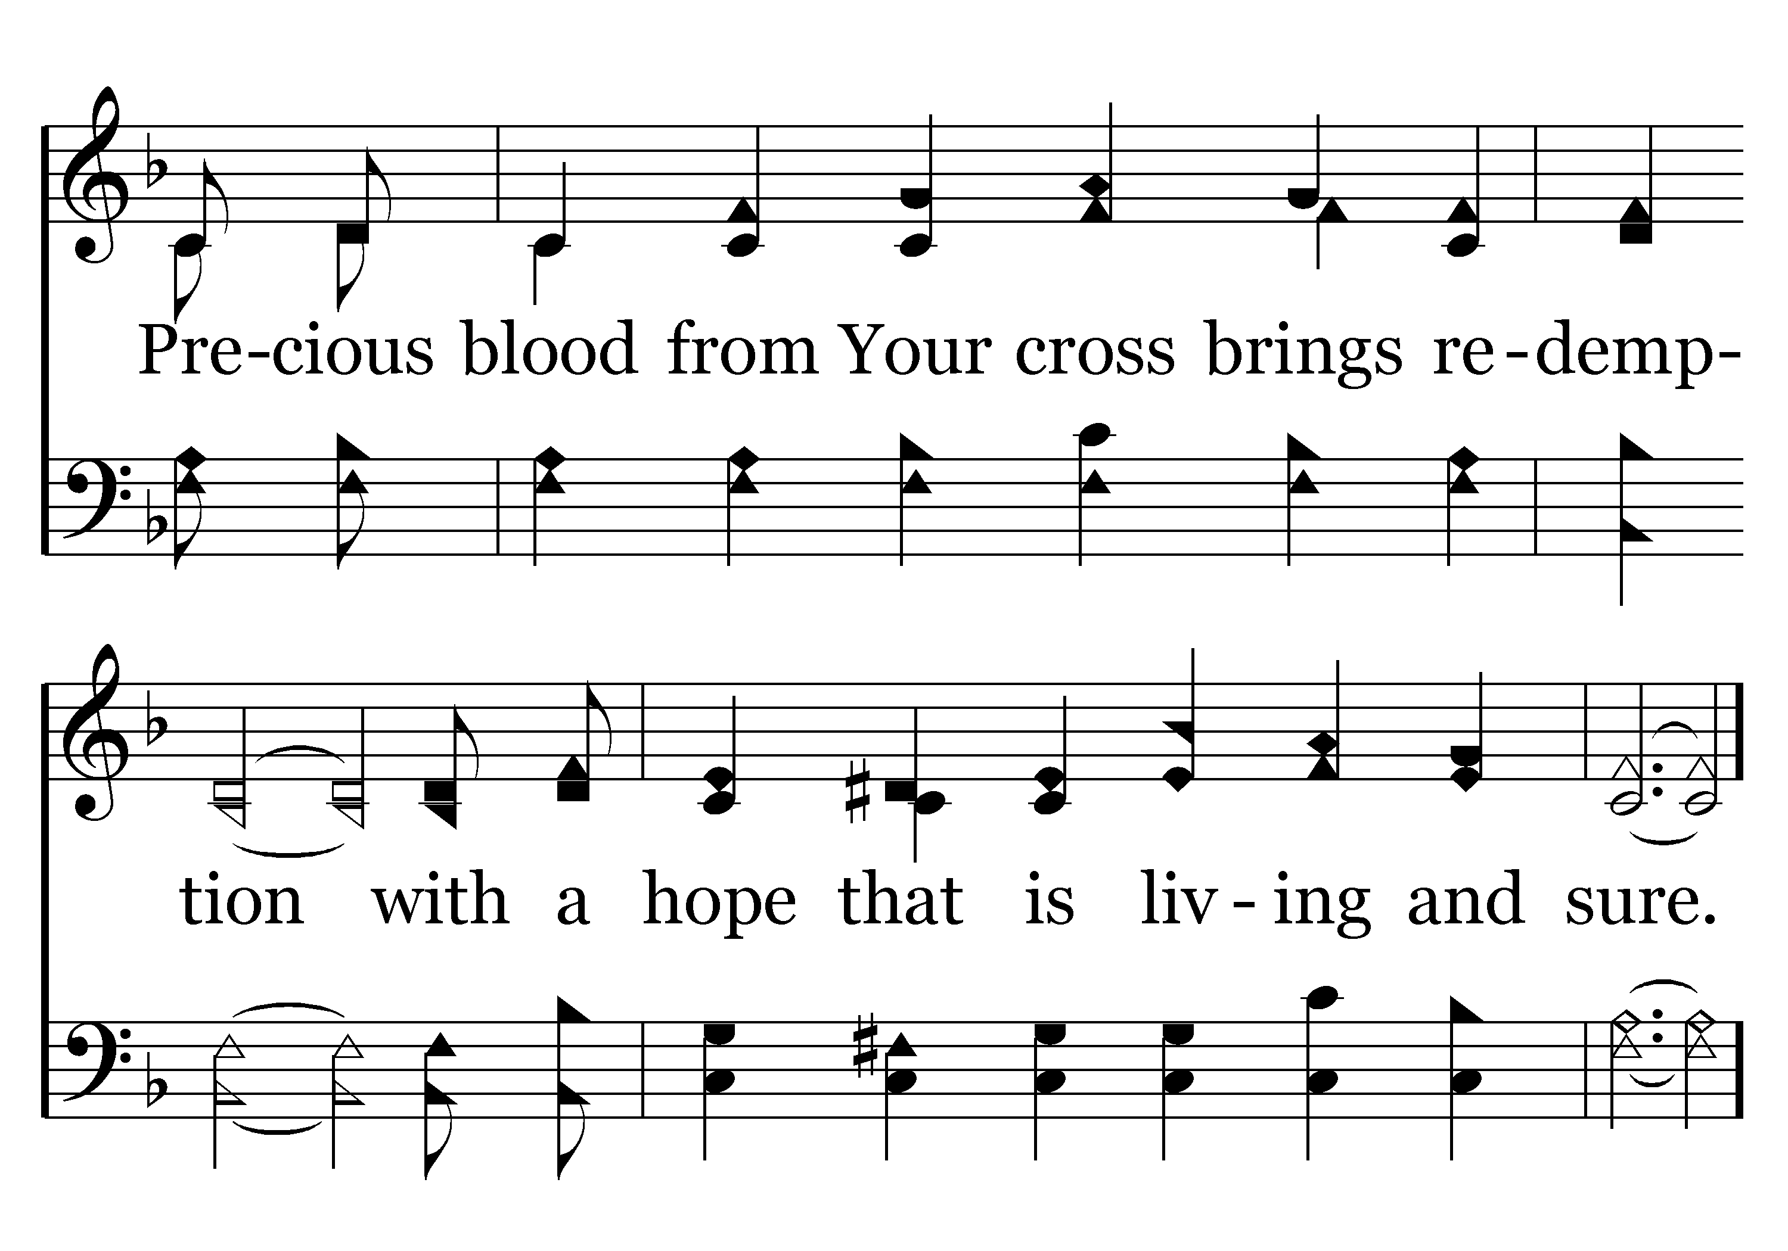
369 - Mended And Whole - 3.2

Slide 41
369 - Mended And Whole - C.1

Slide 42
369 - Mended And Whole - C.2

Slide 43
369 - Mended And Whole - C.3
End of Song

Slide 45
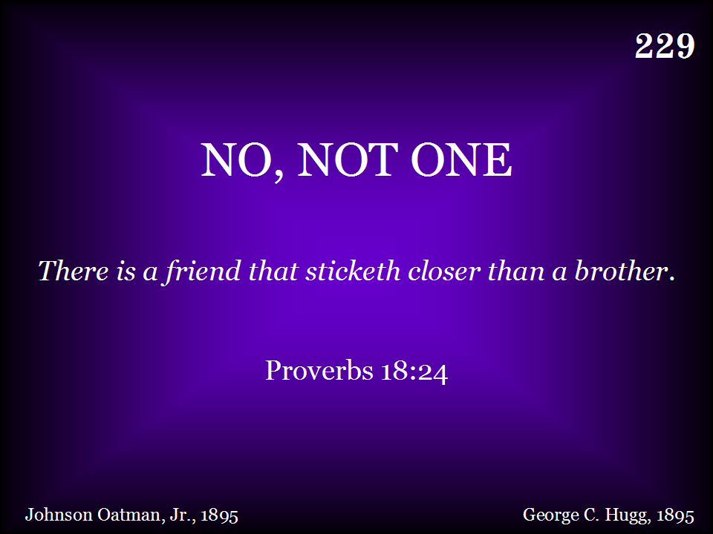
229 - No, Not One - Title

Slide 46
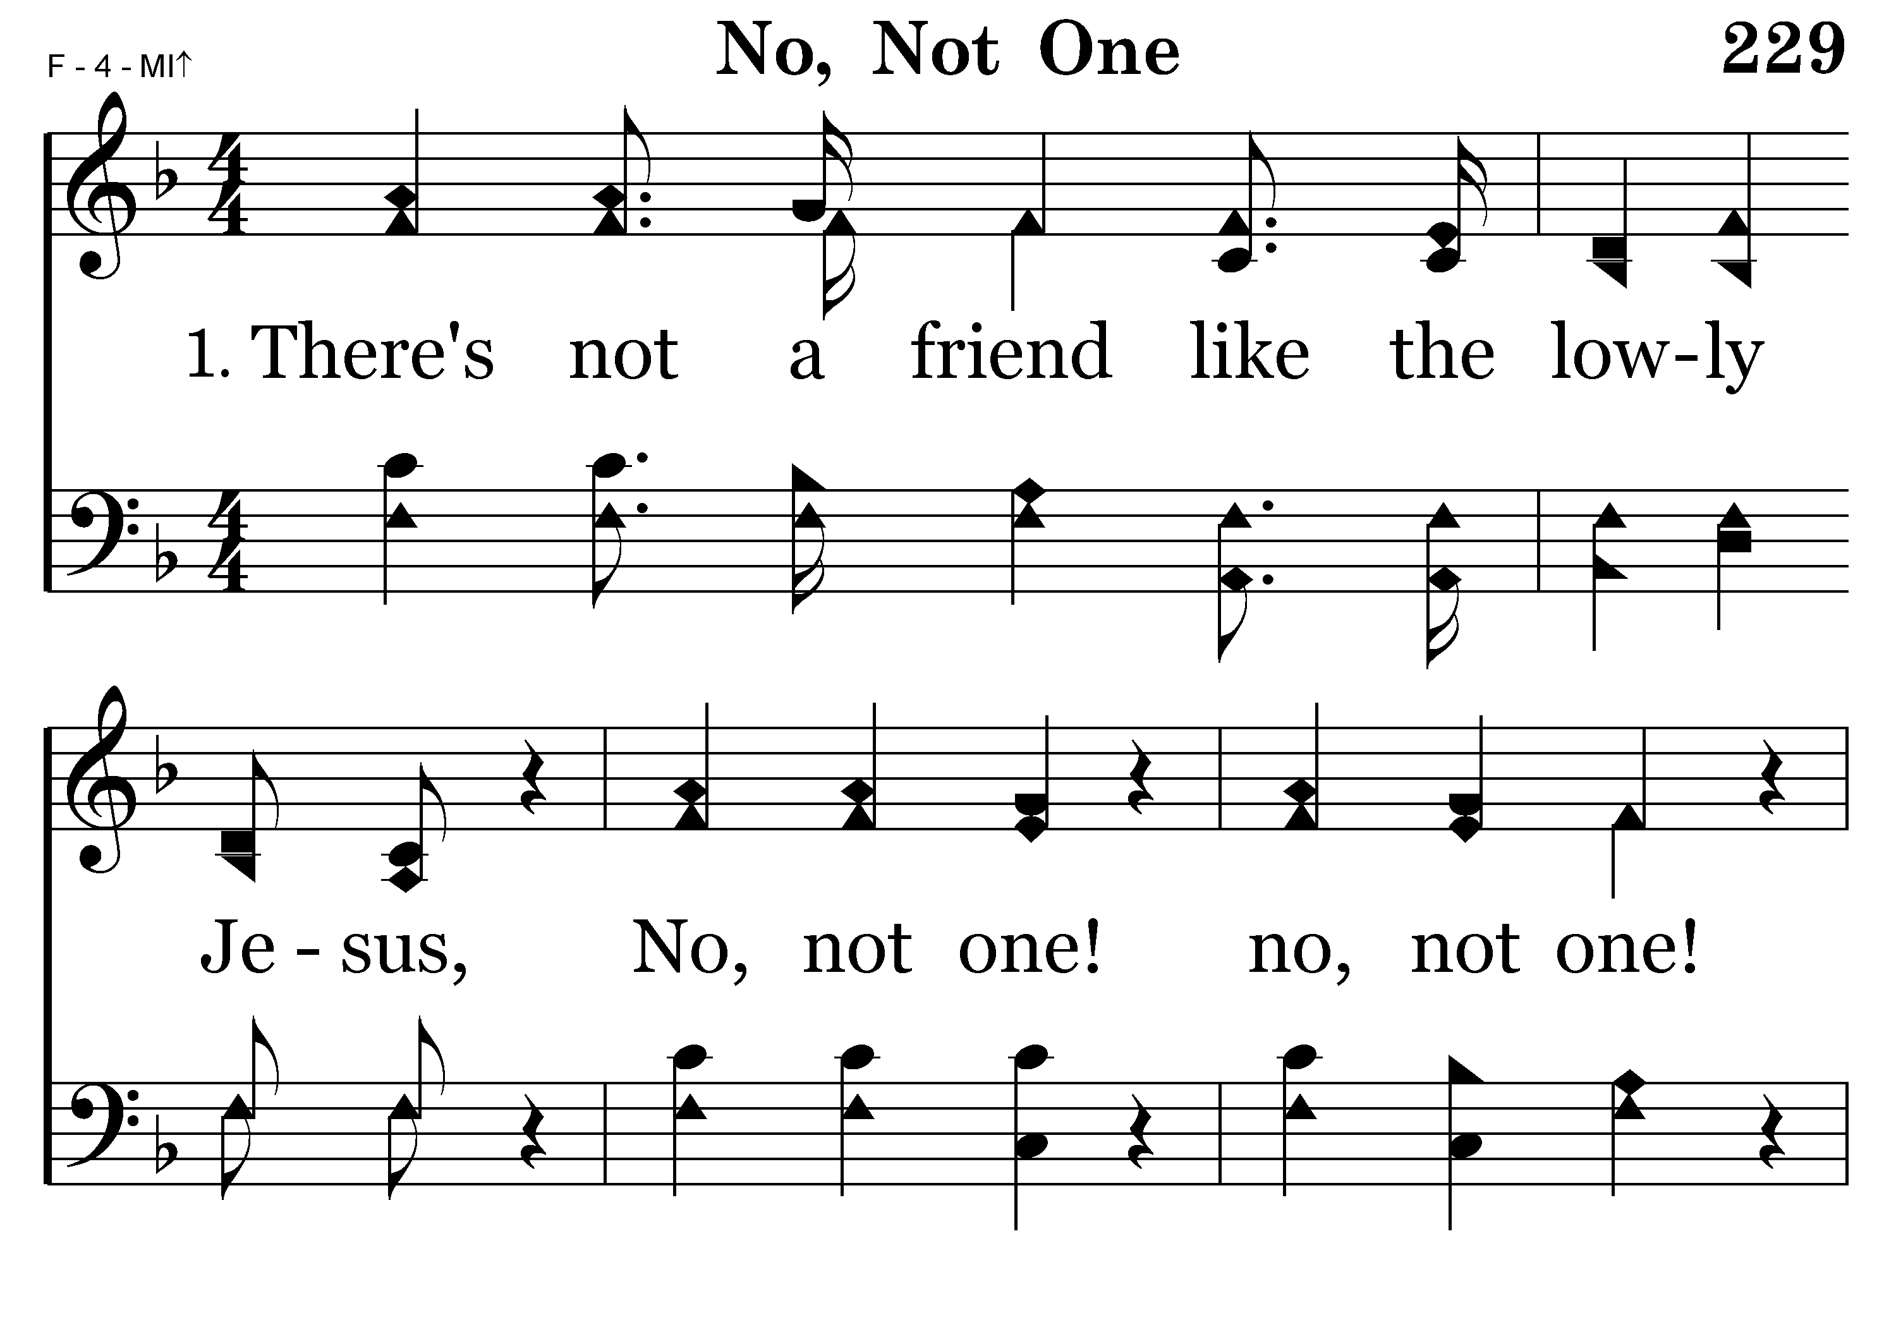
229 - No, Not One - 1.1

Slide 47
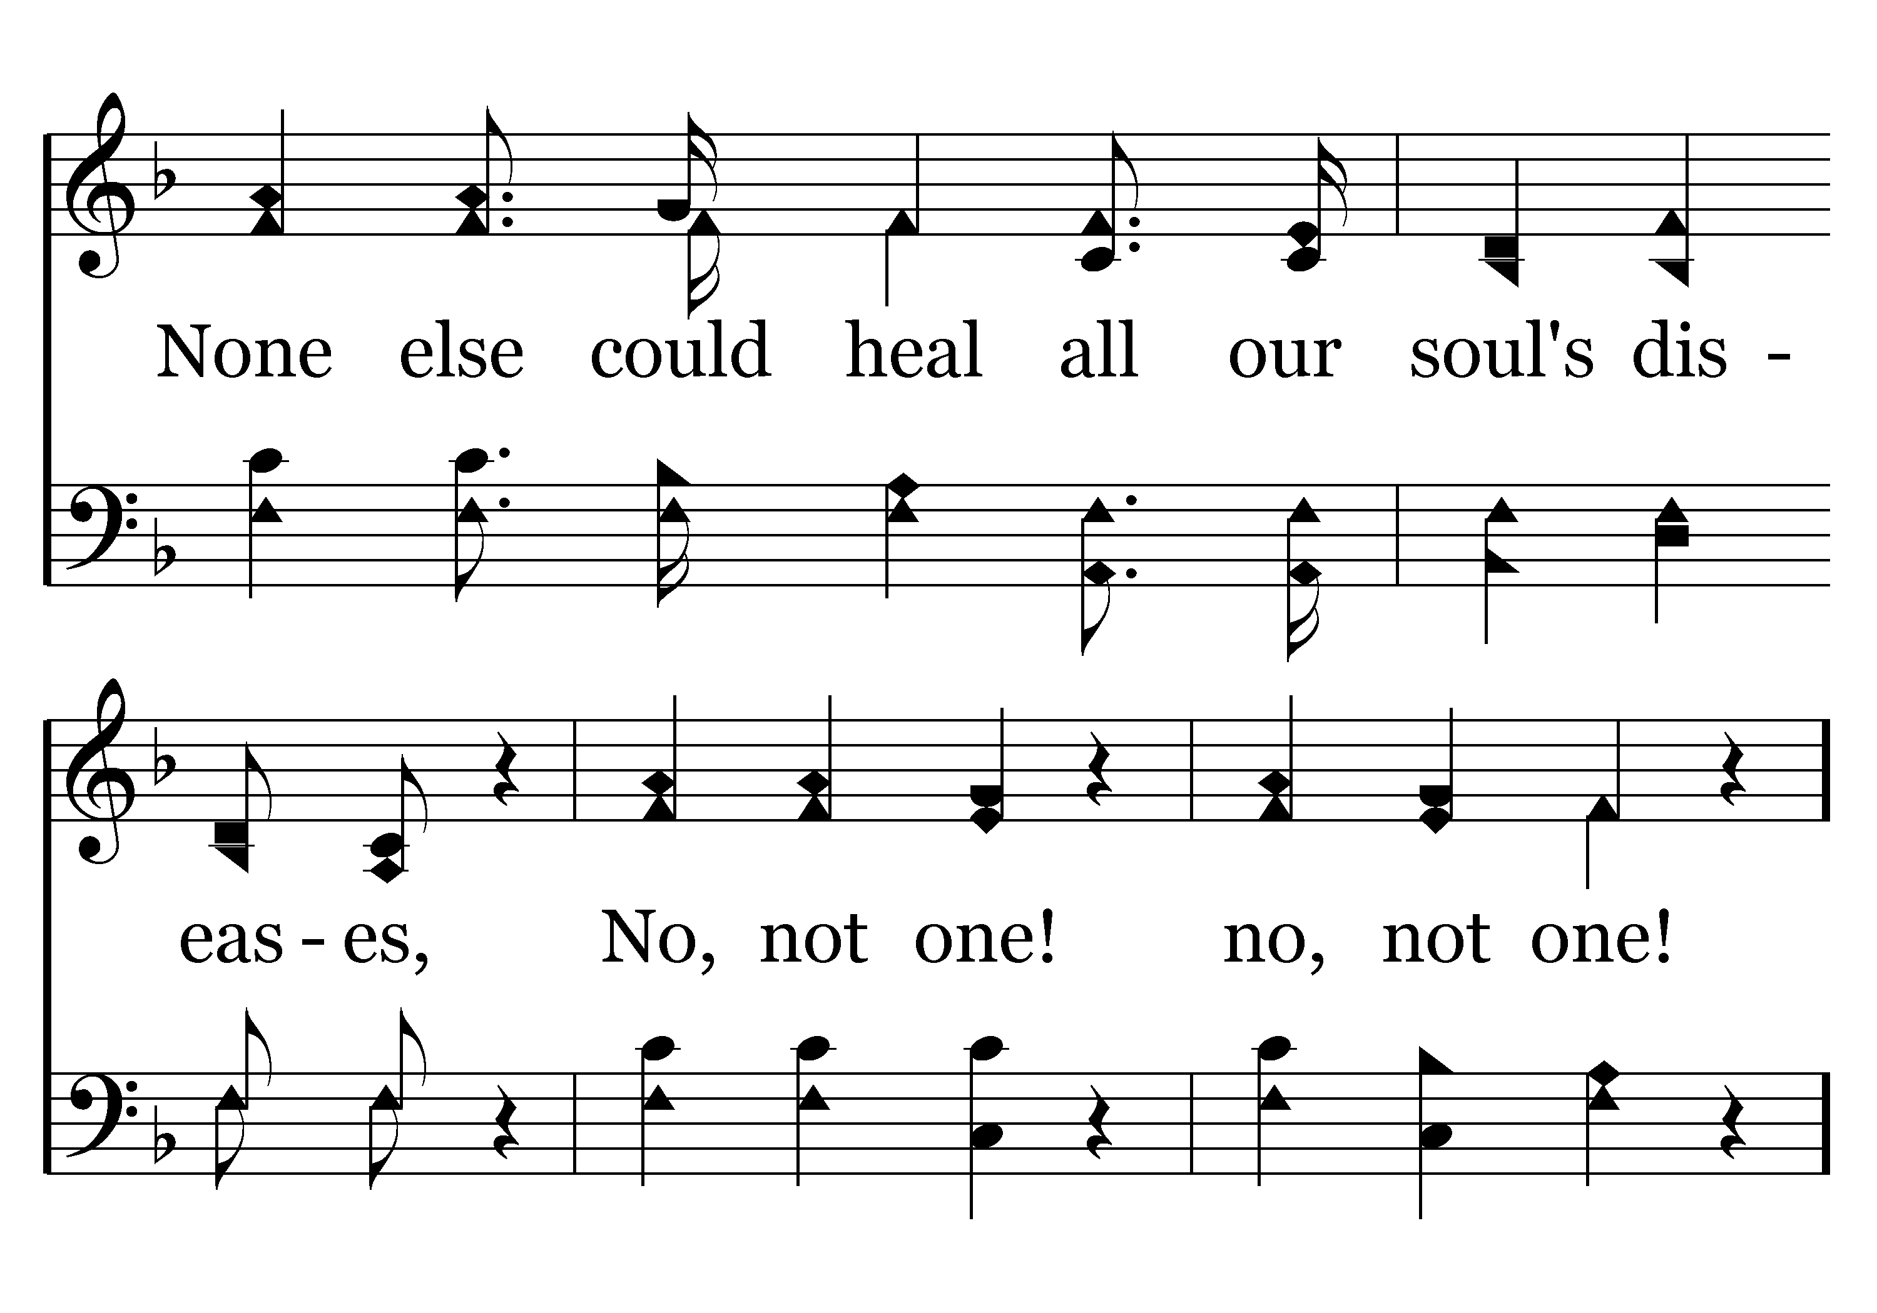
229 - No, Not One - 1.2

Slide 48
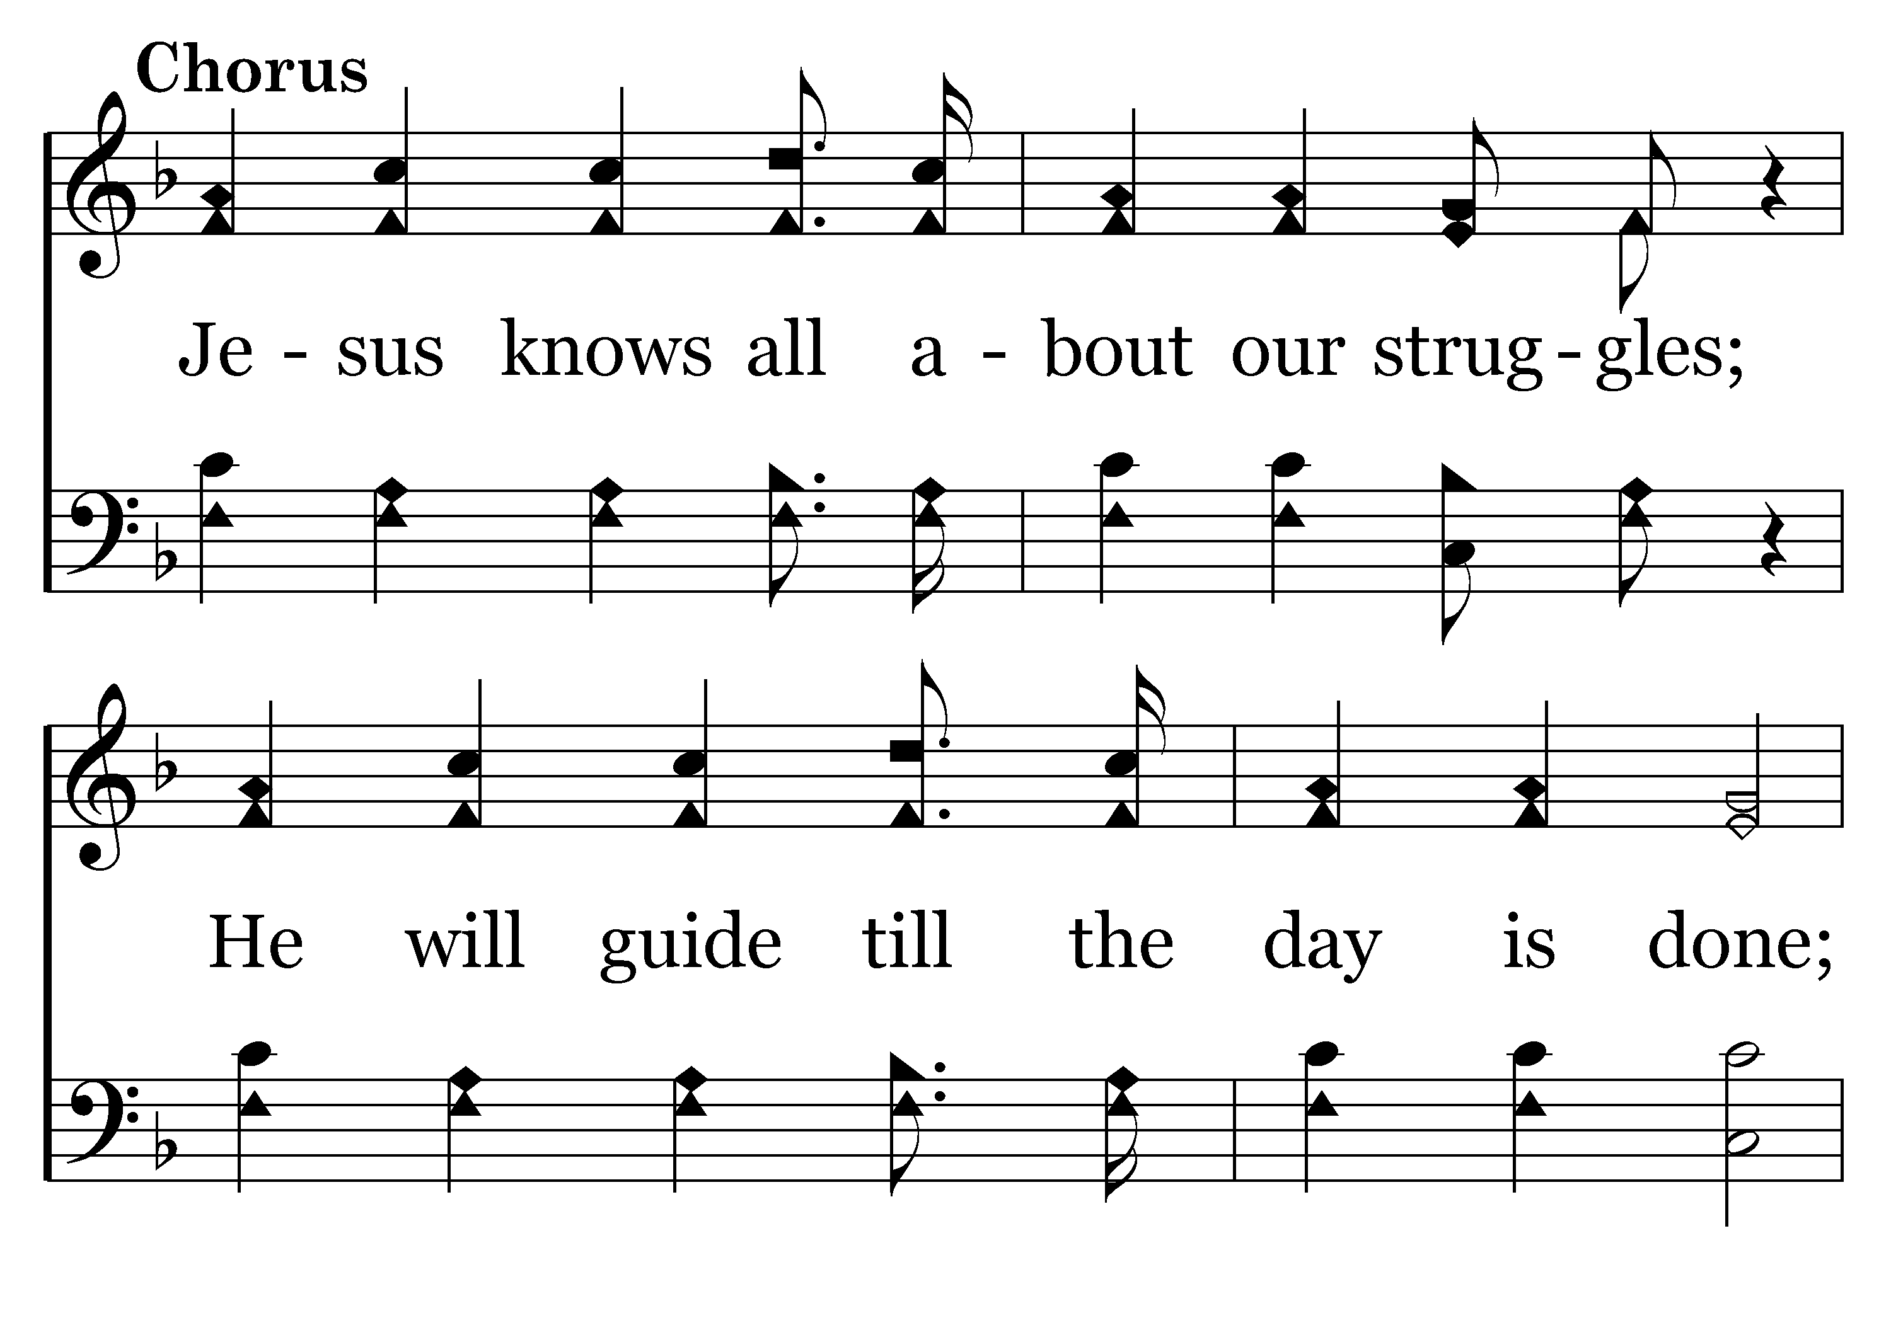
229 - No, Not One - C.1

Slide 49
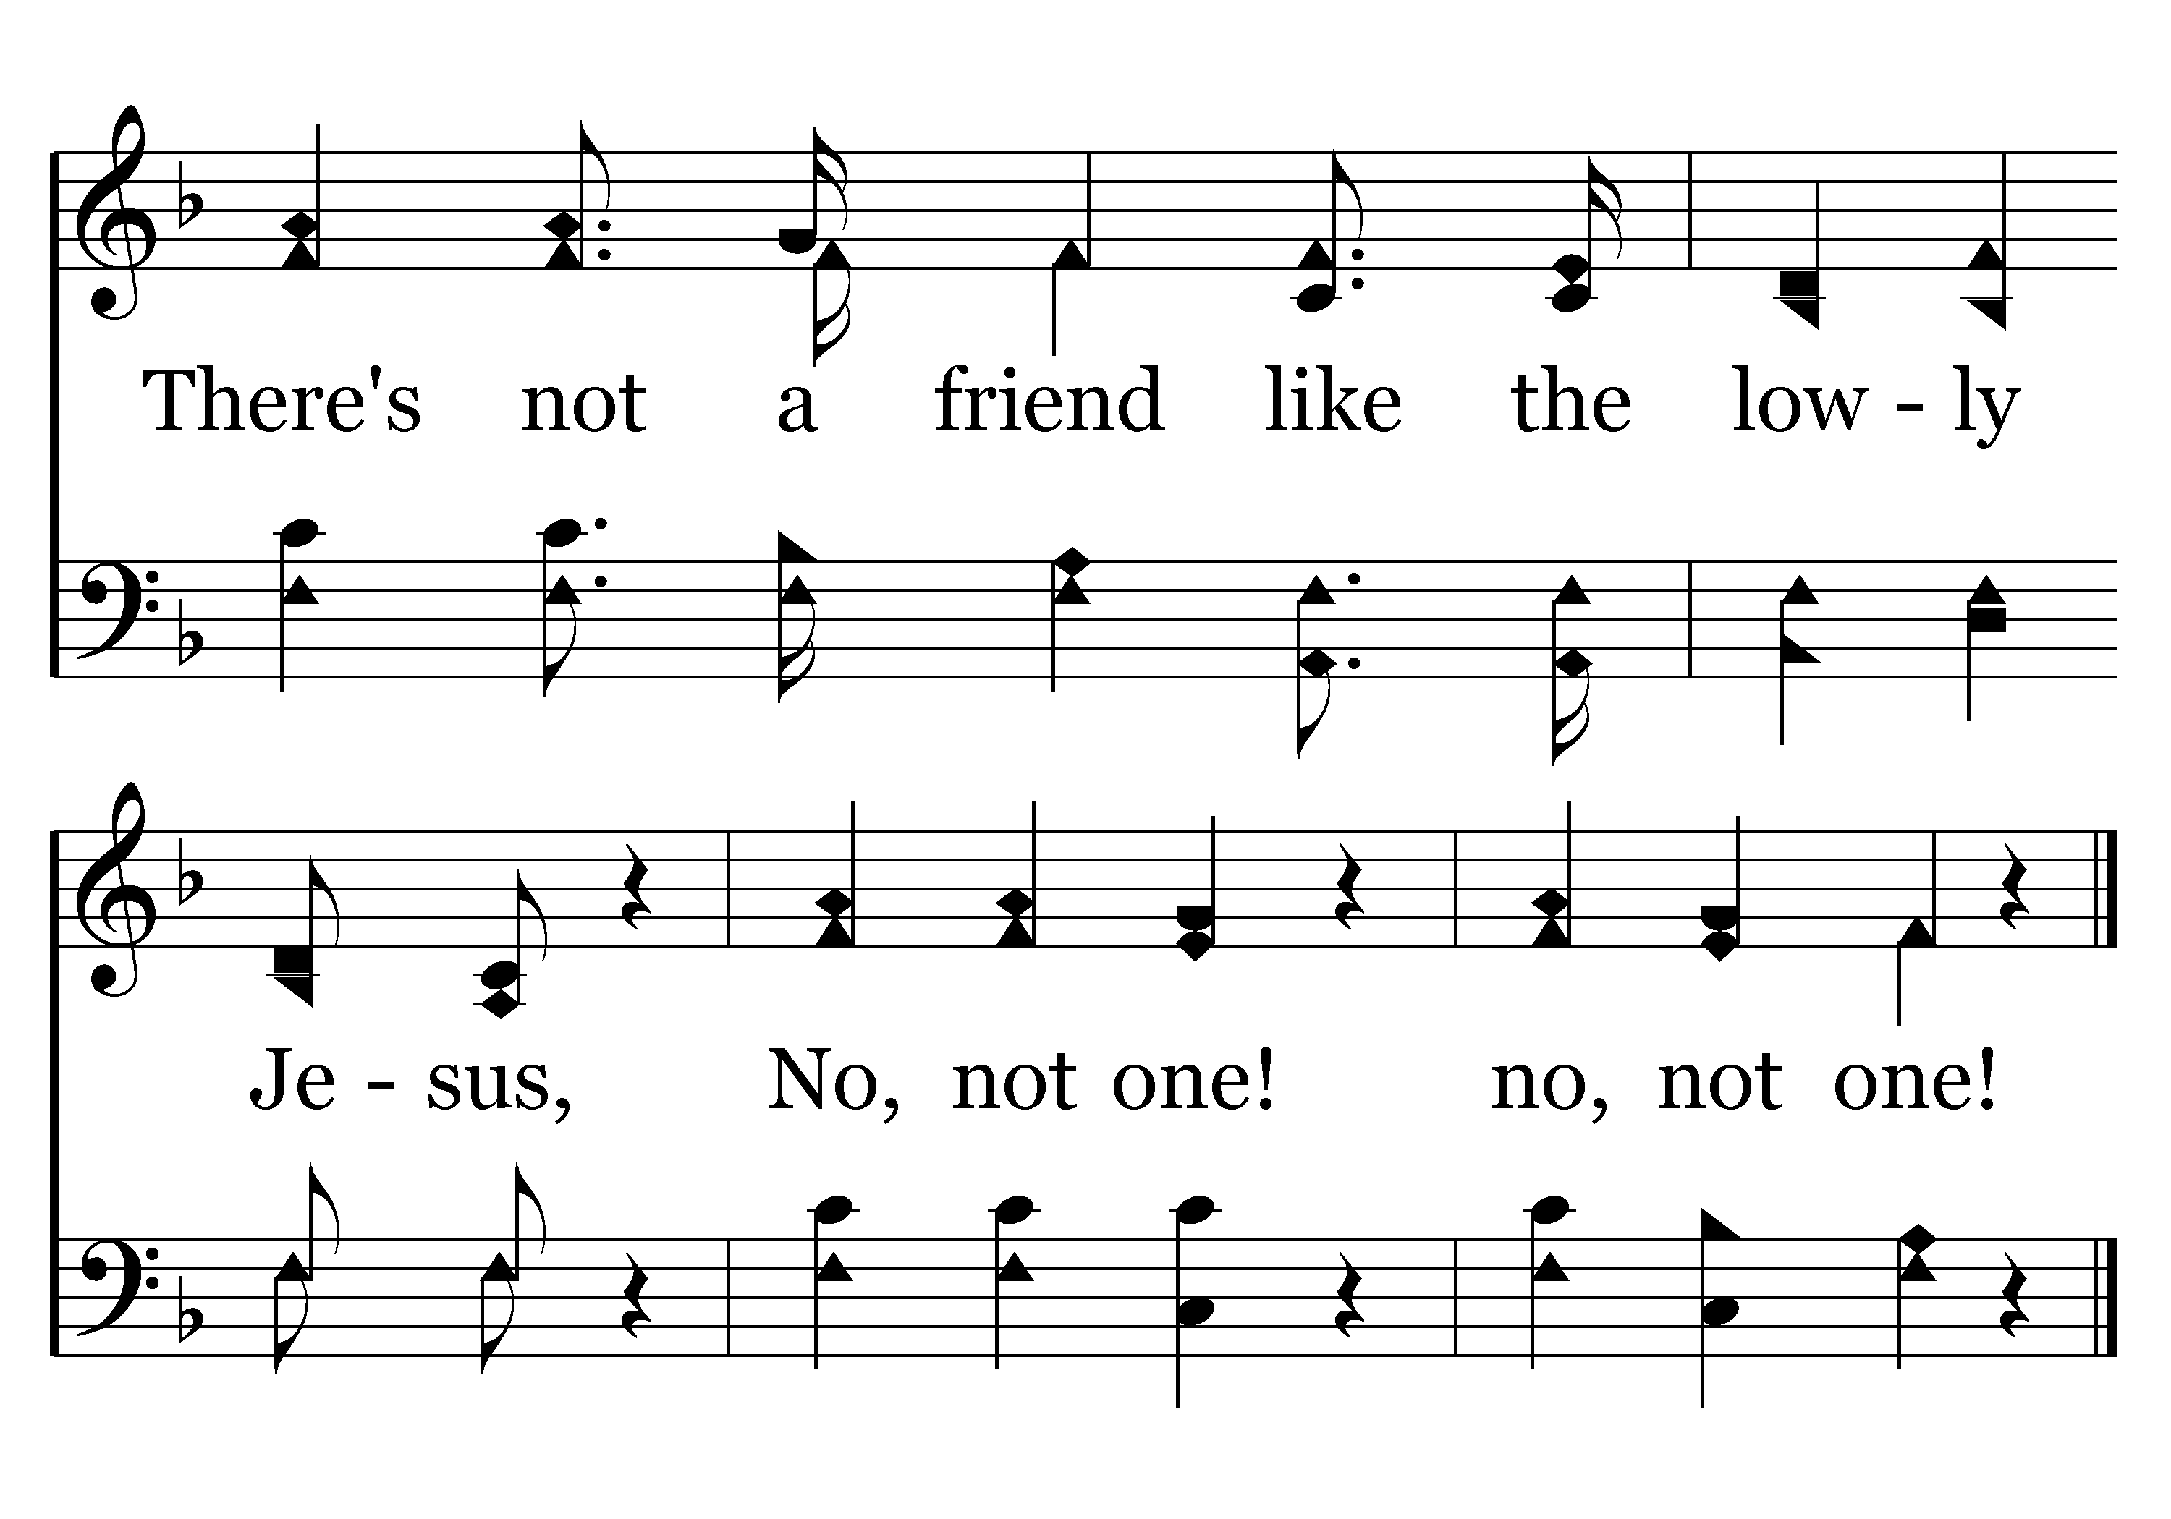
229 - No, Not One - C.2
End of Verse 1

Slide 50
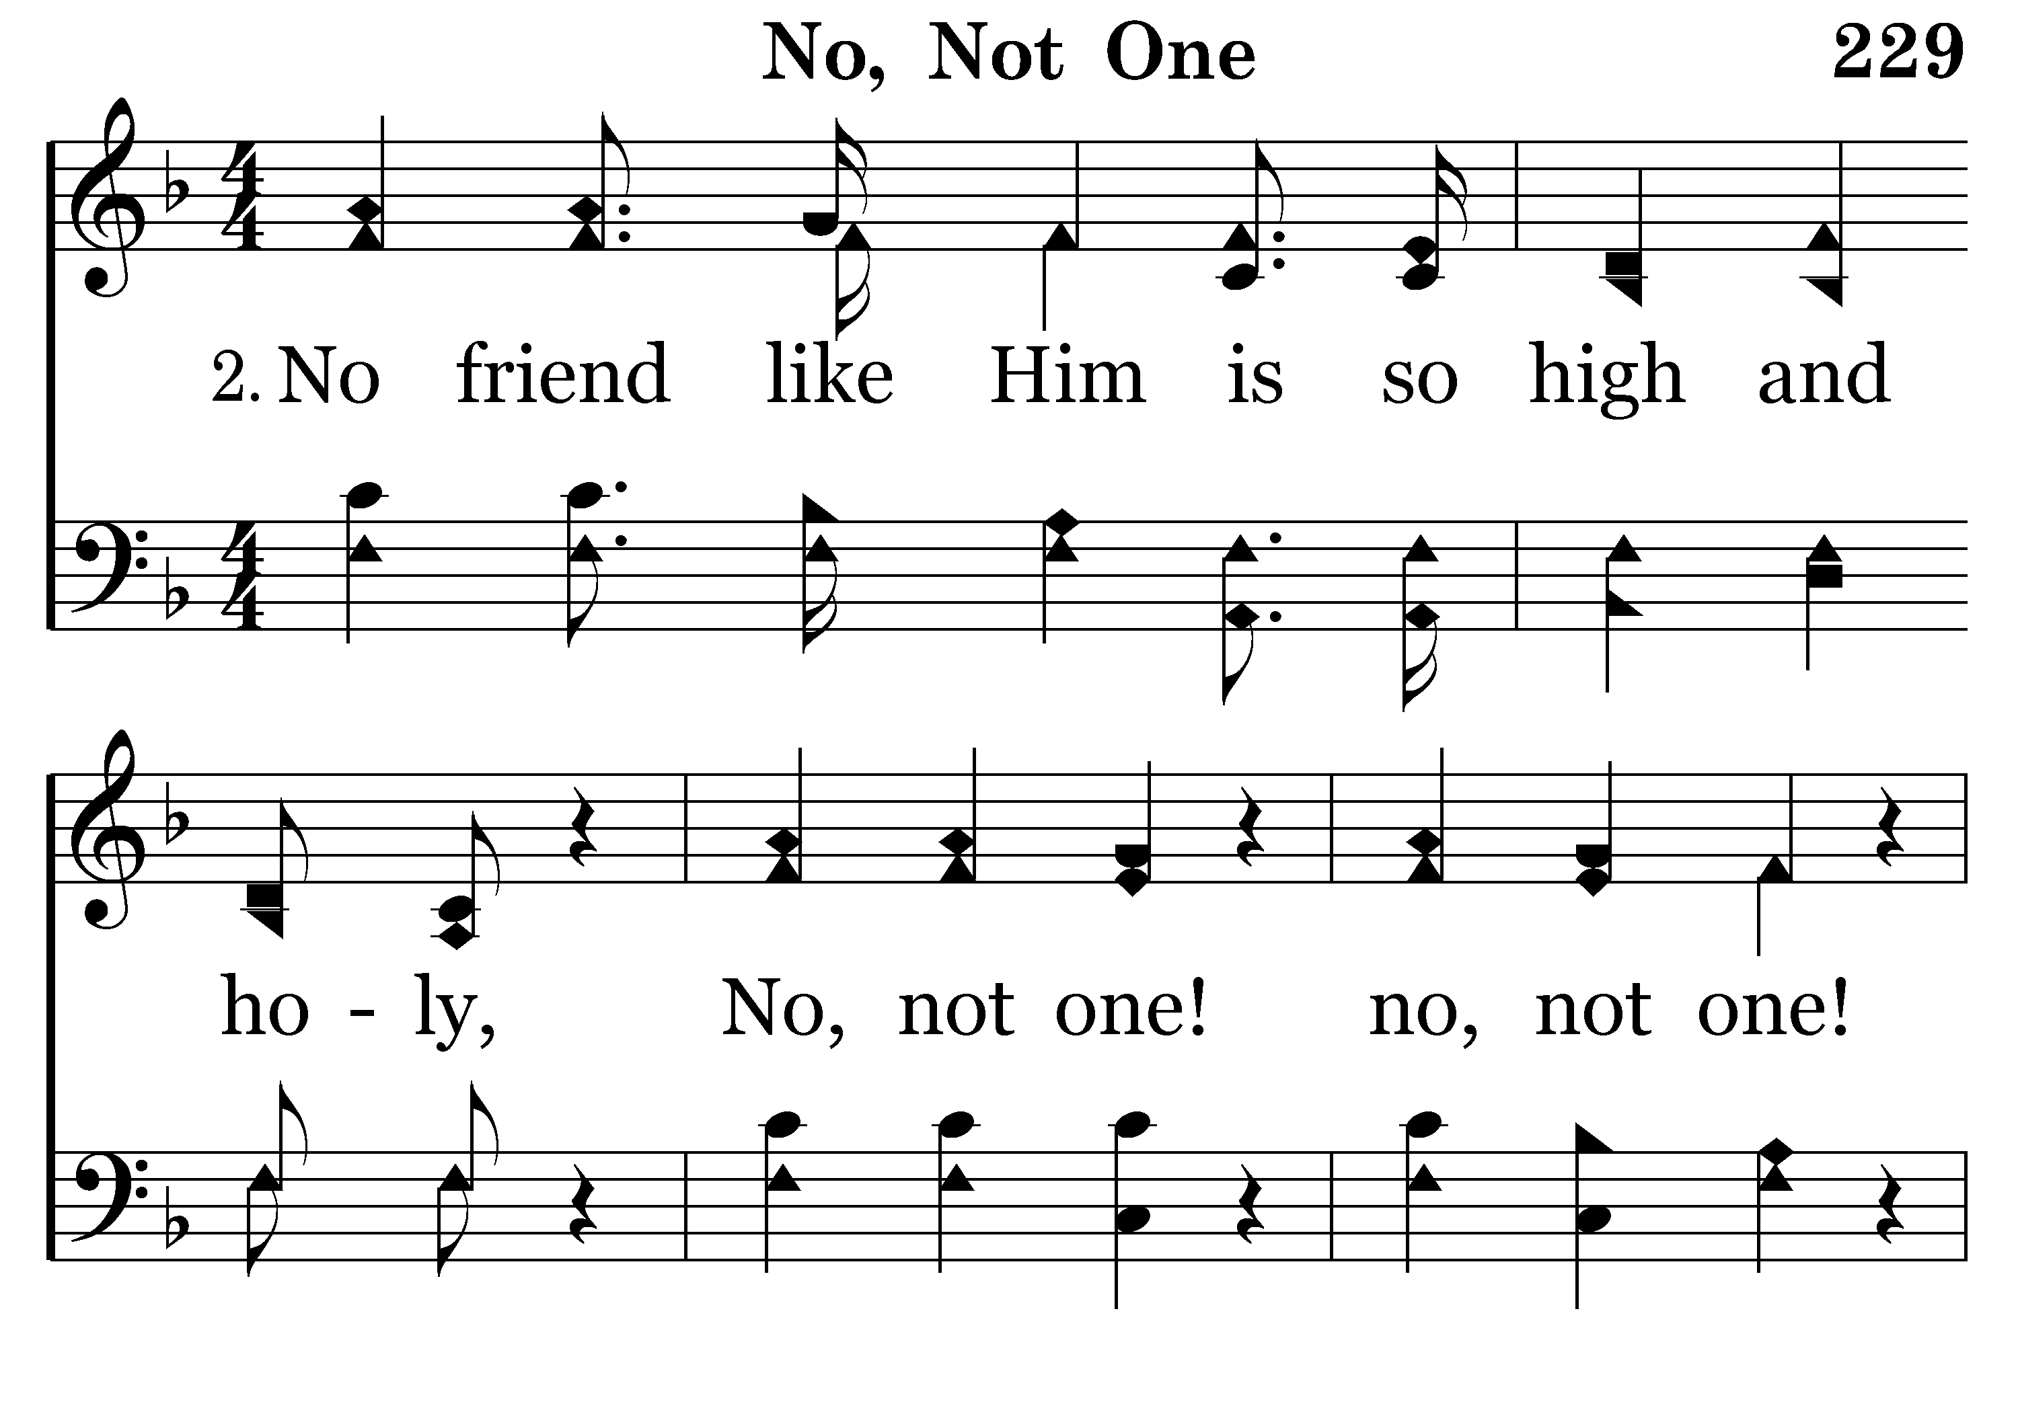
229 - No, Not One - 2.1

Slide 51
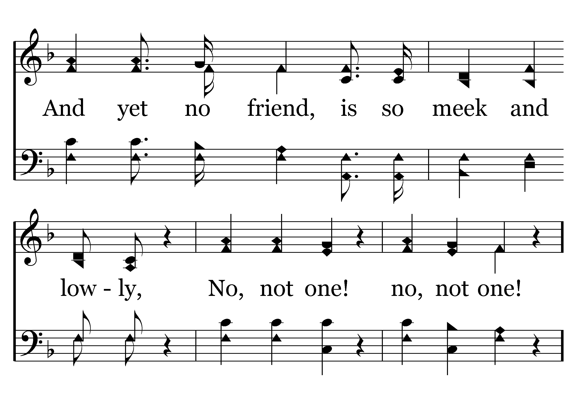
229 - No, Not One - 2.2

Slide 52
229 - No, Not One - C.1

Slide 53
229 - No, Not One - C.2
End of Verse 2

Slide 54
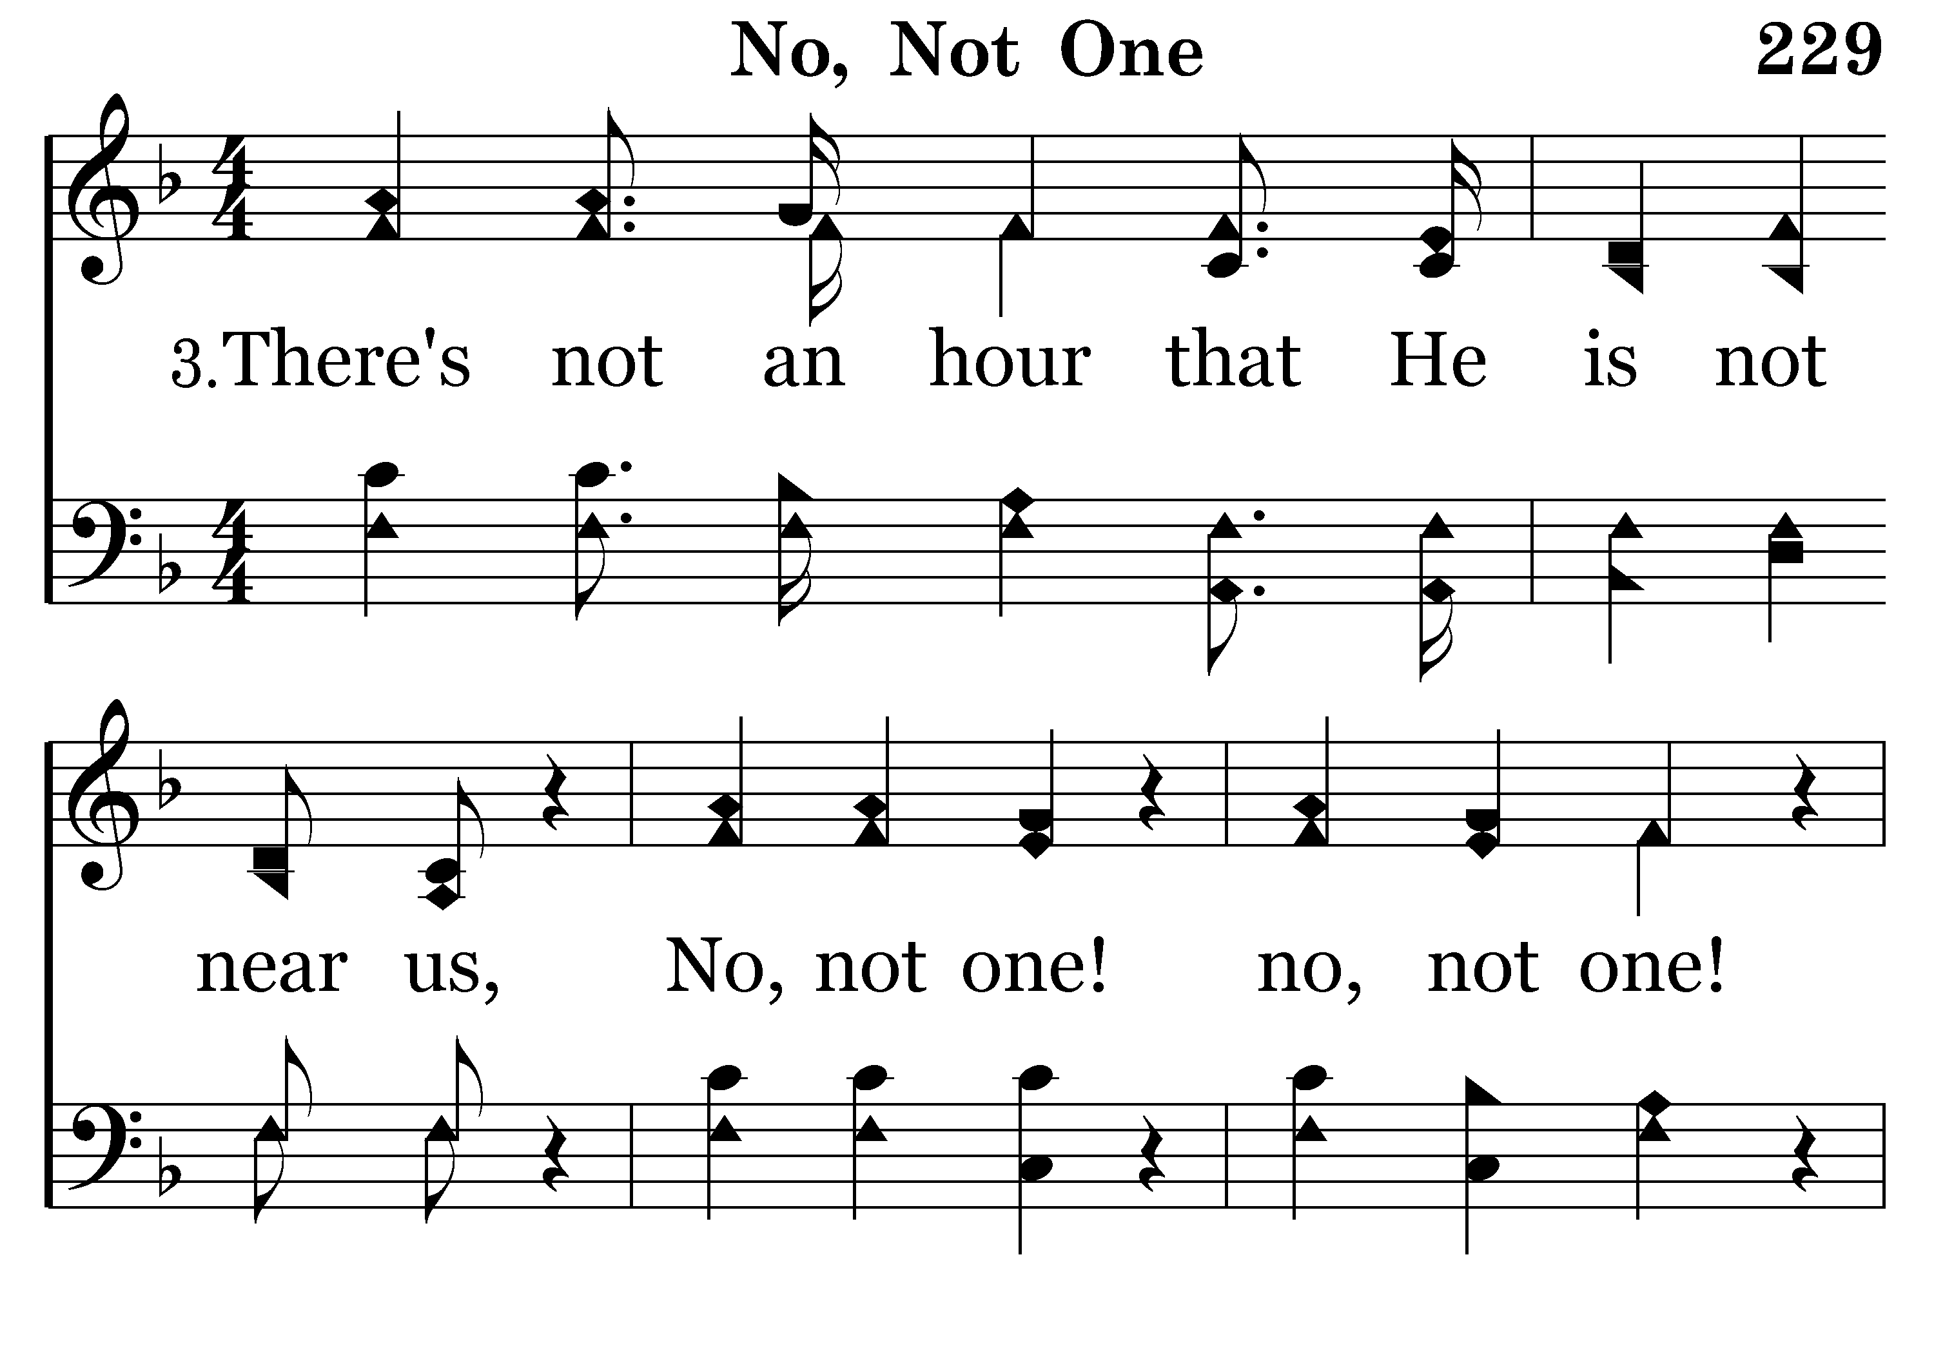
229 - No, Not One - 3.1

Slide 55
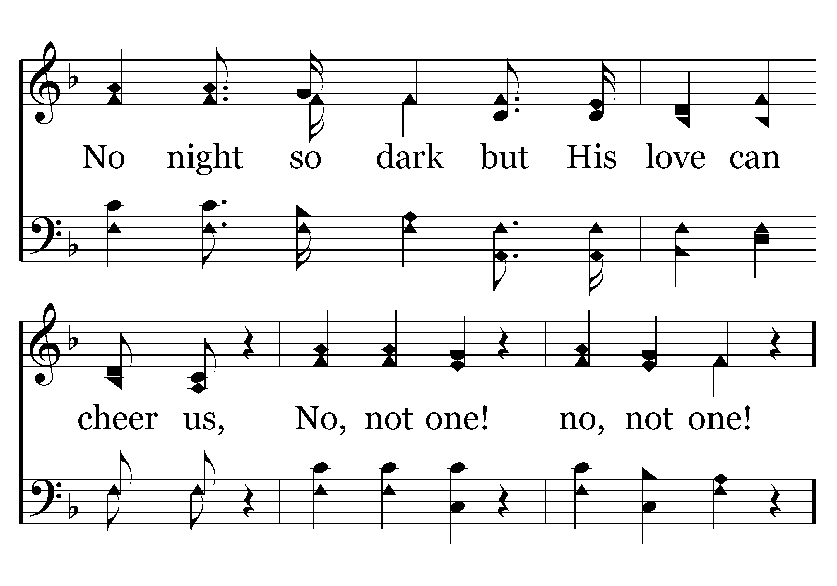
229 - No, Not One - 3.2

Slide 56
229 - No, Not One - C.1

Slide 57
229 - No, Not One - C.2
End of Song

Slide 58
Marriage
Growing together in love - 2.11.18

Slide 59
Growing together in love
Effort and the labor of love
The right attitude
Practical advice
Becoming closer
Notes:
.

Slide 60
A strong marriage is a labor of love…
“For this reason a man will leave his father and mother and be united to his wife, and they will become one flesh.” (Gen. 2:24)
A perfect relationship isn’t actually perfect, it’s just that both people never give up. —Anonymous
Want an extraordinary marriage? You have to choose it! —Justin Davis
Loving while laboring (Col. 3:12-24) – writer addresses husbands and wives during a discourse of putting on the new self
  vs. 17 & 24 bookend husband and wife behaviors toward one another
  DO your work…as for the Lord (1 John 4:8) - GOD IS LOVE

Slide 61
The right attitude
“Attitude is a little thing that makes a big difference”. —Winston Churchill
Christ’s attitude toward the church (Eph. 5:25-29)
Your words are an indicator of your attitude (Eph. 4:29)
  A happy wife…
  Water cooler talk…
Giving
  The ultimate expression of love (John 3:16)
  Difference between giving and an exchange / trade

Slide 62
Practical advice
Keep good communications (Eph. 4:29)
  Listen (2:1)…it is harder than talking
Learn the joy of saying…I Love You! (1 Cor. 13)
  It makes marriages happier, it makes kids recognize their importance and it makes for a better home in every way
Do things together (Eccl. 9:9)
  Engage in and learn about your spouses interests
  Pray and maintain your own prayer list together
  Serve God together (worship P&P, a friend, a service organization)
  Talk about your spiritual growth, the help you need, how God is working on you and in your life

Slide 63
Becoming closer
Husband
Wife
God
“For this reason a man will leave his father and mother and be united to his wife, and they will become one flesh.” (Gen. 2:24)

Slide 64
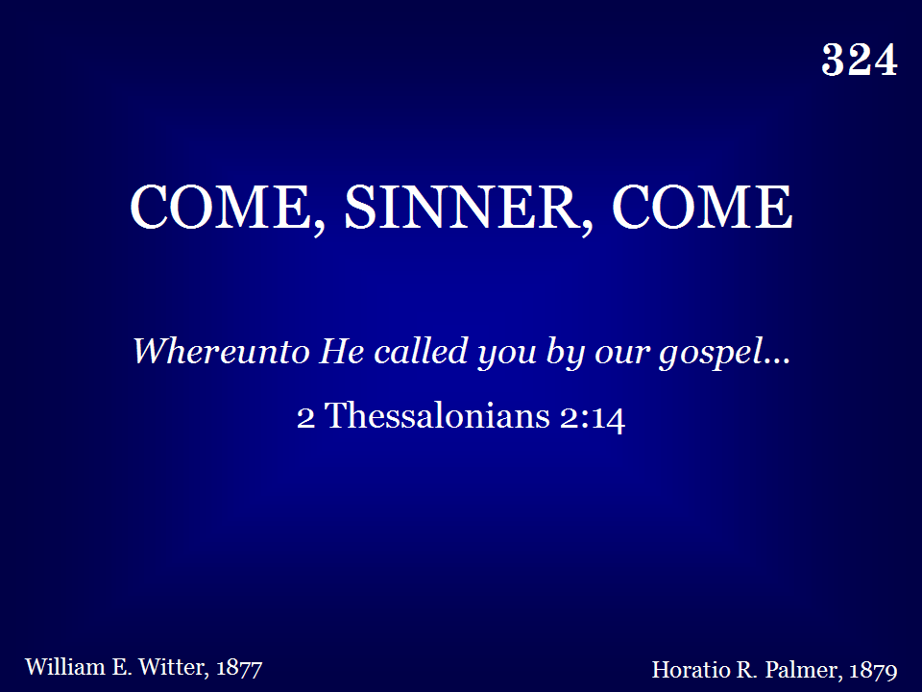
324 - Come, Sinner, Come - Title

Slide 65
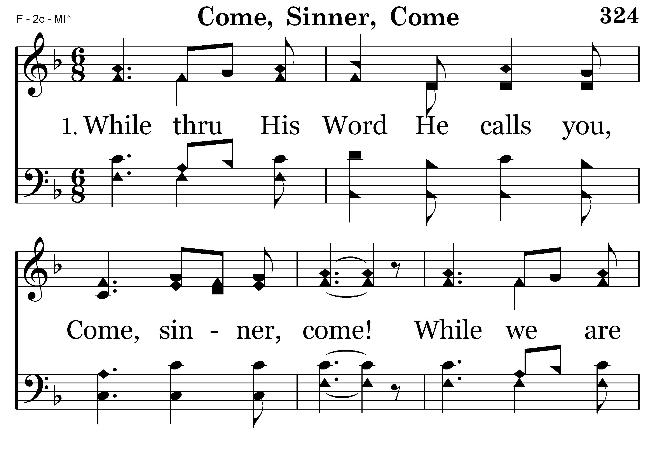
324 - Come, Sinner, Come - 1.1

Slide 66
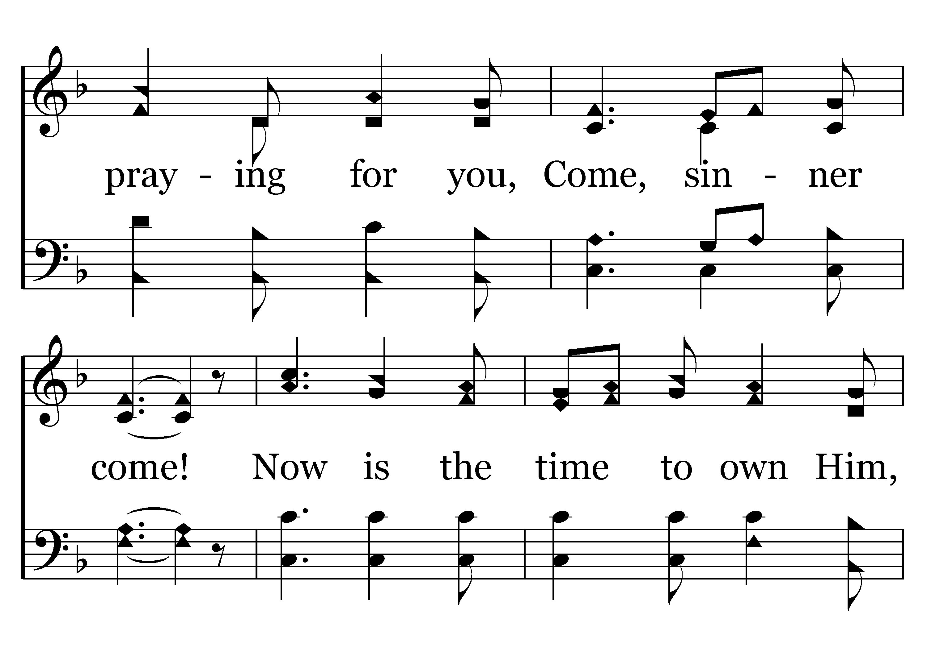
324 - Come, Sinner, Come - 1.2

Slide 67
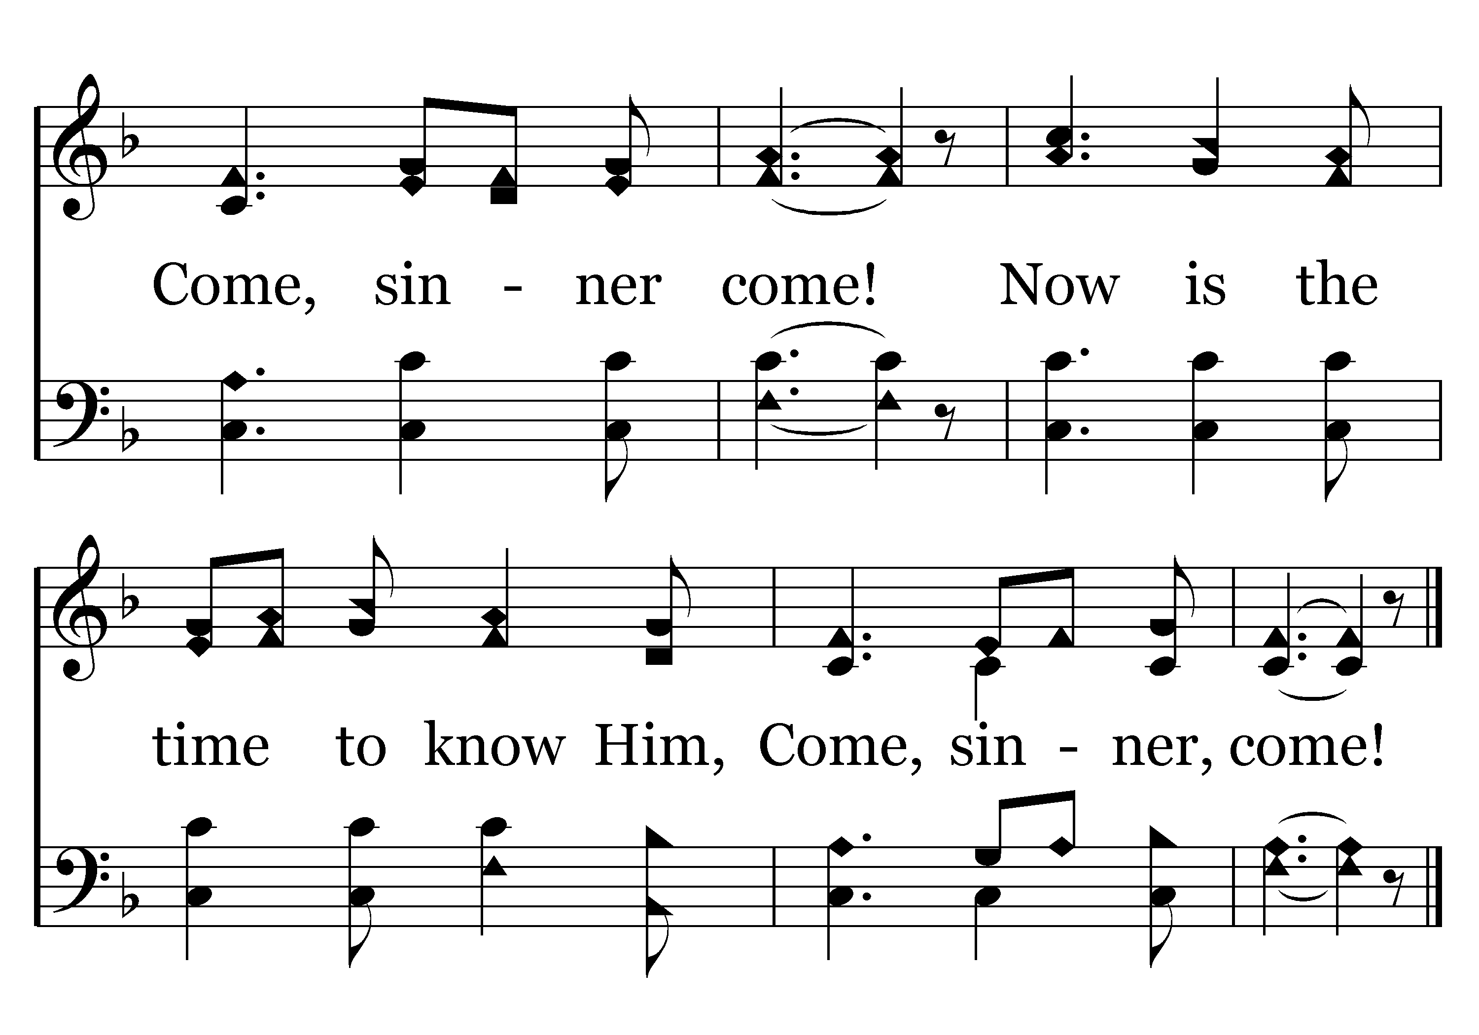
324 - Come, Sinner, Come - 1.3
End of Verse 1

Slide 68
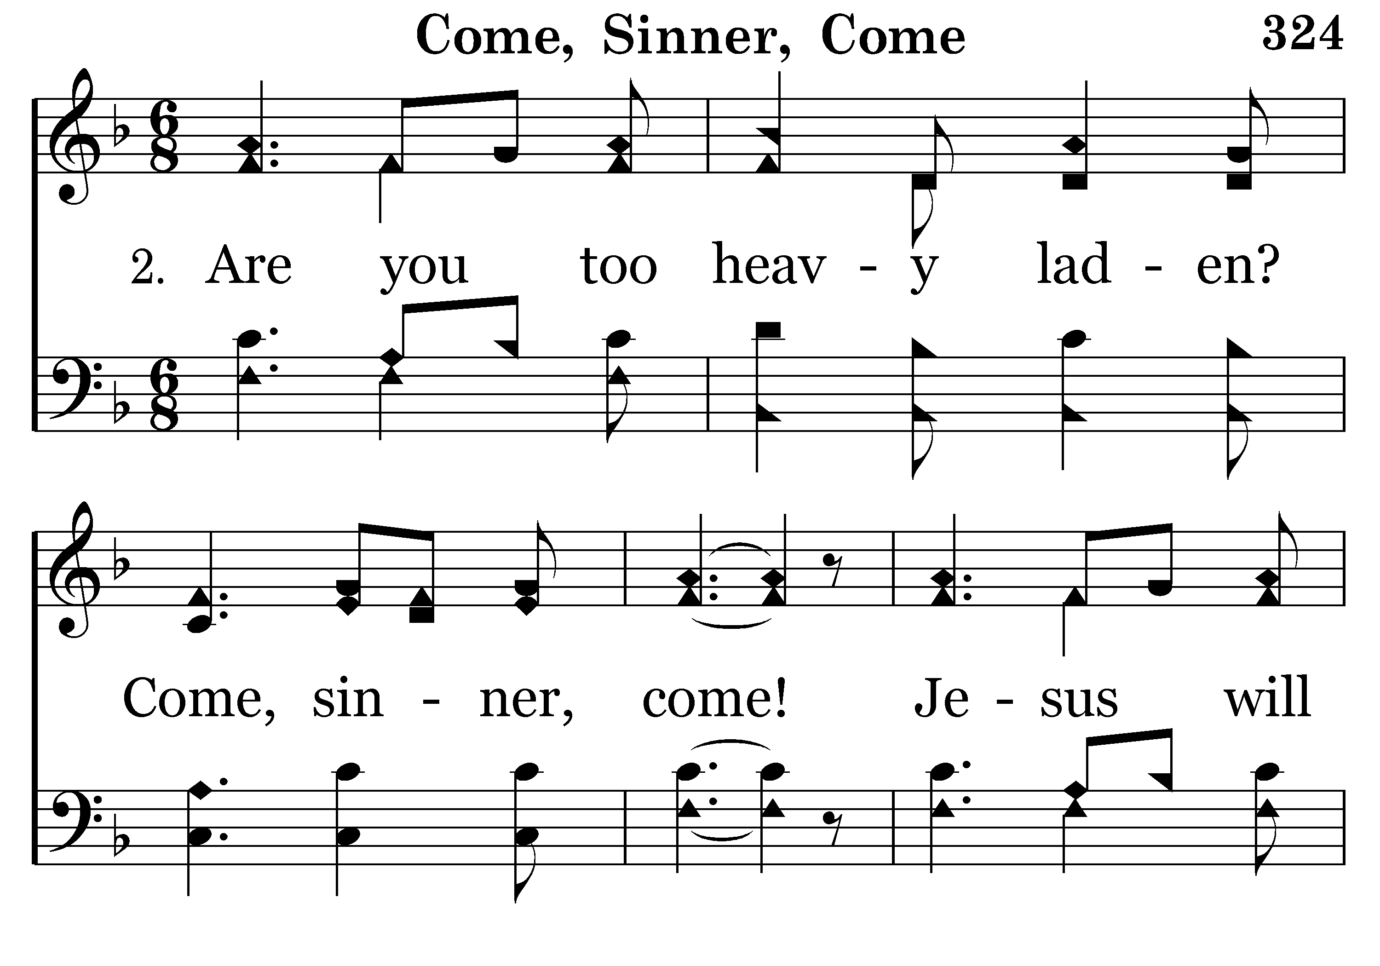
324 - Come, Sinner, Come - 2.1

Slide 69
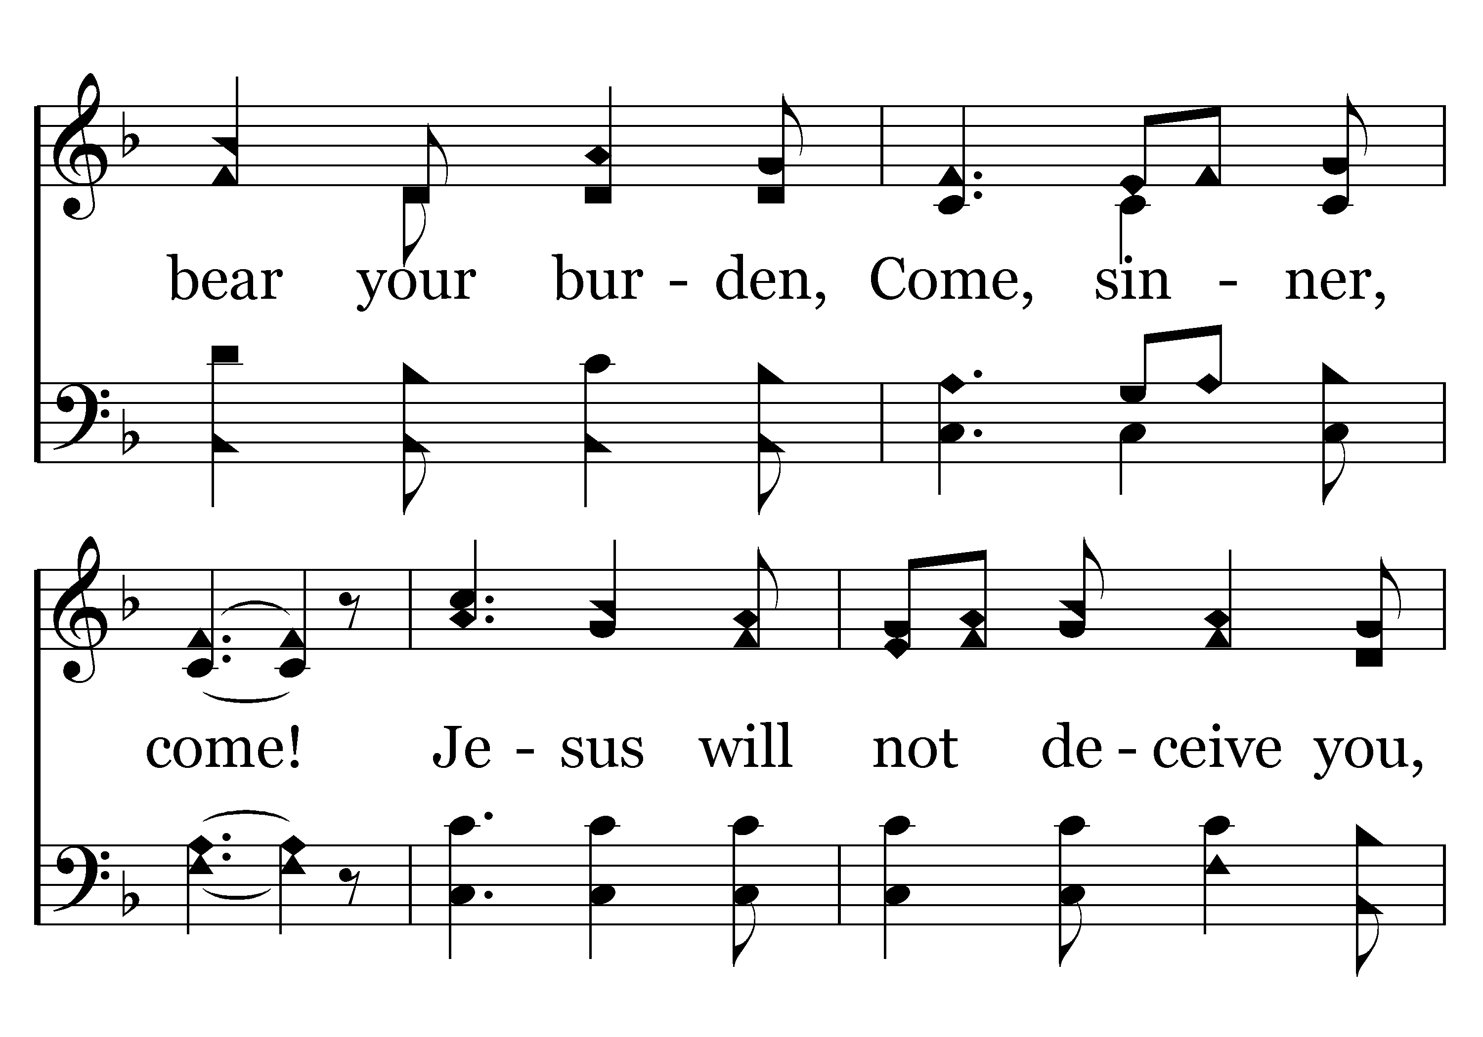
324 - Come, Sinner, Come - 2.2

Slide 70
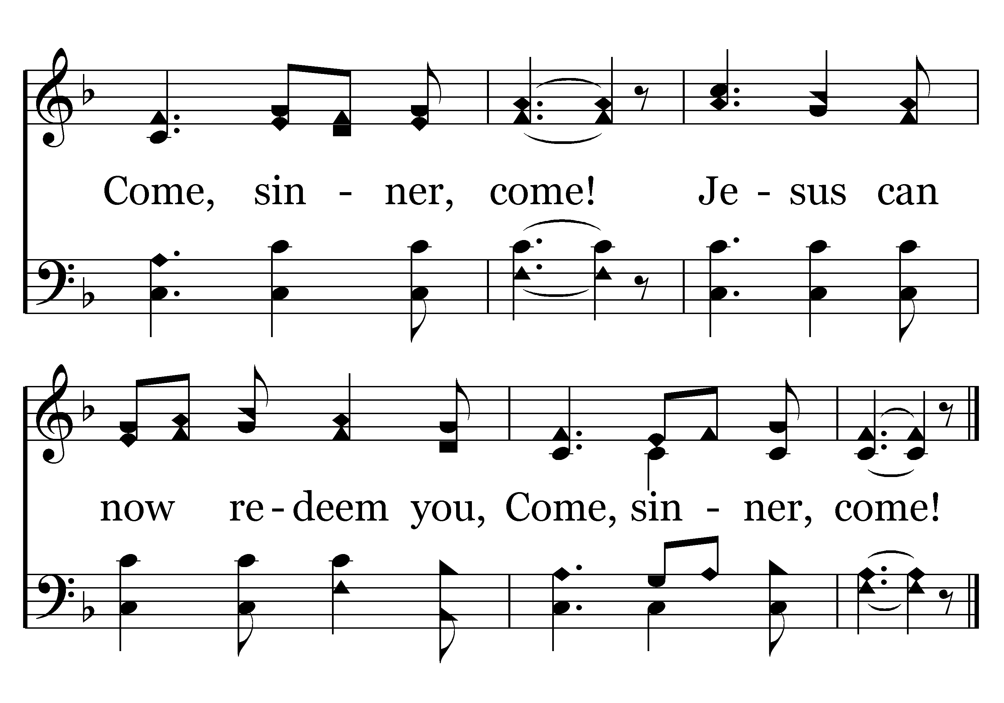
324 - Come, Sinner, Come - 2.3
End of Verse 2

Slide 71
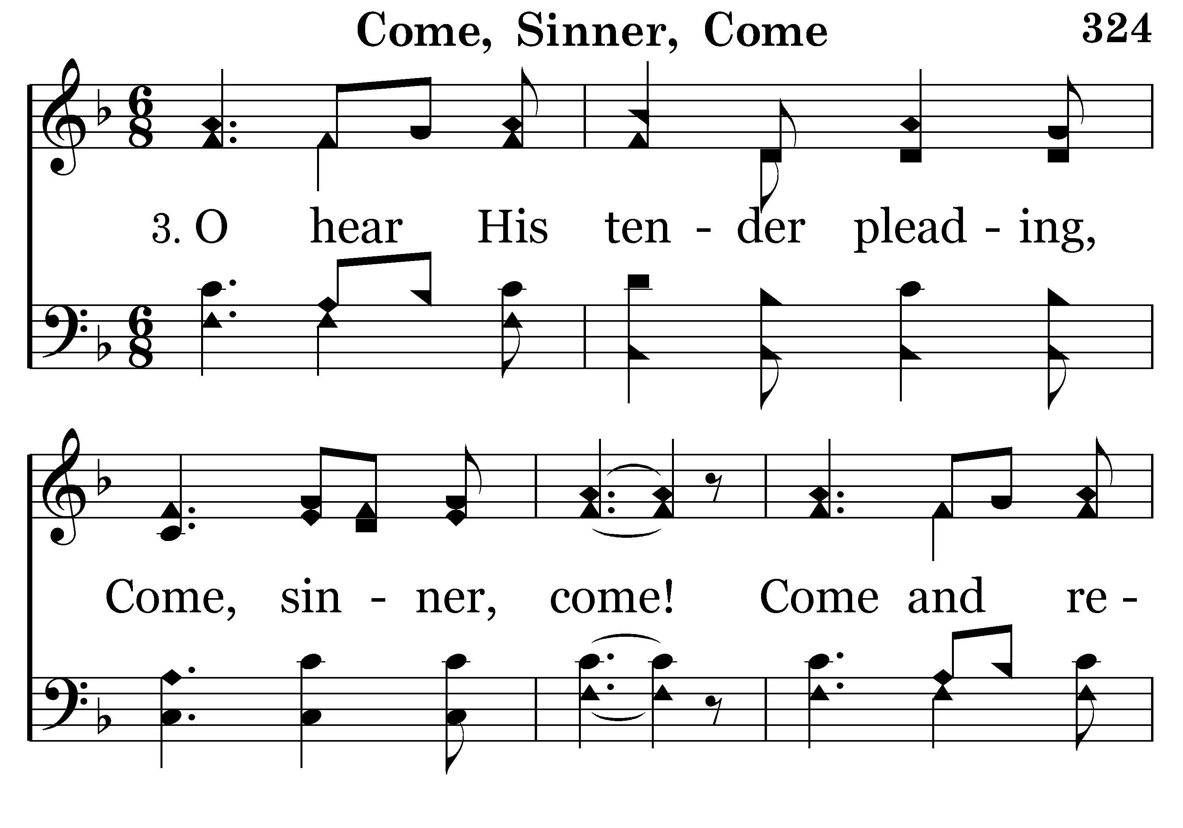
324 - Come, Sinner, Come - 3.1

Slide 72
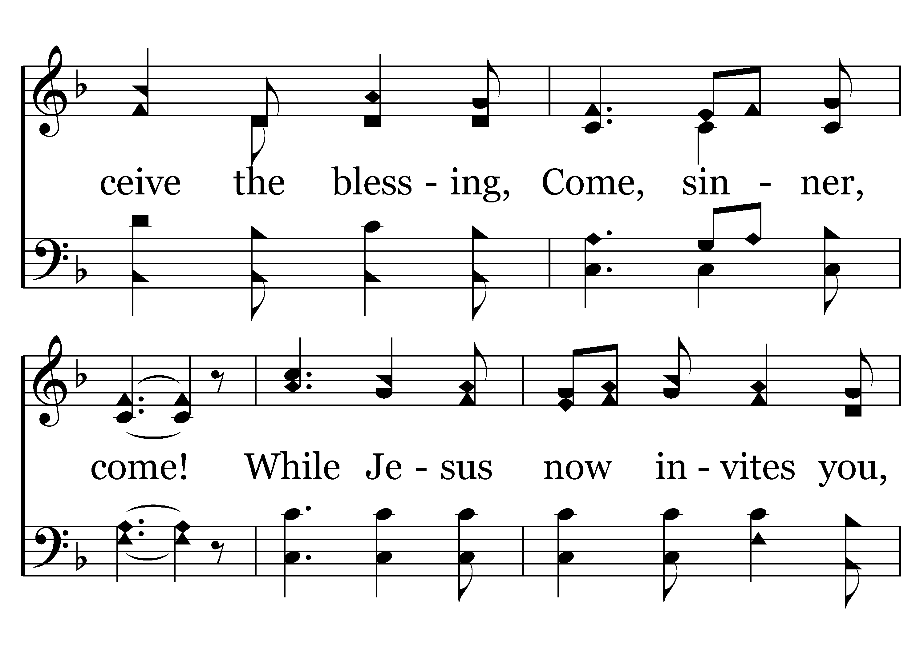
324 - Come, Sinner, Come - 3.2

Slide 73
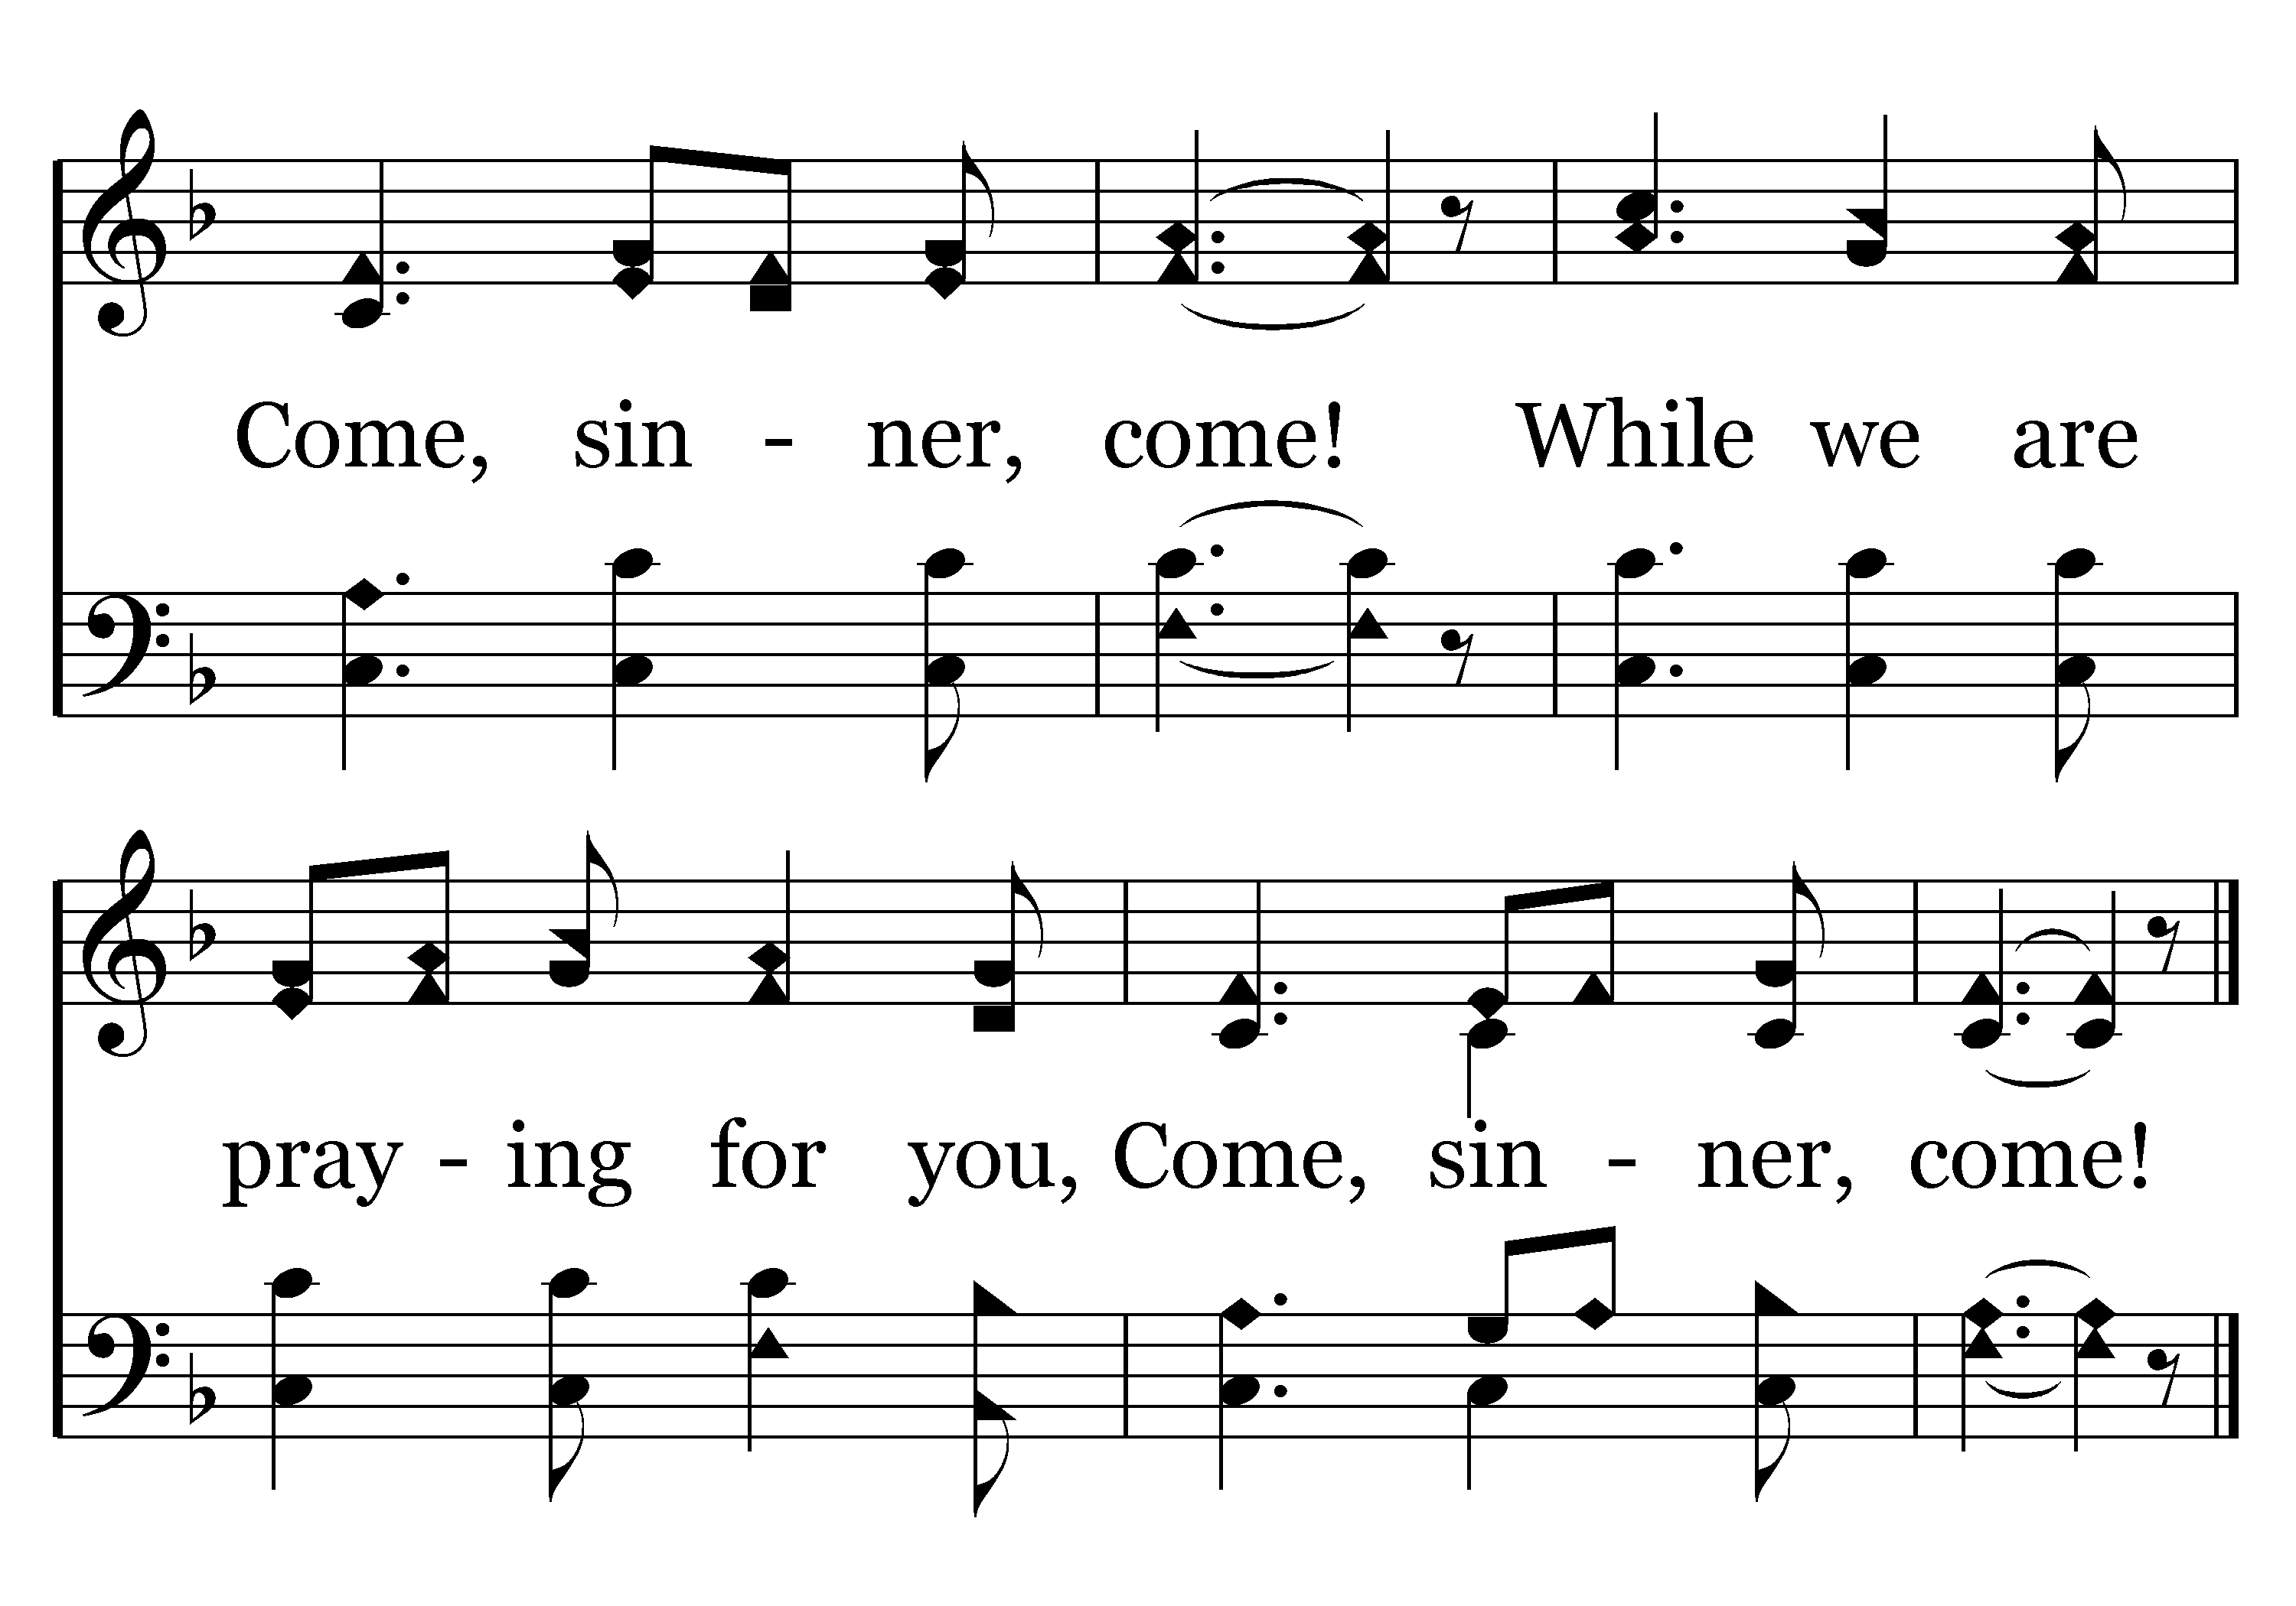
324 - Come, Sinner, Come - 3.3
End of Song

