Slide 1
Wine in the Bible
Sunday
April 2, 2017
6:00 pm

Slide 2
Wine to Water Proportions

Slide 3
Wine to Water Proportions
ISBE
At a later period, however, the Gr use of diluted wines had attained such sway that the writer of 2 Macc speaks (15 39) of undiluted wine as "distasteful" (polémion). This dilution is so normal in the following centuries that the Mish can take it for granted and, indeed, R. Eliezer even forbade saying the table-blessing over undiluted wine (B^{e}rākhōth 7 5). The proportion of water was large, only one-third or one-fourth of the total mixture being wine (Niddāh 2 7; P^{e}ṣāḥīm 108b).

Slide 4
Wine to Water Proportions
2 Maccabees 15:37-39
³⁷ This, then, is how matters turned out with Nica′nor. And from that time the city has been in the possession of the Hebrews. So I too will here end my story. ³⁸ If it is well told and to the point, that is what I myself desired; if it is poorly done and mediocre, that was the best I could do. ³⁹ For just as it is harmful to drink wine alone, or, again, to drink water alone, while wine mixed with water is sweet and delicious and enhances one’s enjoyment, so also the style of the story delights the ears of those who read the work. And here will be the end.

Slide 5
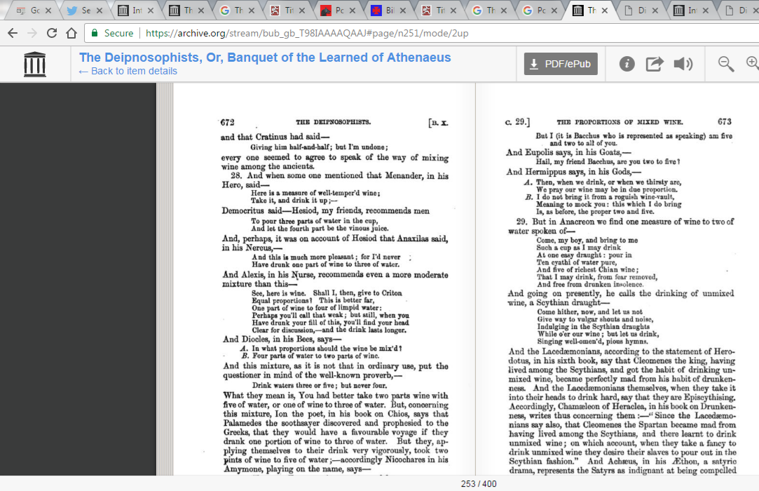
Wine to Water Proportions

Slide 6
Wine to Water Proportions

Slide 7
Wine to Water Proportions

Slide 8
Wine to Water Proportions

Slide 9
Wine to Water Proportions

Slide 10
Even Diluted, Caution Among Christians
1 Titus 2
³ Older women likewise are to be reverent in their behavior, not malicious gossips nor enslaved to much wine, teaching what is good

Slide 11
Even Diluted, Caution Among Christians
1 Timothy 3
⁸ Deacons likewise must be men of dignity, not double-tongued, or addicted to much wine

Slide 12
Even Diluted, Caution Among Christians
1 Timothy 3
² An overseer, then, must be above reproach, the husband of one wife, temperate, prudent, respectable, hospitable, able to teach,
³ not addicted to wine
Pert. to being very moderate in the drinking of an alcoholic beverage, temperate, sober

Slide 13
Even Diluted, Caution Among Christians
1 Timothy 3
¹¹ Women must likewise be dignified, not malicious gossips, but temperate, faithful in all things.

Slide 14
Even Diluted, Caution Among Christians
Titus 2
² Older men are to be temperate, dignified, sensible, sound in faith, in love, in perseverance.

Slide 15
Even Diluted, Caution Among Christians
Romans 14
²¹ It is good not to eat meat or to drink wine, or to do anything by which your brother stumbles.

Slide 16
Even Diluted, Caution Among Christians
1 Timothy 5
²³ No longer drink water exclusively, but use a little wine for the sake of your stomach and your frequent ailments.

Slide 17
Wine in the Bible
Sunday
April 2, 2017
6:00 pm

