Slide 1
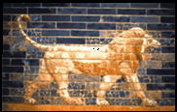
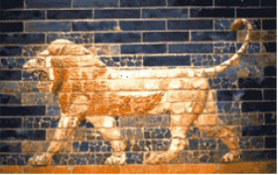
RESPONSES TO
ARGUMENT
OF THE
CRITICS
for a
2nd cent. BC
date
Daniel
Daniel
5th Cent. BC
2nd Cent.BC

Slide 2
Porphory (c.234-305 AD), Grk. Philosopher / author “Against the Christians”
Porphyry wrote his twelfth book against the prophecy of Daniel, (A)
denying that it was composed by the person to whom it is ascribed in its title, but rather by some individual living in Judaea at the time of the Antiochus who was surnamed Epiphanes. He furthermore alleged that "Daniel" did not foretell the future so much as he related the past, and lastly that whatever he spoke of up till the time of Antiochus contained authentic history, whereas anything he may have conjectured beyond that point was false, inasmuch as he would not have foreknown the future. Eusebius, Bishop of Caesarea, made a most able reply to these allegations in three volumes, that is, the eighteenth, nineteenth, and twentieth. Appollinarius did likewise, in a single large book, namely his twenty-sixth.
Jerome (347-420 AD), Commentary on Daniel, Prologue (P. 491) (617-618)
http://infidels.org/library/modern/chris_sandoval/daniel.html

Slide 3
ARGUMENTS for a later date [S.R. Driver]
HISTORICAL issues point to a later date
Not part of the Prophets in the Jewish Canon
Ben Sirach’s silence on Daniel
Neb. taking captives “in the 3rd yr of Jehoiakim” (cf. Jer. 25.9; 36.29)
Use of “Chaldaeans” for “wisemen,” not used in this sense in Babyl. Empire
Belshazzar regarded as King and son of Nebuchadnezzar
Reign of “Darius the Mede” after the fall of Babylon
Dan. 9.2 ref. to Jer. In the “books,” – any such collection not the case in 538
Incorrect explanation of Belteshazzar in 4.8, unless assonance, not etymology.
Improbabilities regarding the 4 Hebrews, Neb. Madness, etc.
LANGUAGE issues point to a later date:
Numerous Persian words in the text (eg.; “satrap”)
3 Greek words in the text
The Aramaic is Western Aramaic, as spoken in Palestine, and is similar to Ezra
The Hebrew is not like Ezek. Or Isaiah, but like Chronicles
THEOLOGY issues like later texts regarding kingdom, named angels, resurrection & judgment)
FOCUS issue on Antiochus: central, surprisingly distinct to a point, then the distinctness ceases

Slide 4
Common Arguments Raised Against Daniel
DANIEL NOT FOUND IN THE PROPHETS
(closed by 200)
Placement Argument
arguments
for dating
Daniel
to the
2nd century (BC)
USE OF GREEK WORDS REQUIRE LATER DATE
Language Argument
NO MENTION IN J. Ben Sirach’s
LIST : 200-175 BC
Silence Argument
Nebuchadnezzar
Belshazzar
Darius
Historical Arguments / 6th century
Reflects & relates hist. to Ant. Epiph.
(up to 11.29).
Unreliable: < & >
Historical Arguments / 2nd century…
Includes, but not ltd. to:
rejection of
miracles & prophecy

Slide 5
Common Arguments Raised Against Daniel
DANIEL NOT FOUND IN THE PROPHETS
(closed by 200)
Placement Argument
arguments
for dating
Daniel
to the
2nd century (BC)
USE OF GREEK WORDS REQUIRE LATER DATE
Language Argument
NO MENTION IN J. Ben Sirach’s
LIST : 200-175 BC
Silence Argument
Nebuchadnezzar
Belshazzar
Darius
Historical Arguments / 6th century
Reflects & relates hist. to Ant. Epiph.
(up to 11.29).
Unreliable: < & >
Historical Arguments / 2nd century…
includes, but not ltd. to:
rejection of
miracles & prophecy

Slide 6
Isaiah
Jeremiah
Lamentations
Ezekiel
Daniel
Hosea
Joel
Amos
Obadiah
Jonah
Micah
Nahum
Habakkuk
Zephaniah
Haggai
Zechariah
Malachi
Joshua
Judges
Ruth
1 Samuel
2 Samuel
1 Kings
2 Kings
1 Chronicles
2 Chronicles
Ezra
Nehemiah
Esther
DANIEL NOT FOUND IN THE PROPHETS
(closed by 200)
Genesis
Exodus
Leviticus
Numbers
Deuteronomy
Job
Psalms
Proverbs
Ecclesiastes
Song of Solomon
What do they mean,
“not in the prophets”
?

Slide 7
The Jewish canon comprises twenty-four books, the five of the Pentateuch, eight books of the Prophets
(Joshua, Judges, Samuel, Kings, Isaiah,
Jeremiah, Ezekiel, the Minor Prophets), and eleven Hagiographa
(Psalms, Proverbs, Job, Song of Solomon, Ruth, Lamentations, Ecclesiastes, Esther, Daniel, Ezra, and Chronicles).
Samuel and Kings form but a single book each, as is seen in Aquila's Greek translation. The "twelve" prophets were known to Ecclus. (Sirach) as one book (xlix. 10), and the separation of Ezra from Nehemiah is not indicated in either the Talmud or the Masorah...
The division of the Prophets into ("Earlier Prophets") and ("Later Prophets) was introduced by the Masorah..
Daniel in the Writings
http://www.jewishencyclopedia.com/
articles/3259-bible-canon.com/articles/3259-bible-canon

Slide 8


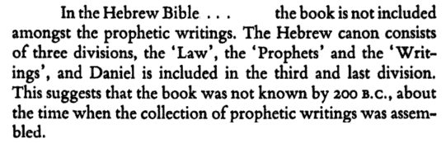
R. Hammer
pg 1
DANIEL NOT FOUND IN THE PROPHETS
(closed by 200)
acc. to critics

Slide 9
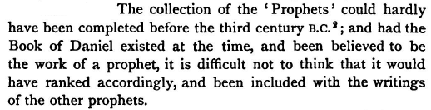
S. R. Driver, The Book of Daniel,
Cambridge, 1900 p. xlviii
The collection of the 'Prophets' could hardly have been completed before the third century B.C.; and
had the Book of Daniel existed at the time, and been believed to be the work of a prophet, it is difficult not to think that it would have ranked accordingly, and been included with the writings of the other prophets.
DANIEL NOT FOUND IN THE PROPHETS
(closed by 200)
acc. to critics

Slide 10
The Jewish canon comprises twenty-four books, the five of the Pentateuch, eight books of the Prophets
(Joshua, Judges, Samuel, Kings, Isaiah,
Jeremiah, Ezekiel, the Minor Prophets), and eleven Hagiographa
(Psalms, Proverbs, Job, Song of Solomon, Ruth, Lamentations, Ecclesiastes, Esther, Daniel, Ezra, and Chronicles).
Samuel and Kings form but a single book each, as is seen in Aquila's Greek translation. The "twelve" prophets were known to Ecclus. (Sirach) as one book (xlix. 10), and the separation of Ezra from Nehemiah is not indicated in either the Talmud or the Masorah...
The division of the Prophets into ("Earlier Prophets") and ("Later Prophets) was introduced by the Masorah..
That is the Hebrew grouping now. But what about earlier?
Daniel in the Writings
http://www.jewishencyclopedia.com/
articles/3259-bible-canon.com/articles/3259-bible-canon

Slide 11

JOSEPHUS Against Apion; Book 1. 8
http://www.gutenberg.org/files/2849/2849-h/2849-h.htm
LEV
NUM
DT
GEN
EX
5+13+4 = 22
For we have not an innumerable multitude of books among us, disagreeing from and contradicting one another, [as the Greeks have,] but only twenty-two books, which contain the records of all the past times; which are justly believed to be divine; and of them
FIVE BELONG TO MOSES, which contain his laws and the traditions of the origin of mankind till his death. This interval of time was little short of three thousand years;
but as to the time from the death of Moses till the reign of Artaxerxes king of Persia, who reigned after Xerxes,
THE PROPHETS, who were after Moses, wrote down what was done in their times in
THIRTEEN BOOKS.
The remaining FOUR BOOKS contain hymns to God, and precepts for the conduct of human life.
Josh
(JudgRuth)
1&2
Sam
1&2
Kings
1&2
Chr
Josh
Judg
Ruth
1&2
Sam
1&2
King
5
regardless-DANIEL
was in the prophets…
Why 22,
not 24?
(A.) JDG/RUTH; JER/LAM;
cf. LXX, Jerome
(B.) exclusion of : Song or Eccl
Yadaim 3.5.
Isa
(Jer
Lam)
Ezek
1&2Chr
The
12
ISA
Dan
the
12
S of
Sol
Ezra
Neh
Est
JER
EZEK
DAN
EZRA NEH
EST.
13
4
PSA
PRO
Eccl?
Job?
Eccl?
Song?

Slide 12
ppp
JOSEPHUS Antiquities of the Jews Book X
Josephus:
Daniel
in the prophets
CHAPTER 10.
CONCERNING DANIEL AND WHAT BEFELL HIM AT BABYLON,
BUT now Nebuchadnezzar, king of Babylon, took some of the most noble of the Jews …
among these there were four of the family of Zedekiah, of most excellent dispositions,
one of whom was called Daniel…
CHAPTER 11.
… we believe that Daniel conversed with God; for he did not only prophesy of future events, as did the other prophets, but he also determined the time of their accomplishment.
…..And indeed it so came to pass, that our nation suffered these things under Antiochus
Epiphanes, according to Daniel's vision, and what he wrote many years before they came to
pass. In the very same manner Daniel also wrote concerning the Roman government, and
that our country should be made desolate by them. All these things did this man leave in
writing, as God had showed them to him, insomuch that such as read his prophecies, and
see how they have been fulfilled, would wonder at the honor wherewith God honored Daniel
http://www.ccel.org/j/josephus/works/ant-10.htm

Slide 13
MELITO OF SARDIS -c.170 (as cited by Eusebius)
12. …the same writer gives at the beginning of the introduction a catalogue of the acknowledged books of the Old Testament, which it is necessary to quote at this point. He writes as follows:
13. “Melito to his brother Onesimus, greeting …
14. …when I went East and came to the place where these things were preached and done, I learned accurately the books of the Old Testament, and send them to thee as written below. Their names are as follows: Of Moses, five books: Genesis, Exodus, Numbers, Leviticus, Deuteronomy; Jesus Nave, Judges, Ruth; of Kings, four books; of Chronicles, two; the Psalms of David, the Proverbs of Solomon, Wisdom also, Ecclesiastes, Song of Songs, Job; OF PROPHETS, ISAIAH, JEREMIAH; OF THE TWELVE PROPHETS, ONE BOOK; DANIEL, EZEKIEL, ESDRAS. From which also I have made the extracts, dividing them into six books.” Such are the words of Melito.
O.T. canon list preserved in Eusebius, Ecclesiastical History iv. 26
https://www.ccel.org/ccel/schaff/npnf201.iii.ix.xxvi.html

Slide 14
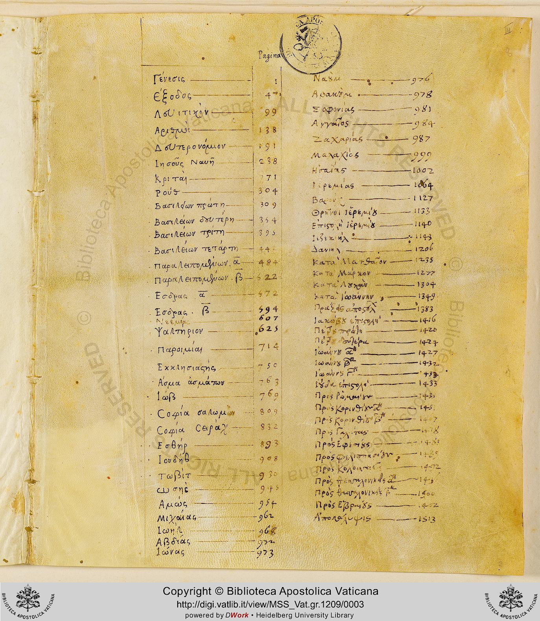

LXX CODEX VATICANUS online: http://digi.vatlib.it/view/MSS_Vat.gr.1209
p. 1-46 Genesis
p. 47-99 Exodus
p. 99-137 Leviticus
p. 138-191 Numeri
p. 191-238 Deuteronomium
p. 238-270 Iosue
p. 271-304 Iudicum
p. 304-309 Ruth
p. 309-394 Samuelis I-II
p. 309-353 Samuelis I
p. 354-394 Samuelis II
p. 395-484 Regum I-II
p. 395-442 Regum I
p. 442-484 Regum II
p. 484-572 Paralipomenon I-II
p. 484-521 Paralipomenon I
p. 522-572 Paralipomenon II
p. 572-594 Esdrae III
p. 594-624 Esdrae II. Septuaginta
p. 625-713 Psalmi
p. 714-749 Proverbia
p. 750-762 Ecclesiastes
p. 763-769 Canticum canticorum
p. 769-809 Iob
p. 809-832 Sapientia
p. 832-893 Ecclesiaticus, praemisso prologo.
p. 832-833 Ecclesiastici prologus
p. 833-893 Ecclesiasticus
p. 893-907 Esther
p. 908-930 Iudith
p. 930-944 Tobias
p. 945-954 Osea
p. 954-962 Amos
p. 962-968 Michaeas
p. 968-972 Ioel
p. 972-973 Abdias
p. 973-976 Ionas
p. 976-978 Nahum
p. 978-981 Habacuc
p. 981-984 Sophonias
p. 984-986 Aggaeus
p. 987-998 Zacharias
p. 999-1002 Malachias
p. 1002-1063 Isaias
p. 1064-1127 Ieremias
p. 1127-1133 Baruch
p. 1133-1139 Lamentationes
p. 1140-1143 Epistola Ieremiae
p. 1143-1206 Ezechiel
p. 1206-1234 Daniel
Ezechiel ---------- 1143
Daniel -------------1206

Slide 15
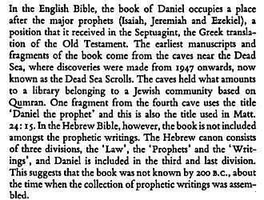
page 1
DSS

Slide 16
MATT. 24.15 ESV
So when you see the abomination of desolation spoken of by the prophet Daniel, standing in the holy place (let the reader understand)

Slide 17
DANIEL
AMONG
THE
PROPHETS
JOSEPHUS 1st Cent.
Jewish Pharisee
MELITO 2nd Cent.
from sources in the east
LXX
DSS
MATT. 24.15

Slide 18
Common Arguments Raised Against Daniel
DANIEL NOT FOUND IN THE PROPHETS
(closed by 200)
Placement Argument
arguments
for dating
Daniel
to the
2nd century (BC)
USE OF GREEK WORDS REQUIRE LATER DATE
Language Argument
NO MENTION IN J. Ben Sirach’s
LIST : 200-175 BC
Silence Argument
Nebuchadnezzar
Belshazzar
Darius
Historical Arguments / 6th century
Reflects & relates hist. to Ant. Epiph.
(up to 11.29).
Unreliable: < & >
Historical Arguments / 2nd century
Rejection of
Miracles & Prophecy

Slide 19
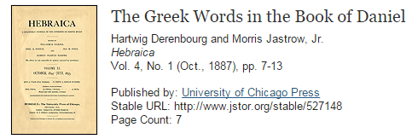
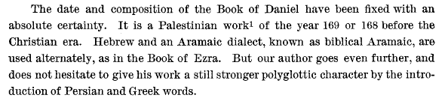
acc.
to critics
http://www.jstor.org/stable/527148?seq=2#page_scan_tab_contents
http://www.jstor.org/stable/527148?seq=2#page_scan_tab_contents
pg 8

Slide 20
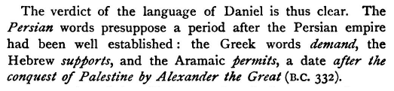
“The Persian words presuppose a period after the Persian empire had been well established: the Greek words demand, the Hebrew supports, and the Aramaic permits, a date after the conquest of Palestine by Alexander the Great (332B.C.)”
The Cambridge Bible for schools and colleges THE BOOK OF DANIEL
- S.R.DRIVER pg. lxii, Cambridge, 1900
acc.
to critics

Slide 21
Farrar; An Exposition of the Bible, Vol. IV; p.360
S.S.Scranton Co. Hartford CN. 1907
the startling fact that it contains at least three Greek words… has always been to me a strong confirmation of the view that the book of Daniel in it’s present form is not older than the days of Antiochus Epiphanes

Slide 22
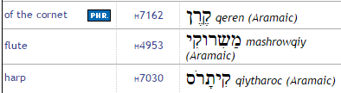
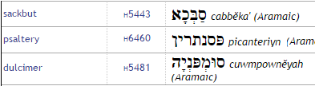

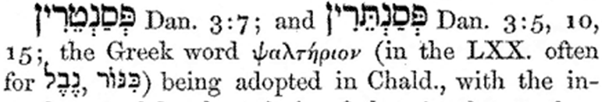
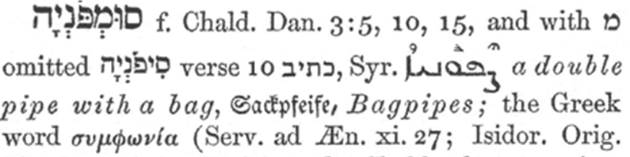
DAN. 3:5 NASB
the moment you hear the sound of
the horn, flute,
lyre,
trigon, psaltery, bagpipe
and all kinds of music,
you are to fall down and worship the golden image
DAN. 3:5 ESV
when you
hear the sound of
the horn, pipe,
lyre,
trigon,
harp, bagpipe,
and every kind of music, you are to fall down and worship the golden image
DAN. 3:5 NKJ
at the time you hear the sound of
the horn,
flute,
harp, lyre, and
psaltery,
in symphony with all kinds of music, and you fall down and worship the image
blueletterbible.org
Gesenius's
Lexicon
translated and edited by S. P. Tregelles in 1847, 1857.
public domain
available online from blueletterbible.org

Slide 23
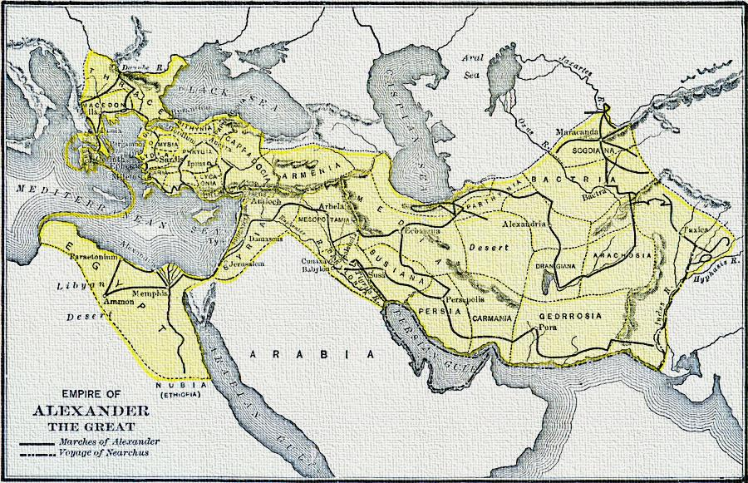
Hellenism was spread by the conquests of Alexander,
But that does not eliminate contact with Greeks earlier
George Willis Botsford, Ph. D., A History of Greece (London, : The Macmillan Company, 1912) 316

Slide 24
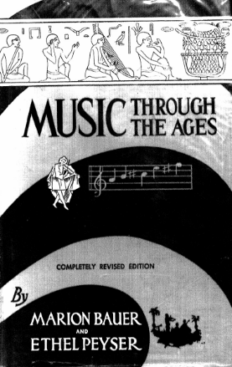

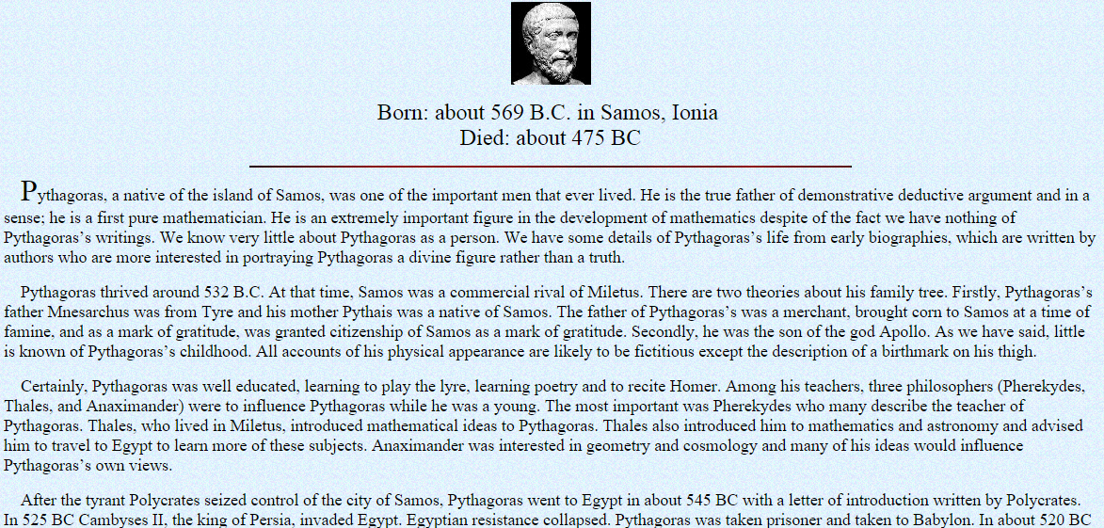
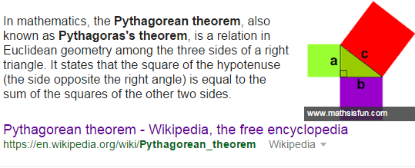
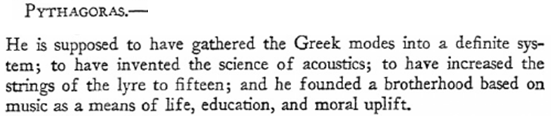
www.personal.kent.edu/~rmuhamma/Philosophy/PhiloHistory/pythagoras.htm
In 525 BC Cambyses II, the king of Persia, invaded Egypt. Egyptian resistance collapsed. Pythagoras was taken prisoner and taken to Babylon.

Slide 25
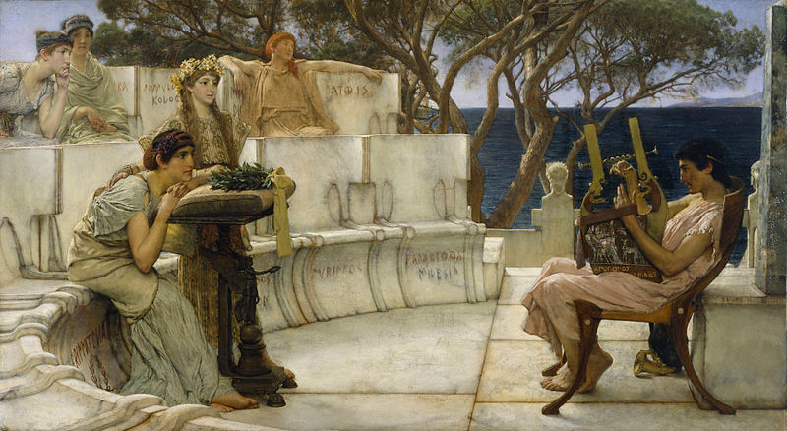
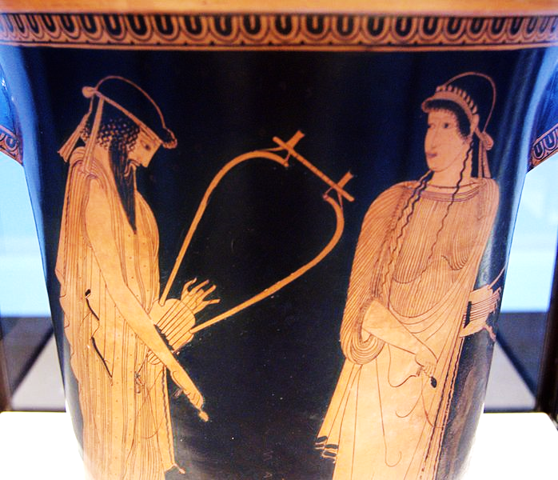
older brother:
ANTIMENIDAS
Alcaeus of Mytilene
(c. 620 – 6th century BC), Greek lyric poet
“Sappho and Alcaeus” by Lawrence Alma-Tadema , Walters Art Museum, 1881
Public Domain / commons.wikimedia.org/w/index.php?curid=18843435
Alcaeus & Sappho, Attic red-figure kalathos, c. 470 BC, Staatliche Antikensammlungen (Inv. 2416)

Slide 26
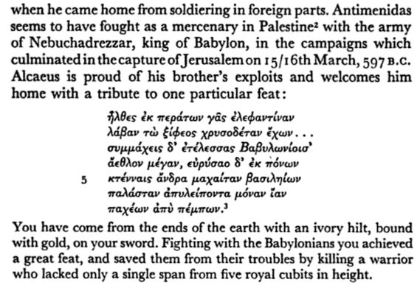
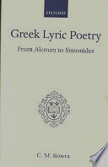
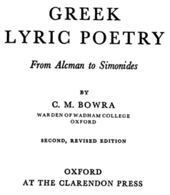
older brother:
ANTIMENIDAS
https://books.google.com/books?id=xiysUGc2EdoC&pg=PA139&lpg=PA139&dq=antimenidas+giant&source=bl&ots=YJPspa402B&sig=tmIMHdpZHwkR0H7JRGrdfpLI9Lw&hl=en&sa=X&ved=0ahUKEwjM79qK7_3KAhVMGx4KHSXDCukQ6AEIKDAC#v=onepage&q&f=false

Slide 27
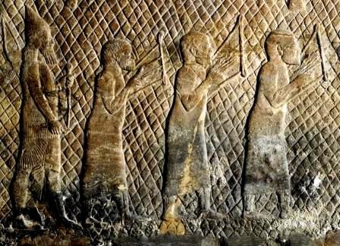

One of the perks of power is to collect trophies from beyond
Solomon:
1 Kings 10.22
ln the 8th century BC, Sennacherib carried off male and female musicians from Jerusalem as part of the spoils of war, while Psalm 137:1-3 bears witness to the Babylonian demand for “songs of Zion".
Captive musicians stolen by Sennacherib as part of the spoils of war
http://www.bible-archaeology.info/music.htm
Jatin Sindhu

Slide 28
ISBE Book of Daniel
R D Wilson
inscriptions of Sennacherib about his campaigns in Cilicia against the Greek seafarers to which Alexander Poly-histor and Abydenus had referred, telling about his having carried many Greeks captive to Nineveh about 700 BC
http://www.internationalstandardbible.com/D/daniel-book-of.html

Slide 29
Psa. 137.1-3 ESV
By the waters of Babylon,
there we sat down and wept,
when we remembered Zion.
On the willows there we hung up our lyres.
For there our captors required of us songs,
and our tormentors, mirth, saying,
“Sing us one of the songs of Zion!”

Slide 30
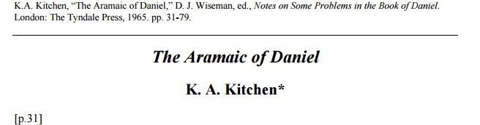
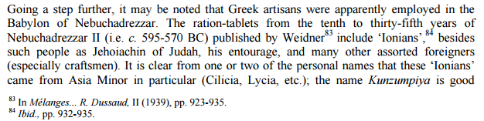

http://www.biblicalstudies.org.uk/pdf/daniel_kitchen.pdf
RATION TABLETS
from Nebuchadrezzer’s
reign included:
“IONIANS”

Slide 31
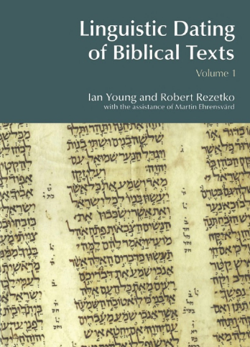
“it is generally accepted among contemporary scholars, contrary to S.R. Driver’s insistence, that Greek linguistic elements in Biblical texts do not demand a date in the Hellenistic period, but theoretically could have come into Hebrew from any period…
In the century since S. R. Driver’s emphatic statement of the chronological linkage of Greek loanwords to the Hellenistic era, it is evident that the scholarly consensus has moved away from such a conclusion. On the contrary, those scholars who find Greek loanwords in BH have commonly placed them in an earlier period, in what they considered earlier sources (12). It is widely acknowledged that cultural interaction with Greeks was not limited to a late period. Therefore, it seems safe to conclude, that if there are Greek loanwords in BH, they do not have any clear chronological implications for the texts in which they are found.”
Linguistic Dating of Biblical Texts:, Volume 1
By Ian Young, Robert Rezetko

Slide 32
ARGUMENT
OF THE
CRITICS:
the age of the instrument names…
So what about
that “later” word argument?

Slide 33
Common Arguments Raised Against Daniel
DANIEL NOT FOUND IN THE PROPHETS
(closed by 200)
Placement Argument
arguments
for dating
Daniel
to the
2nd century (BC)
USE OF GREEK WORDS REQUIRE LATER DATE
Language Argument
NO MENTION IN J. Ben Sirach’s
LIST : 200-175 BC
Silence Argument
Nebuchadnezzar
Belshazzar
Darius
Historical Arguments / 6th century
Reflects & relates hist. to Ant. Epiph.
(up to 11.29).
Unreliable: < & >
Historical Arguments / 2nd century
Rejection of
Miracles & Prophecy

Slide 34
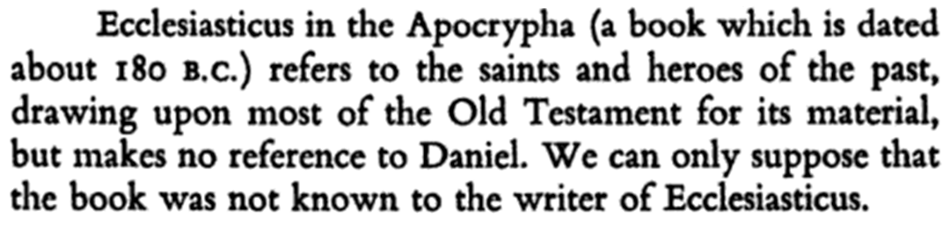
page 1
AKA:
Wisdom of Sirach
Wisdom of
Jesus ben Sirach
Sirach
Ben Sira
Book of the All-Virtuous Wisdom of Joshua ben Sira

Slide 35
acc.
to critics
Driver [Driv.BD, xivii; see also Lacq.Dan, 7]:
Jesus, the son of Sirach (writing c. 200 B.C.), in his enumeration of famous Israelites, Ecclus. xliv--1., though he mentions Isaiah, Jeremiah, Ezekiel, and (collectively) the Twelve Minor Prophets, is silent as to Daniel. In view of the remarkable distinctions attained by Daniel, and the faculties displayed by him, according to the Book, the statement in Ecclus. xlix. 15 that no man had ever been born 'like unto Joseph,' seems certainly to suggest that the writer was unacquainted with the narratives respecting Daniel.
http://www.tektonics.org/af/danieldefense.php

Slide 36
Praise for famous men in Ecclesiasticus (intro; 44:1 ff)
44: 1 Let us now praise famous men, and our fathers that begat us.
2The Lord hath wrought great glory by them through his great power from the beginning.
3Such as did bear rule in their kingdoms, men renowned for their power, giving counsel by their understanding, and declaring prophecies:
4Leaders of the people by their counsels, and by their knowledge of learning meet for the people, wise and eloquent are their instructions:
5Such as found out musical tunes, and recited verses in writing:
6Rich men furnished with ability, living peaceably in their habitations:
7All these were honoured in their generations, and were the glory of their times.
8There be of them, that have left a name behind them, that their praises might be reported.
9And some there be, which have no memorial; who are perished, as though they had never been; and are become as though they had never been born; and their children after them.
10But these were merciful men, whose righteousness hath not been forgotten…

Slide 37
16 Enoch pleased the Lord, and was translated, being an example of repentance to all generations
17 Noah was found perfect and righteous
19 Abraham was a great father of many people
22 With Isaac did he establish likewise… the blessing of all men, and the covenant, And made it rest upon the head of Jacob... among the twelve tribes did he part them.
45:1 he brought out of him a merciful man, which found favour in the sight of all flesh, even Moses
6 He exalted Aaron, an holy man like unto him, even his brother, of the tribe of Levi.
23 The third in glory is Phinees the son of Eleazar
25 According to the covenant made with David son of Jesse
46: 1 Jesus (Joshua) … valiant in the wars, and was the successor of Moses
7 In the time of Moses also he did a work of mercy, he and Caleb the son of Jephunne
11 And concerning the judges
13 Samuel, the prophet of the Lord,
47.1 And after him rose up Nathan to prophesy in the time of David.
2 David chosen out of the children of Israel.
13 Solomon reigned in a peaceable time, and was honoured … (23) and of his seed he left behind him Roboam, even the foolishness of the people,… There was also Jeroboam the son of Nebat, who caused Israel to sin
48.1 Elias (Elijah) … Elias it was, who was covered with a whirlwind: and Eliseus was filled with his spirit:
17 Ezekias (Hezekiah) fortified his city, and brought in water
22 For Ezekias … was strong in the ways of David his father, as Esay the prophet (Isaiah) … had commanded him.
49:1 The remembrance of Josias is like the composition of the perfume
6 They burnt the chosen city of the sanctuary … according to the prophecy of Jeremias.
8 It was Ezekiel who saw the glorious vision, which was shewed him upon the chariot of the cherubims.
10 And of the twelve prophets let the memorial be blessed
11 How shall we magnify Zorobabel?
12 So was Jesus (Joshua) the son of Josedec: who in their time builded the house
13 And among the elect was Neemias, whose renown is great, who raised up for us the walls
14 But upon the earth was no man created like Enoch; for he was taken from the earth.
15 Neither was there a young man born like Joseph, a governor of his brethren, a stay of the people, whose bones were regarded of the Lord.
16 Sem and Seth were in great honour among men, and so was Adam above every living thing in creation.

Slide 38
EZEKIEL
(597 / 571 BC)
14.14 even if these three men, Noah, Daniel, and Job, were in it, they would deliver but their own lives by their righteousness, declares the Lord GOD.
REPLY #1
REPLY #2
Abel
Melchizedek
Job
Boaz
Jonathan
EZRA
Mordecai
(almost Joseph)
skipped in orig. chron. review
EZEKIEL
(597 / 571 BC)
28.3
you are indeed
wiser than
Daniel;
no secret
is hidden
from you

Slide 39
Enoch
Noah
Abraham
Isaac
Jacob
twelve tribes
Moses
Aaron (of Levi)
Phinees the son of Eleazar
Jesus (Joshua)
Caleb
Judges
Samuel
Nathan
David son of Jesse
Elias (Elijah)
Ezekias (Hezekiah)
Esay (Isaiah)
Josias
Jeremias
Ezekiel
Twelve Prophets
Zorababel
Jesus (Joshua son of Josedec)
Neemias
Enoch / Joseph / Sem / Seth / Adam
UNKNOWN
IN 50-70
AD?
WISDOM of SIRACH
REPLY #3
Abel
Enoch
Noah
Abraham & Sarah
Isaac
Jacob (& Esau)
Joseph (& sons)
Moses’ parents
Moses
(Joshua) by deed not name
Rahab
Gideon
Barak
Samson
Jepthah
David
Samuel
the prophets
(Daniel) by deed not name
(Sh. Mesh. & Abed) deed not name
Etc
(Isaiah)
Elsewhere:
(Melchizedek, Levi, Judah)
UNKNOWN
IN 200-180 BC?
HEBREWS 11

Slide 40
16 Enoch pleased the Lord, and was translated, being an example of repentance to all generations
17 Noah was found perfect and righteous
19 Abraham was a great father of many people
22 With Isaac did he establish likewise… the blessing of all men, and the covenant, And made it rest upon the head of Jacob... among the twelve tribes did he part them.
45:1 he brought out of him a merciful man, which found favour in the sight of all flesh, even Moses
6 He exalted Aaron, an holy man like unto him, even his brother, of the tribe of Levi.
23 The third in glory is Phinees the son of Eleazar
25 According to the covenant made with David son of Jesse
46: 1 Jesus (Joshua) … valiant in the wars, and was the successor of Moses
7 In the time of Moses also he did a work of mercy, he and Caleb the son of Jephunne
11 And concerning the judges
13 Samuel, the prophet of the Lord,
47.1 And after him rose up Nathan to prophesy in the time of David.
2 David chosen out of the children of Israel.
13 Solomon reigned in a peaceable time, and was honoured … (23) and of his seed he left behind him Roboam, even the foolishness of the people,… There was also Jeroboam the son of Nebat, who caused Israel to sin
48.1 Elias (Elijah) … Elias it was, who was covered with a whirlwind: and Eliseus was filled with his spirit:
17 Ezekias (Hezekiah) fortified his city, and brought in water
22 For Ezekias … was strong in the ways of David his father, as Esay the prophet (Isaiah) … had commanded him.
49:1 The remembrance of Josias is like the composition of the perfume
6 They burnt the chosen city of the sanctuary … according to the prophecy of Jeremias.
8 It was Ezekiel who saw the glorious vision, which was shewed him upon the chariot of the cherubims.
10 And of the twelve prophets let the memorial be blessed
11 How shall we magnify Zorobabel?
12 So was Jesus (Joshua) the son of Josedec: who in their time builded the house
13 And among the elect was Neemias, whose renown is great, who raised up for us the walls
Of Joseph, what is it that he focuses on? His being captive in a foreign land?
His visions? Interpreting dreams?
No. That’s not the focus.
Instead, this is what he specifies :
14 But upon the earth was no man created like Enoch; for he was taken from the earth.
If Daniel had been a known figure,
how could THIS
be said ?
14 But upon the earth was no man created like Enoch; for he was taken from the earth.
15 Neither was there a young man born like Joseph, a governor of his brethren, a stay of the people, whose bones were regarded of the Lord.
16 Sem and Seth were in great honour among men, and so was Adam above every living thing in creation.

Slide 41
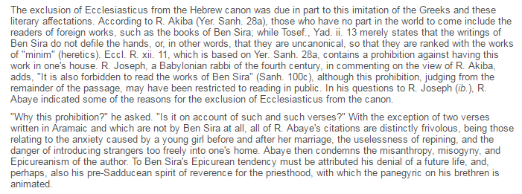
Jewishencyclopedia.com
Motive?

Slide 42
Common Arguments Raised Against Daniel
DANIEL NOT FOUND IN THE PROPHETS
(closed by 200)
Placement Argument
arguments
for dating
Daniel
to the
2nd century (BC)
USE OF GREEK WORDS REQUIRE LATER DATE
Language Argument
NO MENTION IN J. Ben Sirach’s
LIST : 200-175 BC
Silence Argument
Nebuchadnezzar
Belshazzar
Darius
Historical Arguments / 6th century
Reflects & relates hist. to Ant. Epiph.
(up to 11.29).
Unreliable: < & >
Historical Arguments / 2nd century
Rejection of
Miracles & Prophecy

Slide 43
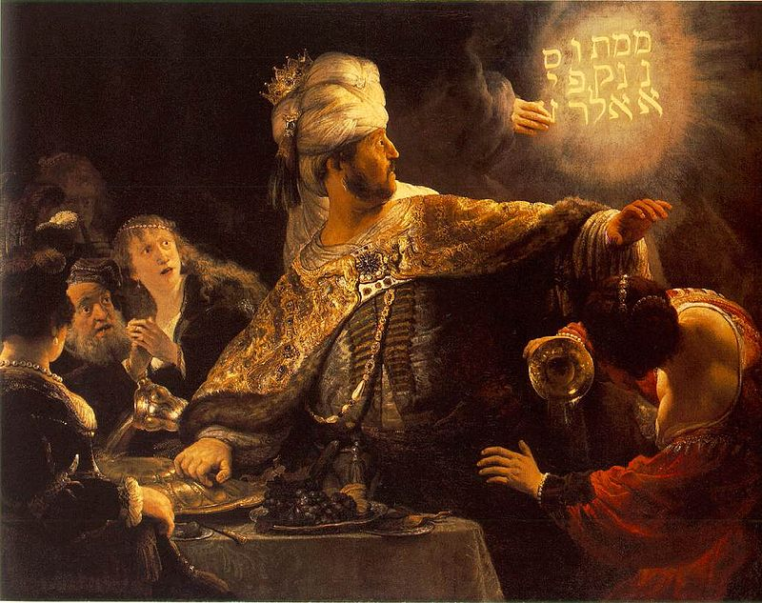
p
BELSHAZZAR
KING?
Son of Nebuch.?
Rembrandt - Web Gallery of Art: Image Info about artwork, Public Domain, https://commons.wikimedia.org/w/index.php?curid=15417265

Slide 44
Dan.5.1 ESV
“Belshazzar the King made a feast” -
Dan.5.30 ESV
“In that night, Belshazzar the Chaldean King was slain”

Slide 45
- Hammer -Driver
Belshazzar … was the son of Nabonidus (Nabuna’id). He was heir to the throne and may have acted as regent in his father’s absence, but
he was never actually king (despite Dan. 5:1-30; 8:1)
“Belshazzar is represented as king of Babylon…
In point of fact…
Nabu-na’id”
[Nabonidus -ss]
“was the last king of Babylon”

Slide 46
ISBE / BELSHAZZAR:
That the city of Babylon alone was sometimes at least governed by an official called king is highly probable,
since the father of Nergal-har-ucur is certainly, and the father of Nabunaid I is probably, called king of Babylon,
in both of which cases, the city, or at most the province, of Babylon must have been meant, since we know to a certainty all of the kings who had been ruling over the empire of Babylon since 626 BC … and the names of neither of these fathers of kings is found among them.

Slide 47
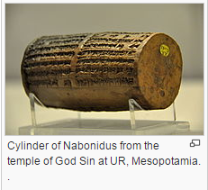
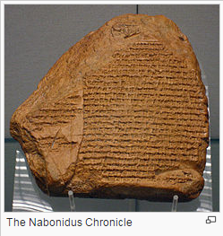
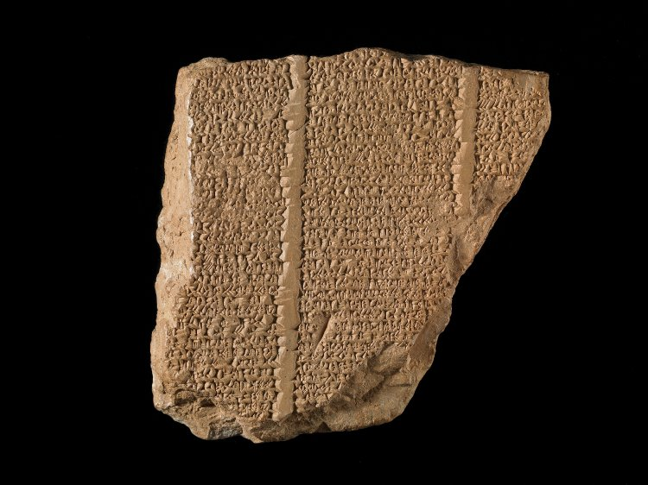
Creative Commons Attribution-Share Alike 3.0 Unported license.
Verse Account of Nabonidus c 539 BC
britishmuseum.org / acquired 1880
As for me, Nabonidus, king of Babylon … grant me as a present a life long of days, and as for Belshazzar, the eldest son - my offspring - instill reverence for your great godhead in his heart … may he be sated with a life of plenitude.
6th c. BC
Acquired by British Museum in 1879
He entrusted the 'Camp' to his oldest (son), the firstborn […], the troops everywhere in the country he ordered under his (command). He let (everything) go, entrusted the kingship to him and, himself, he […] started out for a long journey, the (military) forces of Akkad marching with him; he turned towards Tema (deep) in the west.”
"The king (was) in Tema (while) the prince, the officers, and his army (were) in Akkad [Babylonia]."
tr. By Paul-Alain Neaulieu livius.org/sources/content/nabonidus-cylinder-from-ur/
Grayson, Albert Kirk (1975). Assyrian and Babylonian Chronicles. Winona Lake, IN: Eisenbrauns. p. 108 / cited at wikipedia article on Belshazzar
Pritchard, James B.; (1969). Ancient Near Eastern Texts Relating to the Old Testament ; Princeton University Press cited at wikipedia / Belshazzar

Slide 48
Dan.5:6-7
Then the king's countenance was changed, and his thoughts troubled him, so that the joints of his loins were loosed, and his knees smote one against another. 7 The king cried aloud to bring in the astrologers, the Chaldeans, and the soothsayers. And the king spake, and said to the wise men of Babylon, Whosoever shall read this writing, and shew me the interpretation thereof, shall be clothed with scarlet, and have a chain of gold about his neck, and SHALL BE THE THIRD RULER IN THE KINGDOM.

Slide 49
p
BELSHAZZAR
KING?
Son of Nebuch.?
Rembrandt - Web Gallery of Art: Image Info about artwork, Public Domain, https://commons.wikimedia.org/w/index.php?curid=15417265

Slide 50
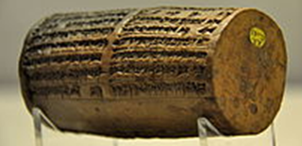
Belshazzar: son of Nebuchadnezzar
DANIEL
5
Belshazzar: son of Nabonidus
?

Slide 51
Dan.5.2 ESV
“Belshazzar... commanded to bring the golden and silver vessels which Nebuchadnezzar his father had taken out of Jerusalem”
Dan.5.11 ESV
“The King Nebuchadnezzar thy father”
Dan.5.18 ESV
“God gave Nebuchadnezzar thy father”

Slide 52
- Hammer p.4 -Driver p.L
One would expect a writer in the sixth century B.C. to be reasonably accurate on major historical events, but such is not the case. Belshazzar is represented as the son of Nebuchadnezzar (Dan. 5:11), although he was the son of Nabonidus (Nabuna’id).
Belshazzar is represented as king … and Nebuchadnezzar is spoken of throughout ch. V…. as his father.
In point of fact… “ Nabu-na’id” [Nabonidus-ss]
“was the last king of Babylon;
he was a usurper, not related to Nebuchanezzar; and his father’s name was Nabu-balatsu-ikbi…
Bel-shar-uzur (i.e., Belshazzar) is mentioned in the inscriptions
as his son”

Slide 53
605: NEBUCHADNEZZAR
> succeeded by his son:
562: EVILMERODACH
> murdered by his brother in law:
560: NERIGLISSOR (also Nebuchadnezzar’s son-in-law)
> succeeded by his young son:
556: Labashi-Marduk (aka Laborosoarchod)
> killed in a conspiracy after 9 mo’s:
Throne usurped by:
556: NABONIDUS:
who left Babylon and entrusts the Kingship to his son: BELSHAZZAR
>> fall: Belshazzar killed in 539 BC./ Nabonidus submits
?

Slide 54
605: NEBUCHADNEZZAR
> succeeded by his son:
562: EVILMERODACH
> murdered by his brother in law:
560: NERIGLISSOR (also Nebuchadnezzar’s son-in-law)
> succeeded by his young son:
556: Labashi-Marduk (aka Laborosoarchod)
> killed in a conspiracy after 9 mo’s:
Throne usurped by:
556: NABONIDUS:
who left Babylon and entrusts the Kingship to his son: BELSHAZZAR
>> fall: Belshazzar killed in 539 BC./ Nabonidus submits

Slide 55
605: NEBUCHADNEZZAR
> succeeded by his son:
562: EVILMERODACH
> murdered by his brother in law:
560: NERIGLISSOR (also Nebuchadnezzar’s son-in-law)
> succeeded by his young son:
556: Labashi-Marduk (aka Laborosoarchod)
> killed in a conspiracy after 9 mo’s:
Throne usurped by:
556: NABONIDUS:
who left Babylon and entrusts the Kingship to his son: BELSHAZZAR
>> fall: Belshazzar killed in 539 BC./ Nabonidus submits
?

Slide 56
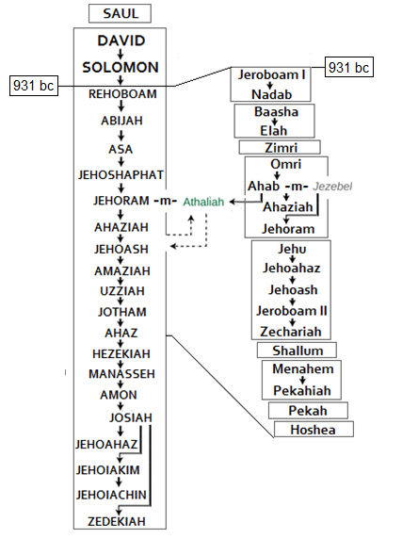


Slide 57
Dan.5

Slide 58
DANIEL 5
King Belshazzar made a great feast for a thousand of his lords…
Belshazzar, when he tasted the wine, commanded that the vessels of gold and of silver that Nebuchadnezzar his father had taken out of the temple in Jerusalem be brought, that the king and his lords, his wives, and his concubines might drink from them.
Then they brought in the golden vessels that had been taken out of the temple, the house of God in Jerusalem, and the king and his lords, his wives, and his concubines drank from them.
They drank wine and praised the gods of gold and silver, bronze, iron, wood, and stone.
Immediately the fingers of a human hand appeared and wrote on the plaster of the wall of the king's palace, opposite the lampstand. And the king saw the hand as it wrote.
Then the king's color changed, and his thoughts alarmed him; his limbs gave way, and his knees knocked together.
The king called loudly to bring in the enchanters, the Chaldeans, and the astrologers. The king declared to the wise men of Babylon, "Whoever reads this writing, and shows me its interpretation, shall be clothed with purple and have a chain of gold around his neck and shall be the third ruler in the kingdom."
Then all the king's wise men came in, but they could not read the writing or make known to the king the interpretation.
Then King Belshazzar was greatly alarmed, and his color changed, and his lords were perplexed.
The queen, because of the words of the king and his lords, came into the banqueting hall, and the queen declared, "O king, live forever! Let not your thoughts alarm you or your color change.
There is a man in your kingdom in whom is the spirit of the holy gods. In the days of your father, light and understanding and wisdom like the wisdom of the gods were found in him, and King Nebuchadnezzar, your father--your father the king--made him chief of the magicians, enchanters, Chaldeans, and astrologers,
because an excellent spirit, knowledge, and understanding to interpret dreams, explain riddles, and solve problems were found in this Daniel, whom the king named Belteshazzar. Now let Daniel be called, and he will show the interpretation."

Slide 59
BELSHAZZAR: Son of Nebuchadnezzar?
Q 2:
Who was NOT at the feast?
Q 1:
Who is with him at the feast?
Who told him about Neb. & Daniel?
Rembrandt - Web Gallery of Art: Image Info about artwork, Public Domain, https://commons.wikimedia.org/w/index.php?curid=15417265

Slide 60
Common Arguments Raised Against Daniel
arguments
for dating
Daniel
to the
2nd century (BC)
Darius the Mede
Historical Arguments / 6th century
Rejection of
Miracles & Prophecy

Slide 61

DARIUS
THE
MEDE

Slide 62
King
Belshazzar

Slide 63
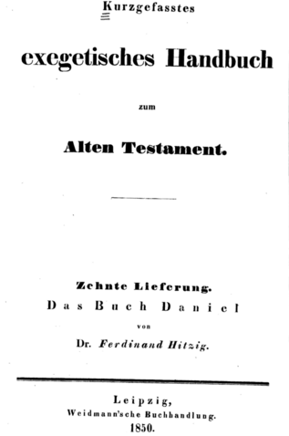
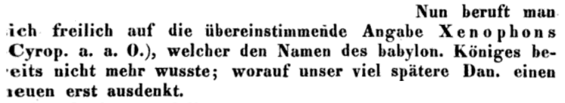
We compare [Daniel] with the matching record of Xenophon, to whom the name of the Babylonian king was already unknown. Whereupon Daniel, much later, invents a new name [=Belshazzar].
— Ferdinand Hitzig 9 tr. By Tim Mitchell http://www.timmitchell.fr/blog/2015/09/16/belshazzar/
Ferdinand Hitzig
Leipzig
1850 p 75
Nun beruft man sich freilich auf die übereinstimmende Angabe Xenophons (Cyrop. a. a. 0.), welcher den Namen des babylon. Königes bereits nicht mehr wusste; worauf unser viel spätere Dan. einen neuen erst ausdenkt
Now you are however refers to providing matching Xenophon (Cyrop. a. a. 0) that's what the name of babylon. King no longer knew; what our much later Dan. only invents a new
.
https://books.google.fr/books?id=qDsCAAAAYAAJ&printsec=frontcover&hl=fr&source=gbs_ge_summary_r&cad=0#v=onepage&q&f=false

Slide 64
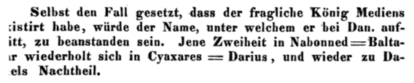
Even supposing that the king of the Medes in question [i.e., Darius; Dan 5:31] had existed, the objection is the name under which he is referenced in Daniel. Each of the two were standardized in Nabonidus = Belshazzar which is repeated in Cyaxares = Darius, to Daniel’s discredit. tr. from wikipedia article on Ferdinand Hitzig
Ferdinand Hitzig
Leipzig
1850 p 77
Selbst den Fall gesetzt, dass der fragliche Konig Mediens existirt habe, wurde der Name, unter welchem er bei Daniel auftritt, zu beanstanden sein. Jene Zweiheit in Nabonned = Baltasar wiederholt sich in Cyaxares = Darius, und wieder zu Daniels nachteil.
Even supposing that the issue of Media Konig had existed, the name under which it occurs in Daniel, be objectionable was. Those duality in Nabonnedus = Baltasar repeats in Cyaxares = Darius, and again Daniel's disadvantage.
https://books.google.fr/books?id=qDsCAAAAYAAJ&printsec=frontcover&hl=fr&source=gbs_ge_summary_r&cad=0#v=onepage&q&f=false

Slide 65

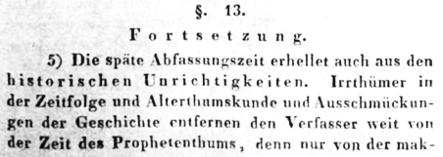
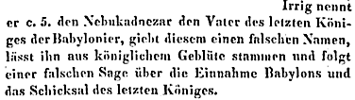
denn nur von der Makkabaischen Zeit berichtet er genan und ausfuhrlich. Zu den historischen Unrichtigkeiten sind aber folgende Angaben zu rechnen because only from the time he reports Makkabaischen Named and ausfuhrlich. The historical inaccuracies but the following details are to be expected
Dr. Caesar von Lengerke
Konigsberg
1835 p Lxiii-lxiv
Irrig nennt er c. 5. den Nebukadnezar den Vater des leizten Konigex der Babylonier, giebt diesem einen falschen Namen,
Erroneously he calls c. 5. Nebuchadnezzar the father of leizten Konigex the Babylonians, gives this a false name
The lateness of its date is clear also through the historical inaccuracies. Errors in chronology and antiquities, and embellishment of the history, remove the author far from the prophetic period. For, only in regard to the Maccabee times, does he give accurate and detailed accounts. … He calls Nebuchadnezzar erroneously the father of the last king, gives that king a false name [=Belshazzar], makes him of royal blood, and follows a false legend as to the capture of Babylon and the fate of the last king.
The translation is that of Edward Pusey, Daniel the prophet : nine lectures delivered in the Divinity School of the University of Oxford ; with copious notes (James Parker, Oxford, 1868) p396.
http://www.timmitchell.fr/blog/2015/09/16/belshazzar/
https://books.google.fr/books?id=KD1VAAAAcAAJ&printsec=frontcover&hl=fr&source=gbs_ge_summary_r&cad=0#v=onepage&q&f=false

Slide 66

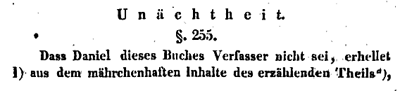
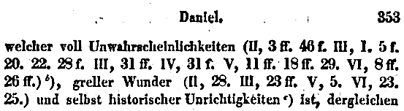

Dass Daniel dieses Buches Verfasser nicht sei, erhellet aus dem mahrchenhaften inhalte des erzahlenden Theila
That Daniel was not this book author , appears from the content of mahrchenhasten erzahlenden Theila
Wilhelm de Wette
BERLIN
1840
Welcher voll Unwahrscheinlichkeiten
Which fully improbabilities
Greller wunder
Flash miracles
Und selbst historischer unrichtigkeiten
And of historical uncorrectness
That Daniel is not the author of this book is clear, out of the fabulous contents of the historical portion, which is full of improbabilities … of monstrous miracles … and even of historical incorrectnesses … Belshazzar, son of Nebuchadnezzar, last king of Babylon … contrary to Berosus in Jos. c. Ap. i. 20.).
The translation is that of Edward Pusey, Daniel the prophet : nine lectures delivered in the Divinity School of the University of Oxford ; with copious notes (James Parker, Oxford, 1868) p396.
http://www.timmitchell.fr/blog/2015/09/16/belshazzar/
Belsazar, sohn Nebucadnezars, letzter Konig von Baylon …. Gegen Berosus
Belshazzar, son of Nebuchadnezzar, the last king of Baylon .... Against Berosus
https://books.google.fr/books?id=WkcAAAAAYAAJ&printsec=frontcover&hl=fr&source=gbs_ge_summary_r&cad=0#v=onepage&q&f=false

Slide 67
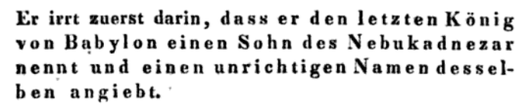
Dr. Caesar von Lengerke
Konigsberg
1835 p 204
Er irrt zuerst darin, dass er den letzten Konig von Babylon einen Sohn des Nebukadnezar nennt und einen unrichtigen Namen desselben angiebt. Um dieses zu erweisen, halten wir uns zuforderst an die nahere Beleuchtung von v. 10 ff.
He errs first is that it is called a son of Nebuchadnezzar the last king of Babylon and angiebt thereof an incorrect name. To prove this, we adhere to the zuforderst more timely illumination of v. 10 ff.
He first of all is mistaken by naming the last king of Babylon as a son of Nebuchadnezzar and gives him an incorrect name [=Belshazzar].
Translation by Tim Mitchell
http://www.timmitchell.fr/blog/2015/09/16/belshazzar/
https://books.google.fr/books?id=KD1VAAAAcAAJ&printsec=frontcover&hl=fr&source=gbs_ge_summary_r&cad=0#v=onepage&q&f=false

Slide 68
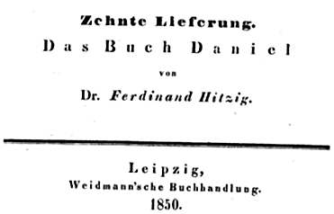

Slide 69
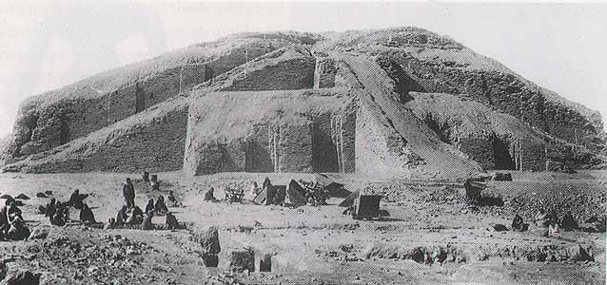
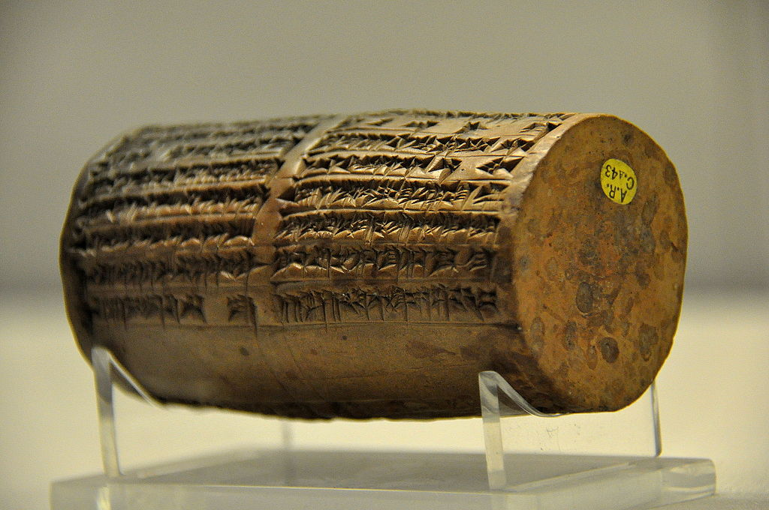
1854
The Nabonidus cylinders are discovered at the
Ziggarut of Ur, which had been rebuilt by King Nabonidus, shortly before the fall of Babylon
1853
John Taylor,
British official
in what is now
known as Iraq,
is commissioned for archaeological digs
ZIGGURAT OF UR
(as it appeared in the 1920’s)
Osama Shukir Muhammed Amin FRCP (Glasg)
Creative Commons Attribution-Share Alike 4.0 International license.
http://www.ancient-wisdom.com/iraqur.htm

Slide 70

As for me, Nabonidus, king of Babylon, save me from sinning against your great godhead and grant me as a present a life long of days, and as for Belshazzar, the eldest son – my offspring - instill reverence for your great godhead in his heart and may he not commit any cultic mistake, may he be sated with a life of plenitude.
Osama Shukir Muhammed Amin FRCP (Glasg)
Creative Commons Attribution-Share Alike 4.0 International license.
-http://www.livius.org/sources/content/nabonidus-cylinder-from-ur/
the spelling differs, not surprising, but the identity is accepted.

Slide 71
FOUND HIM!
BELSHAZZAR

Slide 72
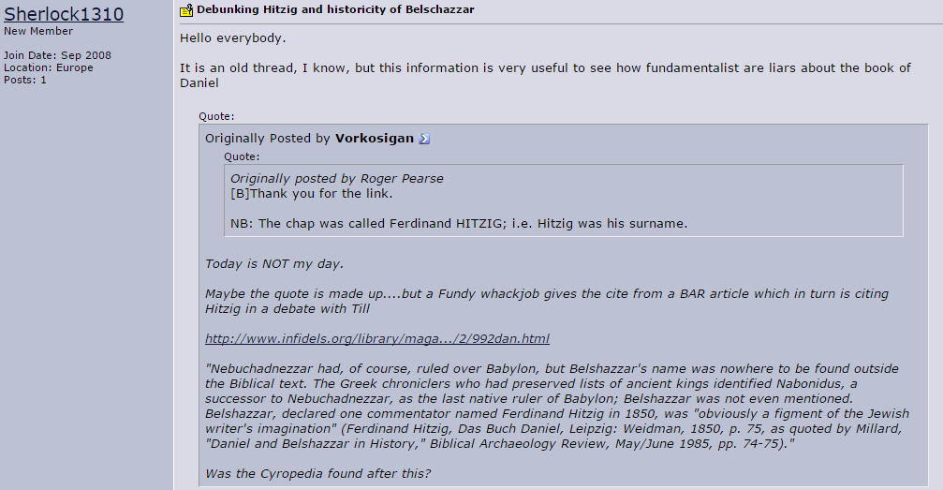
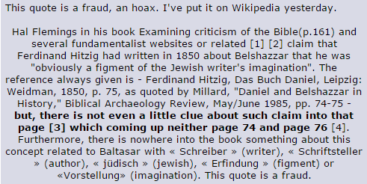

Slide 73
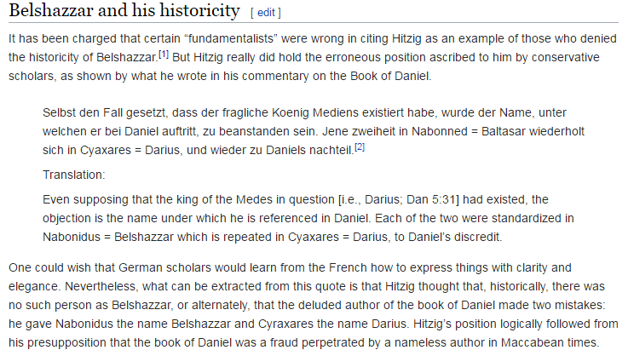

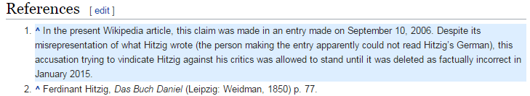

Slide 74

www.britannica.com/biography/Belshazzar

Slide 75
DARIUS
THE
MEDE

Slide 76



Bibliotheca Sacra 173
(July-Sept. 2016); 315-23
Steven D. Anderson and Rodger C. Young online @ http://www.rcyoung.org/articles/darius.pdf

Slide 77


Bibliotheca Sacra 173
(July-Sept. 2016); 315-23
Steven D. Anderson and Rodger C. Young online @ http://www.rcyoung.org/articles/darius.pdf
footnotes / references

Slide 78

http://www.rcyoung.org/articles/darius.pdf
google:
Anderson Young
REMEMBRANCE
OF DARIUS

Slide 79
and now it’s time for…
DANIEL
BEROSSUS
DARIUS
THE
MEDE
?
HARPOCRATION

Slide 80
and now it’s time for…
DARIUS
THE
MEDE
?
HARPOCRATION

Slide 81



485-420 BC ACHAEMENID EMPIRE TIME OF DARIUS I TO XERXES II GOLD AV DARIC NGC AU

Slide 82


Slide 83






Slide 84
and now it’s time for…
BEROSSUS
DARIUS
THE
MEDE
?

Slide 85



BEROSSUS ABYDENUS VALERIUS HARPOCRATION
Babylonian priest Greek Historian Greek Grammarian
active: uncertain date active:
early 3rd cent. BC ~ c. 200 BC 2nd cent. AD

Slide 86
Abydenus on Nebuchadnezzar.
Now when Nebuchadnezzar took power, he built a wall and triple ramparts around Babylon in the space of about 15 days. He then conducted the Armakalen River [away] from the Euphrates and dug a reservoir on the highland above the city of Sippar which was 40 leagues (hrasax) around and 20 fathoms (girk) deep. And he constructed gates which could open and always irrigate the plain. These gates were called E'k'e'tognomonas, to promote [g55] support and enthusiasm for himself. He also built a wall on the shore of the Red Sea [to protect it] from the pounding waves. He built the city of Terendos at the entrance to the Arabs' land. He also decorated the royal court by planting sapling trees, calling this the Hanging Garden. [Abydenus] presents a detailed description of this so-called Hanging Garden. The Greeks, he says, regarded [the Hanging Garden] as [one] of the seven wonders of the world.
In another place the same author has this to say [g56]. In the beginning, he says, everything was water and it was called the sea. Then Belus lowered [? the waters] and distributed the lands to each [nation]. He fortified Babylon by surrounding it with walls, but after the passage of a long time, [the walls] weakened. So Nebuchadnezzar rebuilt them, and they endured until the time of the rule of the Macedonians, together with their bronze gates.
Everything that Abydenus relates is confirmed by what Daniel says. [The book of Daniel, 4:30] describes how Nebuchadnezzar boasted inordinately: "Is not this great Babylon [g57], which I have built by my mighty power as a royal residence and for the glory of my majesty?" This is how Nebuchadnezzar spoke in [the book of] the prophet Daniel, since he regarded his power as proof of his goodness.
Now listen to what Abydenus says [about Nebuchadnezzar] being stronger than Heracles. Here is his account.
Megasthenes says that [g58] Nebuchadnezzar, who was stronger than Heracles, levied troops and went to Libya and Iberia, which he conquered. He took and settled some of them on the fore part of the Black Sea coast. He subsequently relates from the Chaldeans' [accounts] that when he had returned to the royal court, some deity took control of his mind and spoke [through him] in this manner: "Oh brave Babylonians, I, Nebuchadnezzar, I predict that grief [g59] will befall you." He continues on in this vein for a while and then the historian [tells us] that after this eloquent speech he suddenly disappeared from sight. Then [Nebuchadnezzar's] son, Amilmardochus, ruled. The latter was slain by his son-in-law, Niglissarus. [Amilmardochus] left a son named Labossoracus, who also met with a violent [g60] end. Then Nabonedochus was invited to take the throne, although it was certainly not his [by right]. When Cyrus captured Babylon, he granted [Nabonedochus] the marzpanate of the land of Carmania. King Darius partly expelled him from that land.
All this coincides with Hebrew accounts.
For Daniel, in his account of Nebuchadnezzar, relates how he declined mentally. There is really nothing peculiar about the fact that the Greeks or Chaldeans disguised his madness by saying that the gods or a demon (Arm. dew) entered his body and took it over. It is their custom to claim that such things are caused by gods whom they call demons. All this is [from] Abydenus [g61].
http://www.tertullian.org/fathers/eusebius_chronicon_02_text.htm
EUSEBIUS’ CHRONICLE Eusebius of Caesarea, Chronicle, Bk. 1, (2008) Tr. From the Armenian by Robert Bedrosian

Slide 87


“Not only the content, but also the structure and focus of Berossus’ work reminds us of the Babylonian chronographic texts”
R.J. van der Spek
BEROSSUS AS A BABYLONIAN CHRONICLER AND GREEK HISTORIAN
Studies in Ancient Near Eastern World View and Society; Presented to Marte Stol
Bethesda MD CDL 2008, 293
-as cited by Anderson & Young
Babylonian
priest of Marduk
Abridgements
by:
ALEXANDER
POLYHISTOR
(105– 35BC)
&
ABYDENUS
(c. 200 BC?)
“ ”
Josephus
Ag. Apion
“ ”
Vol. 1
Chronicle
of Eusebius
"Cyrus at first treated him [Nabonidus] kindly, and, giving a residence to him in Carmania, sent him out of Babylonia. (But) Darius the king took away some of his province for himself." 13
13 Josef Karst, ed., Die Chronik aus dem Armenischen ilbersetzt mit textkritischem
Commentar, vol. 5 of Eusebius Werke, Die griechischen christlichen Schriftsteller
der ersten drei Jahrhunderte, vol. 20 (Leipzig: J. C. Hinrichs, 1911), 246
cited by Anderson & YOung
BABYLONIACA
3 VOLUMES
BABYLONIACA
3 VOLUMES
BABYLONIACA
3 VOLUMES
abridgements
of
BABYLONIACA
abridgements
of
BABYLONIACA
MEGASTHENES
c.350–c.290 BC
Grk Historian
& ambass. of Seleucus I Nicator
1 of the Diadochi that had served LEXANDER
//\ //]] / //\///
\||\ /[\\//]/\\\\
|[]\/][//[/\\][
][[\/]\\/][//[/\
\][[]\/[\/\/][[\
||\ /[\\//]/\\\\
|[]\/][//[/\\][
][[\/]\\/][//[/\
\][[]\/[\/\/][[\
[[\\]\\]/\//][\//
concurrent w and dedicated to Seleucid Antiochus I
281-261BC
Alx
600 500 400 300 200 100 x 100 200 300

Slide 88

What kind of a work is Eusebius’ Chronicle?
Permit me, right at the outset, to caution everyone against [believing that] there can be complete accuracy with respect to chronology.
[Translated by Robert Bedrosian]
Eusebius' Chronicle
[1] I have perused diverse histories of the past which the Chaldeans and Assyrians have recorded, which the Egyptians [g1] have written in detail, and which the Greeks have narrated as accurately as possible…
about the brave deeds which were performed by barbarians and Greeks, by Aryans and non-Aryans …
I thought it would be appropriate to write down everything in brief, especially the beneficial and important things, and further to put adjacent to [these accounts] the history of the Hebrew patriarchs as revealed in the Bible…
I shall approach the task before me with writings which have come down from the past…
…it is not possible to know unerringly the chronology of the entire world, not from the Greeks, not from the barbarians, not from other [peoples], not even the from the Hebrews
[2] … [And why should I] who so loves the Hebrews point out, in the appropriate places, where I have found inconsistencies [in their accounts]? [I have done it] to reprove the boasting of vainglorious chronographers.

Slide 89
What kind of a work is Eusebius’ Chronicle?
How the Chaldeans chronicled [their past], from Alexander Polyhistor; about their writings and their first kingdom.
Here is what Berosus related in Book One, and in Book Two what he wrote about the kings, one by one….
More apocryphal Chaldean history [taken] from the same book of Alexander Polyhistor about the Chaldeans.
Alexander Polyhistor on the Flood, from the same book we just mentioned.
Alexander Polyhistor on the building of the Tower
From the same Alexander [Polyhistor] on the deeds and valor of Sennecherib and Nebuchadnezzar.
Abydenus on the first Chaldean kings.
Abydenus on Sennacherib.
Abydenus on Nebuchadnezzar.
From Josephus' Antiquities about Nebuchadnezzar
Abydenus on the Assyrian Kingdom.
From the Summary of Castor, on the kingdom of the Assyrians.
From Diodorus' work on the kingdom of the Assyrians
The historian Cephalion on the Assyrian kingdom
Kings of the Assyrians.
Kings of the Medes
Kings of the Lydians
Kings of the Persians
How the Hebrews transmitted [their] chronology.

Slide 90
[22] How the Hebrews transmitted [their] chronology.
We shall set out the chronology of the Hebrews, taken from the writings of Moses and later Hebrew authors, from The Antiquities of the Jews by Flavius Josephus and the chronologies of Africanus.
…
[24] The Septuagint
1. Adam, the first man, was 230 years of age when he fathered Seth. He lived an additional 700 years, until the 135th year of Mahalalel.
2. Seth fathered Enosh when he was 205 years of age. He lived an additional 707 years, until the 20th year of Enoch [g116]
…
10. Noah fathered Shem, Ham, and Japheth when he was 500 years of age. This was 100 years before the flood, which occurred in the 600th year of Noah. He lived an additional 350 years after the flood, until the 83rd year of Eber. [Thus] according to the Septuagint, the full total is 2,242 years [for the period from Adam to the death of Noah].
Now for the Hebrew version of the Jews.
[25] The Jewish [Hebrew Version]
1. Adam fathered Seth when he was 130 years of age. He lived an additional 800 years, until the 56th year of Lamech [g121].
2. Seth fathered Enosh when he was 105 years of age. He lived an additional 807 years, until the 168th year of Lamech.
…
10. Noah fathered Shem, Ham and Japheth when he was 500 years of age, 100 years before the flood. The flood occurred in the 600th year of Noah. He lived an additional 350 years after the flood, until the 58th year of Abraham. The total sum [for this version] is 1656 years.
There is a 586 year discrepancy between this version and the Septuagint….
The Hebrew version of the Samaritans.
[26] The Samaritan [Hebrew Version]
1. Adam fathered Seth when he was 130 years of age. He lived an additional 800 years, until the 223rd year of Noah.
2. Seth fathered Enosh when he was 105 years of age. He lived an additional 807 years, until the 335th year of Noah.
…
10. Noah fathered Shem when he was 500 years of age, 100 years prior to the flood. The flood occurred in the 600th year of Noah. He lived an additional 350 years, until the 83rd year of Eber. The total [for this edition] is 1,307 years.
[The Samaritan Hebrew version] differs from the Jewish Hebrew [version] by 349 years, and from the Septuagint [g128] translation by 935 years.
What kind of a work is Eusebius’ Chronicle?

Slide 91
[21] Kings of the Persians.
1 Cyrus 31 years
2 Cambyses 8 years
3 Smerdis the Mage 7 months
4 Darius, son of Hystaspis 36 years
During his reign the temple in Jerusalem was rebuilt after the first [temple] was burned down by the Babylonians.
5 Xerxes, son of Darius 20 years
6 Artaxerxes(…) Longimanus 41 years
During his reign Ezra and Nehemiah were recognized as leaders of the Hebrews [g104].
7 Darius 7 years
8 Artaxerxes 40 years
7 Ochus 26 years
8 Arses 4 years
8 Darius 7 years
What kind of a work is Eusebius’ Chronicle?
Here’s his Persian list beginning with CYRUS

Slide 92
According to reliable sources, the entire empire of the Assyrians lasted for 1,240 years. Others say that it lasted for 1,300 years. Thonnus Concolerus, who is called Sardanapallus in Greek, was defeated by Arbaces and Belesius and committed suicide by fire. From [Sardanapallus] until the first Olympiad, 40 years elapsed.
Once Arbaces had destroyed Assyrian rule, he designated Belesius as king of the Babylonians. [Arbaces] himself transferred the authority of the Assyrians to the Medes. Here is [a table of] their [kings'] reigns [g100].
[19] Kings of the Medes.
1 Arbaces (Varbak) 28 years
2 Maudaces 20 years
3 Sosarmus 30 years
4 Articas 30 years
5 Deioces 44 years
6 Phraortes 24 years
7 Ciaxares 32 years
8 Astyages (Azhdahak) 38 years
What kind of a work is Eusebius’ Chronicle?
Eusebius is compiling historical records.
He IS NOT trying
to invent or insert a Median King Darius

Slide 93
LOOKING FOR DARIUS THE MEDE:
Reminder of the common possibility of dual names:
Note only in individuals like:
Israel / Jacob; Simon / Peter; Matthew / Levi; Joseph / Barnabas
But also in Kings:
Eliakim / Jehoiakim; Jehoiachin / Coniah; Agrippa / Herod ; Octavius / Augustus
Potential candidates:
Cyaxares :(acc. To Xenophon: Last King of the Medes, son of Astyages, uncle of Cyrus, gave Cyrus the Kingdom as a Dowry)
note exp. In Dan.: according to the laws of the Medes & the Persians
Gobryas (Gubaru) Xenophon: General that took over of Babylon);
Ugbaru? (same or different person?)

Slide 94


OR

Slide 95


On the Relation of Medes & Persians
HERODOTUS
484-425 BC
XENOPHON
430-354 BC
Herodotus contradicts Xenophon at several other points, most notably in the matter of Cyrus’s relationship with the Median Kingdom. Herodotus says that Cyrus led a rebellion against his maternal grandfather, Astyages king of Media, and defeated him, thereafter (improbably) keeping Astyages in his court for the remainder of his life (Histories 1.130). The Medes were thus "reduced to subjection" (1.130) and became "slaves" (1.129) to the Persians 20 years before the capture of Babylon in 539 B.C.
The Cyropaedia relates instead that Astyages died and was succeeded by his son Cyaxares II, the maternal uncle of Cyrus (1.5.2). In the initial campaign against the Lydians, Babylonians and their allies, the Medians were led by Cyaxares and the Persians by Cyrus, who was crown prince of the Persians, since his father was still alive (4.5.17). Xenophon relates that at this time the Medes were the strongest of the kingdoms that opposed the Babylonians (1.5.2).
There is an echo of this statement, verifying Xenophon and contradicting Herodotus, in the Harran Stele, a document from the court of Nabonidus. ^{[11]} In the entry for year 14 or 15 of his reign (542-540 B.C.), Nabonidus speaks of his enemies as the kings of Egypt, the Medes, and the Arabs. There is no mention of the Persians, although according to Herodotus and the current consensus the Medians had been made "slaves" of the Persians several years previously. It does not seem that Nabonidus would be completely misled about who his enemies were, or who was really in control over the Medes and Persians just one to three years before his kingdom fell to their armies. - wikipedia
[11] Pritchard, ed., James B. (1969). Ancient Near Eastern Texts Relating to the Old Testament (3rd ed.). Princeton: Princeton Univ. Press. pp. 562–63.

Slide 96
XENOPHON
Cyropaedia
Book 8
Chap.5:17-20 http://www.gutenberg.org/files/2085/2085.txt
[17] And now when the march had brought them into Media, Cyrus turned
aside to visit Cyaxares. After they had met and embraced, Cyrus began by
telling Cyaxares that a palace in Babylon, and an estate, had been set
aside for him so that he might have a residence of his own whenever he
came there, and he offered him other gifts, most rich and beautiful.
[18] And Cyaxares was glad to take them from his nephew, and then
he sent for his daughter, and she came, carrying a golden crown, and
bracelets, and a necklace of wrought gold, and a most beautiful Median
robe, as splendid as could be. [19] The maiden placed the crown upon the
head of Cyrus, and as she did so Cyaxares said:
"I will give her to you, Cyrus, my own daughter, to be your wife. Your
father wedded the daughter of my father, and you are their son; and this
is the little maid whom you carried in your arms when you were with us
as a lad, and whenever she was asked whom she meant to marry, she would
always answer 'Cyrus.' And for her dowry I will give her the whole of
Media: since I have no lawful son."
[20] So he spoke, and Cyrus answered:
"Cyaxares, I can but thank you myself for all you offer me, the kinship
and the maiden and the gifts, but I must lay the matter before my father
and my mother before I accept, and then we will thank you together."
That was what Cyrus said, but none the less he gave the maiden the gifts
he thought would please her father. And when he had done so, he marched
on home to Persia.

Slide 97


PERSIANS
PERSIANS
MEDES
MEDES
Medes & Persians: portrayed at the Apadana, Persepolis
photo by Bontonbal
GNU Free Documentation License
Creative Commons Attribution-Share Alike 3.0 Unported license. Photo by Aneta Ribarska

Slide 98
Quick note:
Herodotus:
MEDES subjected and slaves 20 yrs before fall of Babylon
Contradicted by inscription:
Around 540/1 (?): Nabonidus lists his most 3 powerful adveraries: INCLUDES THE MEDES
point: Herodotus not reliable here

Slide 99


Can the argument be reversed?
Does lack of Grk. loans prove earlier date?
No.
Qumran Hebrew
Pseudepigrapha from
circa
2nd CENT. BC
Ben Sira

Slide 100

Bibliotheca Sacra 173
(July-Sept. 2016); 315-23
Steven D. Anderson and Rodger C. Young online @ http://www.rcyoung.org/articles/darius.pdf

Slide 101
Bibliotheca Sacra 173
(July-Sept. 2016); 315-23
Steven D. Anderson and Rodger C. Young online @ http://www.rcyoung.org/articles/darius.pdf

Slide 102
Bibliotheca Sacra 173
(July-Sept. 2016); 315-23
Steven D. Anderson and Rodger C. Young online @ http://www.rcyoung.org/articles/darius.pdf
footnotes / references

Slide 103


Keil and Delitzsh
http://www.sacred-texts.com/bib/cmt/kad/dan006.htm

Slide 104

Keil and Delitzsh
http://www.sacred-texts.com/bib/cmt/kad/dan006.htm

Slide 105


BEROSUS
BABYLONIACA / HIST. of BABYLON
Ca. 290-278 BC

Slide 106
Nebuchadnezzar – King of Babylon (605–562 BC)
Belshazzar – Grandson of Nebuchadnezzar, Co-Regent of Babylon with his father Nabonidus (553-539 BC)
Darius – Governor of Babylon under Cyrus (~559 – 530 BC)
Cyrus – King of Persia (559 – 530 BC)
NEBUCHADNEZAR
NEBUCHADNEZZAR 43y
605-562
EVILMERODACH (son of Neb.) 562-560 2y
NERIGLISSOR (Neriglissar) 560-556 4y
son in law of NEB. Killed Evilm. his bro in law
Laborosoarchod/Labashi-Marduk 9 mo young son of Nerigl, killed in consp.
NABONIDUS 17YRS
BELSHAZZAR
DARIUS
CYRUS
reigns of
DARIUS & CYRUS

Slide 107

http://www.livius.org/cg-cm/chronology/canon.html
List of reigns from: Ptolemy's Canon Ptolemy of Alexandria 85-165 AD

Slide 108
OR

Slide 109
XENOPHON
Cyropaedia
Book 8
Chap.5:17-20 http://www.gutenberg.org/files/2085/2085.txt
[17] And now when the march had brought them into Media, Cyrus turned
aside to visit Cyaxares. After they had met and embraced, Cyrus began by
telling Cyaxares that a palace in Babylon, and an estate, had been set
aside for him so that he might have a residence of his own whenever he
came there, and he offered him other gifts, most rich and beautiful.
[18] And Cyaxares was glad to take them from his nephew, and then
he sent for his daughter, and she came, carrying a golden crown, and
bracelets, and a necklace of wrought gold, and a most beautiful Median
robe, as splendid as could be. [19] The maiden placed the crown upon the
head of Cyrus, and as she did so Cyaxares said:
"I will give her to you, Cyrus, my own daughter, to be your wife. Your
father wedded the daughter of my father, and you are their son; and this
is the little maid whom you carried in your arms when you were with us
as a lad, and whenever she was asked whom she meant to marry, she would
always answer 'Cyrus.' And for her dowry I will give her the whole of
Media: since I have no lawful son."
[20] So he spoke, and Cyrus answered:
"Cyaxares, I can but thank you myself for all you offer me, the kinship
and the maiden and the gifts, but I must lay the matter before my father
and my mother before I accept, and then we will thank you together."
That was what Cyrus said, but none the less he gave the maiden the gifts
he thought would please her father. And when he had done so, he marched
on home to Persia.

Slide 110
On the Relation of Medes & Persians
HERODOTUS
484-425 BC
XENOPHON
430-354 BC
Herodotus contradicts Xenophon at several other points, most notably in the matter of Cyrus’s relationship with the Median Kingdom. Herodotus says that Cyrus led a rebellion against his maternal grandfather, Astyages king of Media, and defeated him, thereafter (improbably) keeping Astyages in his court for the remainder of his life (Histories 1.130). The Medes were thus "reduced to subjection" (1.130) and became "slaves" (1.129) to the Persians 20 years before the capture of Babylon in 539 B.C.
The Cyropaedia relates instead that Astyages died and was succeeded by his son Cyaxares II, the maternal uncle of Cyrus (1.5.2). In the initial campaign against the Lydians, Babylonians and their allies, the Medians were led by Cyaxares and the Persians by Cyrus, who was crown prince of the Persians, since his father was still alive (4.5.17). Xenophon relates that at this time the Medes were the strongest of the kingdoms that opposed the Babylonians (1.5.2).
There is an echo of this statement, verifying Xenophon and contradicting Herodotus, in the Harran Stele, a document from the court of Nabonidus. ^{[11]} In the entry for year 14 or 15 of his reign (542-540 B.C.), Nabonidus speaks of his enemies as the kings of Egypt, the Medes, and the Arabs. There is no mention of the Persians, although according to Herodotus and the current consensus the Medians had been made "slaves" of the Persians several years previously. It does not seem that Nabonidus would be completely misled about who his enemies were, or who was really in control over the Medes and Persians just one to three years before his kingdom fell to their armies. - wikipedia
[11] Pritchard, ed., James B. (1969). Ancient Near Eastern Texts Relating to the Old Testament (3rd ed.). Princeton: Princeton Univ. Press. pp. 562–63.

Slide 111
PERSIANS
PERSIANS
MEDES
MEDES
Medes & Persians: portrayed at the Apadana, Persepolis
photo by Bontonbal
GNU Free Documentation License
Creative Commons Attribution-Share Alike 3.0 Unported license. Photo by Aneta Ribarska

Slide 112
Quick note:
Herodotus:
MEDES subjected and slaves 20 yrs before fall of Babylon
Contradicted by inscription:
Around 540/1 (?): Nabonidus lists his most 3 powerful adveraries: INCLUDES THE MEDES
point: Herodotus not reliable here

Slide 113
Keil and Delitzsh
http://www.sacred-texts.com/bib/cmt/kad/dan006.htm

Slide 114


ASSYRIANS
Cyraxres
MEDE 653-585
Nabopolassar
Babylonian
ASTYAGES
585-550
d: AMYTIS
NEBUCHAD.
Cyraxres
gives
K to Cyrus
d: Mandane
Cambyses I
Persian
EVILMERODACH 562-560
NERIGLISSOR 560-556
Labashi-Marduk 9 mo
CYRUS the great born 583 rules 551-530
Nabonidus
“son of nobody” 556--
Deal: Haran to N and Median emp to Cyrus
Belshazzar
CAMBYSES
rules 530-522 (Gore: Xerxes Ezr.4.6)
Pseudo Smernis
Gaumata /Mede (Gore: Artaxerx. Ezr.4.7ff)5
DARIUS the Grt 521-486 eauthorizes temple work
ASSYRIANS
BABYLONIANS
MEDES
PERSIANS
GRK/MACED.

Slide 115
CANON

Slide 116







p
LXX
Table of Contents Codex Alexandrinus
www.symeon-anthony.info/BibleCanon/Alexandrinus/CodexAlexandrinus.html

Slide 117


explanation for placement

Slide 118
LANG

Slide 119
A further argument concerns the age of the words:
Driver states: psalterion was “found first in Aristotle” and sumphonia was “first in Plato, and in the sense of concerted music (or, perhaps, of a specific musical instrument), first in Polybius.” - Driver, lviii.
[time frame note: Aristotle lived 384-322 BC, and Plato lived c. 428/424 -347 BC]

Slide 120
There is also this:
Apollodorus, who around 140 BC said: “the magadis is what we now call psalterion” -Greek Musical Writings, Vol. 1, The Musician and His Art, ed.by Andrew Barker; Cambridge, 1984; p.298
Now the phrase, “what we now call psalterion” could be taken to mean this was a recent term.
But consider: if it was current when Aristotle was say, age 25, then that’s already about 220 years before Apollodorus: “what we now call” psalterion.
So perhaps instead of assuming “psalterion” was a recent word, the point was to explain the identity of the obsolete word, “magadis.”
Compare:
“he that is now called a Prophet was beforetime called a Seer” [1Sam.9.9]: Does that make “prophet” a new word (cf.: 20.7; Ex. 7.1; Dt. 18.15)? Or does it explain the obsolete term “seer”? (cf.: automobiles & car)

Slide 121



Music Through the Ages

Slide 122


https://books.google.com/books?id=42YGAAAAQAAJ&printsec=frontcover#v=onepage&q&f=false

Slide 123
Themistocles b:524 BC Greek General, fought in the Battle of Marathon
From Plutarch’s Parallel Lives, The Life of Themistocles 2.3
Thus it came about that, in after life, at entertainments of a so‑called liberal and polite nature, he was forced to defend himself rather rudely,
saying that tuning the lyre and handling the harp
were no accomplishments of his,
but rather taking in hand a city that was small and inglorious and making it glorious and great.
λέγων, ὅτι λύραν μὲν ἁρμόσασθαι καὶ μεταχειρίσασθαι ψαλτήριον
οὐκ ἐπίσταται
Greek text online at: http://www.perseus.tufts.edu/hopper/text?doc=Plut.+Them.+2.3&fromdoc=Perseus%3Atext%3A2008.01.0074

Slide 124
https://www.academia.edu/10213718/Greek_and_Roman_loanwords_in_Ancient_and_Modern_Hebrew
Greek and Roman loanwords in Ancient and Modern Hebrew -Asher SHAFRIR
The victorious campaign of Alexander the Great in the fourth-century BC linked the East to the West...
The Greek language became a common language for nearer Asia…
The Jewish community in this period was clearly bilingual...
Numerous Greek words entered the Hebrew language. Both the Aramaic and the Hebrew of this period underwent transformation not only in the lexicon –
more than 3,000 Greco-Roman loanwords – but also in phonology, syntax, etc. The loanwords cover all aspects of life …
Q: if well after Alexander, why so few?
3 out of 9001
Rabin 1989

Slide 125
Can the argument be reversed?
Does lack of Grk. loans prove earlier date?
No.
Qumran Hebrew
Pseudepigrapha from
circa
2nd CENT. BC
Ben Sira

Slide 126
Jewish Pseudepigrapha ca. 2nd cent. BC OT Pseudepigrapha, 2V. J. Charlesworth
Testament of the Twelve Patriarchs, 2nd Century BC: “The pervasive use of technical terms for hellenistic piety for which there are no exact counterparts in Hebrew or Aramaic, in addition to the influence of hellenistic romances... points ... to the conclusion that they were originally written in Greek.”
Letter of Aristeas: 3rd Century BC – 1st Century AD: “The original language of Aristeas is Greek”
Jubilees: 2nd Century BC: written in Heb. Tr. Early into Greek, then into Ethiopic, which is where our text comes from. The primary reason for assuming that the Latin and Ethiopic tr’s came via the Greek are the “internal evidence of Greek loanwords, idioms, and obvious mistranslations.”
Prayer of Manasseh: 2nd Cent. BC – 1st Cent. AD: “the position that the prayer was composed in Greek… is defended by many scholars… Other scholars are convinced the original language is Semitic.”
Philo the Epic Poet: 3rd to 2nd cent. BC: “The hexameter verses are written in … obscure Greek”
Orphica: 2nd cent. BC- 1st Cent. AD: “written in archaizing Greek”
Ezekiel the Tragedian: 2nd cent. BC: “text extant in iambic trimeter… commonly used in Greek tragic drama… indicating clearly that Greek was the language in which the author wrote”
Fragments of Pseudo-Grk Poets: 3rd to 2nd c. BC: “in the hellenistic period, Jews composed many works in Greek lit. genre”
Aristobulus: 2nd cent. BC: “no indications that the fragments were written originally in a language other than Greek” Demetrius the Chronographer: 3rd cent. BC: “Greek style… grammatically uncomplex and straightforward”
Aristeas the Exegete ( reconstructs a “Life of Job”) : prior to 1st c. BC: The original language …was certainly Greek”
Eupolemus (on Kings in Judea): prior to 1st cent. BC: “originally composed in Greek”
Pseudo-Eupolemus: prior to 1st cent. BC: “most likely the original language was Greek”
Cleodemus Malchus (desc. Of Abram through Keturah): prior to 1st c. BC: “no linguistic evidence … other than Greek”
Artapanus (Abram , Moses, and Jos. in Egypt): 3rd to 2nd cent. BC: “no reason to suspect that the original language was other than Greek. .. Many points of contact with classical Greek literature as well as the koine of the hellenistic age”
G
G
H
?
G
G
Because of … the influence of Greek upon Semitic languages … and because of the abundant evidence of Greek influence within Palestine, it has become more and more difficult to distinguish between Greek that was translated from a Semitic source and Greek that was composed
Charlesworth, on Pr. Of Manasseh Vol. 2, pg. 627
G
G
G
G
G
g
G
G

Slide 127

Aramaic DSS comparison: Gen. Apoc/ Dan
The Dead Sea Scrolls and Biblical Integrity by Garry K. Brantley, M.A., M.Div.

Slide 128


lyre
bagpipe
harp
Gesenius's
Lexicon
translated and edited by S. P. Tregelles in 1847, 1857.
public domain
available online from blueletterbible.org

Slide 129




Pg.
xxxvi-xxxvii

Slide 130
sumphonia
“In fact, we now know that Pythagoras used this term around 530 B.C.; i.e., about the time of Daniel. If this instrument is a bagpipe then it is also pictured in a Hittite relief at Eyuk (20 miles north of Boghazkoy in central Anatolia); this relief is from the middle of the second millennium B.C.–i.e. 1500 B.C.. What Rowley may be referring to by the words “in this sense” is in terms of a specific musical instrument or an orchestra.
But, it may be that Daniel is NOT using this word to refer to a “specific musical instrument” at all; he may be using it adjectively (“in unison”) which is the meaning of the word in Hymni Homerica, ad Mercurium 51 from the early sixth century B.C. [see the Mitchell and Joyce article, pages 19-27 or Baldwin (1978a): 102; see also the NEB: “concord of sound”; Pusey, 94 note 1 points out that the context of Polybius’ use of the word indicates that it means “concert”]
It has also been pointed out that it could be that this word is a dialectal form of tympanon which dates back to at least the sixth century B.C.. Kitchen notes that it is only “the elementary fallacy of negative evidence” that allows Rowley to claim that this word is first known in the second century B.C. [Kitchen (1965): 47]”
  David Conklin, ‘Evidences Relating to the Date of the Book of Daniel’,2000
  cited @ https://bibleapologetics.wordpress.com/the-book-of-daniel-420/

Slide 131
Check this (loose wikipedia reference):
Three Greek words used within the text have long been considered evidence for a late dating of Daniel. All three are terms for musical instruments: κιθαρις (cithara), ψαλτηριον (psaltery) and συμφωνια (symphonia). The existence of the Greek word symphonia was cited by Rowlings as having its earliest known use in the 2nd century BC, but it has subsequently been shown that Pythagoras, born in the 6th century BC, used the term, while its adjectival use meaning "in unison" is found in the Hymni Homerica, ad Mercurium 51; both instances date from the 6th century BC, the supposed setting of Daniel.

Slide 132
https://www.academia.edu/10213718/Greek_and_Roman_loanwords_in_Ancient_and_Modern_Hebrew
Greek and Roman loanwords in Ancient and Modern Hebrew -Asher SHAFRIR
The victorious campaign of Alexander the Great in the fourth-century BC linked the East to the West. The victory was not simply a political one. Its spiritual influence was much greater. The Greek language became a common language for nearer Asia, and with the language went the culture, the art, and the thought. The influence thus exerted did not entirely drive out the local languages or the civilization. The Jewish community in this period was clearly bilingual and perhaps even trilingual. The texts from this period indicate that there were communities in which Greek was dominant and others in which Aramaic and Hebrew were more central. Numerous Greek words entered the Hebrew language. Both the Aramaic and the Hebrew of this period underwent transformation not only in the lexicon – more than 3,000 Greco-Roman loanwords – but also in phonology, syntax, etc. The loanwords cover all aspects of life …
Q: if well after Alexander, why so few?
There is, however, complete unanimity that Latin was little known, Greek being for nearly a millennium the language of Macedonian, Roman, and Byzantine administrations and many semi-independent cities in Palestine (332 BCE-636 AD). Latin entered the arena with the Roman presence from the first-century BCE onward. Its impact was less than that of Greek, although significant in military vocabulary. Moreover, "Latin" loanwords in Hebrew (dux, matron, Caesar, "legion," "family") were often loanwords already in the Greek from which they had been borrowed. Estimates as to the ratio of Greek to Latin loanwords in rabbinical literature have been as high as one hundred to one …
Hebrew did not undergo a process of modernization for the first time in the nineteenth and twentieth centuries. It did so at least twice in its long history. Once it happened during the period of the Second Temple and the Hellenization of the Middle East that is roughly between 300 BC and 200 AD, just before Hebrew ceased to be spoken… This was done by borrowing hundreds of Graeco-Roman words, as well as by adapting the meanings of existent words and by forming new words. In this process, Hebrew was not alone: similar developments took place in Aramaic and Coptic, and some centuries later in Arabic. In Hebrew, the absorption of the new material was made easier by the contemporary abandonment of later Biblical Hebrew as the written standard and its replacement by Mishnaic Hebrew, a standardized form of the spoken language (Rabin 1989)

Slide 133

http://www.jewishvirtuallibrary.org/rabbinical-knowledge-of-greek-and-latin-languages
Jerusalem in the Time of Jesus, Joachim Jeremias, 1969; pg 64
native assertion which, in Jewish Palestine, led to sporadic condemnations (Meg. 9a) and supposed prohibitions of Greek. Among these, those after 66 C.E. (TJ Shab. 1:6, 3c) and during the "War of Quietus" (116 C.E.; Sot. 9:14, etc. – a prohibition of the use of Greek, which itself employed the Greek loanword polemos for "war"!) are probably real. However the ruling against the use of Greek in 65 B.C.E. because of an incident at the siege of Jerusalem, as cited in the Talmud (Sot. 49b; cf. Jos., Ant., 14:25–8) is probably legendary (although E. Wiesenberg argues that it was probably historical).
Henry Albert Fischel
Source: Encyclopaedia Judaica. © 2008

Slide 134


http://history-world.org/chaldeansneb.htm

Slide 135


older brother:
ANTIMENIDAS
Alcaeus of Mytilene
(c. 620 – 6th century BC), Greek lyric poet
“Sappho and Alcaeus” by Lawrence Alma-Tadema , Walters Art Museum, 1881
Public Domain / commons.wikimedia.org/w/index.php?curid=18843435
Alcaeus & Sappho, Attic red-figure kalathos, c. 470 BC, Staatliche Antikensammlungen (Inv. 2416)

Slide 136



Studies in the Book of Daniel, 2 Volumes: A Classic Defense of the Historicity and Integrity of Daniel's Prophecies, Volume 2

Slide 137
CHRON.

Slide 138
2 Kings 25
DANIEL
&
the
Babylonian
Captivity
2 Chron. 36
Jeremiah 39 ff
deportations:
Jer. 52
Ezk. 1:1; 24:1; 33:21

Slide 139
3 mo
11 YR reign of JEHOIAKIM
2K 23.36
Dan.1.1
3 mo
In his days Neb. came up and Jhkm became his servant 3 yrs
2K24.1
Against
Him came NEB. Bound him in chains to take to Babyl.
Also took part of the temple vessels
2Ch.36.6
11 YR reign of ZEDEKIAH
2K 24.18
23RD YR Jer. 52
Governor: Gedaliah
JEHOIAKIM instl. by Ph.Necho 2K 23.34
JEHOIACHIN inst. 2K 24.6
JEHOAHAZ instl. by people 2CH 36.1
Bands of Chldns, etc., came ag him 2K 24.2
DEATH of JOSIAH 2Ch.36.20ff
JEHOIACHIM rebels 2K 24..1
597 Seige of Jerusalem
Zedekian inst. by Neb. 2K 24.17
587,6 DEST of Jerusalem
18TH YR Jer 52 (19th 2K25.8)
7TH Yr Jer.52 (8th 2K24.12
610 608 606 604 602 600 598 596 594 592 590 588 586 584
23

Slide 140


MOSES
DAVID
FALL OF J
RETURN
J
E
S
U
S
LXX
MASORITES
Aleppo
Codex
4Q DanC

Slide 141
From ISBE: Nebuchadnezzar (bullets & emph. Added)
Nebuchadnezzar succeeded his father on the throne of Babylon in 604 BC, and reigned till 561 BC. He probably commanded the armies of Babylon from 609. BC. At any rate, he was at the head of the army which defeated Pharaoh-necoh at Carchemish on the Euphrates in 605 BC (see 2Ki 23:31; 2Ch 35:20 ff). After having driven Necoh out of Asia and settled the affairs of Syria and Palestine, he was suddenly recalled to Babylon by the death of his father. There he seems quietly to have ascended the throne.
-In the 4th year of Jehoiakim (or 3rd according to the Babylonian manner of reckoning (Da 1:1)), he came up first against Jerusalem and carried away part of the vessels of the temple and a few captives of noble lineage.
-Again, in Jehoiakim's 11th year, he captured Jerusalem, put Jehoiakim, its king, into chains, and probably killed him.
His successor, Jehoiachin, after a three months' reign, was besieged in Jerusalem, captured, deposed, and carried captive to Babylon, where he remained in captivity 37 years until he was set free by Evil-merodach.
In the 9th year of Zedekiah, Nebuchadnezzar made a 4th expedition against Jerusalem which he besieged, captured, and destroyed (see Jer 52:1-34).
In addition to these wars with Judah, Nebuchadnezzar carried on a long siege of Tyre, lasting 13 years, from his 7th to his 20th year. He had at least three wars with Egypt. The first culminated in the defeat of Necoh at Carchemish; the second in the withdrawal of Hophra (Apries) from Palestine in the 1st year of the siege of Jerusalem under Zedekiah; and the third saw the armies of Nebuchadnezzar entering Egypt in triumph and defeating Amasis in Nebuchadnezzar's 37th year.
http://www.internationalstandardbible.com/N/nebuchadnezzar-nebuchadrezzar.html

Slide 142
UNITY

Slide 143





pages 24-26

Slide 144
REC of DAN

Slide 145
Hammer 1976, p. 1-2.
We have evidence, however, that the book was known revered from the middle of the second century B.C. The Sibylline Oracles… contains quotations from the book of Daniel in a section commonly dated to the middle of the 2nd century B.C. The book was also popular with the Qumran community.

Slide 146

page 1,2
“KNOWN
AND
REVERED FROM THE MIDDLE
OF THE
2nd CENTURY B.C.”
Critical comm. R. Hammer

Slide 147


https://books.google.com/books?id=dw1tw9CB_9EC&pg=PA20&lpg=PA20&dq=4Qdanc&source=bl&ots=5AUSLUfirn&sig=8Mf9xB4cAc3EGVde7jRN3WVQSHU&hl=en&sa=X&ved=0ahUKEwitrp6Q05_SAhUIShQKHdT5B0sQ6AEIHzAB#v=onepage&q=4Qdanc&f=false
pg. 19-20

Slide 148


In 1969, based on the evidence available at that time regarding the Qumran Daniel texts, Roland K. Harrison had already concluded that the second century dating of the book of Daniel was “absolutely precluded by the evidence from Qumran, partly because there are no indications whatever that the sectaries compiled any of the Biblical manuscripts recovered from the site, and partly because there would, in the latter event, have been insufficient time for Maccabean compositions to be circulated, venerated, and accepted as canonical Scripture by a Maccabean sect” (Harrison 1969:1127).
The oldest manuscript of Daniel by far is 4QDanc, which Cross dated in 1961 to the “late second century BC” (Cross 1961:43). Scholars who support a date for the writing of the book of Daniel in the Maccabean crisis at about the middle of the second century BC will be able to say that 4QDanc is “only a half century later than the composition of the book of Daniel” (Ulrich 1987:17). This means for supporters of this dating that the manuscript evidence for Daniel is as close to the autograph as the Rylands Papyrus is to the Gospel of John. I quote: “It is thus, for the Hebrew Bible, comparable to the Rylands manuscript of the Johannine Gospel for the New Testament” (Ulrich 1989:3).
Fragments 1 and 2
of 4QDanc
with Daniel
10:5–11:12. IAA
Fragment 3 of 4QDanc
with Daniel 11:13–17, 25–29. IAA
Gerhard Hasel (1935-1994) was Professor of OT & Biblical Theology as well as Dean of the Seventh Day Adv. Theological Seminary.
http://www.biblearchaeology.org/post/2012/07/31/New-Light-on-the-Book-of-Daniel-from-the-Dead-Sea-Scrolls.aspx#Article

Slide 149



pg. 108

Slide 150


Daniel Manuscripts from Qumran. Part 1: A Preliminary Edition of 4 QDan ª
Eugene Ulrich
Bulletin of the American Schools of Oriental Research
No. 268 (Nov., 1987), pp. 17-37
Published by: The American Schools of Oriental Research
Stable URL: http://www.jstor.org/stable/1356992
Photo:
New Light on the Book of Daniel from the Dead Sea Scrolls
by Gerhard Hasel PhD
1992, republished 2012
Fragment 3
4QDan c
2nd CENT
BC
Dan. 11:13–17,
25–29
Photo: http://www.biblearchaeology.org/post/2012/07/31/New-Light-on-the-Book-of-Daniel-from-the-Dead-Sea-Scrolls.aspx

Slide 151

pg 1-2

Slide 152

PROPOSED
DATE
J
E
S
U
S
4Q DanC
597 Fall of Jerusalem
605 Daniel 1:1
RETURN
587 DEST of Jerusalem
TEMPLE REBUILT
FALL OF BABYLON
ALXNDR.
THE GREAT
JULIUS
CEASAR
Medo Persian
Rule
GRK
Maced.
hellenism
ROMAN
RULE
600 550 500 450 400 350 300 250 200 150 100 50 0

Slide 153
QUESTIONS for the critic:
If the book is written in the 160’s (BC), how did it get so widely used that we see multiple copies at Qumran, beginning c. 125?
If the part of the book that predicted what would come next, failed exactly there, why did it receive such quick recognition if it was obviously wrong in what happened next?
If the 2nd and 3rd empires are the Medes and the Persians, why does the book refer to them together in “the laws of the Medes and the Persians?”
Is it just a coincidence that the kingdom of God (according to the NT), came at the time of the 1st century?
Is it just a coincidence that the temple was destroyed, never to be rebuilt again, right in the first century?
If the author is manufacturing names and events, why did he have Belshazzar (thought to be an invented name before the Nabonidas inscriptions came to light) offer Daniel the 3rd place in the kingdom?

Slide 154

The New York Times called it the "no. 1 non-fiction bestseller of the decade."
-Zondervan
30M
20M
10M
1.2 M in its first two years
28 M had sold by 1990
1999:
over 35 million copies.
Christianity Today R.C.Clouse 1999
73 75 77 79 81 83 85 87 89 91 93 95 97 99

Slide 155
Most of what we know about Alexander the great comes from 4 ancient historians, who wrote several hundred years after Alexander died in 323 B.C. They based their mss. on the journals of men who lived and fought alongside the legendary warrior. The historians include Arrian, a Greek author and statesman; Diodorus of Sicily; Curtius Rufus of Rome; and the Greek philosopher Plutarch, the only writer to document Alexander’s boyhood. And devote considerable time to analyzing his character. History Channel Docum. www.youtube.com/watch?v=ORrtZbEMbwY
Arrian
c. 89-146-160 AD
History of the Diadochi or Events after Alexander …
Three extant fragments are the Vatican Palimsest (of the 10th century AD), PSI 12.1284 (Oxyrhynchus), and the Gothenburg palimpsest (of the 10th century also), wikipedia
Curtius
Mid-late 1st cent AD
Historiae survives in 123 codices, or bound manuscripts, all deriving from an original in the 9th century. -Rolfe’s Intro in Delphi Edition
Diodorus
active
60-30
BC
c. 60 MSS. From the 10th to the 16th century (mostly from the 14th to 16th)
http://www.tertullian.org/rpearse/manuscripts/diodorus_sicilus.htm
Plutarch
c46-120 AD
2 mss of the 13th century contain all the “Lives,” and one of the 15th century – these 3 mss of extreme importance
http://penelope.uchicago.edu/Thayer/E/Roman/Texts/Plutarch/Lives/Introduction*.html

Slide 156
ARCH

Slide 157

from www.biblehistory.com

Slide 158

from www.biblehistory.com

Slide 159

from www.biblehistory.com

Slide 160


Cyrus the Great
founder of Achaemenid ( PERSIAN) Empire
Creative Commons Attribution-Share Alike 3.0
Unported license. Attribution: Siamax
TOMB of CYRUS THE GREAT By Truth Seeker - http://blogtext.org/TruthSeeker/, CC BY-SA 3.0, https://commons.wikimedia.org/w/index.php?curid=14482534 Creative Commons Attribution-Share Alike 3.0 Unported license.

Slide 161

Nabonidus
king of Babylonia
slab in the British Museum
Jona lendering GNU Free Documentation License, wikimedia commons

Slide 162

In the month of Tašrîtu, when Cyrus attacked the army of Akkad in Opis
on the Tigris, the inhabitants of Akkad revolted, but he [Cyrus] massacred
the inhabitants. The fifteenth day [12 October], Sippar was seized without
battle. Nabonidus fled. The sixteenth day, Gobryas [litt: Ugbaru], the
governor of Gutium, and the army of Cyrus entered Babylon without battle.
Afterwards, Nabonidus was arrested in Babylon when he returned there.
Till the end of the month, the shield carrying Gutians were staying within
Esagila but nobody carried arms in Esagila and its buildings. The correct
time for a ceremony was not missed.
In the month of Arahsamna, the third day [29 October], Cyrus entered
Babylon, [unidentified objects] were filled before him – the state of peace
was imposed upon the city. Cyrus sent greetings to all Babylon. Gobryas,
his governor, installed subgovernors in Babylon.
From the month of Kislîmu to the month of Addaru, the gods of Akkad
which Nabonidus had made come down to Babylon, were returned to
their sacred cities.
In the month of Arahsamna, on the night of the eleventh, Gobryas
died [6 November].
In the month of Addaru, the [lacuna] day, the wife of the king died. From the twenty-seventh day of Adarru till the third day of Nisannu [20-26 March], an official weeping was performed in Akkad. All the people went around with their hair disheveled. When, the fourth day [27 March] Cambyses, son of Cyrus, went to the temple of [unintelligible], the epa-priest of Nabû who [lacuna] the bull [lacuna] They came and made the weaving by means of the handles and when he led the image of Nabû [lacuna] spears and leather quivers, from [lacuna] Nabû returned to Esagila, sheep offerings in front of Bêl and the god Mârbîti.
(This translation was made by A. Leo Oppenheim and is copied from James B. Pritchard's Ancient Near Eastern texts relating to the Old Testament, 1950 Princeton. Some minor changes have been made, based on the new edition by A.K. Grayson, which you can find here.)
http://www.livius.org/ct-cz/cyrus_I/babylon02.html#17

