Slide 1
Exton church of Christ
Blessed is the Man
Scott Shreve
March 26, 2017

Slide 2
Psalm 1 - Blessed is the man!
Notes:
Psalm 1 – well known & oft memorized – not a particularly difficult passage but very rich in practical application to us today.
Comforting like the 23rd Psalm…but also carries with it a stern warning
Want to walk through it making some observations along the way - examining how it applies to:
the way we live our lives,
where we invest our time and
the impact those two things have on our service to God…and ultimately our destiny.

Slide 3
Psalm 1…key themes
There are only two paths in life…a contrast is presented
Blessedness comes to those who:
Choose not to have systematic contact with godless people
Choose to delight in the “Law” and meditate on it daily
Practical outcomes of godly life…because of their choices, the blessed are:
Established like a firmly planted tree
Fed and renewed by the word continually
Able to endure difficulty
Fruitful and prospered
The ungodly are analogized to chaff and will perish
God knows those who are his

Slide 4
Psalm 1- New King James Version (NKJV)
1 Blessed is the man who walks not in the counsel of the ungodly, nor stands in the path of sinners, nor sits in the seat of the scornful;
2 But his delight is in the law of the Lord, and in His law he meditates day and night.
³ He shall be like a tree planted by the rivers of water, that brings forth its fruit in its season, whose leaf also shall not wither; and whatever he does shall prosper.
⁴ The ungodly are not so, but are like the chaff which the wind drives away.
⁵ Therefore the ungodly shall not stand in the judgment, nor sinners in the congregation of the righteous.
⁶ For the Lord knows the way of the righteous, but the way of the ungodly shall perish.

Slide 5
Blessed is the man who…
Regression / moral decline
Conduct | Fellowship | Darkness
Walks not | in the Council | of the Ungodly
Nor stands | in the path | of sinners
Nor sits | in the seat | of the scornful

Slide 6
Blessed is the man who…
Regression / moral decline
Conduct | Fellowship | Darkness
Walks not | in the Council | of the Ungodly
Take an interest, or incline self toward | Doesn’t seek advice or council from | Those “loose” from God, following their own desires
Nor stands | in the path | of sinners
Wait for, or seek to connect with | Position oneself in order to make contact with | To fall short and miss the mark consistently
Nor sits | in the seat | of the scornful
To abide, or to become content | Part of a gathering, being a card carrying member of “the club” | Mockers, scoffing at God, depraved

Slide 7
Psalm 1- New King James Version (NKJV)
1 Blessed is the man who walks not in the counsel of the ungodly, nor stands in the path of sinners, nor sits in the seat of the scornful;
² But his delight is in the law of the Lord, and in His law he meditates day and night.
³ He shall be like a tree planted by the rivers of water, that brings forth its fruit in its season, whose leaf also shall not wither; and whatever he does shall prosper.
⁴ The ungodly are not so, but are like the chaff which the wind drives away.
⁵ Therefore the ungodly shall not stand in the judgment, nor sinners in the congregation of the righteous.
⁶ For the Lord knows the way of the righteous, but the way of the ungodly shall perish.

Slide 8
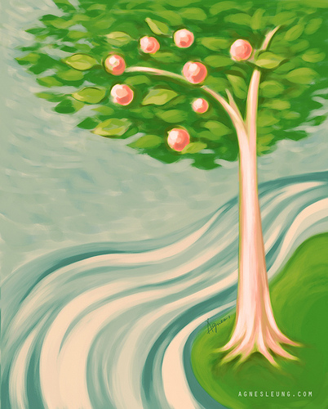
But his delight…
Is in the law of the Lord & he
meditates on it day and night
Delight based in truth | Meditation outcomes
Ps.19:7-14 – Gods’ law is accurate, reliable, actively powerful | Ps. 119: 97-120 Wisdom, understanding, restraint, guidance, joy, hope, protection, sustenance 1 Tim.4:7-10

Slide 9
We all eventually end up where our minds and hearts take us…
Gal. 6:7-8 (NKJV)
7 Do not be deceived, God is not mocked; for whatever a man sows, that he will also reap. 8 For he who sows to his flesh will of the flesh reap corruption, but he who sows to the Spirit will of the Spirit reap everlasting life.

Slide 10
Psalm 1- New King James Version (NKJV)
1 Blessed is the man who walks not in the counsel of the ungodly, nor stands in the path of sinners, nor sits in the seat of the scornful;
² But his delight is in the law of the Lord, and in His law he meditates day and night.
³ He shall be like a tree planted by the rivers of water, that brings forth its fruit in its season, whose leaf also shall not wither; and whatever he does shall prosper.
⁴ The ungodly are not so, but are like the chaff which the wind drives away.
⁵ Therefore the ungodly shall not stand in the judgment, nor sinners in the congregation of the righteous.
⁶ For the Lord knows the way of the righteous, but the way of the ungodly shall perish.

Slide 11
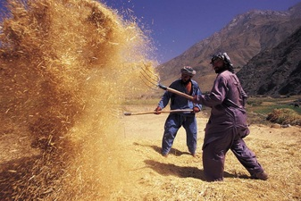
A picture paints a thousand words…
Matthew 3:12 (ESV)
12 His winnowing fork is in his hand, and he will clear his threshing floor and gather his wheat into the barn, but the chaff he will burn with unquenchable fire.”

Slide 12
Closing thoughts...
It’s a race so you need to pick the right training partners
Iron sharpens iron, and one man sharpens another Prov. 27:17
The rich young ruler – Mt.19:16-24
People will take notice as your light shines Mt 5:14-16
Your degree of “delight” in God’s law correlates to how you spend your time
Consider the tree – start small and grow into it
The 66 day challenge – spend time in prayer and meditation
Once you commit - Rev. 3:20-21

Slide 13
Iron sharpens iron

Slide 14
Closing thoughts...
It’s a race so you need to pick the right training partners
Iron sharpens iron, and one man sharpens another Prov. 27:17
The rich young ruler – Mt.19:16-24
People will take notice as your light shines Mt 5:14-16
Your degree of “delight” in God’s law correlates to how you spend your time
Consider the tree – start small and grow into it
The 66 day challenge – spend time in prayer and meditation
Once you commit - Rev. 3:20-21

