Slide 1
What We Can Learn From Genesis 1-7
Sunday
December 18, 2016
11:00 am
Jeff Smelser at Exton

Slide 3
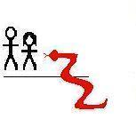

Slide 4
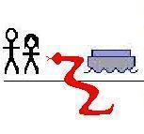

Slide 5
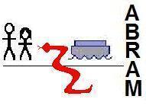

Slide 6
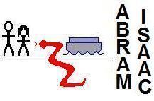

Slide 7
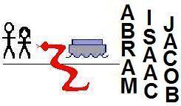
NATION
LAND
ALL FAMILIES BLESSED
“ISRAEL”

Slide 8
NATION
LAND
ALL FAMILIES BLESSED

Slide 15
Important Concepts:
More Fundamentally,
We learn about God and about ourselves
sacrifice required for sin
priest needed as an intercessor
Jesus role as king over his kingdom

Slide 16
More Fundamentally,
We learn about God and about ourselves

Slide 17
More Fundamentally,
We learn about God and about ourselves
God is Holy & Righteous
We are not

Slide 18
Gen 1: Creation
Everything God does is Good
Genesis 1:31
And God saw everything that he had made, and behold, it was very good.
James 1:17
Every good gift and every perfect gift is from above, coming down from the Father of lights with whom there is no variation or shadow due to change.
1 John 1:5
This is the message we have heard from him and proclaim to you, that God is light, and in him is no darkness at all.

Slide 19
Gen 3: 1st Sin
Why do we need Salvation?
Man’s Standing at the first...
Genesis 1:27 In God’s image
So God created man in his own image, in the image of God he created him; male and female he created them.
Genesis 1:28 Blessed
And God blessed them.
Genesis 1:28b Over God’s creation
And God said to them, “Be fruitful and multiply and fill the earth and subdue it and have dominion over the fish of the sea and over the birds of the heavens and over every living thing that moves on the earth.”
Genesis 2:8-9 In Eden with tree of Life
And the Lord God planted a garden in Eden, in the east, and there he put the man whom he had formed. And out of the ground the Lord God made to spring up every tree that is pleasant to the sight and good for food. The tree of life was in the midst of the garden...

Slide 20
Gen 3: 1st Sin
Why do we need Salvation?
Man’s Standing at the first...
Genesis 1:27 In God’s image
Genesis 1:28 Blessed
Genesis 1:28b Over God’s creation
Genesis 2:8-9 In Eden with tree of Life
Genesis 3:23 Cast out of the Garden
therefore the Lord God sent him out from the garden of Eden
Genesis 3:24 Separated from the tree of Life
He drove out the man, and at the east of the garden of Eden he placed the cherubim and a flaming sword that turned every way to guard the way to the tree of life.

Slide 21
Gen 3: 1st Sin
Why do we need Salvation?
Man’s Standing at the first...
Genesis 1:27 In God’s image
Genesis 1:28 Blessed
Genesis 1:28b Over God’s creation
Genesis 2:8-9 In Eden with tree of Life
Sin
Genesis 3:23 Cast out of the Garden
Genesis 3:24 Separated from the tree of Life
Have we sinned?

Slide 22
Gen 4: Cain & Abel
Is One Religion as Good as Another?

Slide 23
Gen 6-8: Flood
Will God Really Condemn Most People?
He did once before...
Genesis 6:7
So the Lord said, “I will blot out man whom I have created from the face of the land, man and animals and creeping things and birds of the heavens, for I am sorry that I have made them.”
Genesis 7:23
He blotted out every living thing that was on the face of the ground, man and animals and creeping things and birds of the heavens. They were blotted out from the earth. Only Noah was left, and those who were with him in the ark.

