Slide 1
A Woman’s
Spiritual Growth
In a Wicked World
Exton, PA Cami Bunting March 7, 2020

Slide 2
Why?
Rather, speaking the truth in love, we are to grow up in every way into him who is the head, into Christ…Ephesians 4:15
For though by this time you ought to be teachers, you need someone to teach you again the basic principles of the oracles of God. You need milk, not solid food, for everyone who lives on milk is unskilled in the word of righteousness, since he is a child. But solid food is for the mature, for those who have their powers of discernment trained by constant practice to distinguish good from evil. Hebrews 5: 12-14
Like newborn infants, long for the pure spiritual milk, that by it you may grow up into salvation— if indeed you have tasted that the Lord is good. 1 Peter 2: 2-3

Slide 3
How?
Ephesians 4:15 …to mature manhood, to the measure of the stature of the fullness of Christ, so that we may no longer be children, tossed to and fro by the waves and carried about by every wind of doctrine, by human cunning, by craftiness in deceitful schemes.Rather, speaking the truth in love, we are to grow up in every way into him who is the head, into Christ…
Hebrews 5: 12-14 For though by this time you ought to be teachers, you need someone to teach you again the basic principles of the oracles of God. You need milk, not solid food, for everyone who lives on milk is unskilled in the word of righteousness, since he is a child. But solid food is for the mature, for those who have their powers of discernment trained by constant practice to distinguish good from evil.
1 Peter 2: 2-3 Like newborn infants, long for the pure spiritual milk, that by it you may grow up into salvation— if indeed you have tasted that the Lord is good.

Slide 4
Growing Like a Child
Know that you are loved
Be grateful
Love the family
Listen to what we say
Be the kind of person we are teaching you to be

Slide 5
Ephesians 1- You Are Loved
1: 3-14 Blessed be the God and Father of our Lord Jesus Christ, who has blessed us in Christ with every spiritual blessing in the heavenly places, even as he chose us in him before the foundation of the world, that we should be holy and blameless before him. In love he predestined us for adoption to himself as sons through Jesus Christ, according to the purpose of his will, to the praise of his glorious grace, with which he has blessed us in the Beloved. In him we have redemption through his blood, the forgiveness of our trespasses, according to the riches of his grace, which he lavished upon us, in all wisdom and insight making known to us the mystery of his will, according to his purpose, which he set forth in Christ as a plan for the fullness of time, to unite all things in him, things in heaven and things on earth.In him we have obtained an inheritance, having been predestined according to the purpose of him who works all things according to the counsel of his will, so that we who were the first to hope in Christ might be to the praise of his glory. In him you also, when you heard the word of truth, the gospel of your salvation, and believed in him, were sealed with the promised Holy Spirit, who is the guarantee of our inheritance until we acquire possession of it, to the praise of his glory.

Slide 6
To Grow
“1: 6-19 I do not cease to give thanks for you, remembering you in my prayers, that the God of our Lord Jesus Christ, the Father of glory, may give you the Spirit of wisdom and of revelation in the knowledge of him, having the eyes of your hearts enlightened, that you may know what is the hope to which he has called you, what are the riches of his glorious inheritance in the saints, and what is the immeasurable greatness of his power toward us who believe…

Slide 7
Ephesians 2 - A grateful heart
2: 1-6 And you were dead in the trespasses and sins in which you once walked, following the course of this world, following the prince of the power of the air, the spirit that is now at work in the sons of disobedience— among whom we all once lived in the passions of our flesh, carrying out the desires of the body and the mind, and were by nature children of wrath, like the rest of mankind. But God, being rich in me because of the great love with which he loved us, even when we were dead in our trespasses, made us alive together with Christ—by grace you have been saved— and raised us up with him and seated us with him in the heavenly places in Christ Jesus…

Slide 8
To Grow
2: 8-9 For by grace you have been saved through faith. And this is not your own doing; it is the gift of God, not a result of works, so that no one may boast. For we are his workmanship, created in Christ Jesus for good works, which God prepared beforehand, that we should walk in them.

Slide 9
Ephesians 2-3 - Love the Family
2:17-18 And he came and preached peace to you who were far off and peace to those who were near. For through him we both have access in one Spirit to the Father.
3: 6 This mystery is that the Gentiles are fellow heirs, members of the same body, and partakers of the promise in Christ Jesus through the gospel.

Slide 10
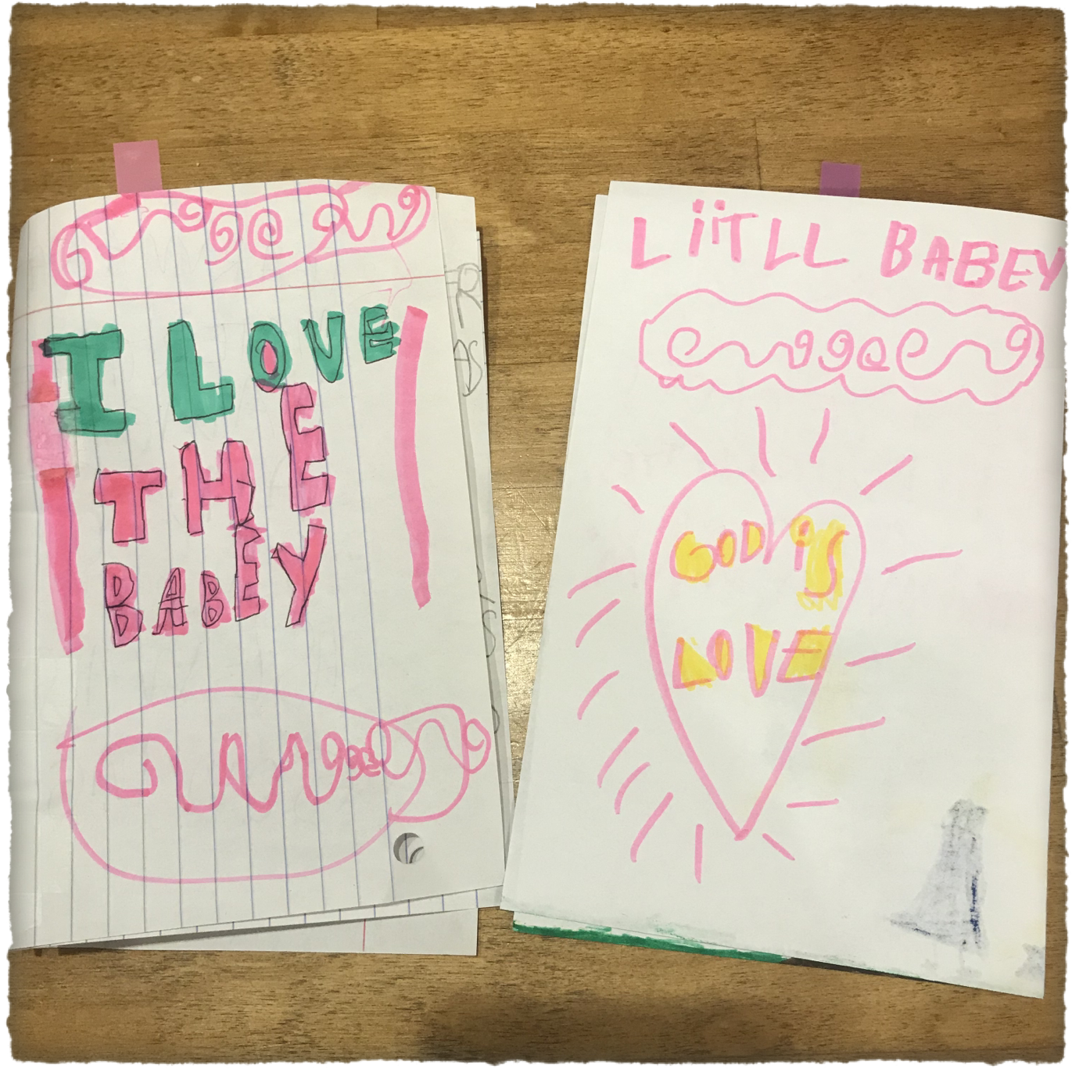

Slide 11
Ephesians 2-3 - Love the Family
2:17-18 And he came and preached peace to you who were far off and peace to those who were near. For through him we both have access in one Spirit to the Father.
3: 6 This mystery is that the Gentiles are fellow heirs, members of the same body, and partakers of the promise in Christ Jesus through the gospel.
3: 9-10 …and to bring to light for everyone what is the plan of the mystery hidden for ages in God, who created all things, so that through the church the manifold wisdom of God might now be made known to the rulers and authorities in the heavenly places.

Slide 12
To Grow
It’s bigger than you
Open your heart to all God’s children
Take your part in the church
Manifold wisdom of God
Fullness of Christ

Slide 13
Ephesians 4-5
Nourishment and Training
4:11 And he gave the apostles, the prophets, the evangelists, the shepherds and teachers, to equip the saints for the work of ministry, for building up the body of Christ…
4: 15-16 we are to grow up in every way into him who is the head, into Christ … when each part is working properly, makes the body grow so that it builds itself up in love.

Slide 14
Become the Person You Have Been Taught to Be.
4: 25
4: 26
4: 29-30
4: 31-32
5: 3-5
5: 6-10
5: 11-14
5: 15-16
5: 18-19
5: 20-21
5: 22 - 6: 9
Wives
Husbands
Children
Parents
Servants
Masters

Slide 15
Ephesians 6 - Be Strong in the Lord
6: 13 Therefore take up the whole armor of God, that you may be able to withstand in the evil day, and having done all, to stand firm.

Slide 16
Joshua 1
Just as I was with Moses, so I will be with you. I will not leave you or forsake you. Be strong and courageous, for you shall cause this people to inherit the land that I swore to their fathers to give them. Only be strong and very courageous, being careful to do according to all the law that Moses my servant commanded you. Do not turn from it to the right hand or to the left, that you may have good success wherever you go. This Book of the Law shall not depart from your mouth, but you shall meditate on it day and night, so that you may be careful to do according to all that is written in it. For then you will make your way prosperous, and then you will have good success. Have I not commanded you?
Be strong and courageous. Do not be frightened, and do not be dismayed, for the Lord your God is with you wherever you go.

Slide 17
Ephesians 6 - You’ve Got This
6: 14-18 Stand therefore, having fastened on the belt of truth, and having put on the breastplate of righteousness, and, as shoes for your feet, having put on the readiness given by the gospel of peace. In all circumstances take up the shield of faith, with which you can extinguish all the flaming darts of the evil one; and take the helmet of salvation, and the sword of the Spirit, which is the word of God, praying at all times in the Spirit, with all prayer and supplication.

Slide 18
Growing Like a Child
Know that your are loved
Be grateful
Love the family
Listen to what we say
Be the kind of person we are teaching you to be
With my help, I know you can do this

Slide 19
A Prayer for Spiritual Strength
3:14-19 For this reason we bow our knees before You, Father, from whom every family in heaven and on earth is named, that according to the riches of Your glory You may grant us to be strengthened with power through Your Spirit in our inner being, so that Christ may dwell in our hearts through faith—that we, being rooted and grounded in love, may have strength to comprehend with all the saints what is the breadth and length and height and depth, and to know the love of Christ that surpasses knowledge, that we may be filled with all the fullness of God.Now to You, who are able to do far more abundantly than all that we ask or think, according to the power at work within us, to You be glory in the church and in Christ Jesus throughout all generations, forever and ever. Amen.

